Slide 1
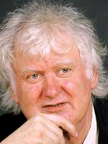
LEFT REALISM

Slide 2
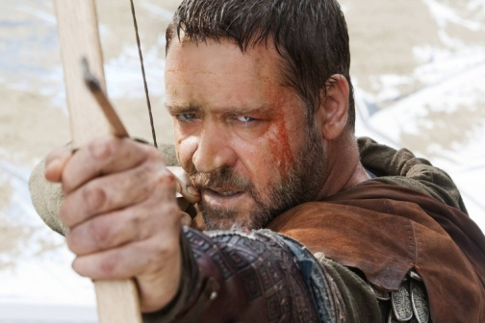
A left realist is:
Socialist, rather than Marxist. The belief is that deprivation underlies much crime and that efforts must be made to improve working class conditions.
Associated with the work of John Lea and Jock Young in 1980s.
Realistic about the suffering of victims, who are often working class. Offenders have free choice and are responsible for their actions.
Reject Marxist explanations of crime.
Wary of Right Realist/ New Right’s views on minimising crime without improving social conditions.

Slide 3
Taking crime seriously
Argued from 1950s there was a real increase in crime, especially working-class crime.
Young argued this led to an aetiological crisis – a crisis of explanation- i.e. labelling and neo-Marxist criminology tend to deny that the increase was real, instead it was just due to an increase in reporting (socially constructed).
Left realists argue against this and believe the crime rate has increased – this is evidenced in the Crime Survey.

Slide 4
What are the causes of crime?
Causes of Crime
Relative Deprivation
Subculture
Marginalisation
Victims and Communities
The Criminal Justice System

Slide 5
There is not one explanation for crime
There is no single explanation for crime (i.e. status frustration, economic deprivation, capitalism etc) – helps to explain why not everyone turns to crime.
It is a toxic mix of late modernity and the factors below where crime is most likely in young people in the most deprived communities.
A range of factors have to be combined:
Subculture
Relative Deprivation
Marginalisation

Slide 6
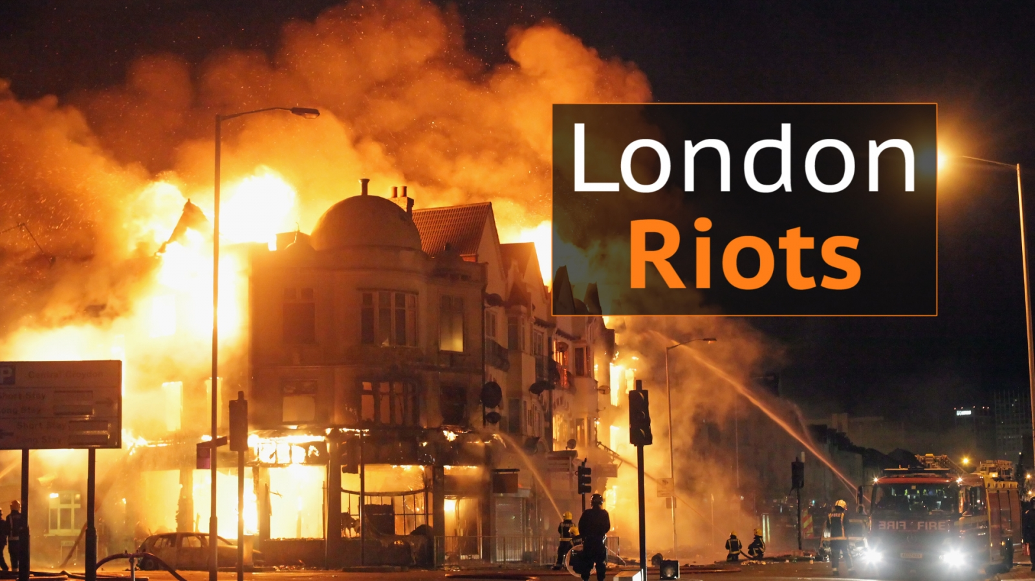
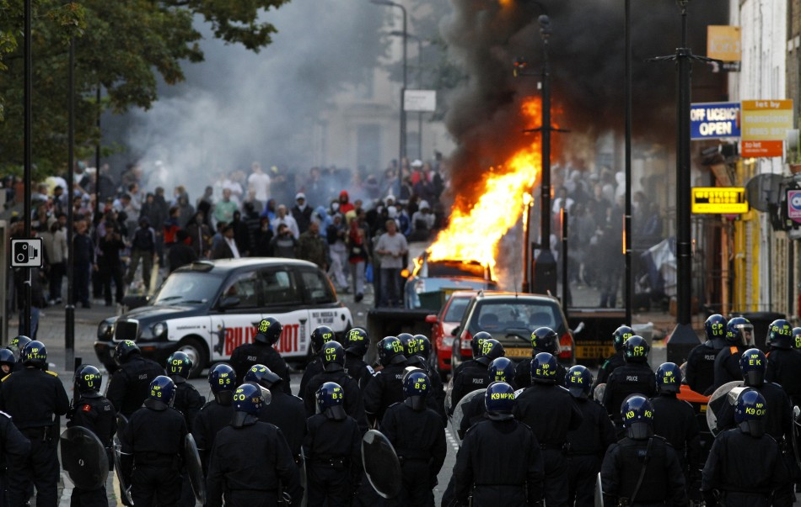
The well- socialised individual
It is the well socialised individual who turns to crime as a ‘solution’ to personal/social problems because capitalism produces:
a) Egalitarian ideal e.g. political equality
b) Material shortages/deprivation.
People who are socialised to expect/want material success are more likely to turn to crime as a solution (similar to Merton).
Crime is seen as a group/cultural response rather than simply a matter of individual choice.
Crime will occur if a group thinks they’re being given a raw deal, because its east or there’s no political channel to express feelings of discontent.
Problems with this?

Slide 7
Relative Deprivation
Media – presents attractive images of consumer goods and myths about equality of opportunity.
People feel frustrated that they’re excluded from the ‘glittering prizes of capitalism’. Bulemic society
This affects ALL classes. The vast majority of criminals hold conventional social values.

Slide 8
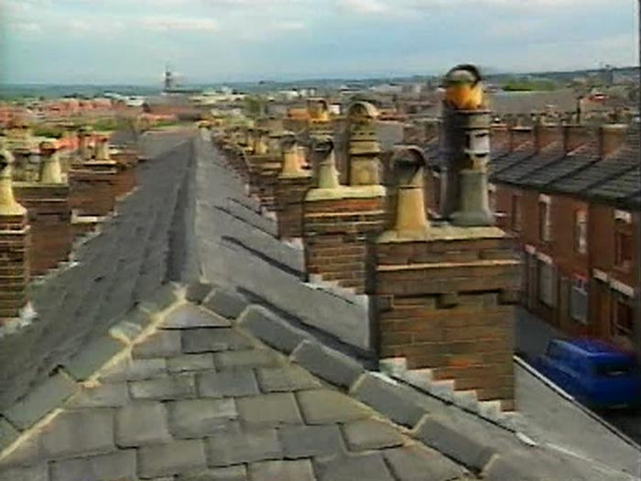
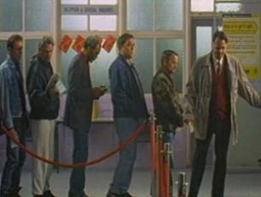
Relative Deprivation
Sense of relative deprivation has been made worse by features of late-modernity and a bulimic society (where we always want more):
Growing individualism
Weakening of informal controls (close knit communities breaking up)
Growing economic inequality and economic change.

Slide 9
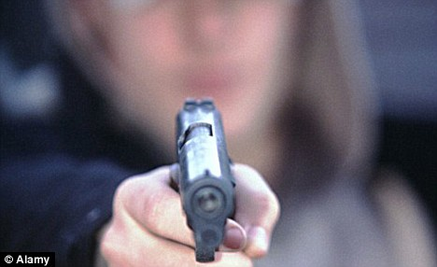
Subculture
Working class subcultures emerge as group solutions to the problems of relative deprivation and marginality. It has taken many forms e.g. street gangs or various youth subcultures.
May result in behaviour that includes risk taking and thrill seeking and what Lyng (1990) calls ‘edgework’

Slide 10
Marginalisation
Some groups experience marginality – as they find themselves politically and economically ‘on the edge’ of mainstream society. When this is combined with relative deprivation it can lead to anti-social behaviour, crime, violence and rioting as there are few other means of expressing their frustrations.

Slide 11
Victims and communities
Social changes have increased the number of potential victims.
Increase in car ownership More people going out = leaving houses unguarded and more vulnerable to crimes in public places.
Attacks on ‘outsiders’ are more common in culturally diverse communities. (Lack of close bonds)
Structural unemployment reduced family stability.

Slide 12
Criminal Justice System
Police clear-up rates are low, offering little deterrent to committed offenders. (e.g. 8% for burglary)
Police resorting to military style/ conflict policing.
Conflict policing antagonises communities, those who feel they have been treated unfairly lose respect for the law.
E.G 2011 shooting of Mark Duggan.
Their solution is a more democratic approach to policing that involves the community.

Slide 13
The square of crime: understanding and tackling crime
Social structural factors and formal social control: looking at styles of policing, labelling processes | The extent of informal social control in the community – do people trust the police? Do the public report offences?
The role of victims – why do people become victims and what do they do about it? How do victims view offenders? | The offenders: what meaning does the act have to the offender? Why do they choose to offend?

Slide 14
What are the solutions?
Solutions
Sound welfare provision
Regeneration of inner city areas
Support for victims – e.g. support groups, victim compensation and victim-offender mediation.
Change in policing style – move towards consensus policing
Avoid marginalising offender – assign them useful community roles.

Slide 15
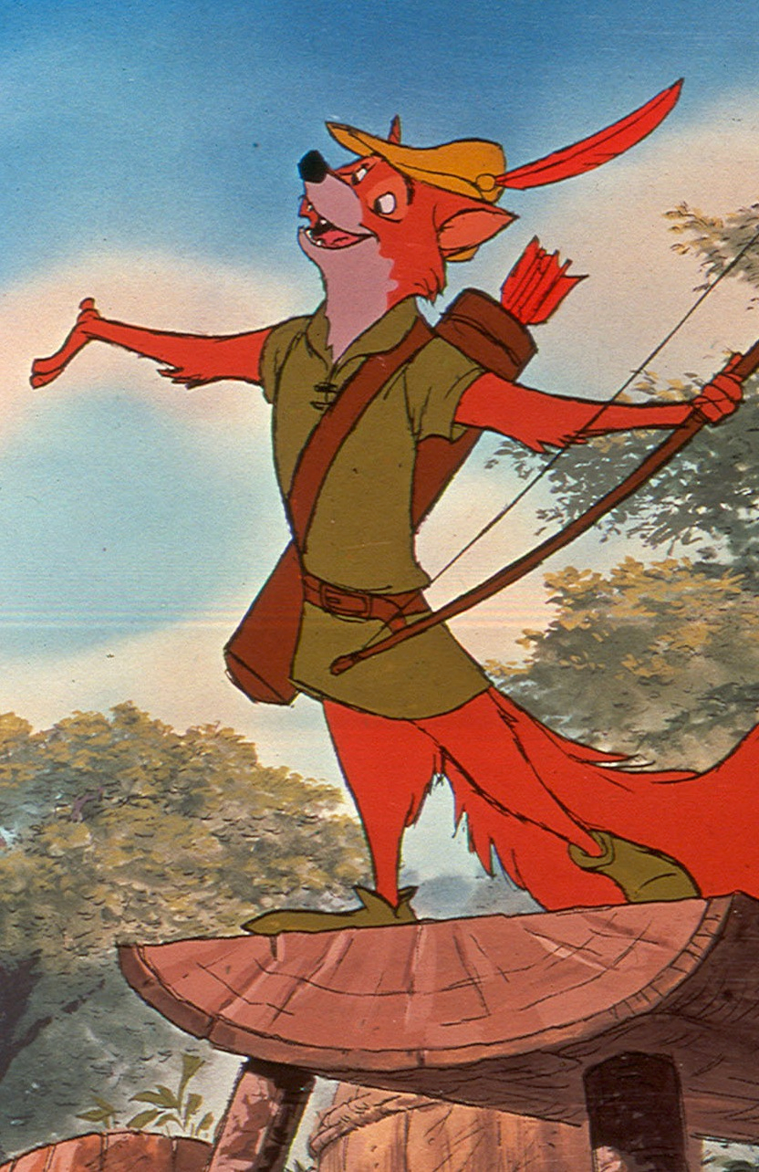
Comparison with Marxism
Critical of traditional Marxist and Neo-Marxist approaches which it has accused it of:
Not taken working class crime seriously. Sees these groups as ‘Robin Hood’ characters fighting social inequality (left realists argue that the people most likely to be victims are the poor)
Failing to take victimisation seriously.
Having no practical policy solutions.

Slide 16
Evaluation
STRENGTHS | WEAKNESSES
Draws on a range of theories including Marxist ideas of the importance of social inequality, Merton’s concept of strain, Cohen’s idea of status frustration, labelling and the growth of individualism and consumerism. Do not glamorise crime Recognises that most offenders and victims are poor and working class. Has offered solutions that have informed government policy e.g. community policing in Labour government, Safer Neighbourhood projects, ASBOs, New Deal for Young People, Youth Offending Teams | Neglects other responses to relative deprivation and marginality. Neglects gender as a significant issue. Doesn’t address crimes like domestic abuse, rape etc. Doesn’t pay much attention to white-collar and corporate crimes, even though these crimes may have a big impact on deprived communities e.g. neglect of health and safety. Doesn’t really explain why most deprived working- class youth don’t turn to crime, a may instead turn to use of drugs etc. Policy solutions are expensive.

Slide 17
Exam questions
Outline two right realist solutions to the problem of crime [4 marks]
Outline three reasons people might commit crimes according to left realists [6 marks]

