Slide 1
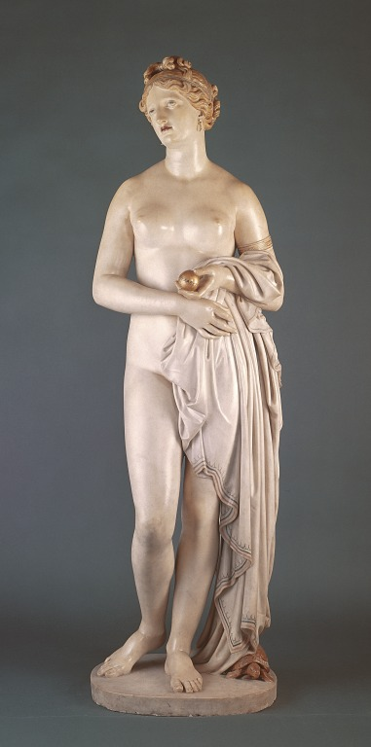
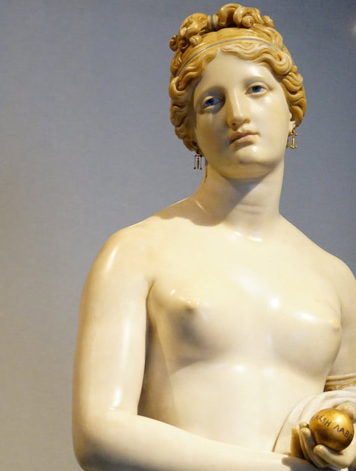
John Gibson, Tinted Venus, 1851-56
Marble, coloured varnish, wax, 176 cm high

Slide 2
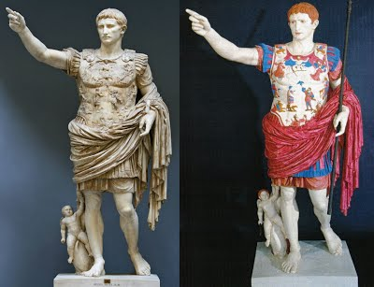
Venus, the goddess of love, stands nude and holds a golden apple, awarded to her by Paris. She was given this prize as Paris considered her the most beautiful of the goddesses.
Gibson was a popular Victorian sculptor who was a great admirer of classical antiquity.
During this period, research into the classical era revealed that sculptors in Ancient Greece and Rome painted their white marble sculptures to make them appear more realistic.
Such research inspired Gibson to colour his sculptures to make them seem as authentic to classical sculpture as possible.
The figure is carved from white marble and Gibson used a coloured varnish painting technique to provide flesh tones to the figure. Hair, eyes and lips are also coloured. Accents of gold appear on the pattern of the robe draped over Venus’s arm, her jewellery and the apple she holds.

Slide 3
Full length nude depictions of Venus had been popular since the classical era. This work follows many classical rules in sculpture
Venus stands contrapposto.
Drapery with a classical pattern on its hem hangs over her arm. This covers her modesty but exposes her torso. This makes the figure suitably chaste for a Victorian audience.
Her hair is styled in a typically classical manner with blue coloured detailing to represent a ribbon.
She looks upwards, her head tilted to avoid our gaze. This allows us to objectify and admire her beauty.
Her form and features are typically idealised. Her long neck suggests elegance. Her facial features are symmetrical and refined. Lips, eyes and hair are realistically coloured.
The figure itself is tinted in a light pink or flesh tone, giving the sculpture its name.
The figure is highly polished, suggesting perfection. A wax coating protects the coloured varnish.
At her feet we see a tortoise which bears the name of the sculptor.
The rough unpolished base she stands on contrasts with her polished form.
This work was carved in Rome where Gibson lived and worked and deliberately references sculptures he would have seen in museums there.

Slide 4
The work was shown at the 1862 International Exposition in London. Responses were mixed….
Some understood Gibson’s desire to create a sculpture in an authentic classical style. The Sculptor’s Journal wrote: It is one of the most beautiful and elaborate figures undertaken in modern times
The art publication the Athenaeum, however wrote: There is enough vulgarity in it to destroy all alluring power, and every sign of the goddess
The poet Elizabeth Barrett Browning was also dismissive, saying she had seldom seen so indecent a statue. (She is) rather a grisette than a goddess.
The general attitude was that by colouring a statue in flesh tones, it removed the appearance of purity which is associated with white marble.
Many felt that the sculpture was overtly sexualised despite the coy pose and classical subject matter.
Gibson himself wrote: At moments I forgot that I was gazing at my own production; there I sat before her, long and often. How was I ever to part with her!
The term used to describe coloured sculptures is polychrome
It was displayed in a white classical temple at the 1862 International Exposition.

Slide 5
