Slide 1
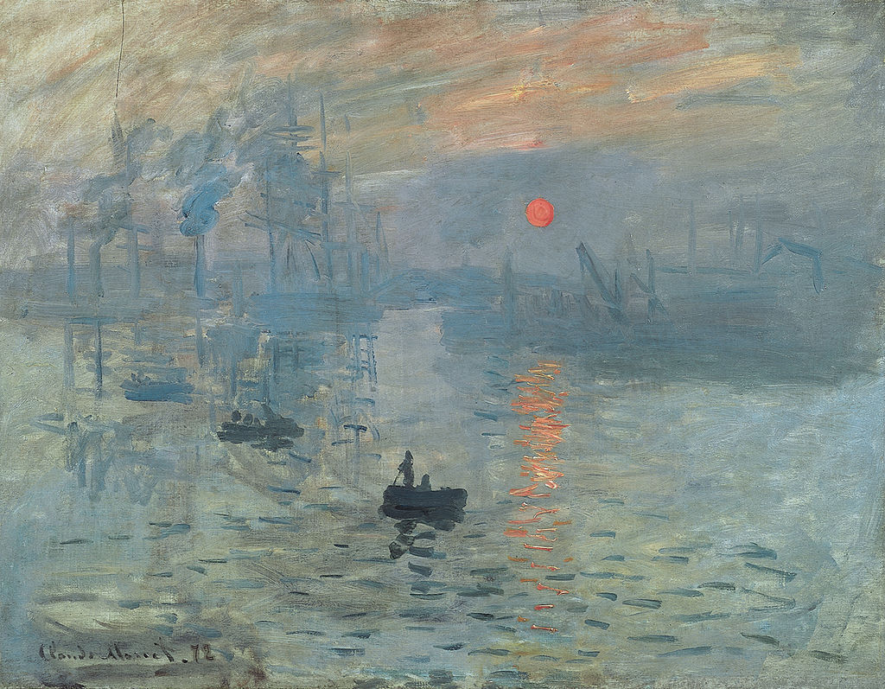
Claude Monet, Impression- Sunrise, 1872, oil on canvas, dimensions

Slide 2
Use for: Landscape Painting/ Materials,
Techniques and Processes in Painting/
Impressionism/ Avant-garde painting
This painting would give the Impressionist movement its name- however the word
impressionism was meant as an insult to artists including Monet, Renoir, Morisot, Pissarro
Painted almost a decade after the movement began, this work shows the port of Le Harve as the sun rises
Monet and his fellow Impressionists created their landscapes en plein air
They did so in an effort to capture as accurately as possible the effects of natural light falling on figures and forms
The invention of tubes of paint allowed for artists to create their outside of a studio space
Landscapes featuring rivers or the sea were particularly appealing to the Impressionists as this allowed them to attempt to capture light flickering on rippling water
To capture these changing effects artists had to work quickly. This resulted in works which appear unfinished or sketchy by Academic standards
Impressionist works such as this landscape would outrage the critics and public who were unused to paintings with a lack of finish
This work is one of a series Monet painted when he visited his hometown of Le Harve. The series of paintings show the port at different times of the day- demonstrating Monet’s interest in light and atmospheric conditions

Slide 3
The painting is made up of various shades of grey, pink and blue as Monet shows the early morning sun colouring the sky while its form is reflected in the rippling waters
Buildings, boats and their rigging in the port create a horizontal divide between sky and sea
The docks appear industrial, suggesting a modern scene rather than an idealised, picturesque landscape
The sky is made up of thin washes of unblended colours which overlap. Areas of bare canvas appear in the upper left corner
The sea is also made of thin washes, however Monet applies thick horizontal dabs of paint to show ripples on the surface of the sea. Thick pink and orange dabs show where the rising sun is reflected on the water
The sun is a small orange sphere in the upper right of the painting and acts as the focal point. Thick paint gives it a solid form.
Dark blue paint, also thickly applied shows figures on small boats in the lower half, near the viewer. The colour suggests they are in silhouette with the sun behind them
The vague, unspecific forms of the port imply that it may be a foggy morning. Monet titled the work impression as the work attempts to show a brief, passing impression of a scene rather than a static and clearly detailed outlined view

Slide 4
Exhibited at the First Impressionist Exhibition in 1874, this work was singled out for the worst criticism
Their paintings were considered the works of madmen and lunatics. The pubic were totally unprepared for art which broke with all the academic conventions
The public couldn’t understand that these works, which they thought were sketches should be considered finished works of art
This is not a romanticised or idealised setting. Instead it breaks with all concepts of the picturesque
Landscape conventions are broken through the lack of an actual horizon line, unspecific topographical references, portrayal of an industrial landscape
Academic conventions are broken through the loose application of paint, unidealised forms, lack of a polished surface finish, unblended and muddied colours, avoidance of the rules of landscape
Monet uses the landscape genre simply as a vehicle for experimenting with painting techniques and focussing on light effects over traditional landscape features
As with other Impressionist painters who worked plein air, Monet travelled by train- a recent technological development- in search of landscapes outside Paris which would become locations for his works

Slide 5
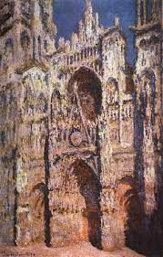
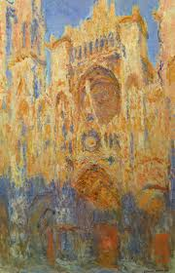
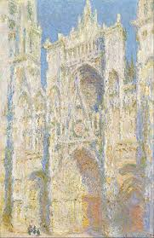
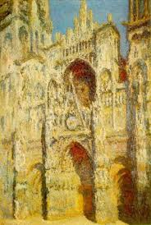
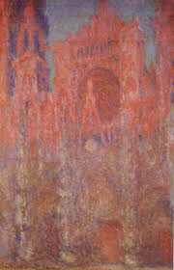
Monet’s series of paintings depicting Rouen Cathedral at different times of day and year.
Over 30 were created

Slide 6
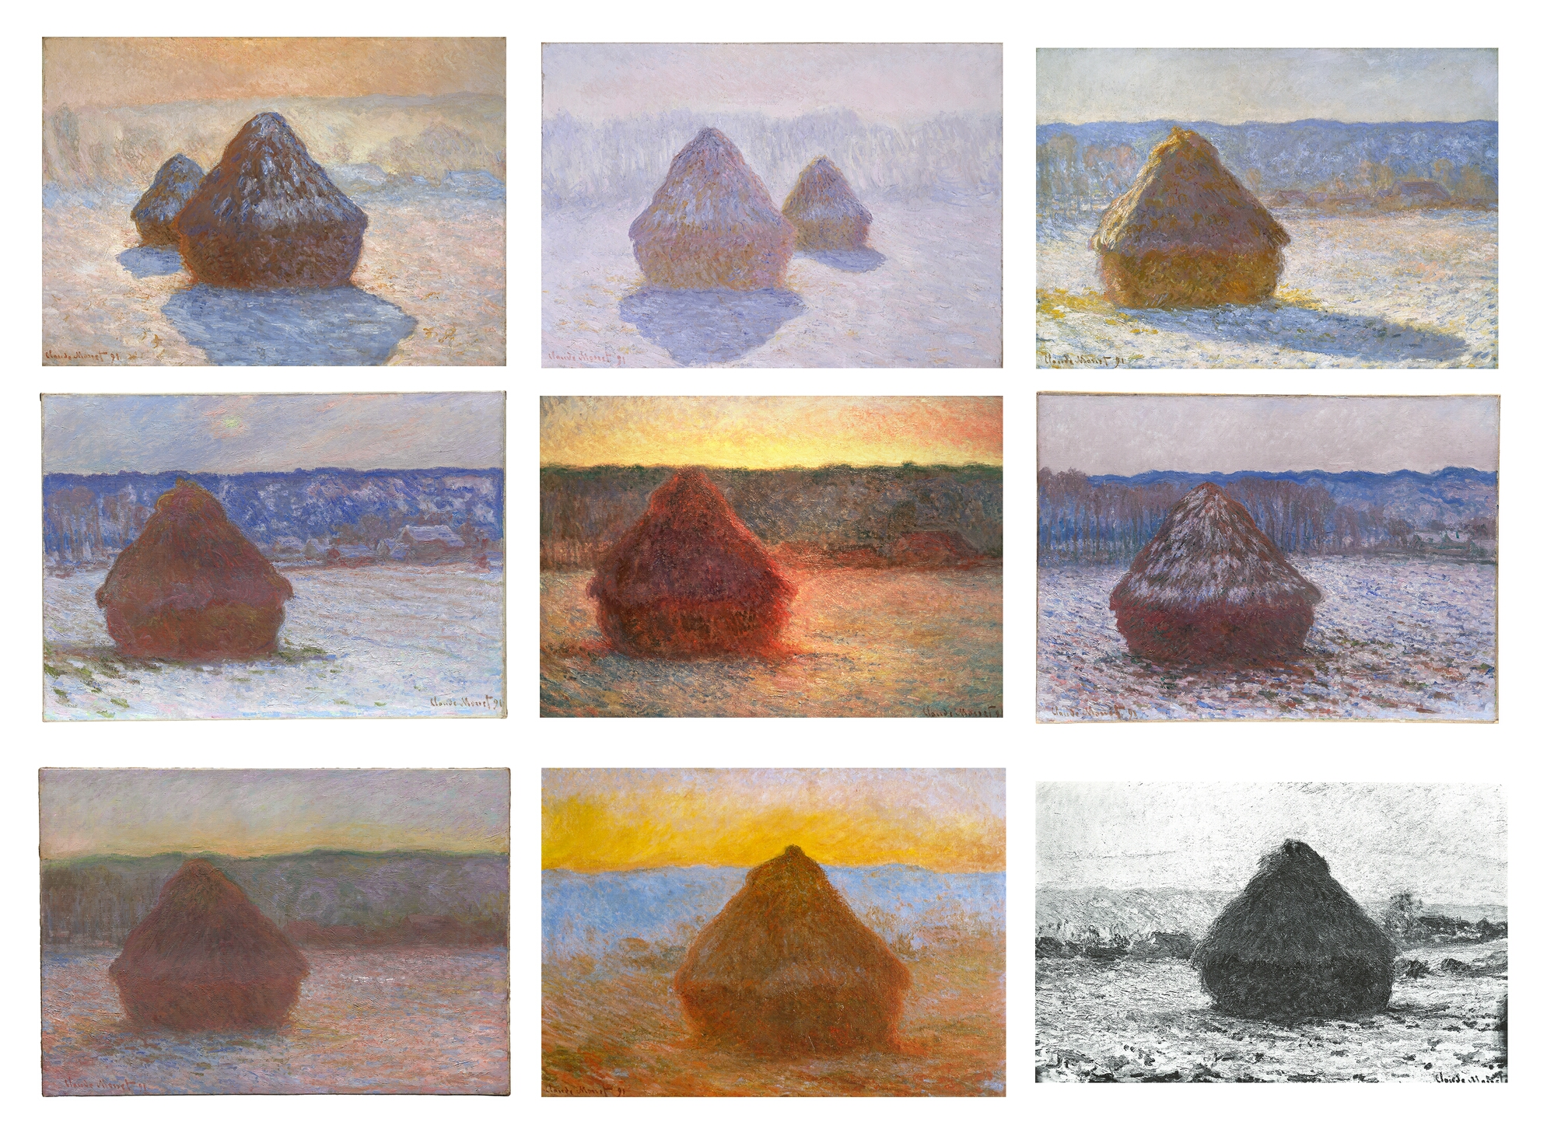
Monet’s Haystack series again focus on light at various times of the day and year falling on haystacks

