Slide 1
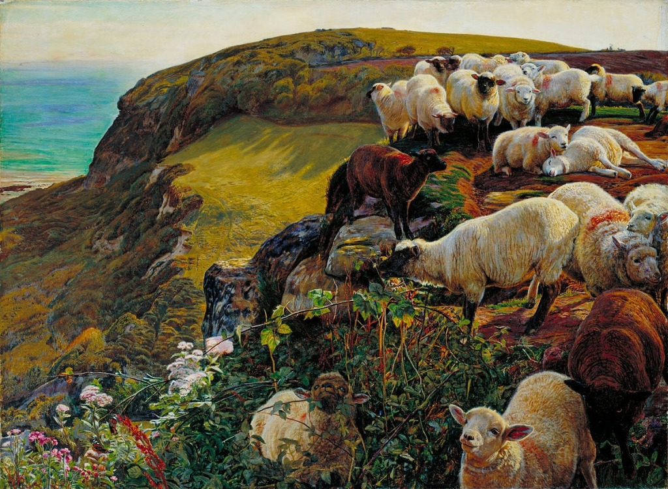
William Holman Hunt, Our English Coasts (Strayed Sheep), 1852, oil on canvas, 76x122cm

Slide 2
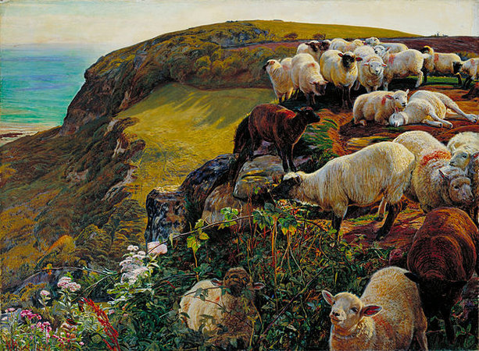
Completed a year after The Hireling Shepherd, this was a commission from a collector who wished for a replica of the Hireling Shepherd. Holman Hunt instead chose a close up of a flock of sheep
This painting also shows straying sheep, similar to The Hireling Shepherd,
Painted en plein air, Holman Hunt journeyed from London by train, a convenient and essential facility for artists wanting to paint rural locations
Set on a cliff on the English coast near Hastings, Holman Hunt is making links to the country’s previous military history
Despite Hunt’s faithfulness to location, the landscape and animals were painted from a number of viewpoints to achieve a satisfactory composition
This is not a straightforward landscape but a comment on political issues of the time
Hastings was the scene of a famous battle in 1066 between the Normans (French) and the Anglo Saxons (English). Norman troops led by William the Conqueror sailed across the English Channel, landing at Hastings, defeating the English king and leading to centuries of rule under the Normans
In the early 19th century there was a genuine fear that England would once again come under threat of invasion from the French via the English Channel, during the Napoleonic Wars
By the time this painting was completed France had a new ruler- Napoleon III, nephew of Napoleon Bonaparte
The sheep, possibly representing English people are perched dangerously close to the edge of the cliffs and risk death because they are not adequately protected. Holman Hunt implies therefore that England itself is in danger of invasion from intruders due to lack of defences along the English coast
A boat on the horizon reinforces the idea of invasion by sea

Slide 3
The composition is asymmetric. The sheep are packed onto uneven ground on the right.
The left side shows a sheer drop with no barrier between the sheep and lower ground and sea
Apart from the boat on the horizon, the landscape lacks human figures and is instead filled with nature
Sheep bask in the sun, oblivious to any danger. Others are shown tangled in briars and some stand on the edge of the precipice. These all indicate a reckless attitude towards safety
Hunt spent the summer and autumn capturing the detail of the
scene as accurately as possible. We see wildflowers, butterflies, rocks, land, sea and animals all depicted as realistically as possible- showing the influence of John Ruskin
Strong sunlight casts shadows across the land. Hunt also shows the sun shining through the flesh of the sheep in the foreground
Lands fills almost the entirety of the canvas, except for a strip of sky on the top and an area of sea in the top left corner
Colour is intense- showing how paint applied to a wet white ground gives a vivid appearance. The Red Admiral butterflies complement the bright green land
White sheep contrast with deeper brown sheep and stand out against the green landscape
The bright blue sea indicates summertime
The coastline of France on the horizon is shrouded in mist and suggests a hidden threat
The uneven landscape may suggest instability (political)
All the sheep appear distracted except for one which looks to the horizon and what possibly waits
The sheep are untended, the lack of a shepherd could suggest that the government of the time was neglecting the safety of the people of England

Slide 4
How does this work challenge the conventions of landscape painting?
What makes it avant-garde?
Consider this work in relation to Holman Hunt’s other key works we have studied
Consider this work in relation to Monet’s Impression-Sunrise
What is Holman Hunt’s agenda with this work?
What developments in technology and art has Holman Hunt relied upon to complete this work?
How is this work Pre-Raphaelite?
How does this work respond to Ruskin’s theories on art?
https://www.youtube.com/watch?v=tIqO2GS8O64

