Slide 1
Volver Ensayos para A level

Slide 2
Either
Describe la relación entre Raimunda y otros personajes
principales de la película.
Puedes mencionar:
● Sole
● Paula, la hija de Raimunda
● Agustina
● Irene [35 marks]
Or
Compara la importancia de varios lugares en la película.
Puedes mencionar:
● el piso de Raimunda
● el restaurante
● el pueblo manchego
● el piso de Sole [35 marks]

Slide 3
Either
. Analiza la manera en la que el pasado influye en el presente en la película. [40 marks]
Or
. Analiza la importancia en la película del pueblo manchego en el que vivió la familia de Raimunda y Sole. [40 marks]

Slide 4
Volver
Almodovar
Los personajes
Las técnicas
El contexto
Los temas

Slide 5
El contexto de Volver
La Mancha
La muerte y las supersticiones
Las mujeres
El mundo laboral
La telebasura

Slide 6
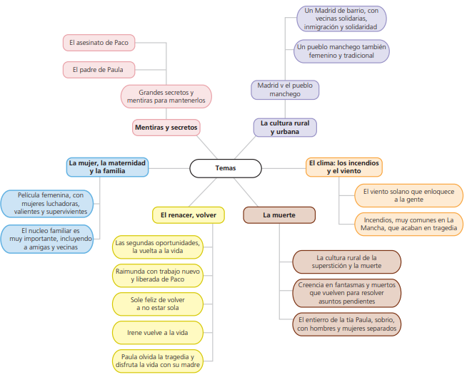

Slide 7
Temas | Personajes | Técnicas | Author Context
La muerte | Raimunda | El uso del color | Educación católica La muerte y las supersticiones en los pueblos
La maternidad y la familia | Irene | El sonido y la música | La telebasura y el voyerismo
La solidaridad de las mujeres | Sole | Los planos (y ángulos) | Recuerdo del río y las mujeres del pueblo lavando, infancia de Almodóvar en La Mancha
La cultura urbana y rural Tradición vs modernidad | Paula | Movimientos de la cámara | El machismo y la violencia de género en España
Volver: Rebirth and return | Agustina | Uso de iluminación/luz | Actrices (Carmen Maura, Penélope Cruz), La Mancha, La comedia, la maternidad
Secretos y mentiras | Tía Paula

Slide 8
AS | A level
Critical response | Critical an analytical response
Conclusions based on understanding of the subject | Evaluation of the issues, themes and cultural and social contexts

Slide 9
More specifically in each of the two essays students are required to:
• select relevant information
• present and justify points of view
• develop arguments
• draw conclusions based on understanding issues, themes and cultural and
social contexts
• evaluate issues, themes and cultural and social contexts.
Move away from storing telling…..

Slide 10
The Constant question:
What does this
• shot
• lightening/camera angle
• scene
• character
• music
• use of colour
• social/cultural setting
• mise-en-scène (character’s clothes/make up/hair)
• interaction with other characters tell us?
Can you relate to this?
How?
Why?

Slide 11
• The role of women in Spain
• The role of religion in Spain
• City life v country life in Spain
• The role of reality TV in Spain
The normality in Spain of leaving
rural life to go to the city for a better
life in 2006 when Volver was set.

Slide 12
Rural life- ageing population, traditions (Raimunda and Sole astounded by the quality of typical Manchegan food when they return to Tia Paula’s house)
Superstition is rife in rural towns and villages. Catholicism plays an important role in rural Spain in rites and rituals- especially in death, having been preserved for centuries.
Repeated reference to customs and traditions which people follow unquestioningly.
Paula, who is growing up in Madrid, finds such traditions strange.

Slide 13
The “village mentality” rural, conservative, backward, superstitious and church-ridden. It has ghosts, secrets, gossip and the cult of the dead.
The city has sickness, murder—and foreign movies on the tv. But Madrid provides the safety of anonymity. Here young Paula and Raimunda can get away with murder.
The village houses the supernatural. Death in the village involves ghosts and volver—return.
Madrid represents the natural world. Death in the city is more prosaic, a frozen food locker rather than a tombstone that must be tended.

Slide 14
Volver – Film techniques

Slide 15
The title “to return” The actresses Penelope Cruz and Carmen Maura – Almodóvar’s favourite ladies both make a “return”.
The opening titles ; the camera tracks from right to left- “ a return”

Slide 16
The colour red used as often as possible- the opening credits already set the “temperature for this film”
red: danger, passion, death and love

Slide 17
Almodóvar puts lots of red in all his movies, but in this one, he lets no chance of red go by. He gives us the opening credits in red, a red sweater, the red reel of a fire hose, a bin of tomatoes, red peppers being sliced, a red station
wagon, hair dyed red, and on and on. The final shot has red-skirted Irene walking down a red-tiled, red-curtained hallway.
Crucially, he has Raimunda mop up a floor full of her husband’s blood, some of it with lacy paper towels.
When a caller points out that she has blood on her neck, “Women’s troubles,” she explains. As Anthony Lane quips, “She could be describing the whole film”

Slide 18
The role of men/women in Volver

Slide 19
Volver is a ‘manless’ movie: one is murdered and the other goes away.
The opening dialogue tells us that women here—in this village—live longer than men. Women are strong and noble, while husbands are sexually insatiable lechers who molest their own daughters. There are two of them, hence a pattern of “volver—return.” The women dominate. They don’t need
men, who are, with the exception of the filmmaker, the artist, worthless. But women can be artists, too. At the center of this film, as in other Almodóvar films, there is a work of art: Raimunda sings the title song. (Actually, she lipsyncs
to the beautiful singing of flamenco star, Estrella Morente.) The song tells of someone returning to a first love after a long time, just what this film is about: first love is mother love.

Slide 20
More than 40% of Spanish mothers are not married- a consequence of a more liberal society in which religious blessings is no longer compulsory. These mothers
are increasingly a symbol of strength and heroism in modern society, given that in many cases they work in demanding jobs for low pay. Almodóvar undoubtedly bestows his female characters an awe-inspiring determination to get on with life,
come what may.
Paco’s death leads to a change in fortune for the women: Raimunda’s restaurant opportunity, the return of Irene and the potential for closer family bonds.

Slide 21
Essay Tick list
Good effective use of structure:
introduction
Point/Evidence/Evaluation/Link to question
conclusion.
Advanced opinion phrases and justification with a variety of sophisticated structures/wow words
Subjunctive/verbs/complex structures
Good evaluation of themes/issues and cultural and social context of the text
Literary/cinematic language/techniques
Around 350 words

Slide 22
• Introduce what you’re going to be talking about making sure that you address all the points included in the questions.
• Use expressions to link and contrast phrases and ideas.
• If you have not mentioned quotations from the book, you can paraphrase them.
• State your opinion and justify it with examples.
• Address all the points from the question in an orderly fashion.
• Have a few phrases/expressions that you can use to introduce anything.
• In Spanish the nosotros form and expressions with se are used in
academic writing; use it to show that you can write in a formal register.
• Conclude the essay by summarising the points you have made throughout.

Slide 23
Self assessment questions
1. Do I answer the question, linking back to it often?
2. Do I have a variety of sophisticated structures/wow words?
3. Do I have a variety of complex structures/verbs/subjunctive?
4. Do I show a real understanding of the film?
5. Do I talk about the film techniques, change in pace, plot, powerful open or closing scenes? Do I use appropriate examples how cinematographic techniques enhance the theme or message of the film
6. Does the essay use quotes effectively to support my ideas?
7. Have I used P(point)E(evidence)E(explain)L(link to question) to expand and justify?
8. Is my essay well organised and structured with clear introduction and conclusion?
9. Do I more or less meet the word limit requirement (350-400)? (No waffling)
10. What mark would I give myself?

Slide 24
A LEVEL SPANISH WORD FRAME
PHRASES
A primera vista – At first sight/initially
En primer lugar – in the 1st place
Por un lado … por otro lado – on one hand … on the other hand
Por una parte … por otra parte - on one hand … on the other hand
En cuanto a – when it comes to/as for
Además de – as well as
No obstante/sin embargo – however
Como resultado/consecuencia – as a result/consequence

Slide 25
SOME SUBJUNCTIVE PHRASES
No creo/No me parece que + SUBJUNCTIVE – I don’t think that
Es importante que veamos…/ que entendamos…/ que la audiencia sienta…
Es esencial que entendamos…
Pareciera que …- it would seem that
Almodóvar quiere que sepamos que ….
Es probable que/ Es posible que + SUBJUNCTIVE
Agustina quiere que Raimunda le pregunte al fantasma de Irene sobre su madre.

