Slide 1
A celebration of spirit and determination….
Chris Ofili ‘No Woman No Cry’

Slide 2
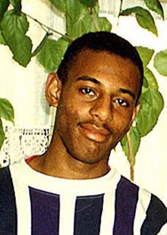
What happened?
An 18 year old school boy was stabbed at the bus stop, waiting for the bus home.
5 young men were arrested and questioned, but the case was dropped for ‘insufficient evidence.
Despite trying to cope with such terrible personal tragedy, Stephen’s mother campaigned publicly for years for closure for her son and a fairer system for us all.

Slide 3
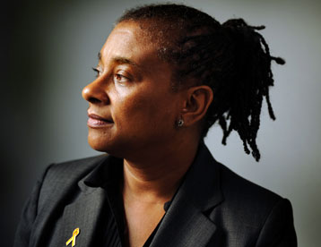
Doreen Lawrence’s campaign
In 1997, the Home Secretary commissioned the MacPherson report which subsequently found the Metropolitan Police force guilty of ‘institutional racism’
During this time, Chris Ofili painted a portrait of Stephen’s mother, in which she was shown with falling tears, each of which contained her son’s image.
Laws were changed, and a number of recommendations made for better policing.
Finally, in 2012, 19 years later, 2 of Stephen’s killers were brought to court and are now in jail.

Slide 4
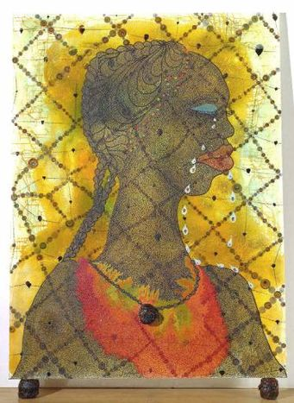
Chris Ofili ‘No Woman No Cry’1998, mixed media
Clearly, Ofili is not interested in a photographic likeness of Doreen Lawrence.
In this painting, he challenges us to stop and think about what kind of a woman she is and what kind of world she (and we) live in?

Slide 5
What do you think?
Why is her head turned to the side?
Why does he only show her head and shoulders?
How would this work be different if she looked directly at us?
Why does she wear a ‘bib’ of bright colours?
What do these colours make you think of?

Slide 6
Keep thinking!
Why does she cry tears full of her son?
Most paintings have a ‘backdrop’ or setting. Ofili has put his heroine ‘behind bars’ which criss-cross over the painting. Why?
What does the golden light behind her head make you think of?
How does Ofili express his pride in the Lawrence spirit?

Slide 7
Ofili interview (Tate Shots) https://www.youtube.com/watch?v=k0ztLFtL2Yk
We hang pictures on the wall in a frame when they are finished. Ofili does not hang this on the wall – what is he saying about the campaign for racial equality?
The black lump on the ‘necklace’ around her neck and holding the painting up are lumps of elephant dung! What does this say about the way she was treated in 1993?

Slide 8
PS
Sadly, nothing will ever bring Stephen back.
But, for the rest of us, his life and the memory of him have provoked art and politics to make a difference to the world we live in here in the UK.
Doreen Lawrence is now a Member of the House of Lords where she continues to fight for recognition and awareness of racial injustice.
Chris Ofili’s painting sits in the Tate Britain – still challenging visitors to think about the past and the present and our country……
Go and have a look for yourself!
Tinie Tempah talks about Ofili’s work: https://www.youtube.com/watch?v=XlXk8pR20xM

