Slide 1
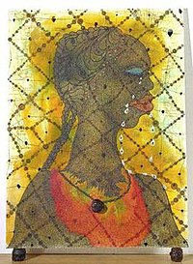
Research tasks
Research the work of earlier black British artists who worked to create a space for Ofili and others:
Ronald Moody
Lubina Himid
Sonia Boyce
Eddie Chambers
Keith Piper
Donald Rodney
Make an image sheet, including titles, dates. Think about (and make notes on) the ways they have influenced Ofili – both artistically and in terms of political and social context/message

