Slide 1
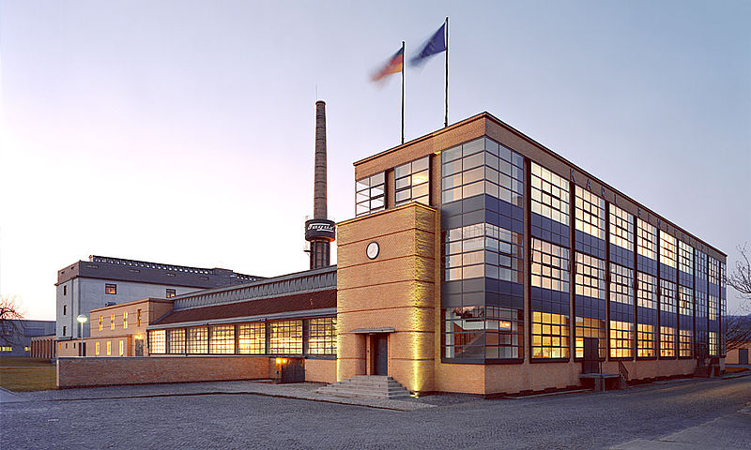
The Fagus Factory, 1911-3
Designed by Walter Gropius & Adolf Meyer
Commissioned by shoe factory owner, Carl Benscheidt

Slide 2
