Slide 1
Aim High 1
SHP Jan 2019

Slide 2
What’s it for?
Students who wish to apply to particular universities require particular admissions support
Tests
Interviews
Etc
Students need to demonstrate that they are the right kind of candidate – the self-motivated learner
These sessions also provide an important opportunity for you to meet other motivated learners at College – so make the most of it!

Slide 3
What Are They Looking at?
AS Grades/ UMS scores
Sample Work
The Reference
GCSE results
A level predictions
Interview Performance
The Personal Statement
Specialist test results
Specific Course Requirements
And then …
Meeting their conditional offer

Slide 4
What Are They Looking for?
Enthusiasm for your chosen subject
Knowledge of your chosen subject
Intellectual interest and initiative
The confidence and capacity to respond to demands of tutorial/supervision systems
Evidence of forethought and research
Relevant work experience where necessary
Above all they want a “self-motivated learner” – someone keen enough to be able to show this degree of motivation – ENTHUSIASM!

Slide 5
What it’s not
Picking out the Oxbridgers only
Exclusive to Oxbridge
The master key to easy entry… there isn’t one!

Slide 6
Who am I?
Sarah Phillips
English and History of Art Teacher
Part-time (Monday, Tuesday, Wednesday)
shp@godalming.ac.uk

Slide 7
Aim High Timeline
Year One
Year Two
Preparing for University
Extra
Tutor Group support

Slide 8
The timeline

Slide 9
Now available – Online Courses
14th January – FutureLearn - “Preparing for Uni” https://www.futurelearn.com/courses/preparing-for-uni University of East Anglia
3 hours pw over 8 weeks
Starts in January – Coursera – “Applying to US Universities” https://www.coursera.org/learn/study-in-usa (University of Pennsylvania)
14 hours of video
For Architects/Art and Cultural Historians: use www.henitalks.com and www.smarthistory.org for short podcasts on a huge range of topics…

Slide 10
Forthcoming Events - Talks
29 January (Next week): College INSET – no session
31st January – Oxford and Cambridge entry1:10-2:00 in the Hall
5th February: Exploring the EPQ in Room 413
12th February: Thinking tests and problem solving in Room 413
26th February: Mohsin Hamid ‘The Reluctant Fundamentalist’ in Room 413
5th March: Architecture students only in Room 413
12th March: English students only in Room 413
19th March: MFL students only in Room 413
26th March: Team debate in Room 413
Specific tasks and pre-reading/watching material will be circulated via email for each session. Please ensure that you check (and empty) your message box regularly so that I can make contact with you and know that you will read it!

Slide 11
Competitions and prizes
Cambridge architecture: https://www.fitz.cam.ac.uk/sites/www.fitz.cam.ac.uk/files/Architectural%20Design%20Competition%20brief_0.pdf
Tower Poetry
Peterhouse Humanities Prize
Fitzwilliam Ancient World Essay prize
Newnham Essay prize for Girls
St Peter’s College Philosophy Prize
Regents Park Literary Worlds Prize
Look for Year 12 competitions, bookmark them and set an alarm for the deadlines. (Not all 2019 competitions are open yet but you need to watch them.)

Slide 12
More prizes and actions!
New College of the Humanities is inviting competition essay entries from Y12 students Write an essay of approx 1,500 words on the statement:
“Oscar Wilde claimed that ‘All art is quite useless’. Can art’s uselessness be a source of it usefulness?”
Full details found here: https://www.nchlondon.ac.uk/essay/ Closing date is 31st January 2019, register at the above weblink. Prize is £1000!
Take the initiative: Register with www.Eventbrite.com for talks relevant to your subject area.
Create WhatsApp groups with others in this room who are interested in the same field as you so that you can inform each other and go together

Slide 13
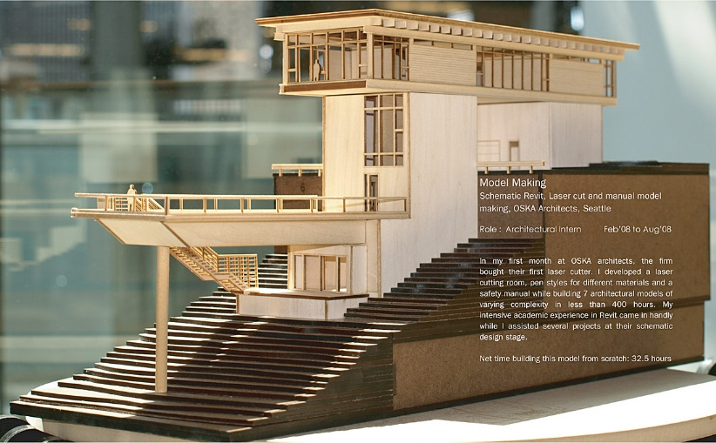
Forthcoming Events - Trips
Monday 25th February – Architecture Modelling workshop, London.
Wednesday 27th March – Epsom Downs Trip – Oxford and Cambridge student conference – the “Oxford and Cambridge Road Show” – useful for
Preparing for Open Days
Finalising subject choices

Slide 14
Forthcoming Events – Summer Schools
UNIQ – Oxford - applications close on 28th January
http://www.uniq.ox.ac.uk/
Sutton Trust Summer Schools
https://summerschools.suttontrust.com/
University of London, etc
http://www.lse.ac.uk/study/summerSchools/summerSchool/Home.aspx
Google, check GOL, get booking…

Slide 15
Aims for this Group
To try to sharpen your application for next September/October
The application and action planning
Tests and thinking skills
Interviews
Being an obviously better student
study skills
reading
research
getting the most out of your courses

Slide 16
The Godalming Online site

Slide 17
Who are you?
The forms: please complete the online questionnaire by Friday 8th February at the latest.

