Slide 1
About The Dacians

Slide 2
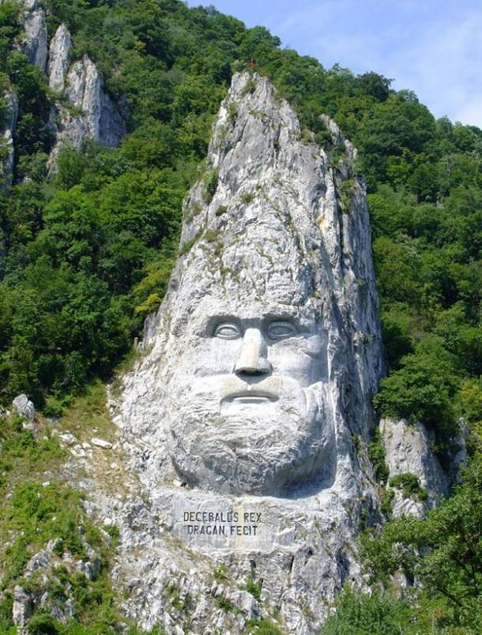
Leader of the Dacians was king Decebalus
The Dacians and Trajans had 2 wars and a number of earlier disputes
The Dacian Wars were two military campaigns fought between the Roman Empire and Dacia during Emperor Trajan's rule. The conflicts were triggered by the constant Dacian threat on the Danubian province of Moesia and also by the increasing need for resources of the economy of the Empire.
The first war lasted from 101 AD to 102 AD
The second lasted from 105 AD to 106 AD
The Roman’s won both wars. After the first war the dacians and the romans tried to live without conflict however, the tribes soon revolted and the second war broke out.
After the second war the romans won again. Emperor Trajan announced there to be 123 days of celebrations and the Dacian gold mines were secured. After this the Dacians contributed 700 million Denarii per annum to the Roman economy helping the empire’s expansion through Europe. The southern part of Dacia was captured however, the North was kept free. The wars marked the start of a peaceful period for Rome and Trajan spent the time expanding his empire and building new structures.
The present day countries of Romania, Moldova and smaller parts of Bulgaria, Serbia, Hungary, Poland, Slovakia and Ukraine made up ancient Dacia

Slide 3
