Slide 1
About trajan

Slide 2
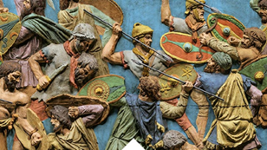
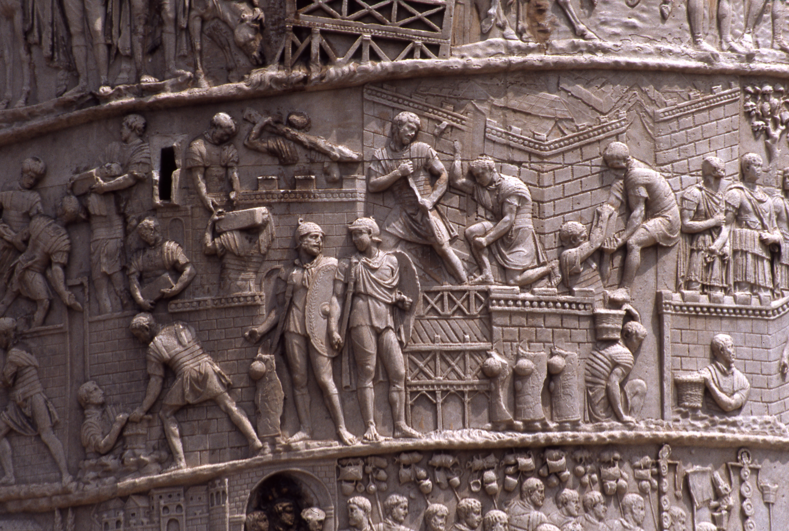
Who was Trajan?
He was a roman emperor ruled form AD98-AD117,he was born in Italica (Spain)
When did he live?
He was the first roman emperor born outside of Italy,
Born in 53AD-117AD died age 63
Trajan held which position of authority?
He was the Senate Optimus Princeps - “the best ruler”-presided over the greatest military expansion in roman history

Slide 3
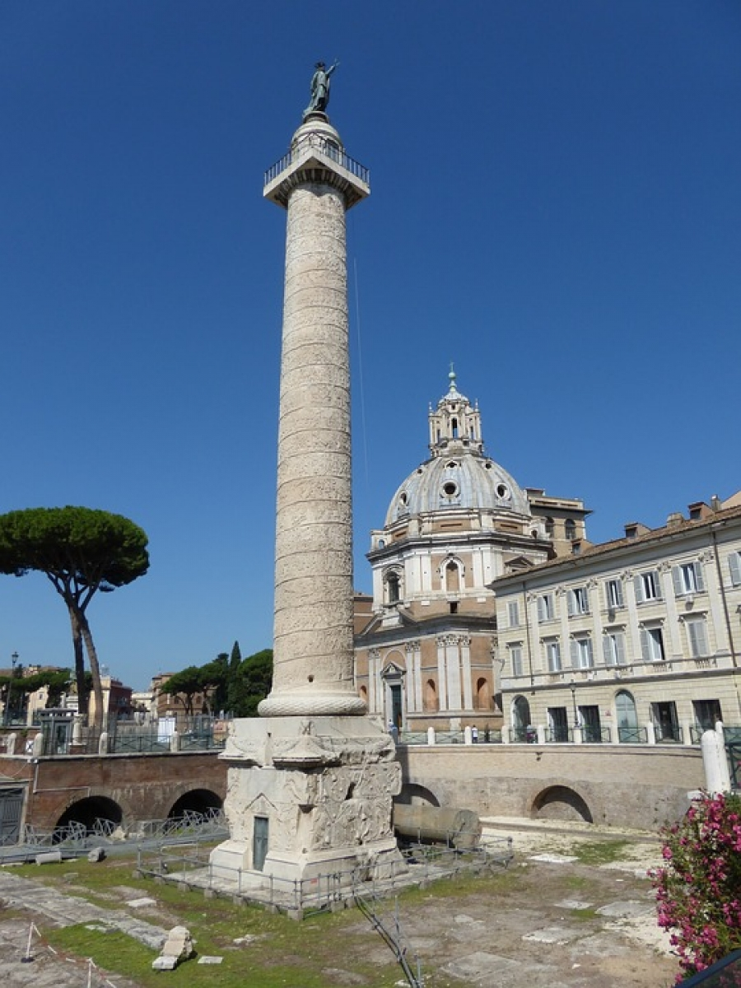
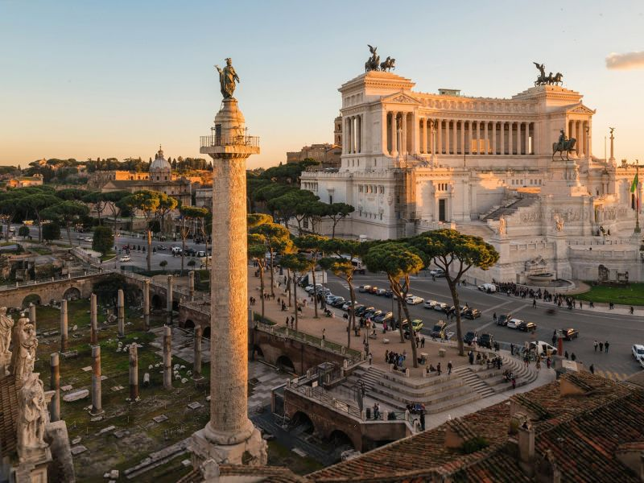
Who commissioned this column?
Constructed under supervision or architect Apollodorus or Damascus, commissioned by roman senate.
How did the columns design commemorate Trajan military success?
Trajan commemorated his victories in the two Dacain wars .
The column stands over 100 feet high and is decorated with a strip of relief sculptor.
The sculptural scenes on the3 column where decorated with paint and gilding and a gold covered statue of Trajan.
Where did he rule?
He ruled for 19 years and conquered many lands and grew the roman empire

