Slide 1
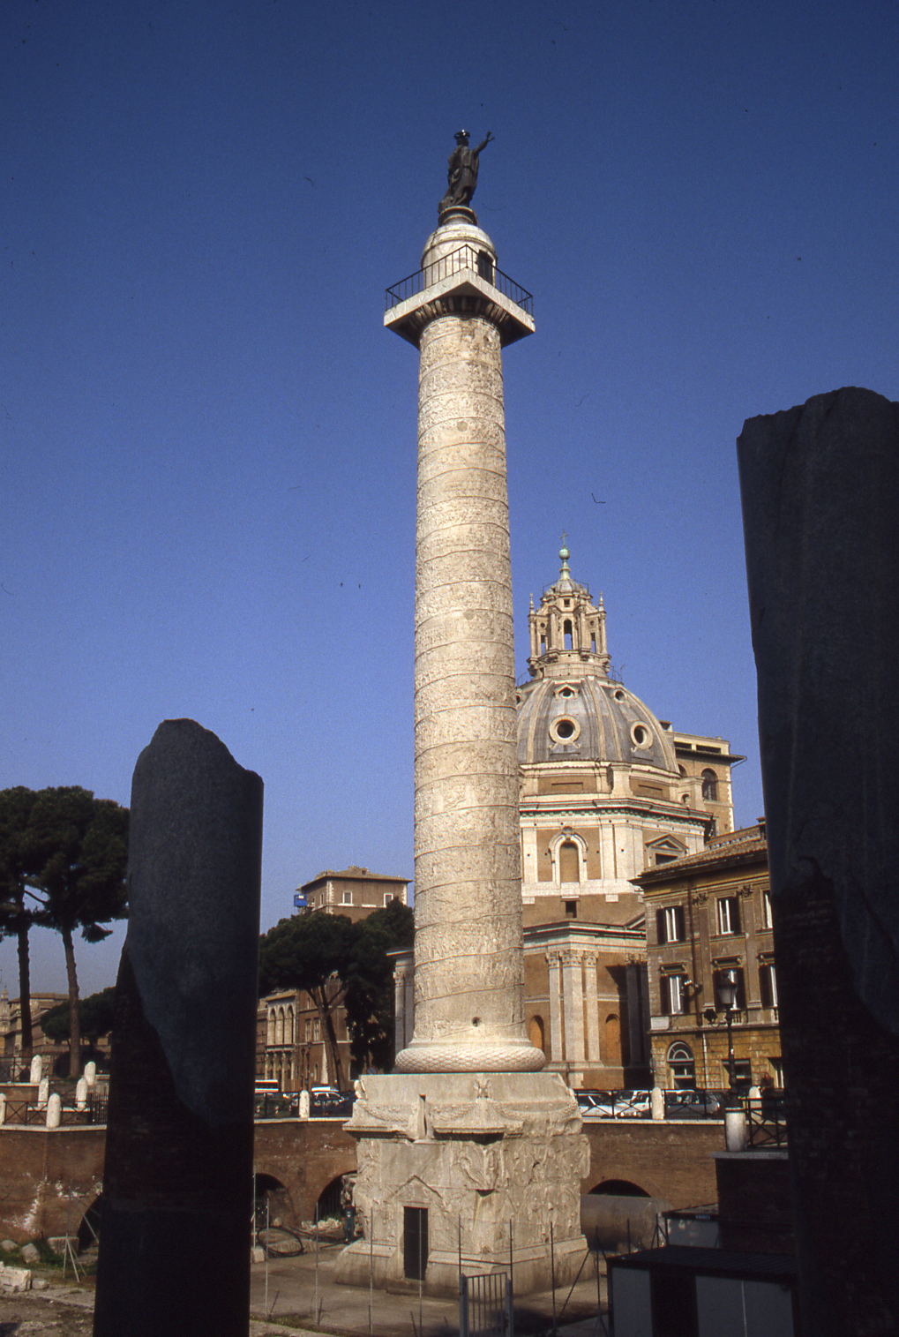
Trajan’s Column
CONTEXT

Slide 2
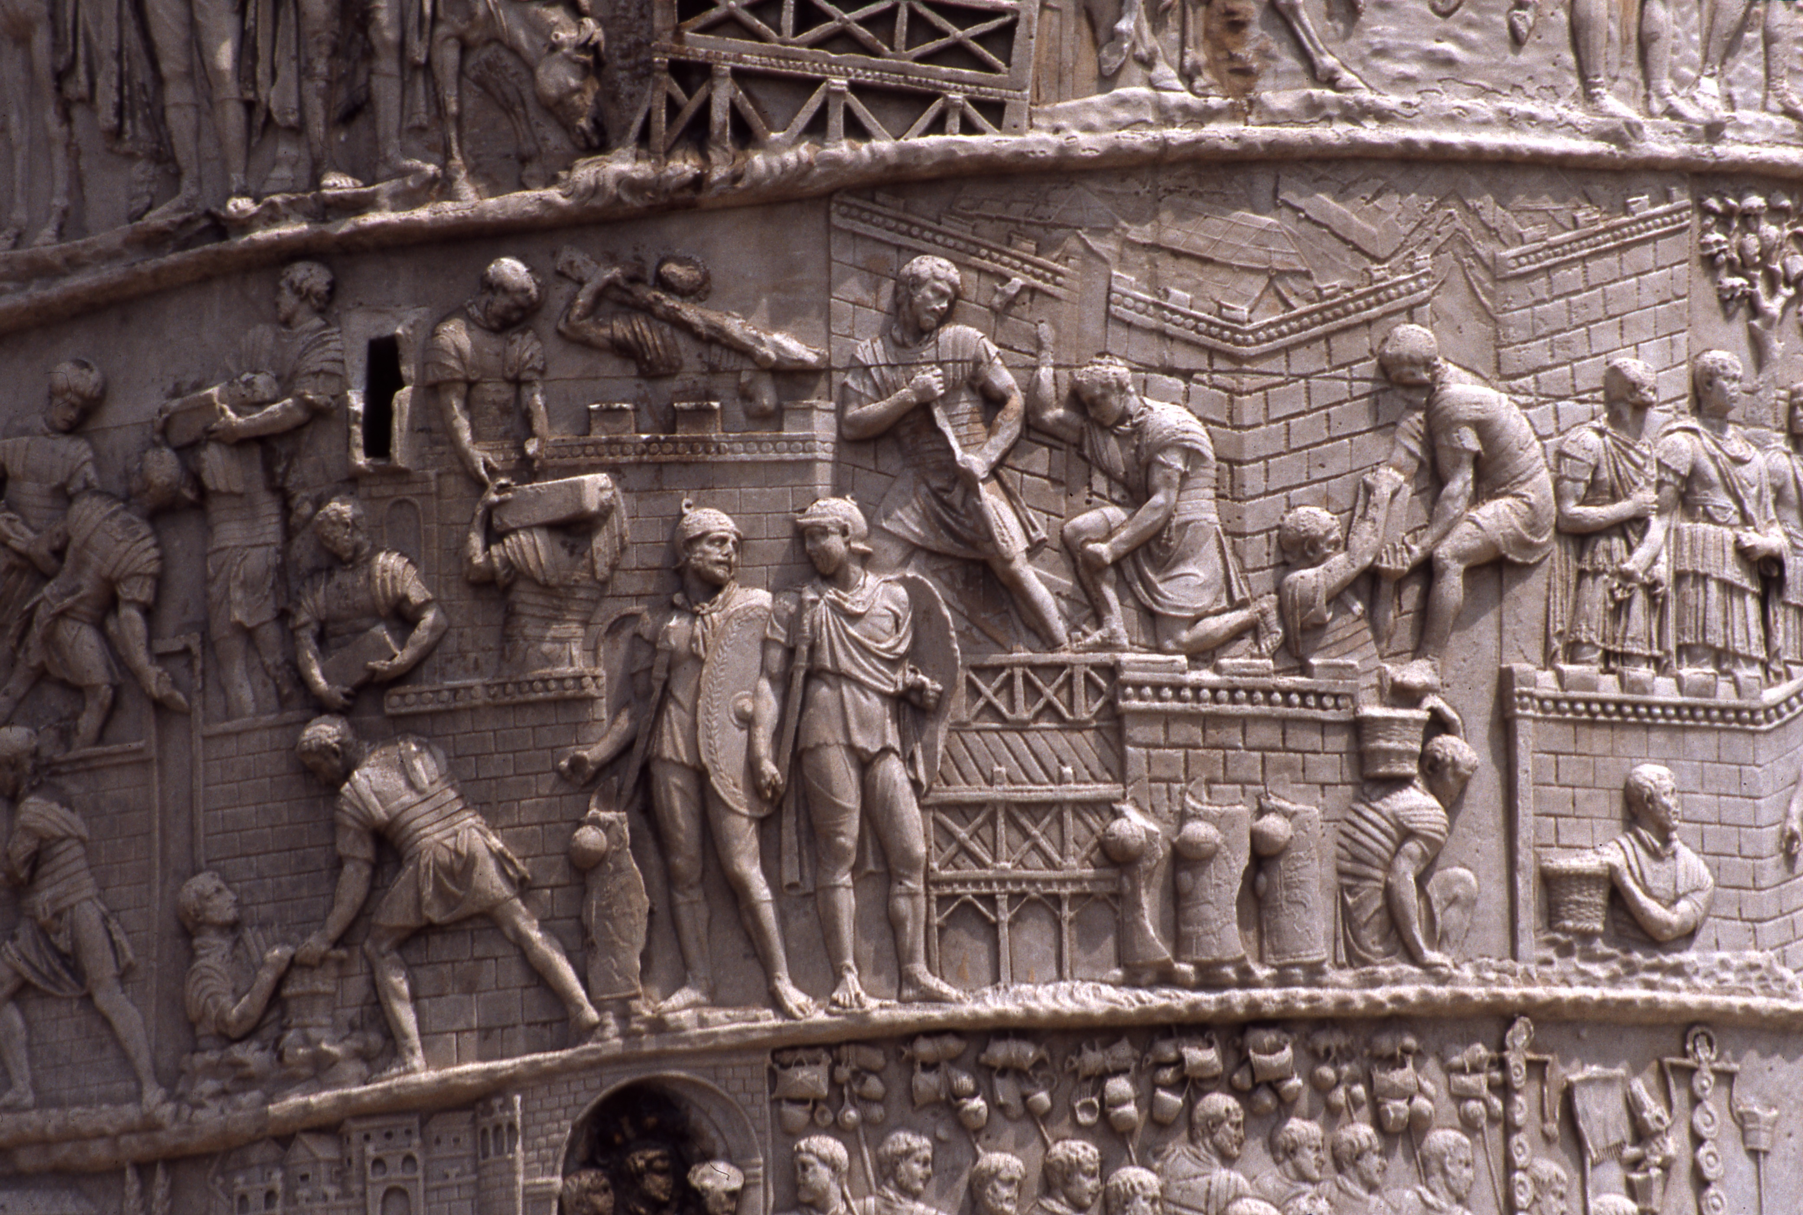
Structure
A column stood in the middle of the courtyard and surrounded by galleries.
It is covered with low-relief sculpture that demonstrates a narrative of an emperor’s two campaigns in Dacia.
There is a spiral staircase within the shaft’s interior. A bronze eagle had been placed on the top of the column and after Trajan’s death a bronze statue of the deceased emperor replaced it.
There are 58 Trajan battle scenes in the column, and 155 scenes in total.

Slide 3
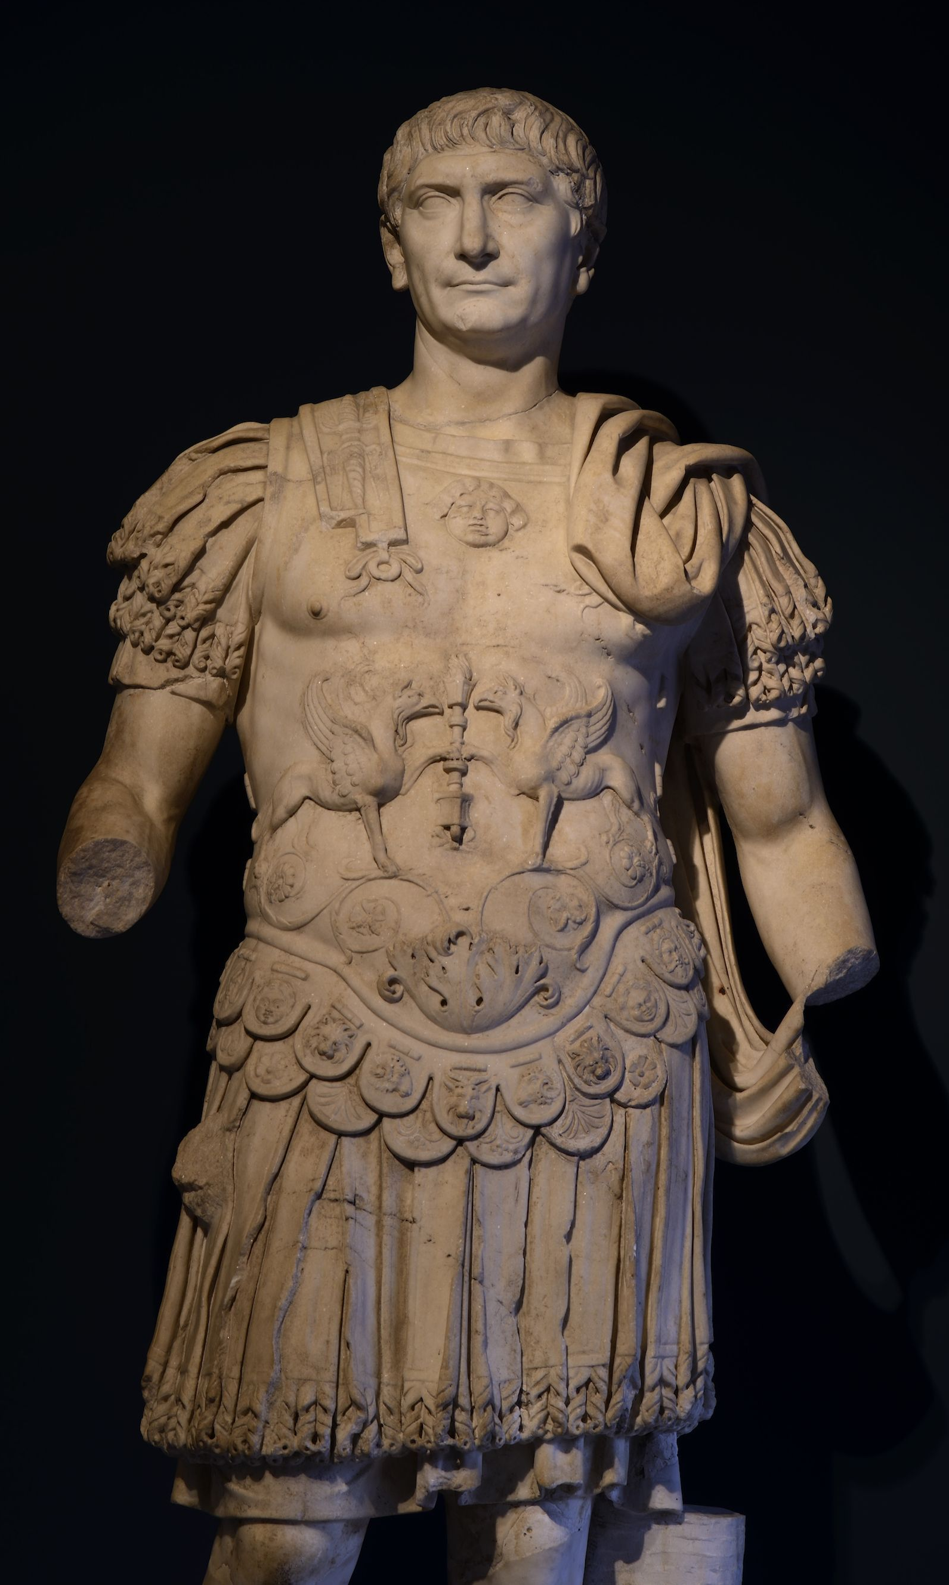
Purpose
Trajan’s column is a Roman triumphal column that commemorates Emperor Trajan’s victory in the Dacian wars.
Viewers were meant to follow the story from bottom to top standing in one place rather than circling the column 23 times, as the frieze does.
It honoured the qualities and achievements of Emperor Trajan.
After Trajan died a statue of St. Peter was placed on top of the column in the 1500s by Pope Sixton.
Eagle – Trajan – St. Peter

