Slide 1
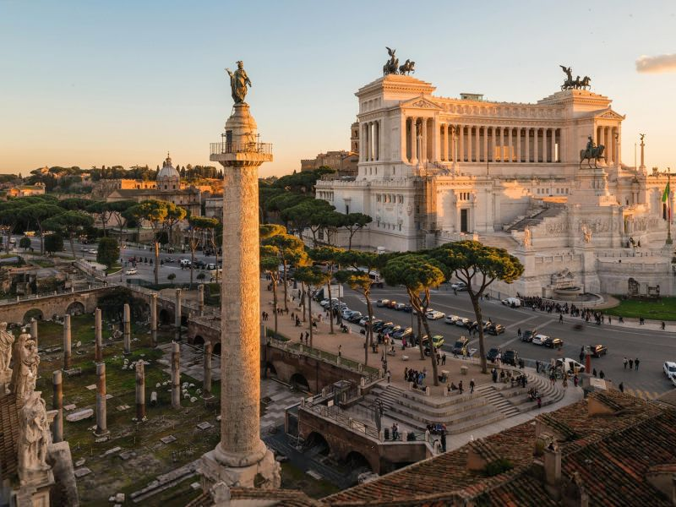
Trajan’s column
About the column

Slide 2
Made out of 19 drums of Italian white marble. Originally a bronze statue of Trajan stood on top but was replaced by a statue of Saint Peter in 1588.
It was completed in 107-113 AD
112 feet 34 meters tall
It is located in Italy, Rome in the ruins of Trajan's forum
Built in 113 AD
It was built for emperor Trajan, to commemorate his victory in the Dacian wars.
The statue of Trajan is placed on a Doric column
The column is a bas sculpture of low relief.

