Slide 1
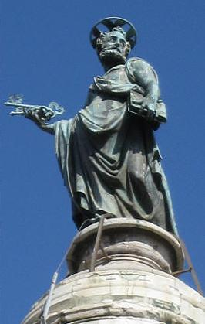
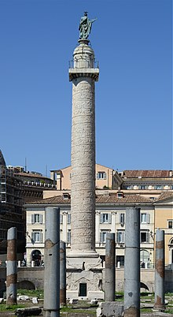
Trajan Column
Context

Slide 2
It is freestanding Roman triumphal column that originally had two libraries on either side, that contained Trajan’s despatches from his Roman – Dacian Wars. The figure on the top of the column is St Peter and on the 4th of December 1587 it was crowned by Pope Sixtus V. He appears 58 times throughout the column. Overall there are 2662 figures and 155 scenes.

