Slide 1
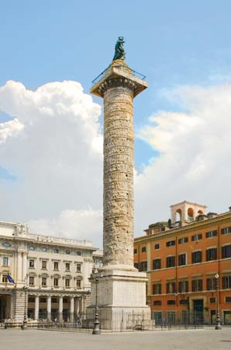
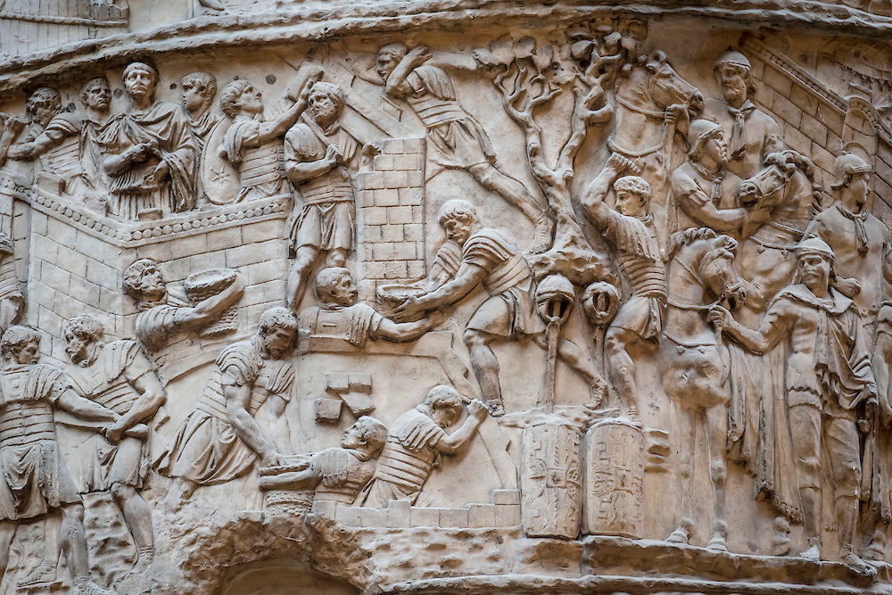
Trajan’s Column

Slide 2
Group 1: About Trajan. Who was Trajan? When did he live? Trajan held which position
of authority? Where did he rule? Who commissioned this column? This column was designed to commemorate Trajan’s military success. How does it achieve this?
Group 2: About the column. The column was created in which era/period?
What material is it made from? How tall is it? Where specifically is the column located?
The column was completed in which year? What do we call the type of sculpture technique found on this column? What classical feature is the column placed on?Describe the column- what was its purpose?
Group 3: About the Dacians. Who was the leader of the Dacians? How many wars did Trajan fight against the Dacians? Briefly explain the two Dacian wars. Who was
involved in them and why did the Romans go to war against them? What was the outcome of each war? How long did each war last for? Dacia eventually became which modern day countries?
Group 4: Context. What type of structure is Trajan’s Column? Which type of public buildings were originally placed either side of the column? What was their purpose? A statue of which Christian saint was placed on top of the column in the 1500s? How many times does Trajan appear in battle scenes in the column?
Answer each of the above questions clearly and succinctly. Illustrate your powerpoint. Split the questions evenly. You have 15 minutes.

