Slide 1
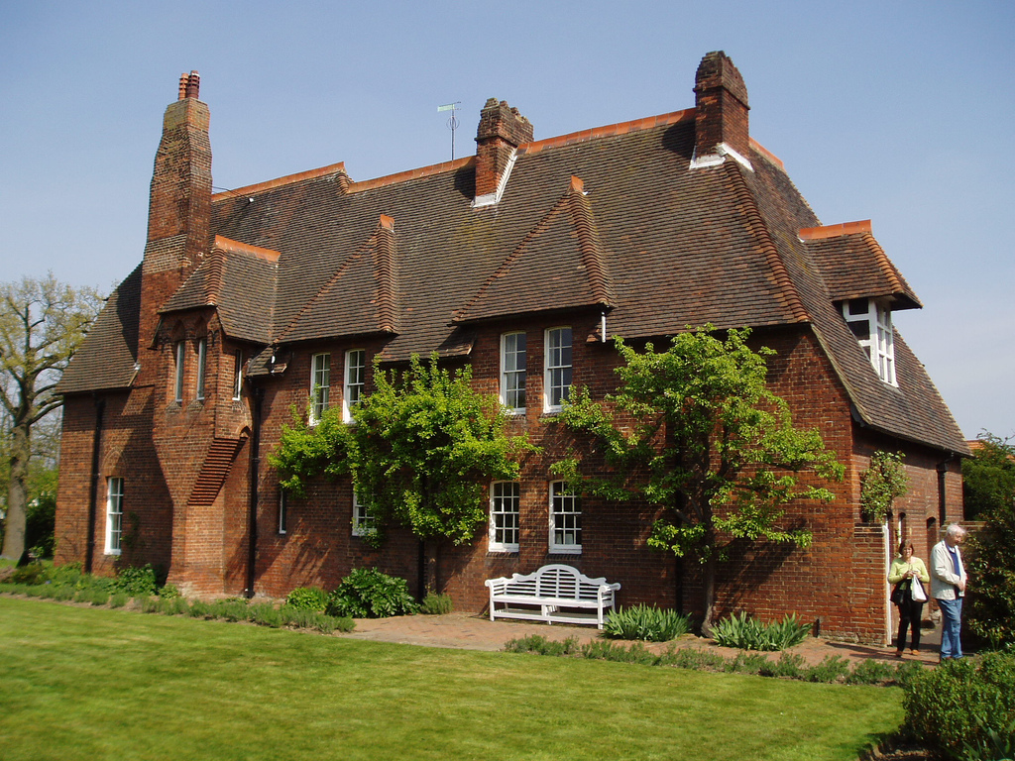
William Morris and Philip Webb, The Red House, 1860, Bexleyheath, England

Slide 2
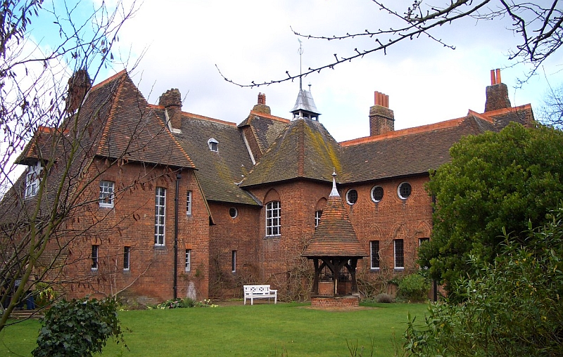
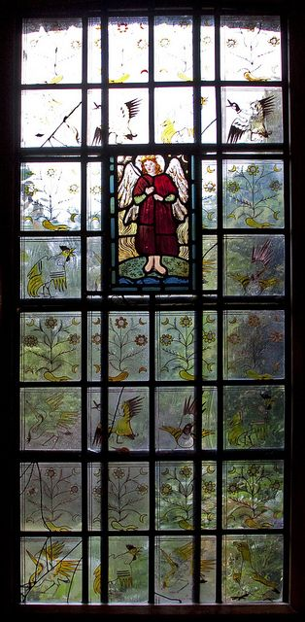
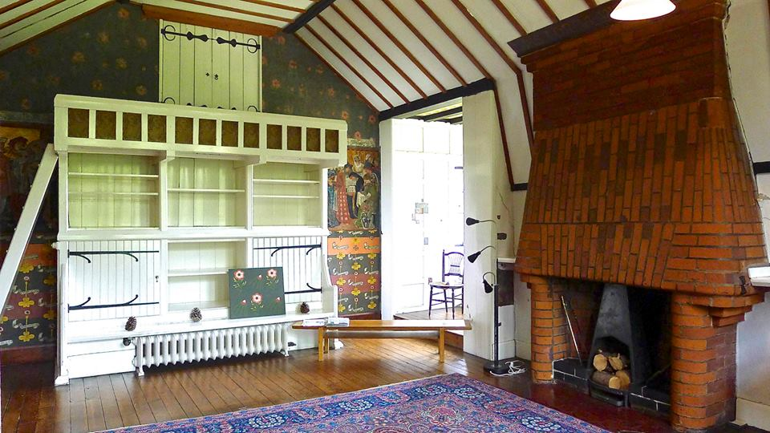
Architect: Philip Webb
Title: Red House
Date: 1860
Location: Bexleyheath, England
Style: Arts & Crafts
Category: Domestic Architecture

Slide 3
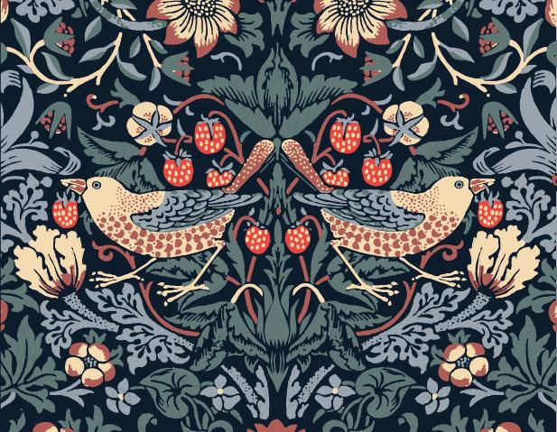
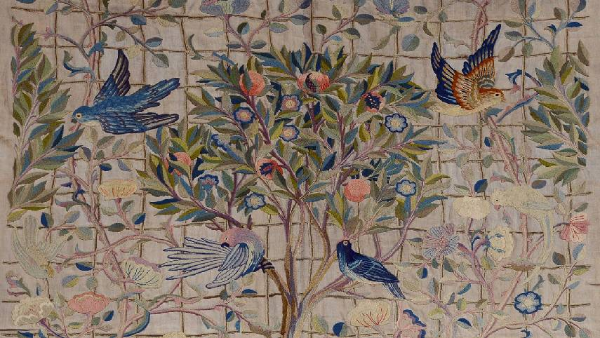
Arts & Crafts: A design style during the mid 1800s in Britain and leading towards Art Nouveau.
Begun by William Morris in the 1860s, his aim was to raise the quality of design to be as important and respected as art.
An emphasis was placed on craftsmanship and the role of the individual craftsperson to challenge the rise of mass-produced decoration and furniture which had become popular in this era due to machine produced manufacturing. (Link this to the revival of the Gothic style during this period)
A focus on imagery including plants, wildlife and animals to celebrate the natural world. The landscape of Britain had undergone huge changes due to the Industrial Revolution so Morris and others wanted to emphasise what was at risk of being lost due to modernity.

Slide 4
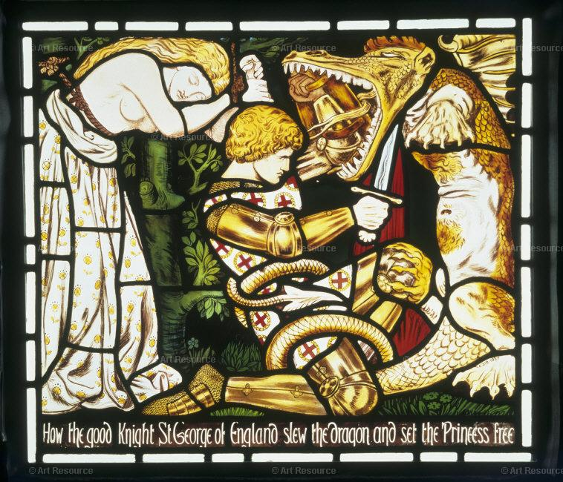
Diverse figures in mid 19th Century Britain including John Ruskin, Pugin and William Morris all individually reacted against the rise of machinery and factory mass-produced design.
They wanted to reform design, craft and architecture as a reaction against the Victorian taste for overtly ornate and superficial design they instead felt was artificial.
Ruskin, Pugin and Morris all looked to the past, in particular the Medieval/Gothic eras where they felt that the skill and originality of the craftsman was key to producing authentic pieces which they felt could challenge machine made products in the 19th century.
Both Ruskin and Pugin felt that the industrial city and architecture were detrimental to the health and wellbeing of those living and working in built up areas. They advocated better living conditions
Both felt that by living and working in better conditions, society could also improve

Slide 5
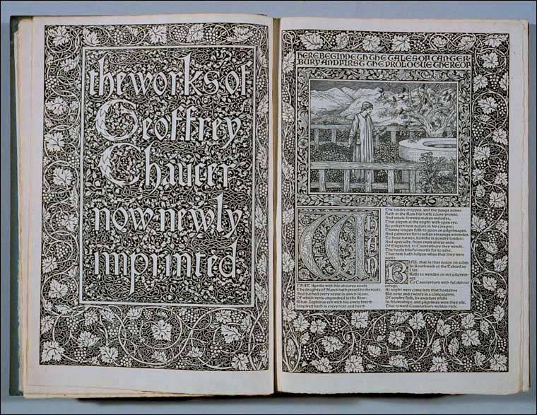
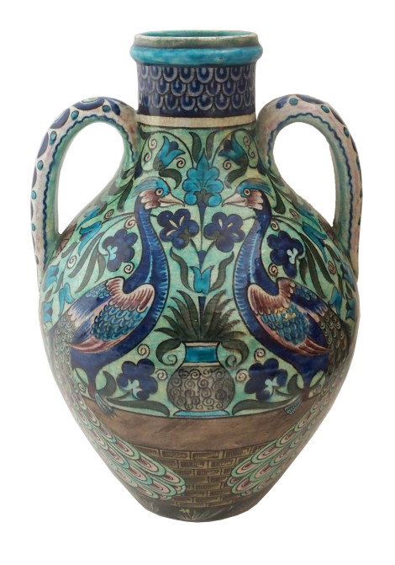
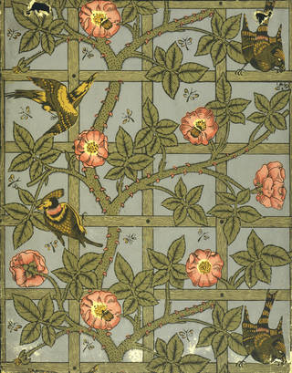
William Morris set up his own design and manufacturing company known as Morris & Co.
Morris was particularly inspired by medieval craftsmen who produced everything by hand using traditional tools and methods.
His company produced textiles, ceramics, stained glass, furniture, books on a commercial scale but using
traditional methods and through the training of both men and women to work together.
An emphasis was placed on using materials which were appropriate to the design and function of the product with traditional working methods.
Due to Morris’s interest in medieval history and design/architecture he would become friendly with the Pre-Raphaelites.
Rossetti (a founder of the Pre-Raphaelites) and Edward Burne Jones (a Pre-Raphaelite painter) both worked with Morris, contributing designs and art to his company.

Slide 6
Morris & Co’s designs would initially appeal to few other than those with avant-garde tastes, however as the decades progressed the public would come to appreciate Morris’s approach to production.
Red House is typical of Morris’s theories. It is a domestic dwelling for Morris and his family. It is furnished with products from his own company.
He approached the building and decoration of the house with the same attitude towards running his business. Traditional methods and materials would be used, a communal attitude towards work was used.
He employed Pre-Raphaelites such as Rossetti and Burne-Jones to contribute painted decorations to many of the items of furniture and also design stained glass windows and ceramic styles for the house.
These artists and craftspeople lived in the house and worked there until it was completed and the family could then take up residence.
In keeping with Morris’s interests in medieval history and design, the house itself is Tudor Gothic in composition.
Philip Webb, the architect responsible for the design of Red House was involved in a number of projects with Morris. Webb was known as the ‘father of Arts & Craft Architecture.
Webb specialised in vernacular English architecture. This is architecture which is sympathetic to its location, uses locally sourced building materials and has a traditional appearance.

Slide 7
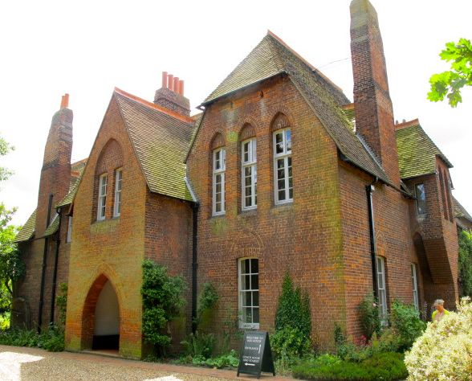
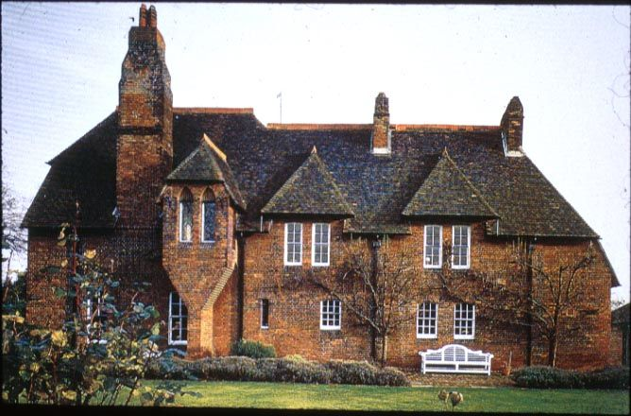
The building is located in the English countryside, however it is close to London and was accessible by train. Morris needed to be within commuting distance of London because of his business but live in a rural area surrounded by nature and wildlife.
It is built with traditional red brick, typical of vernacular domestic architecture in this area of England. Thus linking to tradition.
The building is two-storey and L-shaped with regular fenestration on the exterior facades.
The rear of the building frames a garden and well. Windows here are irregular and vary from circular to square and elongated.
The roof is steeply pitched with gable and attic windows. Tall chimneys add height and are typically English in appearance.
The red roof tiles and red brick exterior unify many of the irregular parts of the structure and also give the
house its name.

Slide 8
Ground floor rooms include a library, dining room, kitchen. First floor consisted of living rooms, drawing rooms, bedrooms.
The irregular placement of the windows was due to the function of the rooms they illuminated rather than for visual effect. Larger windows appear in rooms requiring more daylight whereas bedrooms had smaller windows.
The exterior lacks decoration, this was a deliberate contrast to Victorian architecture of the period which was typically over-ornamented.

Slide 9
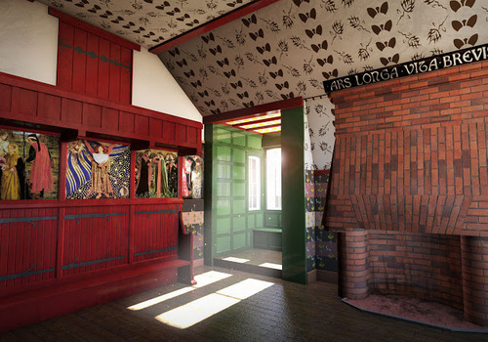
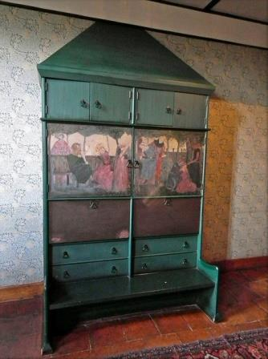
Red brick is also used on the interior, including the fireplaces and chimney breasts. This links the interior and exterior giving a sense of harmony to the home.
Other natural materials such as wood are used for floors, stairs and the exposed rafters supporting the pitched interior ceilings.
Wooden furniture in hand crafted with ornamentation linking to the natural world.
Artists including Rossetti and Burne Jones hand-painted scenes from Medieval history and literature to the walls of rooms and pieces of furniture.

Slide 10
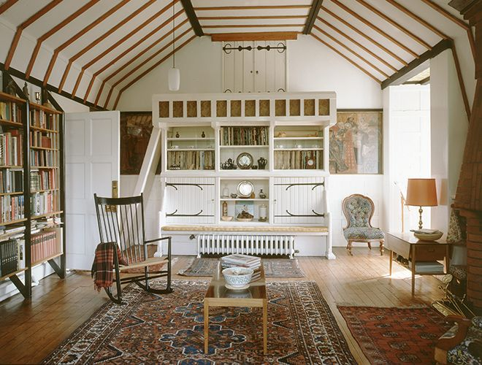
First floor rooms have steep pitched ceilings. This gives the appearance of medieval banqueting rooms or Tudor halls.
Hand painted Latin inscriptions in Gothic style writing appear over the fireplace, reinforcing the medieval theme.
Walls and ceilings are plastered in white to give a natural appearance and place an emphasis on the hand-painted furniture.

Slide 11
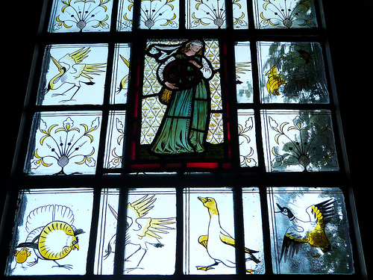
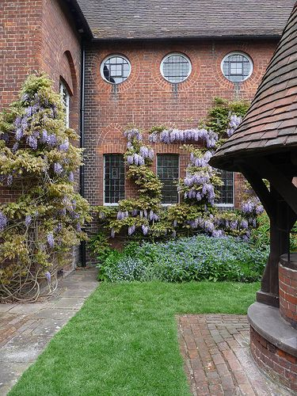
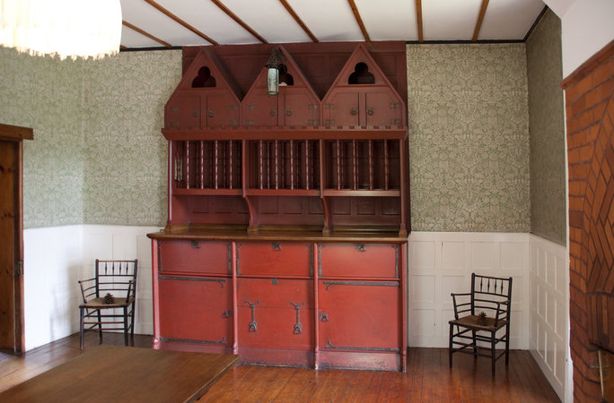
Furniture is strictly functional. Any decoration links
to the medieval era.
The L-shaped rear of the house was designed to frame the garden. It acts in a similar way to a courtyard, a common feature in large houses of the medieval period.

Slide 12
https://www.youtube.com/watch?v=sjdCOUGrNK8
https://www.youtube.com/watch?v=dn1PHpfshok
https://www.nationaltrust.org.uk/red-house
https://smarthistory.org/william-morris-and-philip-webb-red-house/

