Slide 1
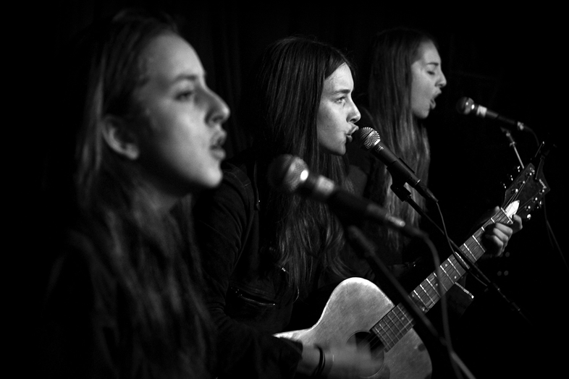
My Magazine
By Lucy Fowler

Slide 2
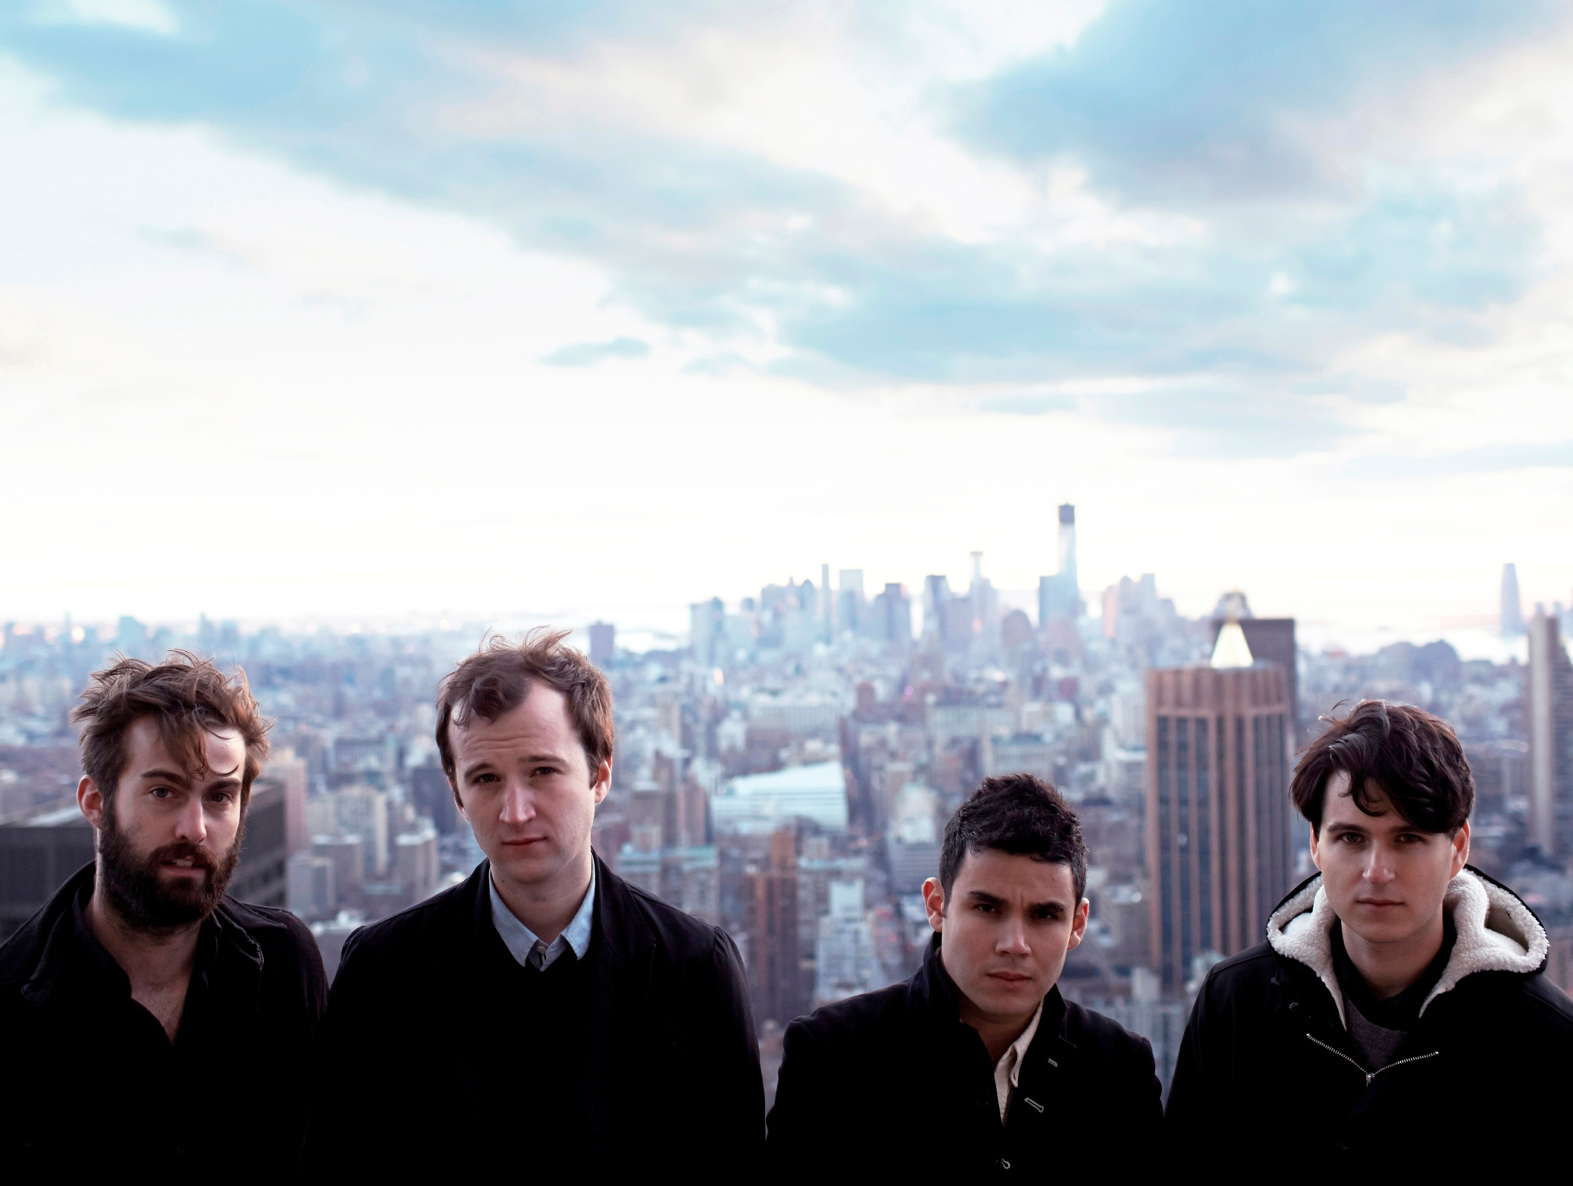
CONTENT
Interviews with artists/bands
It will also be aimed at people who love performing – so will have information about shows, advice and so on.
News on artists
Album reviews
Events
Fashion – clothes inspired by artists and other styles

Slide 3
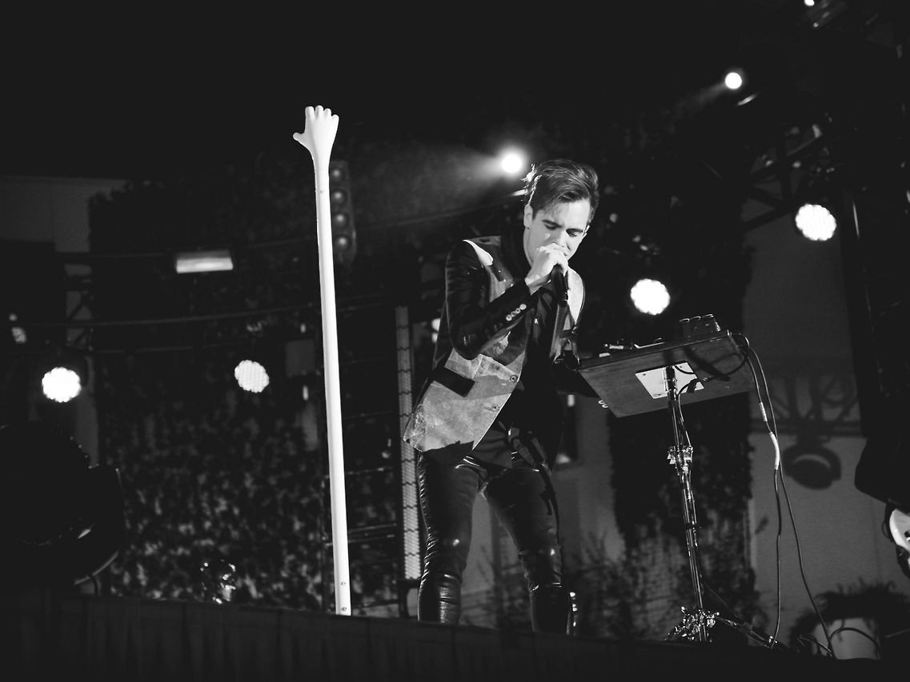
LENGTH
150 pages.

Slide 4
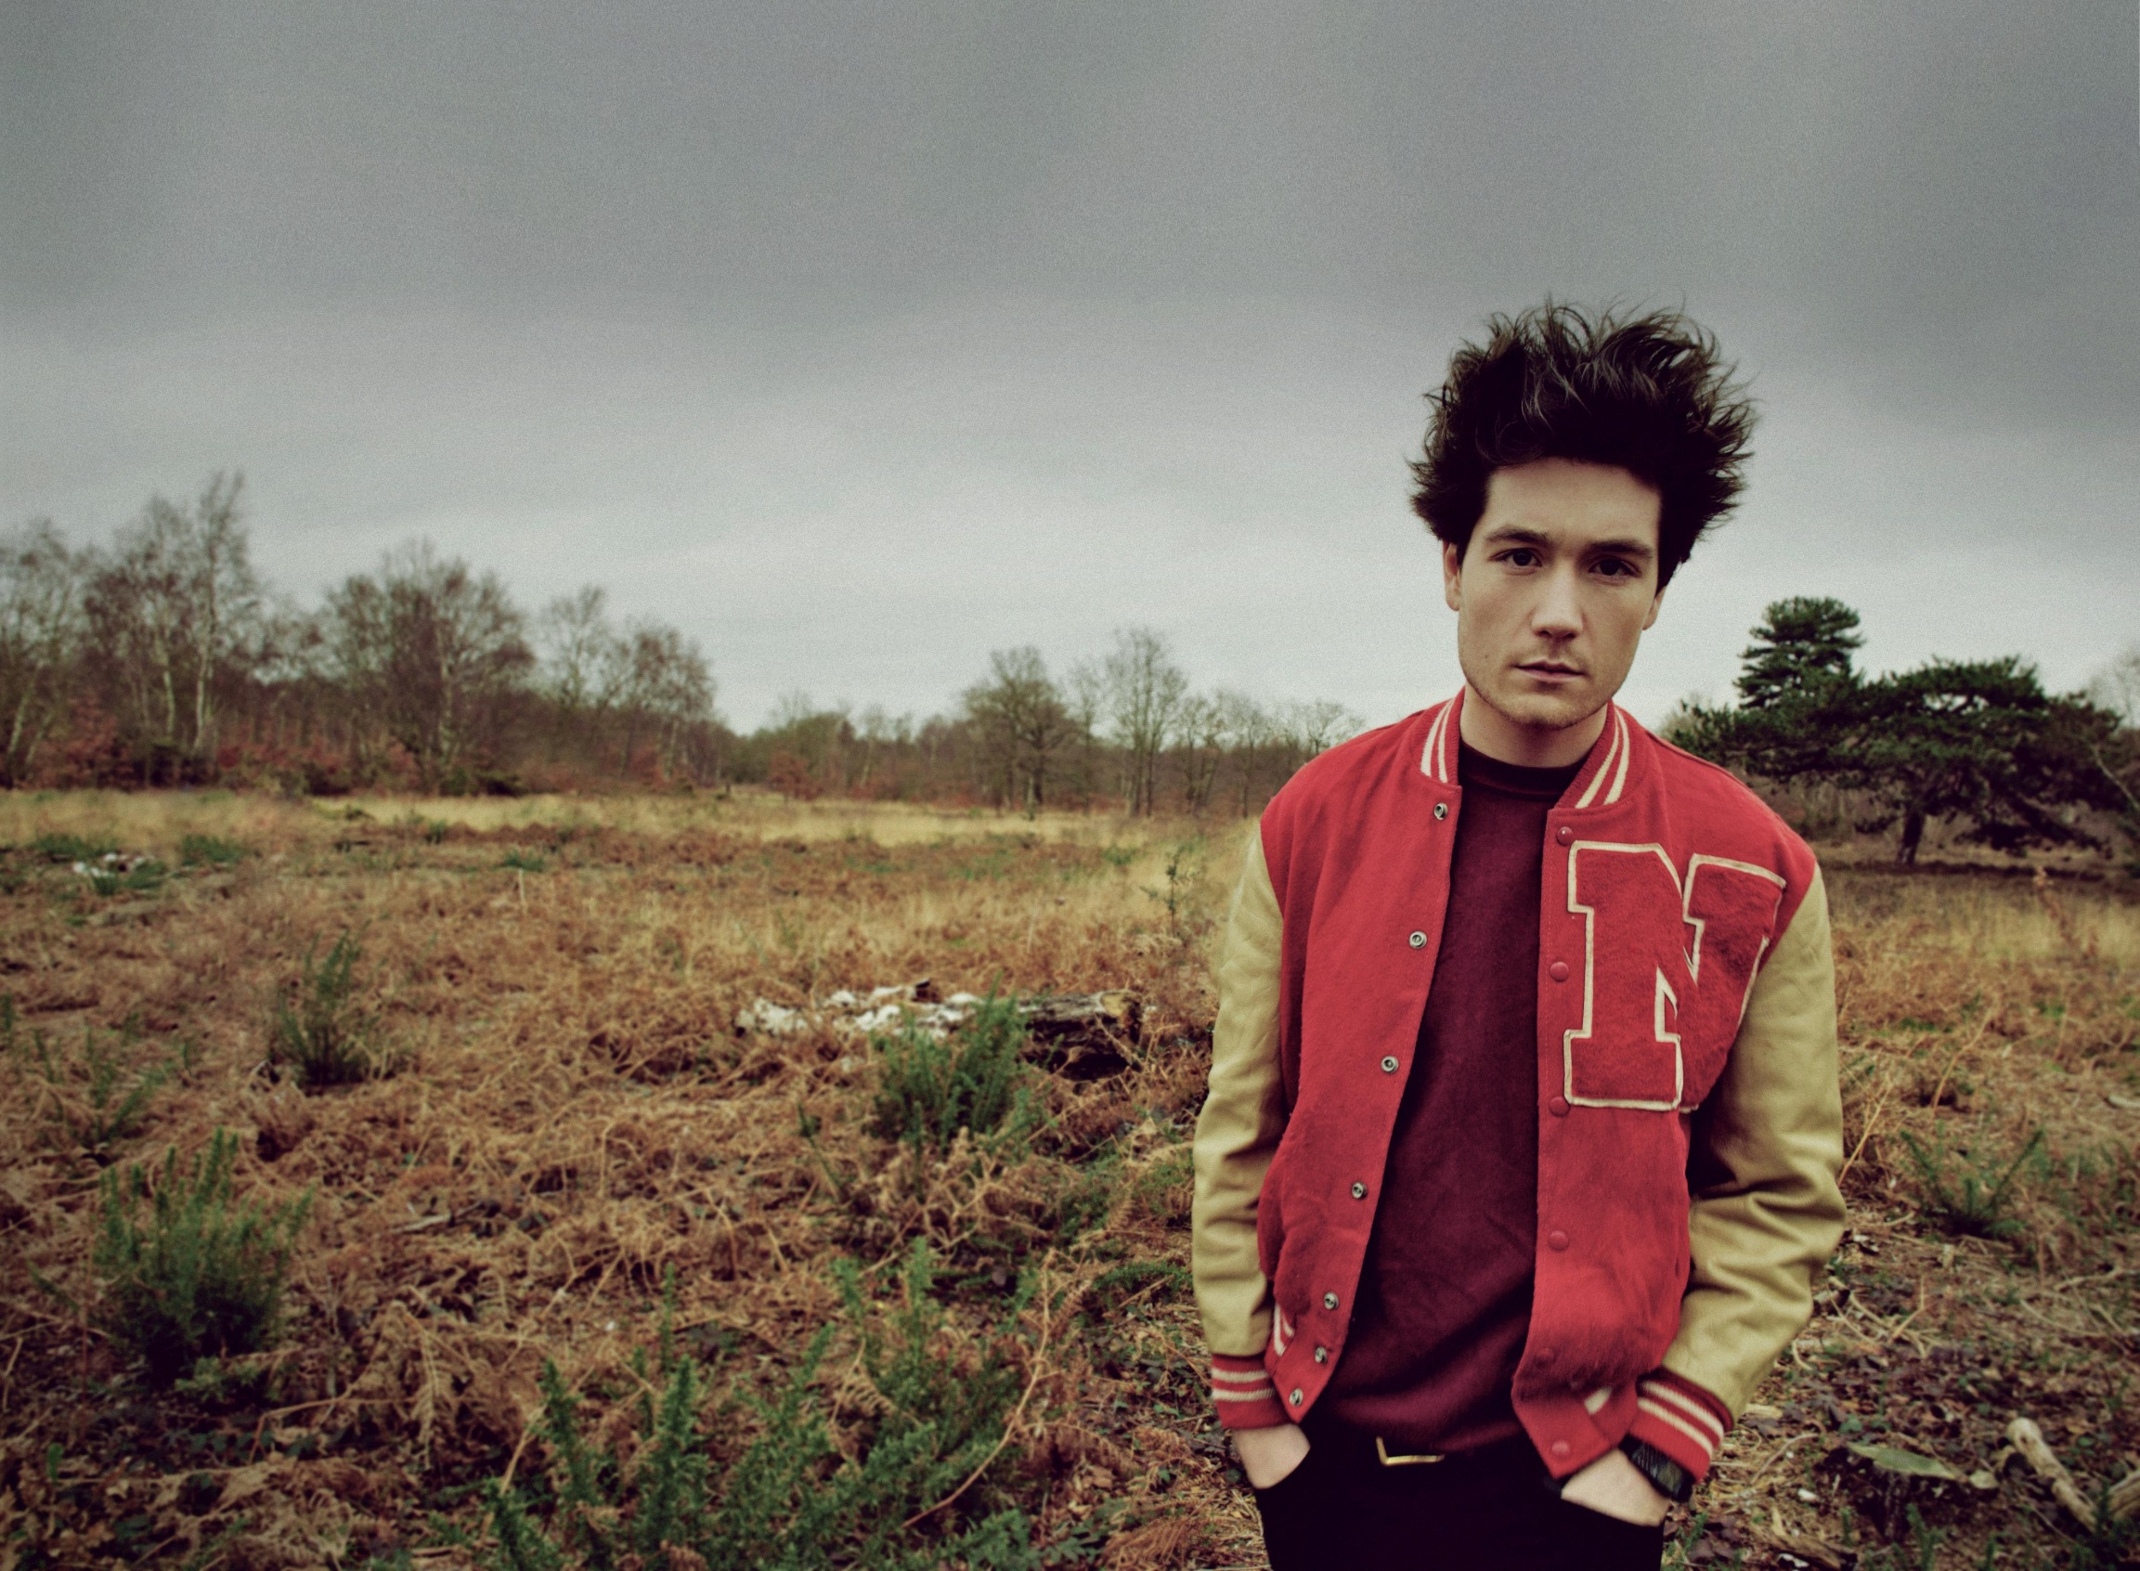
STYLE
of articles and pictures
My magazine will be quite formal but with a friendly tone.
There will be quite short articles – not too wordy and the pictures will be large.
There will be lots of full page photos with short bursts of text.
It will have mostly formal language (although with humour, not too serious) and address people who know a lot about music – meaning it will be professional.
However it will also be inspiring for young artists and offer friendly advice for performers and singers.

Slide 5
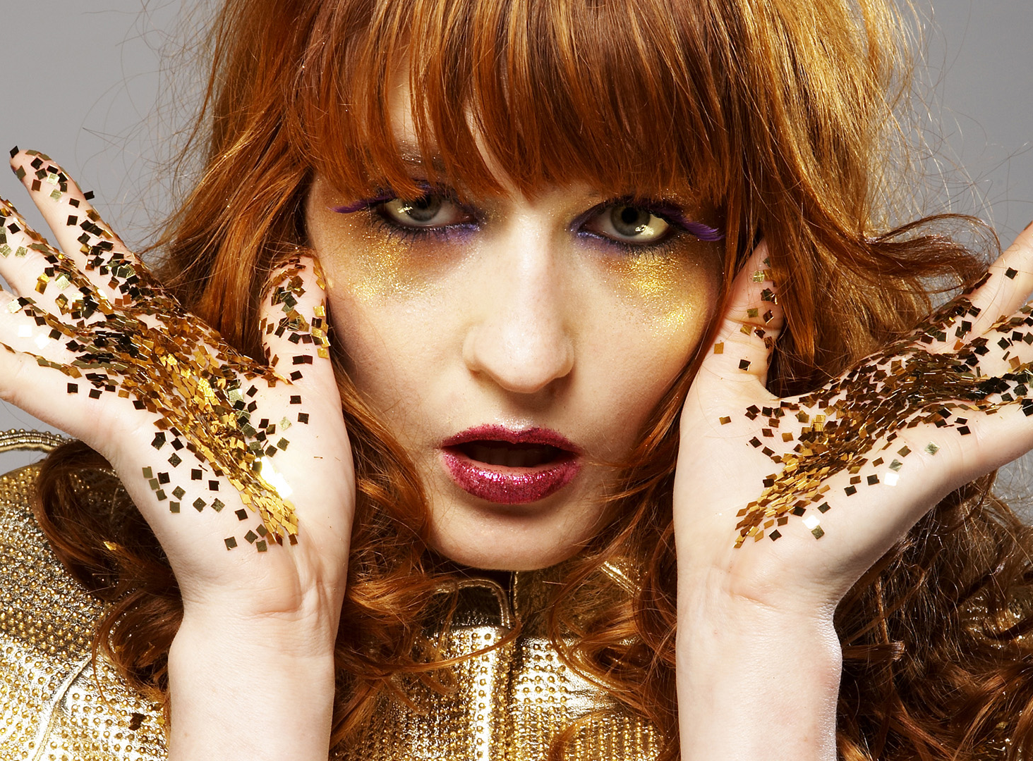
Genre
of music
Alternative rock/pop
Electronic Pop
Indie
Explores a few other genres briefly (e.g. musicals)
Focuses quite a lot on female artists

Slide 6
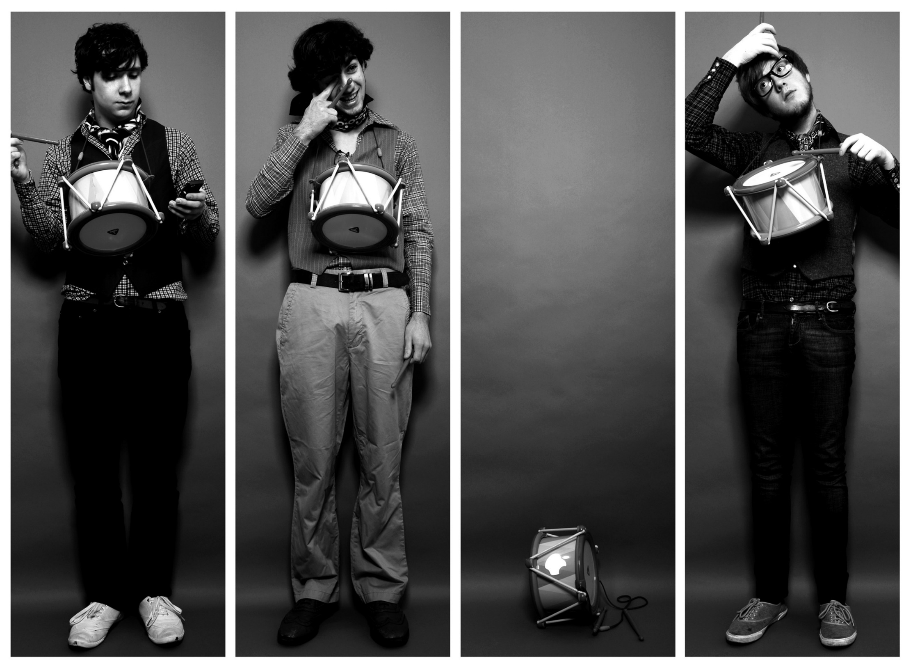
Name
Chord
Forte

Slide 7
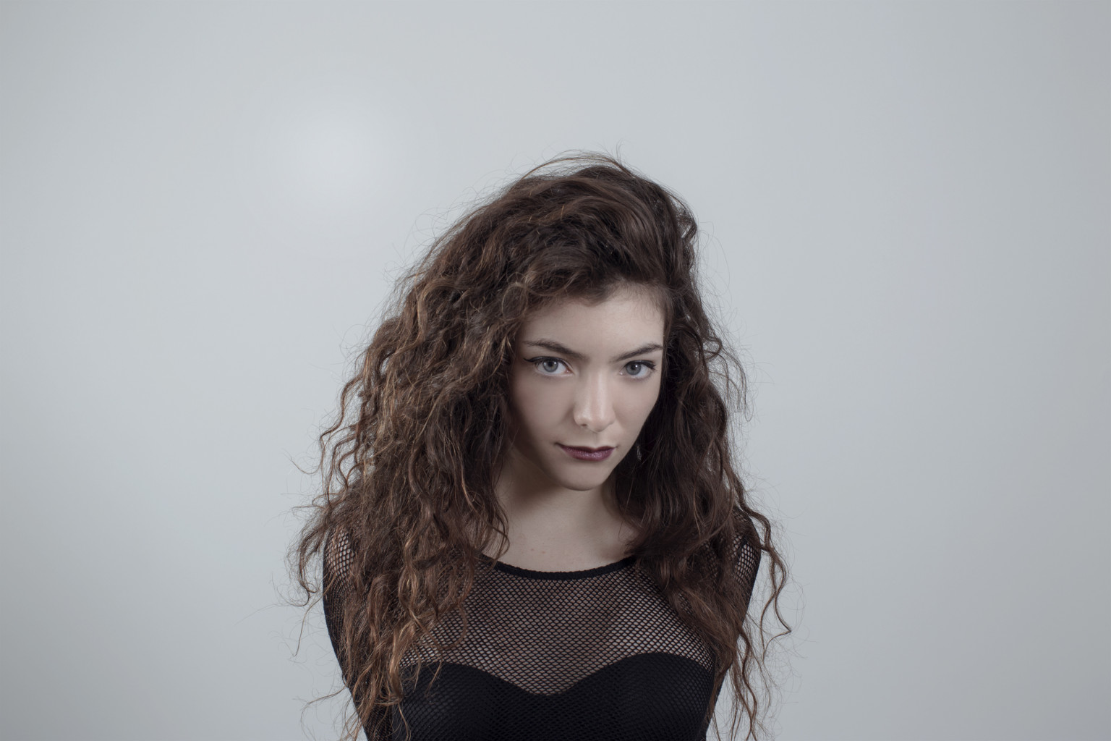
Price
£3.50
Monthly

Slide 8
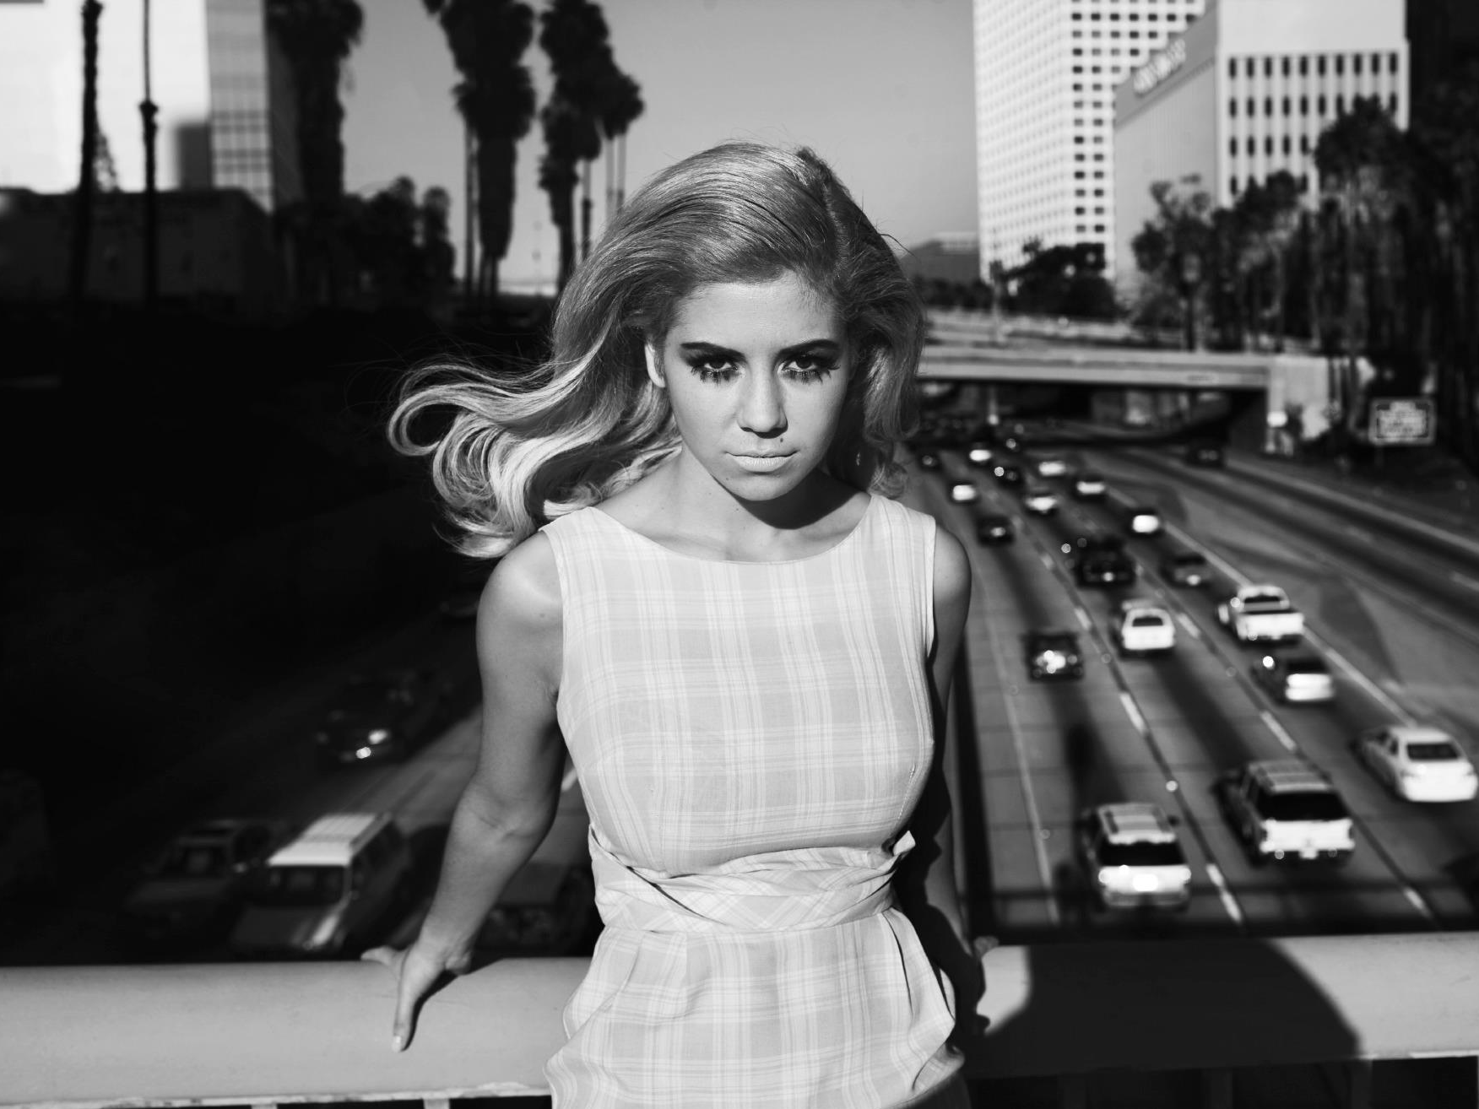
Target
audience
Interested in: Performing, fashion, music, reading.
Age: 15-25
Gender: Aimed at females.
Favourite artists: Marina and the Diamonds, Haim, Lorde, Fun, Vampire Weekend, Little Mix, Florence and the Machine, Panic! At the Disco, Two Door Cinema Club, Bastille, Lily Allen, LIGHTS, Imagine Dragons.
Favourite TV shows: Glee, New Girl, Miranda, How I Met Your Mother.
Class: B/C1

Slide 9
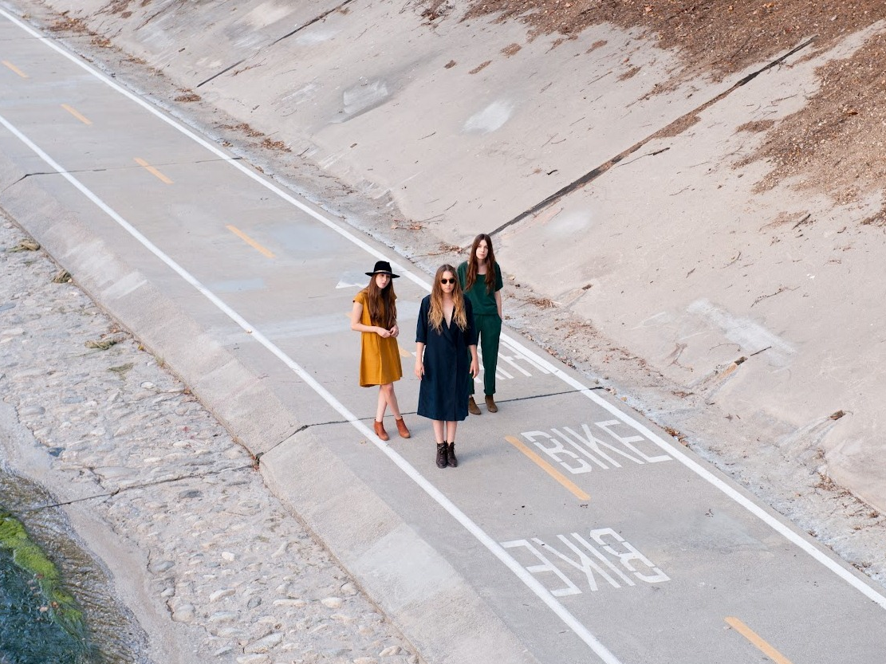
Research
From looking at Q magazine which had 170 pages I decided I wanted my magazine to be quite thick therefore 150 pages.
I realised that printing this amount of pages would make the magazine quite expensive so I made it a monthly magazine.
Looking at other magazines such as Clash magazine I could see that full paged photos add a good effect. The front cover is usually quite minimalistic and is quite thick and printed on thick paper.
I decided my magazine should look like this as it looks professional.

Slide 10

Problems
I might face
I may find that the paper I print on doesn’t look as high quality.
There may also be an issue with taking photos – if they will be good enough quality and so on. I shall have to plan ahead to avoid this.

