Slide 1
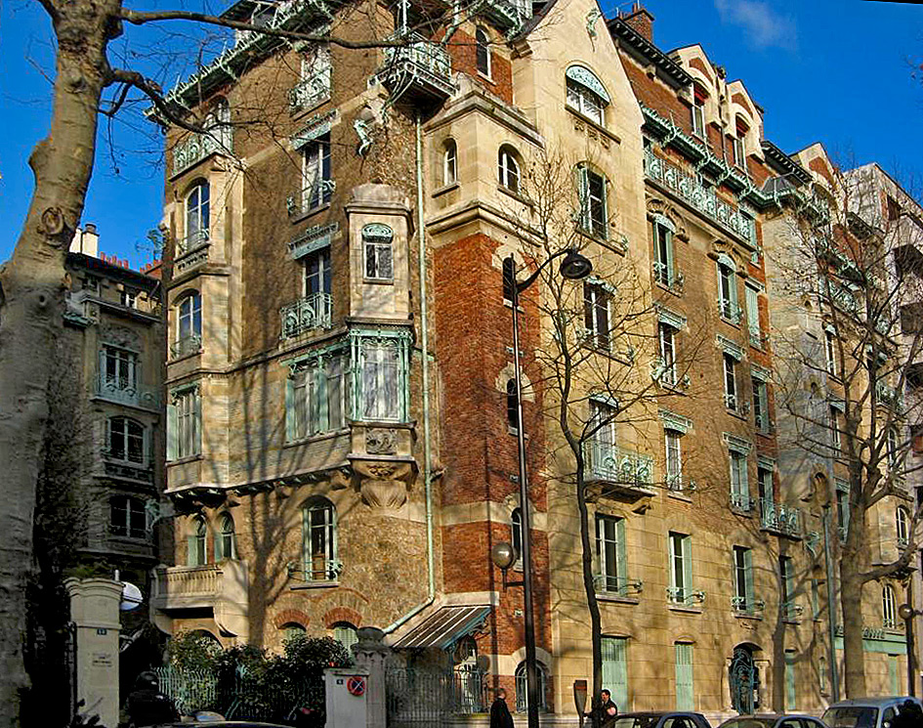
Hector Guimard, Castel Béranger, 1895-1898, Paris

Slide 2
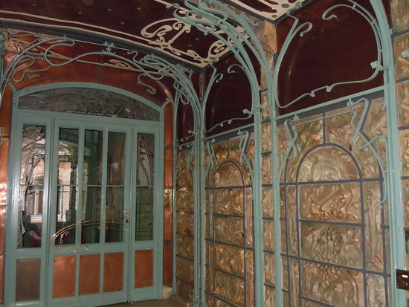
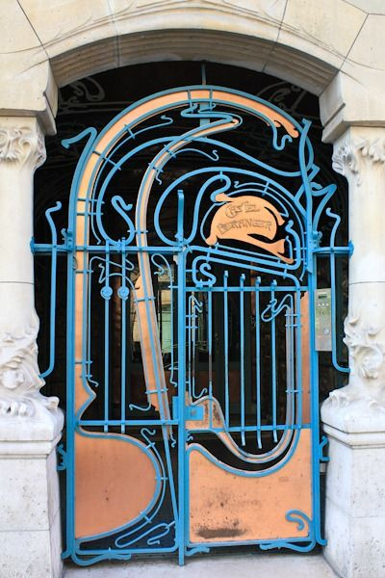
Architect: Hector Guimard
Title: Castel Béranger
Date: 1895-1898
Location: Paris
Style: Art Nouveau
Category: Domestic Architecture

Slide 3
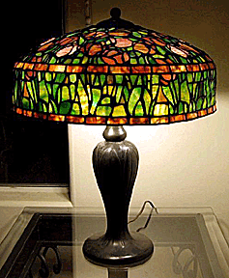
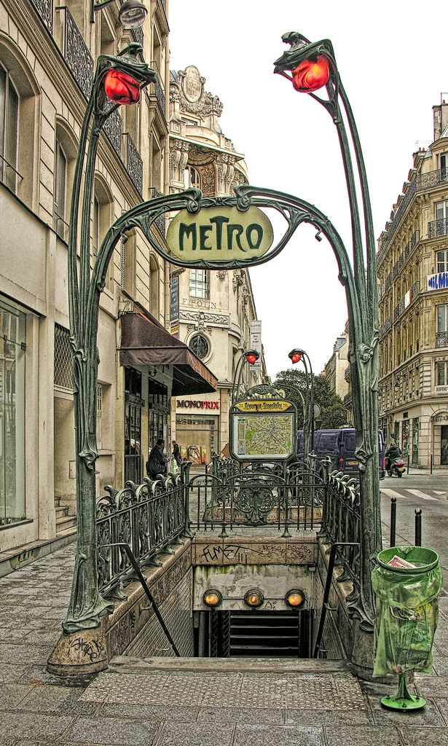
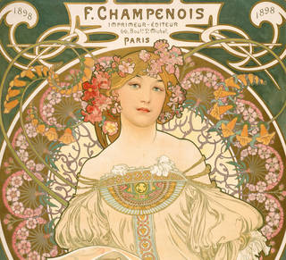
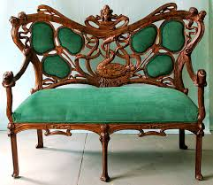
Art Nouveau: Translated as ‘new art’, developed in the 1890s France before spreading internationally. It was a rejection of academic art.
The style was also used in architecture, fashion, design. Art Nouveau is typified by flowing organic forms, natural imagery and clear lines.
The style was a development from the British Arts & Crafts style.
Art Nouveau designers took the Arts & Crafts references to nature and stylised them further.
However, unlike Arts & Crafts practitioners, those working in Art Nouveau did embrace of the production methods and technologies of the period.

Slide 4
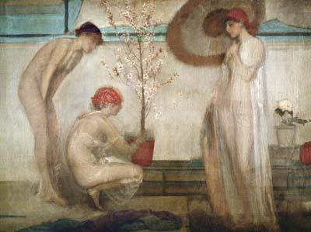
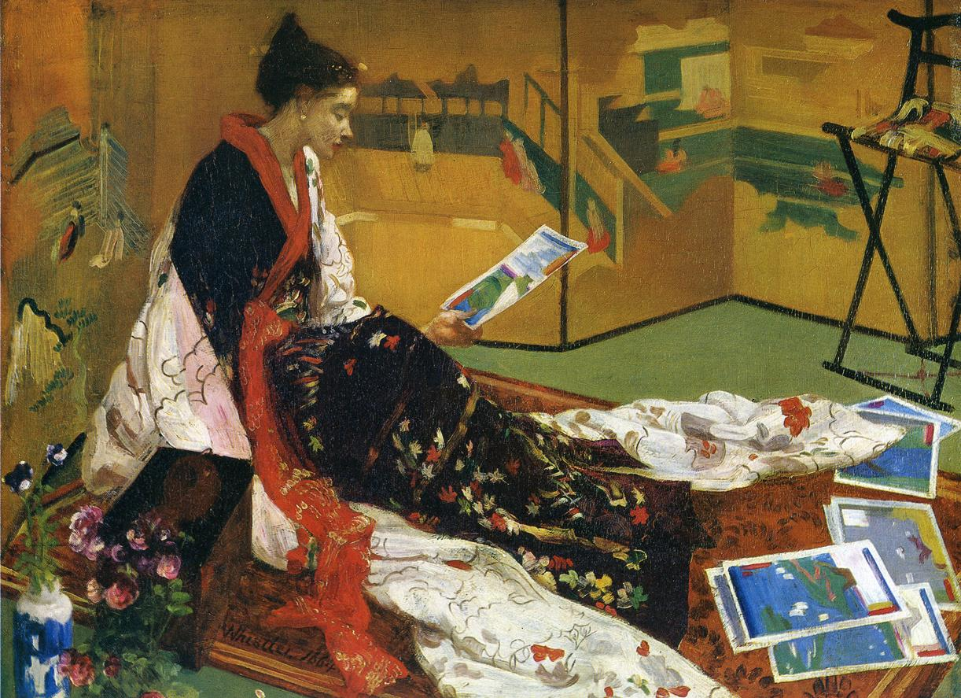
Art Nouveau came at a time when many social commentators felt that there should be no distinction between fine art and the decorative arts. All art forms should be treated equally.
Aside from the Arts & Crafts movement, another concept of thinking arose in late 19thC Britain. This was Aestheticism which advocated art for arts sake.
Supporters of Aestheticism argued that art and design should be pleasing to the eye rather than carry a deeper meaning or message.
Aesthetic artists would create a painting which was organised around the formal features such as colour, line and form. The subject matter of such works was of no consequence.

Slide 5
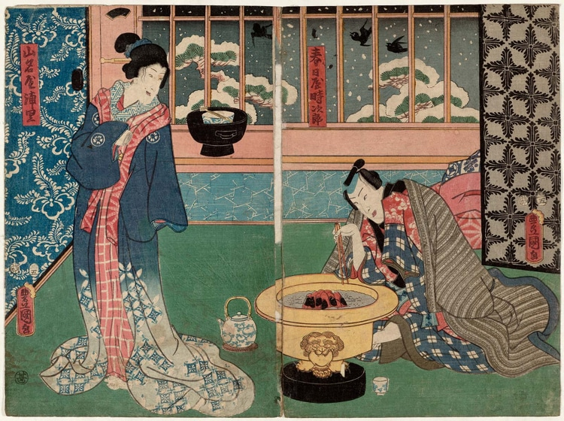
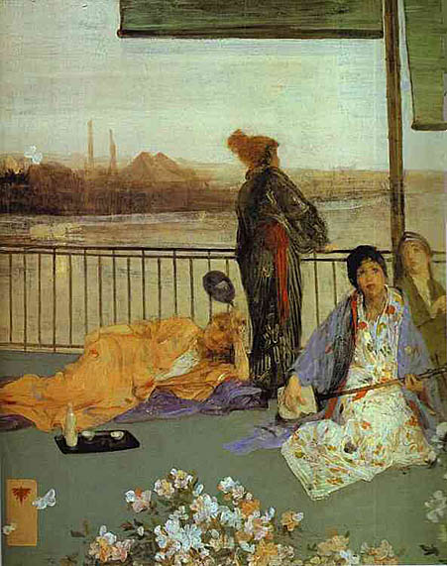
The popularity of Japanese design would also have an impact on Aestheticism and as a result on Art Nouveau design. In particular the use of clear, solid flowing lines.
Arts Nouveau had different titles in each country that it spread to. Liberty’s in London was the main seller of goods in the Arts & Crafts style to British customers.
Japanese woodblock print
JM Whistler,
Variations in Flesh Colour and Green: The Balcony

Slide 6
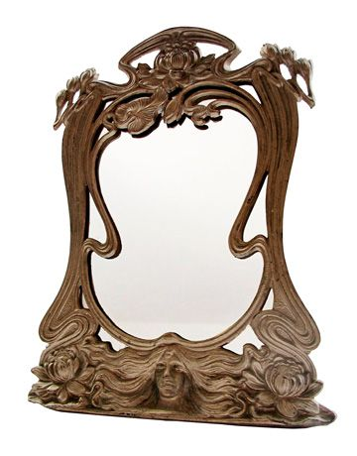
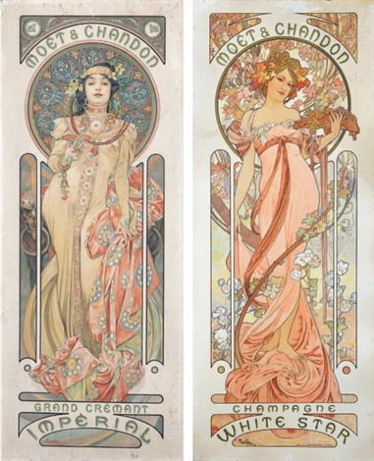
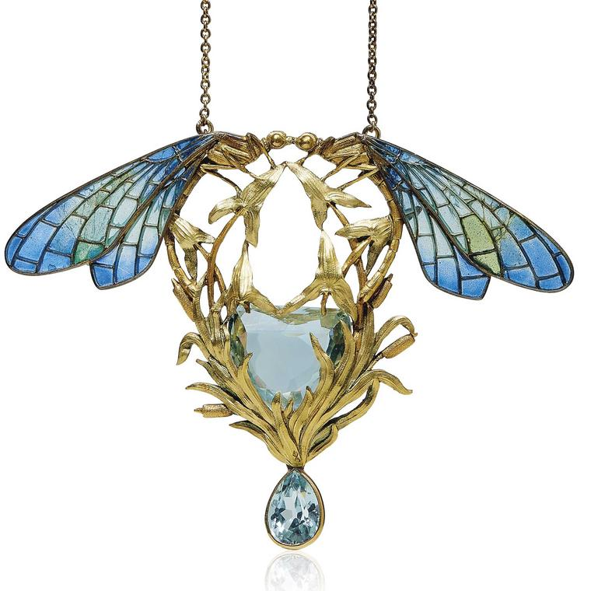
Arts Nouveau is characterised by flowing lines and forms, references to nature, stylised figures and forms, intricate patterns of overlapping lines and forms. It is found in furniture, graphic design, architecture, ceramics, glass, textiles, jewellery, fashion

Slide 7
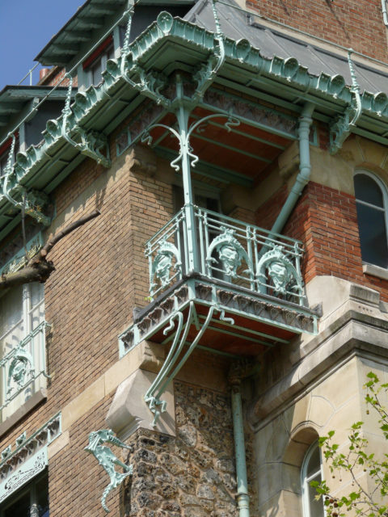
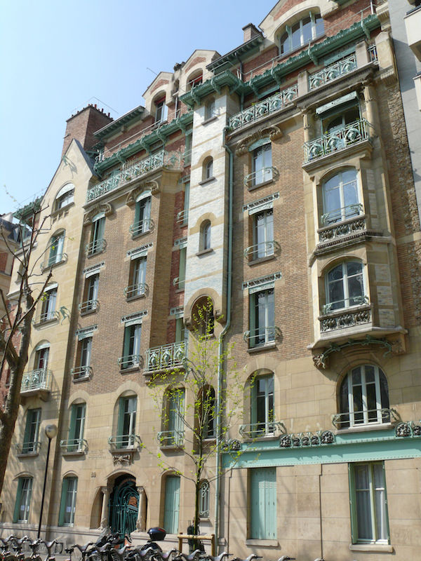
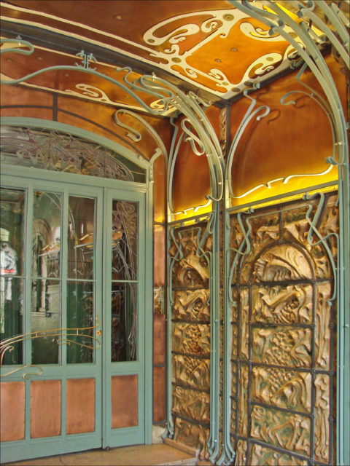
Castel Béranger is a block of 36 privately owned apartments.
It was the first building in Paris constructed in the Art Nouveau style.
The building was commissioned by a wealthy widow Madame Fournier.
The design of each apartment within the block was different, giving a sense of individuality to the occupants.
By this time in Paris, building laws were relaxing and there was a move towards the construction of buildings which broke with the strict symmetry and traditional appearance of Second Empire Hausmann style architecture.
Architects could now include larger projecting architectural forms on the facades of buildings.

Slide 8
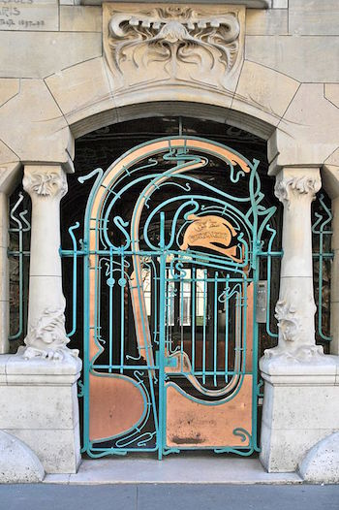
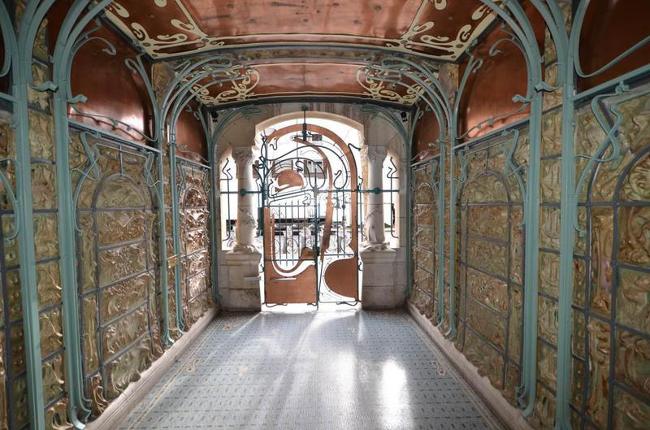
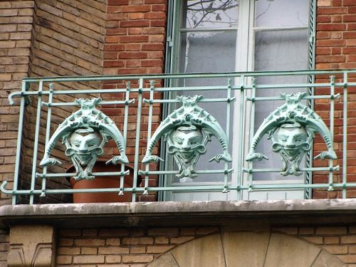
The building is six storeys high including an attic storey
Asymmetric facade, breaks with the symmetry found in Second
Empire architecture
A cast iron gate set into a curved arch with Art Nouveau columns on each side give access to a main hallway
Cast iron framework of organic lines continues inside and the walls are lined with terracotta tiles

Slide 9
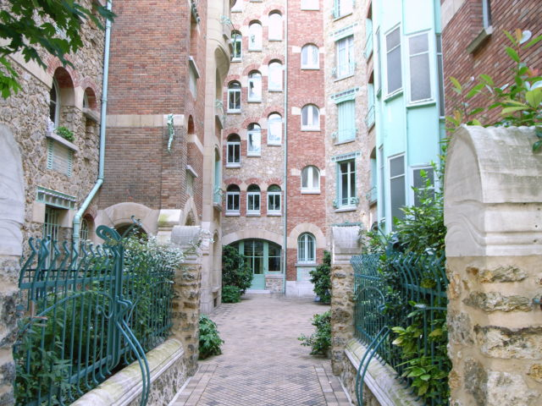
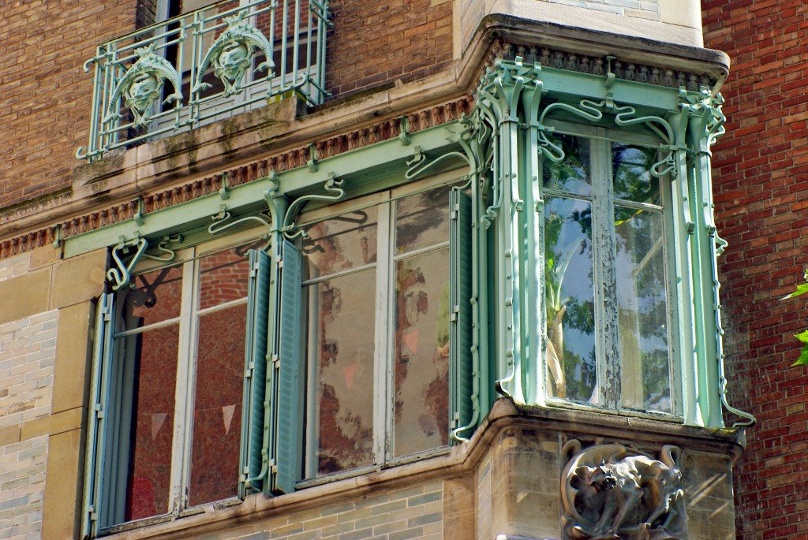
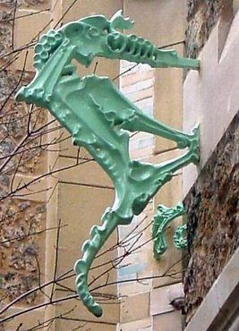
The ground floor has a centrally placed interior courtyard
Natural features, such as trees and plants link back
to the organic themes in Art Nouveau design
Red and brown brick and stone used for construction.
The green patina of the cast iron metalwork complements
the red brick
Exterior decoration references Gothic features but with an
emphasis on natural forms
Windows and balconies are framed in cast iron

Slide 10
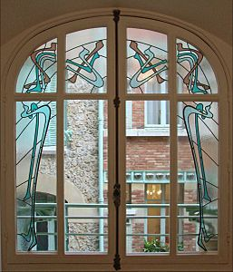
Curved, organic lines also appear in the interior.
The balustrades, windows and ceilings all link back to the Art Nouveau style
Technological developments such as cast iron allowed for curving, sinuous forms to be created which
act as the framework for various aspects of the building
The top of the building is a cast iron framework which projects beyond the facade. This shows the use of new materials but also the changes in building laws which allowed architects to extend the facade of their buildings outwards.

Slide 11
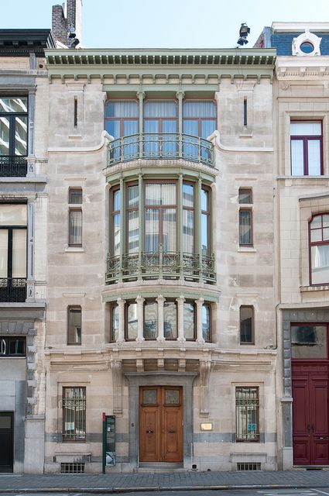
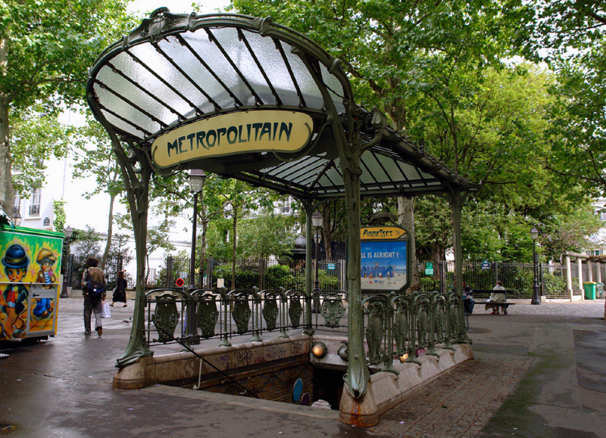
Guimard named the building Castle (castle) to link to the popularity of medieval or Gothic themes of the time.
Guimard was inspired by the Belgian Art Nouveau architect Victor Horta whom he visited in Belgium
to see Horta’s famous Hotel Tassel. Hotel Tassel is considered the first Art Nouveau building and would inspire the Castle Béranger.
In 1898 city officials organised an architectural competition to celebrate the most original and beautiful new architectural designs in Paris. This was done to encourage a
break away from more conservative Second Empire architecture.
Castel Béranger won the prize for the 16th arrondissement.
Guimard would become famous and be commissioned to design
the entrances for the new Paris Metro. He did these in the
Art Nouveau style.

Slide 12
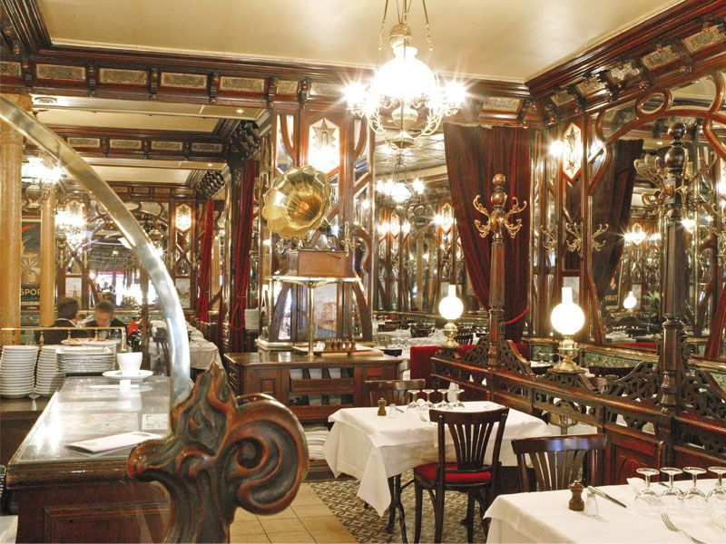
These changes in attitude towards architectural styles and progressive developments in the arts and society have been called the Belle Époque (Beautiful Era). The Belle Epoque began in France after the end of the Second Empire (1870s) and continued until the outbreak of WW1.

