Slide 1
pitching for a new business
19.1 P2

Slide 2
P2 Review the factors that will impact upon the chosen micro business idea
Research a new business that you could start up yourself eg
Pop-up café
Gift stall
Sandwich delivery service
Mobile beauty unit
Dog grooming
Car wash
Any mobile sales unit eg a burger van at a festival

Slide 3
P2 Review the factors that will impact upon the chosen micro business idea
For your chosen business review the following factors:
Capabilities and core competence (skills table)
Time constraints (Gantt chart)
Financial constraints (prioritise spending see table)
Availability of IT (What do you need? Cost?)
Physical resources (What do you need? Cost?)
Potential stakeholder influences (spider gram)
Environmental influences (PESTLE)

Slide 4
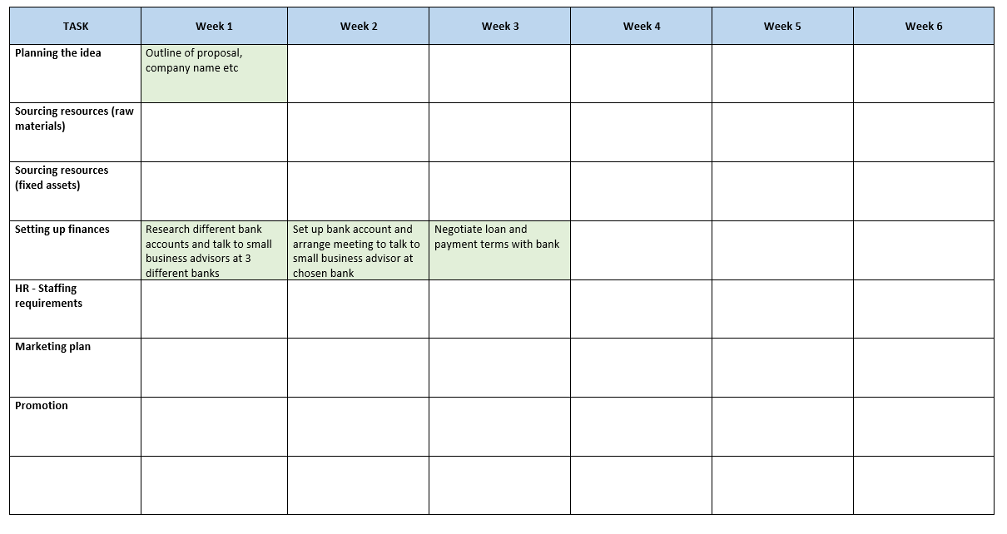

Slide 5
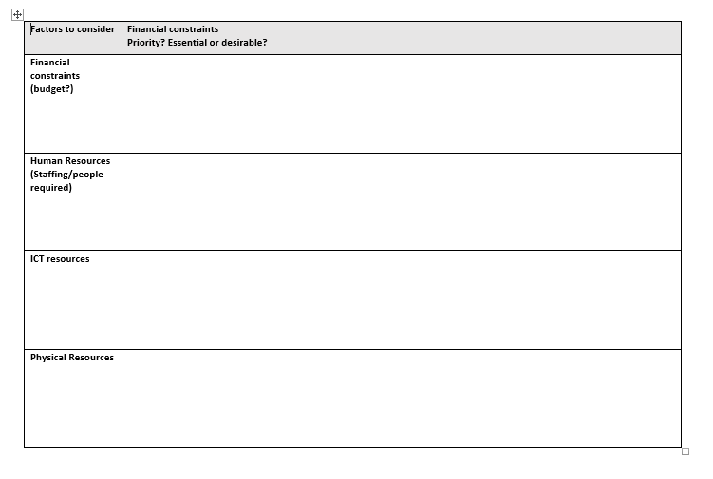

Slide 6
The business environment
What environment will your business operate within?
Carry out a PESTLE analysis for your proposal (see separate ppt)
Political factors
The Economy
Sociological & cultural aspects
Potential Technological developments
Current & potential Legislation
Environmental considerations

