Slide 1
The marketing plan the business environment
19.2 PART 1

Slide 2
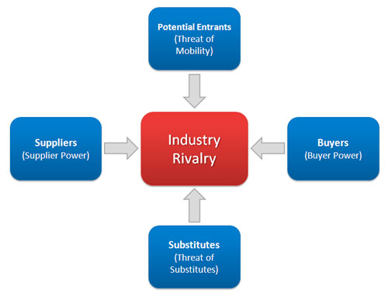
THE BUSINESS ENVIRONMENT
PORTER’S 5 FORCES
Explain how this will apply to your business proposal
https://www.youtube.com/watch?v=hUWAwor9rcA
Notes:
Five categories are considered:
Existing competitive rivalry
Threat of new market entrants
Bargaining power of buyers (customers)
Power of suppliers
Threat of substitute products

Slide 3
Industry rivalry is high when:
There are number of small or equal competitors and less when there’s a clear market leader.
Customers have low switching costs
Industry is growing
Exit barriers are high and rivals stay and compete
Fixed cost are high resulting huge production and reduction in prices
Notes:
Five categories are considered:
Existing competitive rivalry
Threat of new market entrants
Bargaining power of buyers (customers)
Power of suppliers
Threat of substitute products

Slide 4
THREAT OF NEW ENTRY IS HIGH WHEN:
Capital requirements to start the business are less
Few economies of scale are in place
Customers can easily switch (low switching cost)
Key technology is not hard to acquire or isn’t protected well
The product is not differentiated
Notes:
Five categories are considered:
Existing competitive rivalry
Threat of new market entrants
Bargaining power of buyers (customers)
Power of suppliers
Threat of substitute products

Slide 5
Buyers have more bargaining power when:
There are few buyers chasing too many goods
Buyer purchases in bulk quantities
Product is not differentiated
Buyer’s cost of switching to a competitors’ product is low
Shopping cost is low
Buyers are price sensitive
Credible threat of integration
Notes:
Five categories are considered:
Existing competitive rivalry
Threat of new market entrants
Bargaining power of buyers (customers)
Power of suppliers
Threat of substitute products

Slide 6
Suppliers are more powerful when:
Suppliers are concentrated and well organised
Few substitutes available to supplies
Their product is most effective or unique
Switching cost, from one suppliers to another, is high
You are not an important customer to the supplier
Notes:
Five categories are considered:
Existing competitive rivalry
Threat of new market entrants
Bargaining power of buyers (customers)
Power of suppliers
Threat of substitute products

Slide 7
Threat of substitute is high when:
There are many substitute products available
The customer can easily find the product or service that you’re offering at the same or less price
The quality of the competitors’ product is better
Substitute product is by a company earning high profits so can reduce prices to the lowest level.
Notes:
Five categories are considered:
Existing competitive rivalry
Threat of new market entrants
Bargaining power of buyers (customers)
Power of suppliers
Threat of substitute products

Slide 8
Applying Porters Five Forces:
Consider
Technological change – effect on barriers to entry?
Takeovers – change the bargaining power of buyers or customers?
Low cost or differentiation – which is most profitable?
Innovation – an increased threat of substitutes to an industry?
Now apply Porter’s Five Forces to your proposed micro-business start-up
Notes:
http://www.tutor2u.net/business/reference/porters-model-of-industry-rivalry-five-forces

