Slide 1
The marketing plan the business environment
19.2 PART 1

Slide 2
PESTLE analysis
PESTLE looks at the external factors that might influence an organisation
It is a useful tool for understanding the industry situation as a whole, and is often used in conjunction with a SWOT analysis to assess the situation of an individual business
PESTLE is a framework for evaluating external factors & their impact on the business to inform strategy.
http://www.marketingminefield.co.uk/pestle-analysis/

Slide 3
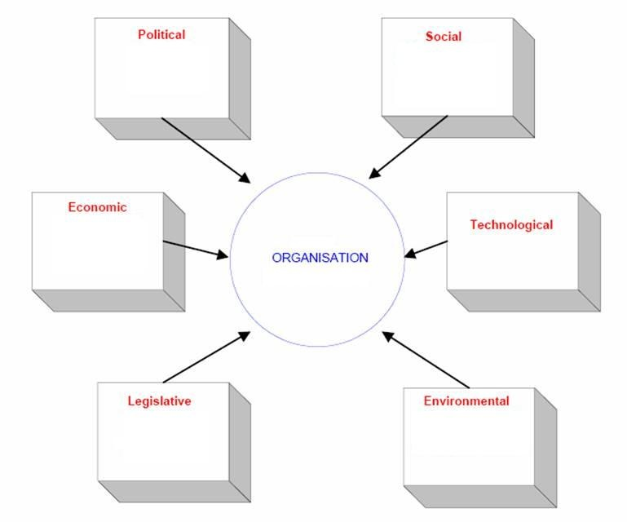
Notes:
http://www.marketingminefield.co.uk/pestle-analysis/

Slide 4
PESTLE Analysis
Political factors
The Economy
Sociological & cultural aspects
Potential Technological developments
Current & potential Legislation
Environmental considerations
Textbook page 238

Slide 5
Political factors
These factors represent the way and the extent to which a government influences the economy and a certain business
Political factors are represented by specific areas, such as labour law, tax policy, tariffs, trade restrictions and even environmental law

Slide 6
ECONOMIC factors
This refers to areas directly influenced by the economy, areas such as the inflation rate, interest rate, economic growth or exchange rates
For example, international businesses are always influenced by changing exchange rates. Similarly, UK exporters are also influenced by the exchange rate as when the sterling becomes weaker their exports become more competitive

Slide 7
SOCIAL factors
These factors refer mainly to demographic factors such as
population growth rate
cultural aspects
changing tastes
fashion
age distribution
health consciousness

Slide 8
Technological factors
Technological factors refer to automation, incentives, the rate of technological change and R&D activity.
These factors greatly influence areas such as the minimum efficient production level, quality, costs and even outsourcing decisions.

Slide 9
legal factors
The legal part refers to all the laws directly connected to a business or company and its area of activity, including
consumer law
antitrust law
anti-discrimination law
health and safety law

Slide 10
Environmental factors
This refers to all the factors directly related, influenced or determined by the surrounding environment
This includes, but is not limited to, weather, climate, geographical position, climate change, waste emissions, pollution levels and even insurance
Environmental factors are crucial to industries such as transport or tourism and can greatly influence the way a company operates or the products it offers

Slide 11
next addition to the business environment section of the marketing plan
Using the table on page 238 for guidance, complete a PESTLE analysis for your proposed micro-business start-up

