Slide 1
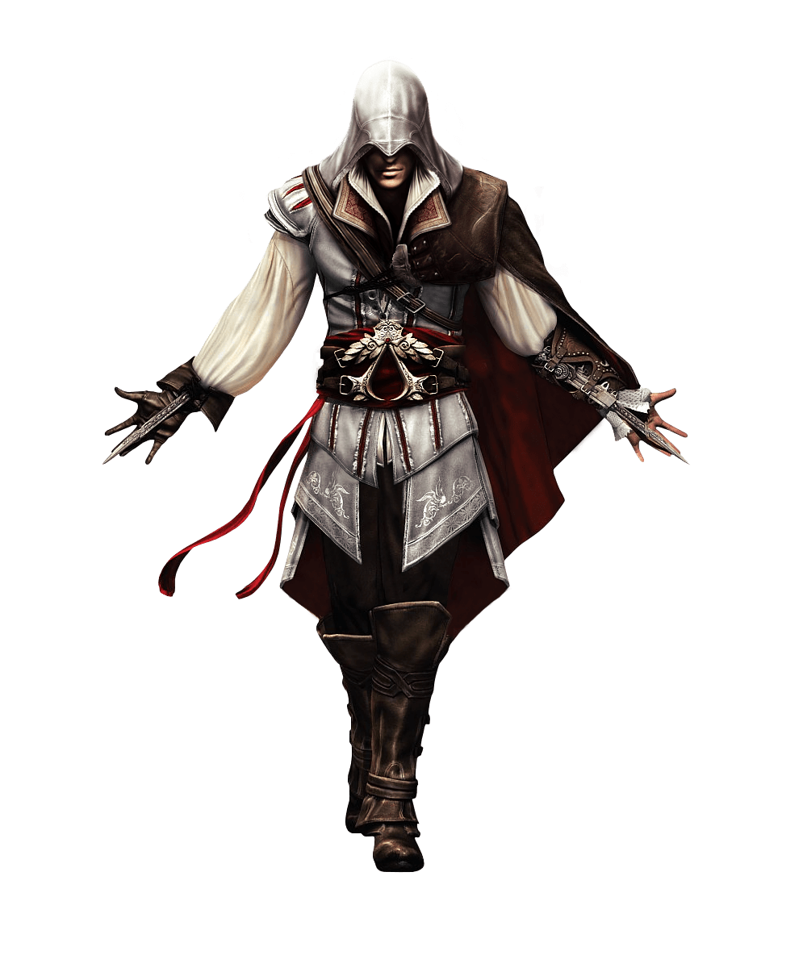
Assassin’s Creed III – Liberation
A Level Media Studies
Component 1:
Media Products, Industries and Audiences

Slide 2
Command words
Key words

Slide 3
TASK
Using Assassins Creed III Liberation as your case study, you now have 40 minutes to answer both questions.
Remember to look at the command words and weighting (amount of marks) awarded for each question. This will dictate how much detail to include in each answer.
Both answers draw only from the AO1 Assessment Objectives.

Slide 6
Marks for this question draws from the AO1 1a&b Assessment Objectives.

Slide 8
Marks for this question draws from the AO1 2a&b Assessment Objectives.

Slide 10
Responses may refer to fandom as a theoretical perspective.

Slide 11
Peer Marking
Swap papers with the person sitting next to you.
Using the mark scheme in front of you, award points for each question.
Place the work into a Band and hand the work back to the author.
Identify the areas you were weak on – e.g. detail, examples, context etc.

Slide 12
Now complete detailed plans for the following question:
(b) Explain how industry contexts and historical contexts influence audience interpretations of media products. Refer to Assassin’s Creed III Liberation to support your points. [8]

Slide 13
Consider the following:
HISTORICAL
historical period and settings featured in the game
controversial nature of the narrative
representations of gender and ethnicity
INDUSTRY
how the game relates to other titles within the franchise – brings in a pre-sold audience
the development in technology embraced by Ubisoft and Sony (PS Vita and realistic graphics)
AUDIENCE THEORY
Stuart Hall – cultural positioning
Henry Jenkins - fandom

Slide 14
Next week…
Benchmark 7
In Monday’s lesson you will have a 45 minutes timed exam question. Your mark from this will form the basis for your next Benchmark Assessment grade. Get revising now…

