Slide 1
Representation in Roar
Put the scenes from the music video in order.
Choose the two most important scenes that show ‘female empowerment’.
Justify why you have chosen those themes.
Challenge
Use elements of mise-en-scene in your justification.

Slide 2
The female becomes more accustomed to the dark and begins to see the beauty in the nature around her rather than the dangers.
That night, when walking through the jungle, the male meets his demise after being attacked by a tiger, leaving the female alone.
We see her completely absorbed into the jungle lifestyle wearing a skirt made of leaves and a garland of flowers.
She has converted the broken plane into a home and made the best of her situation.
A mid-shot again showing the female’s abject terror whilst two tarantulas crawl over her. Her clothing indicates how she is unprepared for such an environment and she is seen as a victim who we sympathise with.
Establishing shot of a plane crash in the jungle leaving only two survivors. The female looks visibly shaken and scared whilst the male is seen, through a point of view shot, to be taking selfies.
The female soon turns cat-like and a mid-shot shows her crawling on all fours and roaring at the water’s edge.
A wide shot of her sitting centrally on some kind of throne made from plants and flowers. Either side she is flanked by wild animals perhaps protecting her and her flowers form a crown, suggesting she is now the Queen of the Jungle.

Slide 3
Establishing shot of a plane crash in the jungle leaving only two survivors. The female looks visibly shaken and scared whilst the male is seen, through a point of view shot, to be taking selfies.
That night, when walking through the jungle, the male meets his demise after being attacked by a lion, leaving the female alone.
A mid-shot again showing the female’s abject terror whilst two tarantulas crawl over her. Her clothing indicates how she is unprepared for such an environment and she is seen as a victim who we sympathise with.
The female becomes more accustomed to the dark and begins to see the beauty in the nature around her rather than the dangers.
The female soon turns cat-like and a mid-shot shows her crawling on all fours and roaring at the water’s edge.
We see her completely absorbed into the jungle lifestyle wearing a skirt made of leaves and a garland of flowers.
A wide shot of her sitting centrally on some kind of throne made from plants and flowers. Either side she is flanked by wild animals perhaps protecting her and her flowers form a crown, suggesting she is now the Queen of the Jungle.
She has converted the broken plane into a home and made the best of her situation.
Choose the two most important scenes that show ‘female empowerment’.
Justify why you have chosen those themes.

Slide 4
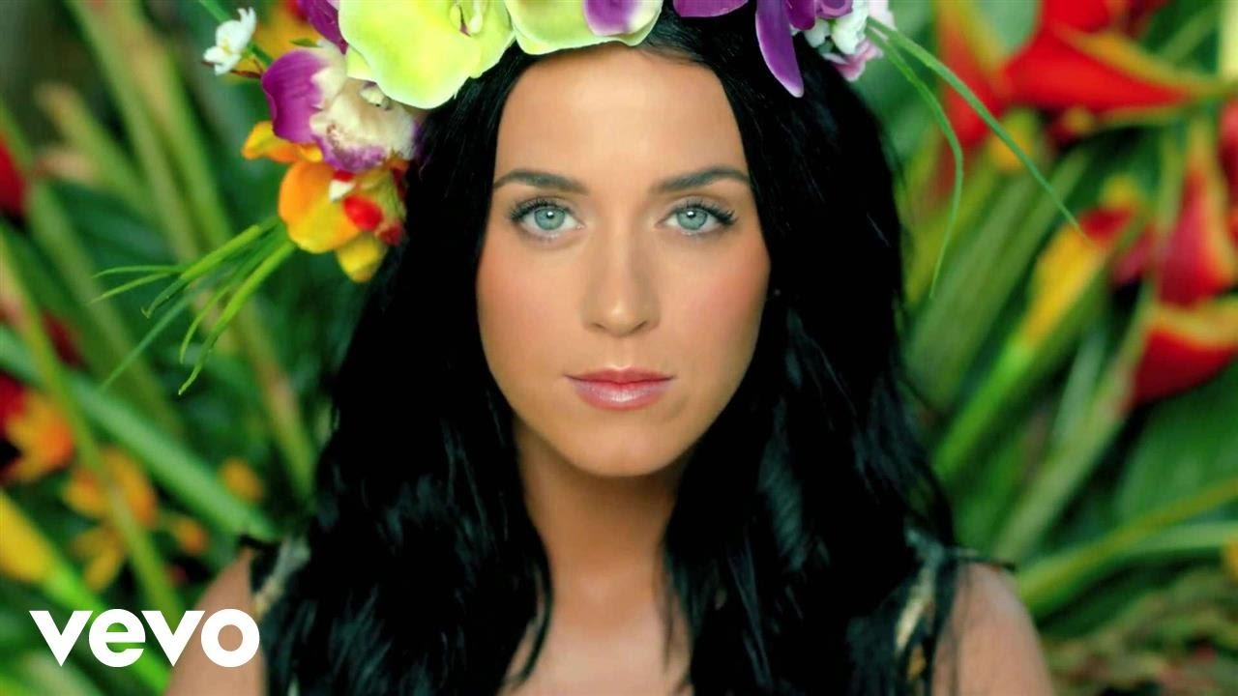
What we will be studying…
Today! > > > > > > > > >
Contemporary
Katy Perry – Roar
Music video (2013)
https://www.katyperry.com/
Notes:
Music videos Katy Perry, Bruno Mars & Michael Jackson
Online – Katy Perry and Bruno Mars websites.

Slide 5
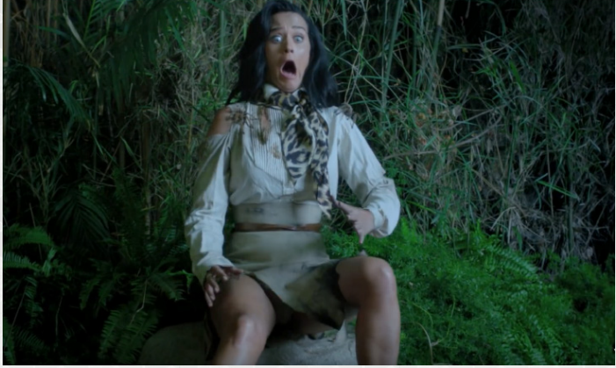
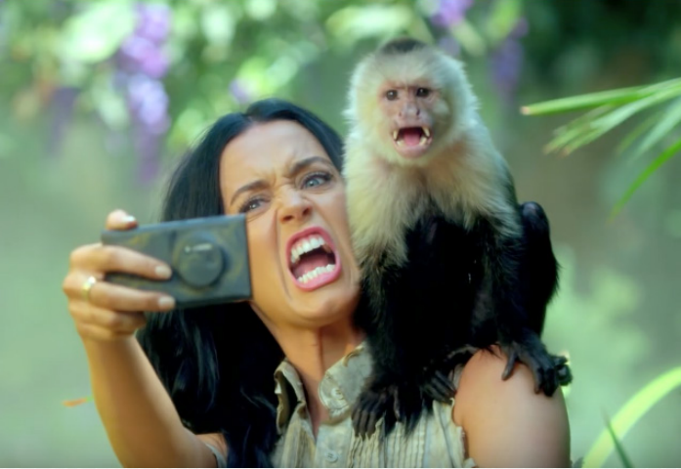
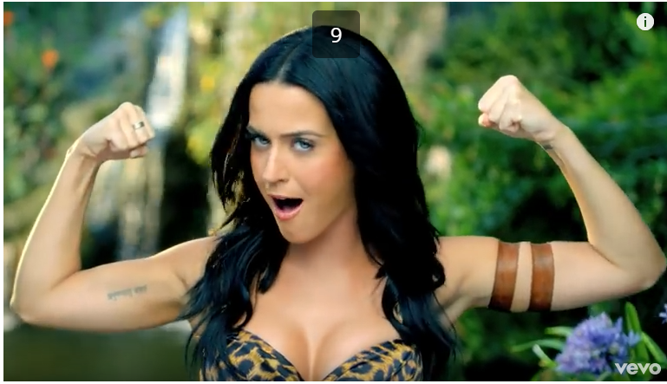
Look at the images from the music video ‘Roar’.
Categorise each image into whether they ‘support the idea of female stereotypes’ or ‘challenge the idea of female stereotypes’.
Be prepared to justify your answer.
1
2
SUPPORTS
challenges
3
3
4
challenges
SUPPORTS

Slide 6
Explain in 12 words why a photo challenges the female stereotype.
Explain in 12 words why a photo supports the female stereotype.
Challenge: Argue against two of the photos and suggest it does the opposite.
1
2
SUPPORTS
challenges
3
3
4
challenges
SUPPORTS

Slide 7
Reinforcing Female Stereotypes?
1
Females are scared of spiders/ insects.
Females don’t like being in the outside/ wilderness.
Females don’t like doing physical activity (walking/ exploring)
Females don’t like getting muddy (stay clean and pretty).
1
SUPPORTS
2
Females should be pretty and take care of their appearance – Katy Perry is pulling a funny face and doesn’t look like she cares about her appearance.
challenges

Slide 8
Reinforcing Female Stereotypes?
3
Katy Perry is showing her strength and muscles – females are stereotypically weak
Supports: she still looks pretty/ feminine.
Showing cleavage to support her feminine image.
challenges
4
Females should be pretty and take care of their appearance – Katy Perry still finding something to use as lipstick in the jungle.
SUPPORTS

Slide 9
Choose the statement you agree with. Justify your choice in a PEE paragraph.
Create a balanced argument about your chosen statement stating how you agree and disagree in a PEE paragraph.
“Both Katy Perry and Bruno Mars reinforce gender stereotypes in their music videos.”
“Both Katy Perry and Bruno Mars challenge gender stereotypes in their music videos.”
“Katy Perry challenges gender stereotypes whereas Bruno Mars reinforces gender stereotypes.”
“Bruno Mars challenges gender stereotypes where as Katy Perry reinforces gender stereotypes.”

Slide 10
Group Assessment
Create your own mark scheme!
Now that you have had a go at writing the paragraph, what would you expect to see in a paragraph that gets full marks?
Create four points in a group that you would expect to see in a well-written PEE paragraph based on the statements.

Slide 11
Reflection
Based on what you have just discussed, add in green pen one point to improve your answer.
Support: Use the points on the board that we have discussed as a class.
Challenge: Can’t add anything else? Make your argument a balanced argument.

