Slide 1
Homework table
Class of food | Exercise related function
Carbohydrate E.g. Rice
Fats E.g. Nuts, Dairy
Protein E.g. Fish,
Fibre E.g. Cereals
Vitamins E.g. Fruits & vegetables
Minerals E.g. Fruits & Veg
Water
Main energy fuel for both aerobic and anaerobic work
Secondary energy fuel (for low intensity work)
Good source of vitamins E.g. A, D, E, K
For muscle/tissue growth and repair
For making enzymes, hormones and haemoglobin
Can provide energy when glycogen/fat stores are low
Allows slower, more sustained release of energy
Vit K/Vit B9 (folic acid)/B12 – helps production of red blood cells/ haemoglobin
Vit D – for bones
Vit B2/Vit B3 (Niacin) – energy metabolism
Calcium/magnesium - for muscle contraction
Phosphorus/sodium/iron – energy metabolism
Potassium/sodium/calcium – nerve transmission
Calcium /phosphorus/ - for bones
Removes waste products, carries nutrients to cells and controls body temperature.

Slide 2
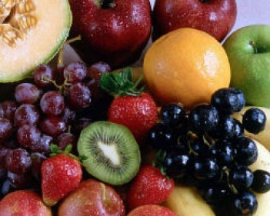
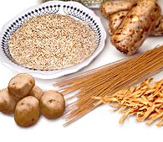
Carbohydrates
Simple carbs: quickly digested by the body. Found in fruits and anything with refined sugar added.
Complex carbs: take longer for the body to digest. Found in wholemeal bread, pasta and rice.
Exercise related function:
They are the main fuel for high intensity or anaerobic work
Also the main source of energy for the first 20 minutes of aerobic exercise
Carbohydrates play an important role in the performance of exercise lasting an hour or more.
3-4 hours before exercise: beans on toast, pasta or rice with a vegetable based sauce, breakfast cereal with milk, crumpets with jam or honey.
1-2 hours before exercise: include fruit and cereal bars
one hour before exercise: sports drinks

Slide 3
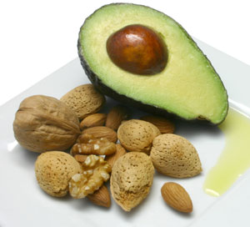
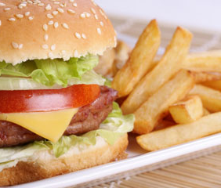
Fats
Unsaturated:
Saturated:
Fats are made from glycerol and fatty acids. Each glycerol is attached to three fatty acids. Glycerol and fatty acids contain the elements carbon, hydrogen, and oxygen. Fats contain a lot of carbon. This is why they give us so much energy.
Exercise related function:
Fat is an important energy fuel during low intensity exercise.
Fats are the secondary energy fuel for low intensity, aerobic work such as jogging.
It is also a carrier for fat soluble vitamins A D E and K.
Too much fat can lead to excessive weight which will affect levels of stamina and limit flexibility.

Slide 4
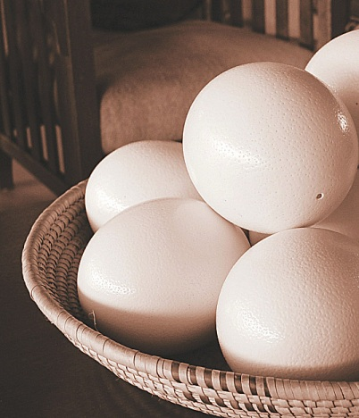
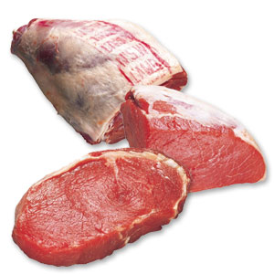
Protein
These are a combination of many chemicals called amino acids.
Exercise related function:
Important for tissue growth and repair
Important for making enzymes, hormones and haemoglobin
Can provide some energy when glycogen/fat stores are low

Slide 5
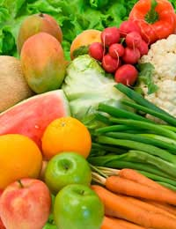
Vitamins
Minerals
Minerals tend to be dissolved by the body as ions and are called electrolytes.
Vitamins are organic compounds which are needed in small quantities to sustain life.
Exercise related function:
Vit D – for bones
Exercise related function:
Vit B2/Vit B3 (Niacin) B Complex - energy metabolism
Iron – helps form haemoglobin which will enhance the transport of oxygen and therefore improves stamina and for energy metabolism.
Vit B9 (folic acid)/B12 – helps production of red blood cells/ haemoglobin
Vit C - helping to protect cells and keeps them healthy, maintaining healthy skin, blood vessels, bones and cartilage, helping with wound healing
Sodium – regulation of fluid levels.
Calcium – for strong bones also facilitates nerve transmissions, aids muscle contractions

Slide 6
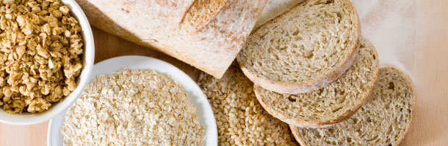
Fibre
Fibre or "roughage" as it is also known, is essentially a carbohydrate and is found solely in plants. It is found in the walls of the plant's cells and is the only part of the plant that cannot be digested by the human body
Exercise related function:
Slows down the time it takes the body to break down food
results in slower, more sustained release of energy
This improves stamina

Slide 7
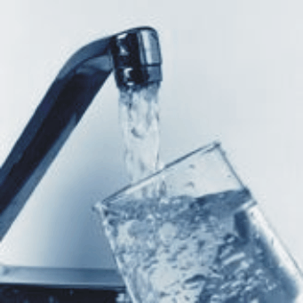
Water
When an athlete starts to exercise their production of water increases (water is a bi-product of the aerobic system).
We also lose a lot of water through sweat.
The volume of water we lose depends on the external temperature, the intensity and duration of the exercise and the volume of water consumed before, during and after exercise.
Make sure you take on fluids regularly.
Exercise related function:
It carries nutrients to cells in the body and then removes waste products.
Controls temperature
Water is important to maintain optimal performance.

