Slide 1
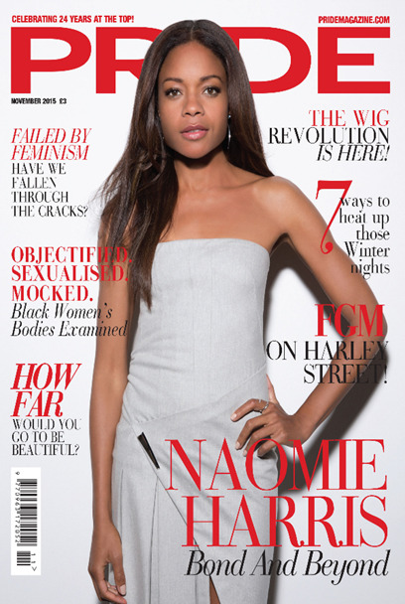
Uptown Funk
LO: To be able to understand what meanings are created in Uptown Funk
Look at your ‘Pride’.
Be ready to answer these questions:
Identify the gender, age and ethnicity of the target audience.
Why does the primary image appeal to women of colour?
Why does ‘Bond and Beyond’ appeal to women of colour?
Why would an article about ‘wigs’ appeal more to women of colour?

Slide 2
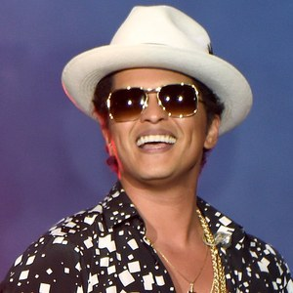
What we will be studying…
Today! > > > > > > > > >
Contemporary
Bruno Mars – Uptown Funk
Music video (2014)
http://www.brunomars.com/
Notes:
Music videos Katy Perry, Bruno Mars & Michael Jackson
Online – Katy Perry and Bruno Mars websites.

Slide 3
Memory Game
You are going to be shown some pictures of items for 1 minute only.
Try and remember as many items as possible in your head.
NO CHEATING!
Are you ready…?

Slide 4
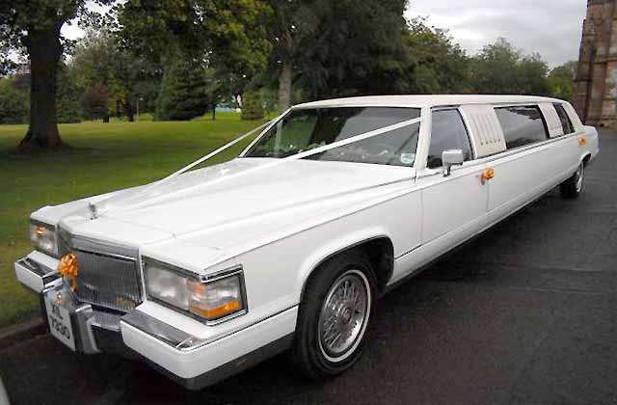
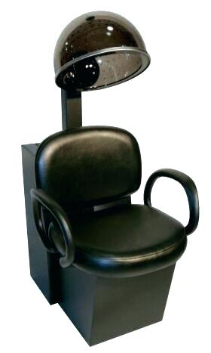
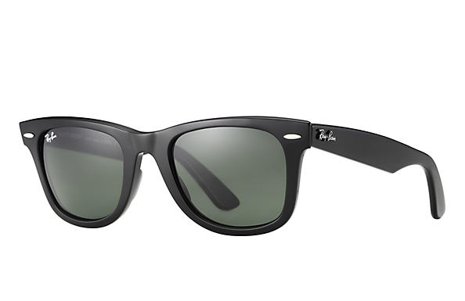
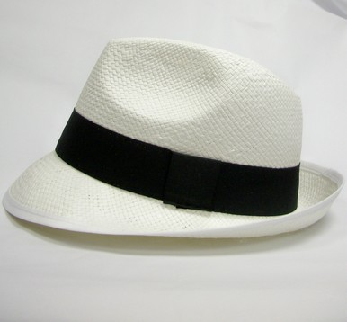
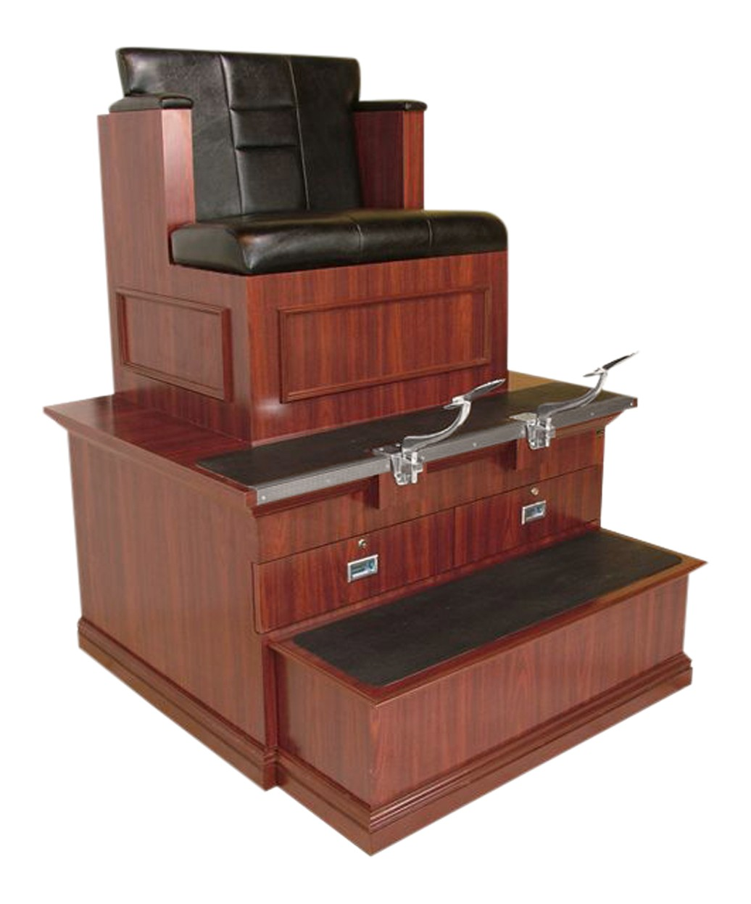
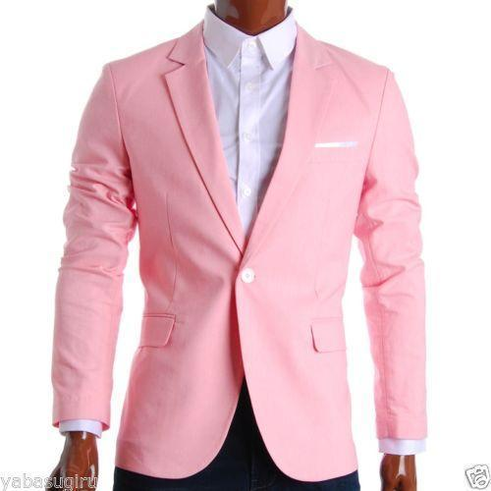
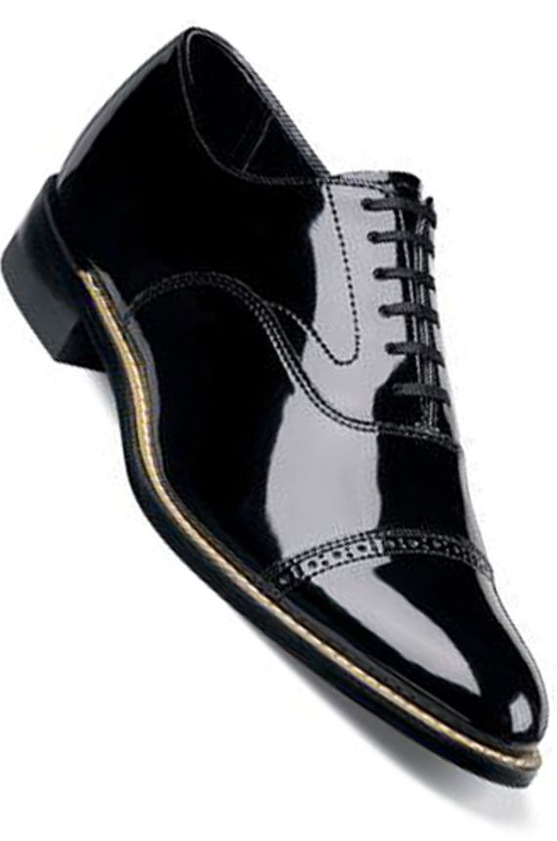
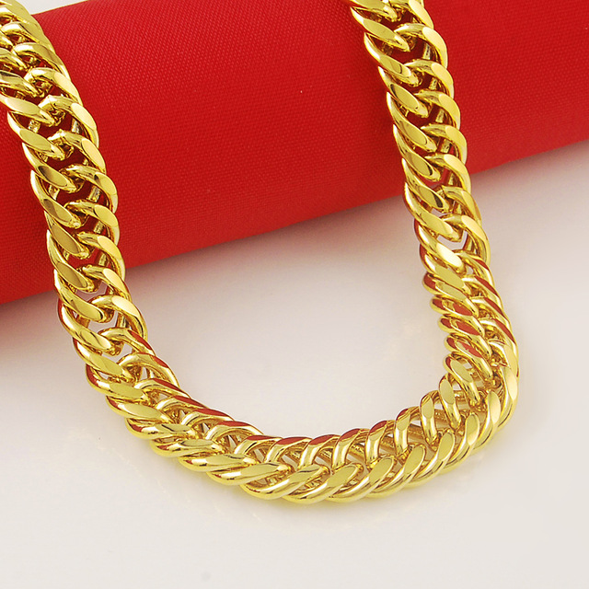
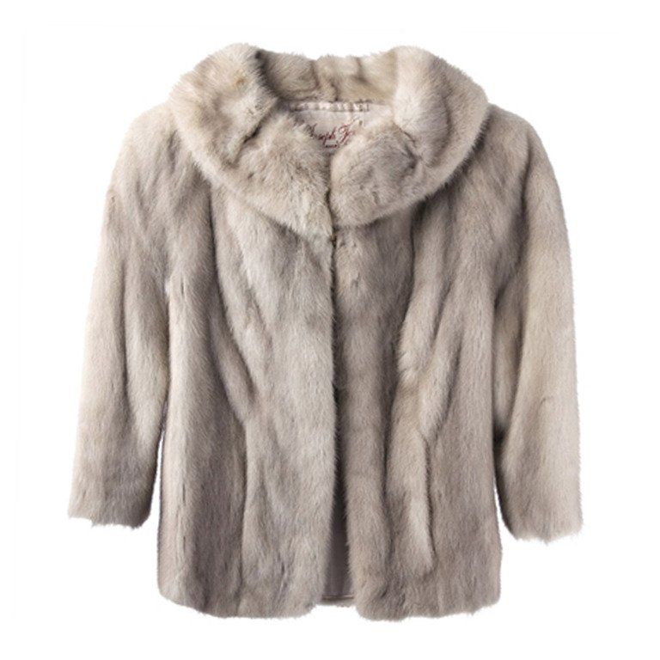
Shoe shine chair

Slide 5
Memory Game
You now have 1 minute to write as many items down as possible!

Slide 6
Mise-en-Scene Mind-Map
1
Put each of the items from the music video into the mise-en-scene categories they come under on the worksheet.
Add in your own examples from the music video of elements of mise-en-scene. (E.g. facial expressions? Body language?)
2
Explain what meanings each mise-en-scene element creates. Use the items as your examples.
EXAMPLE SUPPORT: The costumes creates a meaning of wealth. For example gold jewellery and smart clothing like blazers shows that they have money to spend on nice clothes.
Extension: Identify three camera angles used in the music video and explain what meanings they could create.

Slide 7
Plenary
“Uptown Funk portrays Bruno Mars as a wealthy and confident male.”
Explain whether you agree or disagree with this statement. Use examples from the music video to support your point.
SUPPORT Bruno Mars is portrayed as a wealthy male because…
For example…
Therefore this shows he is wealthy because…
CHALLENGE
Disagree with the statement.
EXTENSION Write a balanced argument. Add another paragraph that is the opposite argument to consider both sides.

Slide 8
Costume, hair and make-up
Body Language & Facial Expression
BRUNO MARS – UPTOWN FUNK
Setting
Props

