Slide 1
COMPONENT 1 SECTION a
REPRESENTATION
(COULD BE q1 OR q2)

Slide 2
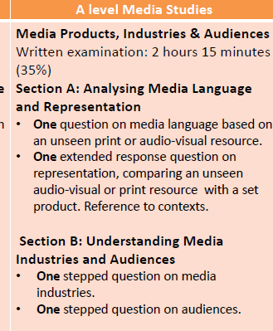
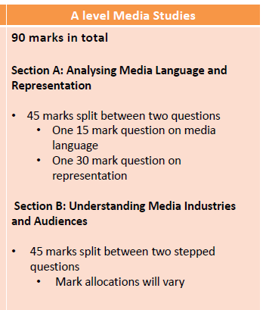

Slide 3
Example Representation question
Question 1 is based on the unseen audio-visual resource and the set print advertisement you have studied: Tide
The audio-visual resource consists of a television advertisement for This Girl Can – Sport England, released in 2015 https://www.youtube.com/watch?v=toH4GcPQXpc

Slide 4
Component 1 Section A: REPRESENTATION
You will be allowed one minute to read Question 1
The advertisement will be shown three times
First viewing: watch the advertisement
Second viewing: watch the advertisement and make notes
You will then have five minutes to make further notes
Third viewing: watch the advertisement and make final notes
Once the third viewing has finished, you should answer Question 1

Slide 5
question
Q.1. Compare the representations of gender in this advertisement and the set Tide advertisement you have studied.
In your answer, you must consider:
how representations convey ideologies
the similarities and differences in the ideologies conveyed
how far social and cultural contexts affect the representations

Slide 6
THIS GIRL CAN: IDEOLOGIES
The campaign (targeted at women 14-40) was started because there is a huge gender gap in terms of the number of women who play sport vs. men (1.7m less)
Ideologies: anyone can get fit, whatever your background, size, age, level of ability. The campaign is shining a spotlight on bodies of all types, and saying that they’re all capable of moving in a variety of ways.
Sport is for women
Sweat is good
Empowering. Positive representations. Inspiring
Shouldn’t worry about what you look like while exercising (hot, choice of clothes etc)
Highlights the social benefits – getting together with others to do it
Sound track: Get Your Freak On, Missy Elliot creates energy – challenging gender stereotypes

Slide 7
THIS GIRL CAN: IDEOLOGIES
Various clips of women participating in sports usually associated with men
Challenges fear of being ‘judged’
Written codes – use of humour to challenge stereotypes
Challenges stereotypes of elite sportswomen (Olympians) with their athletic bodies. A representation of ‘normal’ women
Liesbet Van Zoonen’s feminist theory could be applied to this ad (the media can contribute to social change by representing women in non-traditional roles and using non-sexist language)

Slide 8
Tide: IDEOLOGIES
In the 1950s, while men were being targeted for the post-war boom in America’s car industry, women were the primary market for the technologies and products being developed for the home.
In advertising for these types of texts, stereotypical representations of domestic perfection, caring for the family and servitude to the ‘man of the house’ became linked to a more modern need for speed, convenience and a better standard of living than the women experienced in the pre-war era.
The ad highlights the importance of achieving clean, white laundry – that is considered to be one of women’s key aims

Slide 9
the similarities and differences in the ideologies conveyed
Similarities:
With Tide, Stuart Hall’s theory of representation can be applied. The image of domesticity (including two women hanging out the laundry) forms part of the ‘shared conceptual road map’ that gives meaning to the ‘world’ of the advert. Despite its comic strip visual construction, the scenario represented was familiar to the audience as a representation of their own lives – this is similar to This Girl Can, but for different reasons
Applying David Gauntlett’s theory of identity, the women represented in the Tide advert act as roles models of domestic perfection that the audience may want to construct their own sense of identity against. This is also similar to This Girl Can, but again, for a different purpose
Differences include:
a wider range of female representations in terms of ethnicity/size in This Girl Can. Women come in all shapes and sizes
representations challenging gender stereotypes in This Girl Can

Slide 10
how far social and cultural contexts affect the representations
Liesbet Van Zoonen’s feminist theory is contradicted with Tide as the ad does not contribute towards social change; it is placing women back in the home, overturning the social changes that had taken place in the proceeding war years
bell hooks’ feminist theory argues that lighter skinned women are considered more desirable and fit better into the western ideology of beauty.Tide reinforces this by only representing ‘modern’, white women. This Girl Can, challenges this theory, however, as it features more racial diversity, which reflects the more diverse society of the 21st century
Gauntlett’s theory of the media offering ‘singular and straightforward messages of representation in the past’ can also be applied, as the representations within Tide are narrow (white, slim women), whereas This Girl Can demonstrates that today we have far more pluralistic representations of women’s body shapes, activities, lifestyles

Slide 11
mark scheme

Slide 12
ASSESSMENT OBJECTIVES
Responses will apply knowledge and understanding of aspects of representation from the theoretical framework, such as:
the way issues, individuals and social groups are represented through a process of selection and combination
how representations invoke discourses and ideologies and position audiences
theoretical perspectives on representation
Responses will analyse how ideologies are conveyed by the representations in the unseen advertisement and the set print advertisement, including for example:
use of visual codes and mise-en-scène
technical and audio codes used to construct representations in order to convey ideologies
editing that is used to convey ideologies
analyse the similarities in the ideologies that are conveyed by the representations in the unseen advertisement and set print ad, including for example how the representations convey positive, empowering messages and dominant ideologies through the representations of gender in This Girl Can and more traditional messages in the Tide ad

Slide 13
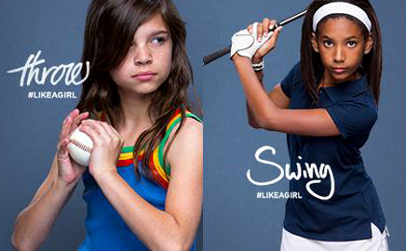
ANOTHER EXAMPLE…
Always advert #LikeAGirl

