Slide 1
Apprentice Task

Slide 2
The Apprentice/Junior Apprentice
Find an episode of The Apprentice/ Junior Apprentice on YouTube
Watch the episode (Up to the Boardroom section)
Observe when the groups use Enterprise skills
Note when they conduct research
Pause, Take a screenshot and annotate these scenes
Save them to your EduBlogs under the title “Enterprise Skills for Generating Ideas”

Slide 3
Types of Research demonstrated:
• Primary
• Secondary
• Qualitative
• Quantitative
Enterprise Skills demonstrated:
commercial awareness,
creative and innovative thinking,
prioritisation
time management,
problem solving,
communication,
negotiation
persuasiveness
The Apprentice
Enterprise Skills for Ideas Research

Slide 4
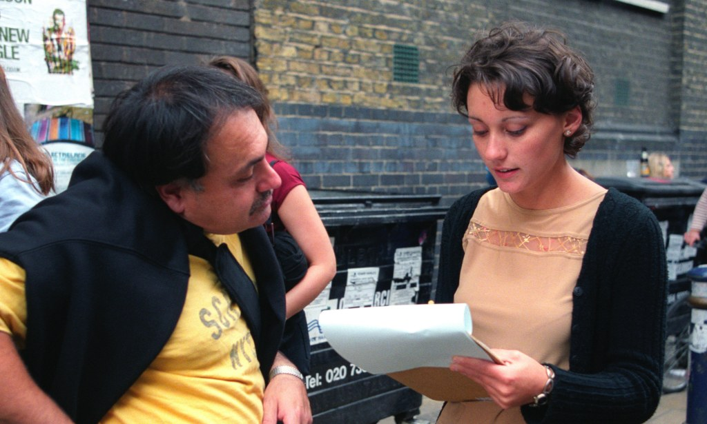
Primary Research
This is research that a person or a group conducts themselves. It is hands-on research and could consist of;
Observation. Watching how consumers behave provides many insights, but can leave questions unanswered.
Postal surveys.
Telephone interviews.
Online surveys.
Face-to-face surveys.
Focus groups.

Slide 5
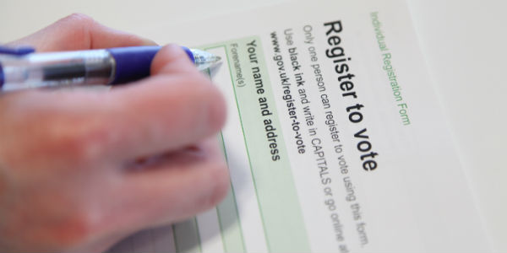
Secondary Research
This is the gathering and collating of research carried out by someone else. It may draw data from
published academic papers
government documents
statistical databases
historical records etc.
For example – if you need to find out how many people live in a particular area you can look at electoral registers.

Slide 6
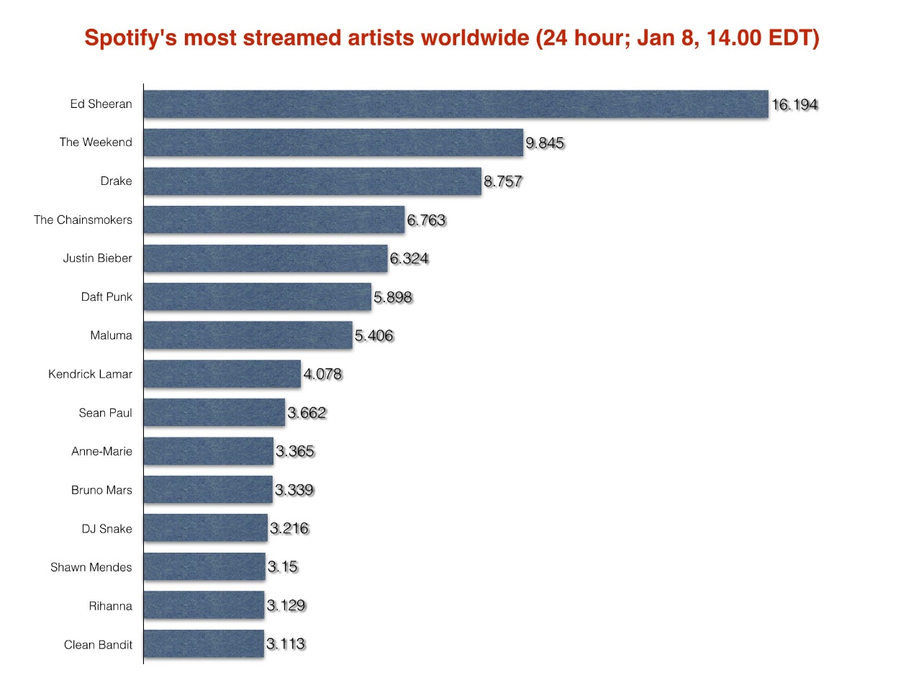
Quantitate Research
This is research made up of statistics and data.
e.g. How many people have watched Peaky Blinders
How many London boroughs are there
How many Ed Sheeran songs are streamed in 24 hours

Slide 7
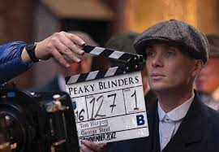
Qualitative Research
This involves collecting and analysing non-numerical data (e.g., text, video, or audio) to understand concepts, opinions, or experiences.
So, how do you feel after listening to an Ed Sheeran song?
Or
What’s your opinion on Peaky Blinders?

Slide 8
Example Slides:

Slide 9
Communication
The team had great communication throughout the tasks. The teams were split into pairs so they could be the most time efficient. Throughout tasks they would have phone calls with other members of the team to give them updates and ask for their input and opinions on creative and business based decisions that they were making. In this screenshot she calls to ask if the other team member likes his name “A Trifle Different” and they respond with their opinion and feedback.

Slide 10
Problem Solving
They experienced a problem with the flavouring when they were testing different combinations in the kitchen. They said the saffron wasn’t strong enough despite their primary research findings. They used their problem solving skills and decided to use less of the saffron and do another flavour too. They overcame it by trial and error and getting the other team members to give their input.

Slide 11
Primary research
They went to a supermarket to ask the general public to rate the samples for the puddings they made. They asked they public to rate them out of ten and how they could improve. One person said “not something I would distinguish or stand out” and another said “too much going on”. This research enables them to make changes to their products so they get more sales in the end.

