Slide 1
REVISING TRENDS, PATTERNS AND DIVERSITY

Slide 2
TRENDS AND ISSUES TO REVISE
Changing family patterns
[Topic 2 in Browne, Topic 5 in Webb textbook]
Increase in divorce
Decline in the number of marriages
Increase of marriages that are remarriages
People marrying later in life
Increase in the number of cohabiting couples
Increase in same-sex relationships and families
Increase in one/lone person households
Growth in the number of households
Increase of living apart together (LATS)
Reduction in family size/Women having children later
Women choosing not to have children
Increase in lone parent families
Increase in step/reconstituted families
Ethnic differences in families
Changes in the extended family (inc. beanpole)
Changing demographic patterns
[Topic 5 in Browne, Topic 4 in Webb textbook]
Fall in birth rate
Decline in infant mortality rates
Fall in death rates
Increased life expectancy/Ageing population
Impact of migration on types of families and UK population structure
Increase of young people living with their parents
ARE TOPICS THAT ARE COVERED IN HERE

Slide 3
Marriage, Divorce and Cohabitation

Slide 4
Marriage, Divorce and Cohabitation
Focussing on the first aspect of bullet point two of the AQA’s A-level sociology specification:
‘changing patterns of marriage, cohabitation, separation, divorce, childbearing and the life course, including the sociology of personal life, and the diversity of contemporary family and household structures’.

Slide 5
Sub-topic overview
What are the main trends in marriage, divorce and cohabitation?
Why is marriage in decline?
Why is cohabitation increasing, and what does this mean?
Why is there a long term increase in divorce? (and recent decrease?)
Perspectives on the decline of marriage and increase in divorce

Slide 6
Trends in Marriage, Divorce and Cohabitation
These are the general trends – there are variations by class/ ethnicity etc…
Trends in marriage and cohabitation
Trends in Divorce and separation
Long term decline in marriage
People are more likely to cohabit (although in most cases this is a step before marriage)
People are marrying later
The number of remarriages has increased.
Couples less likely to marry in church
Greater diversity of marriages (greater ethnic diversity and civil partnerships)
There has been a very recent increase in the marriage rate
There has been a long term increase in divorce.
Today, approximately 42% of marriages end in divorce.
The divorce rate has declined since 2005.
The separation rate is higher for cohabiting than married couples.

Slide 7
Reasons for the Long Term Decline of Marriage
Main ‘social changes’
Brief Explanation
Economic Factors
Housing more expensive, young adults live can’t afford to get married.
Changing Gender Roles
Liberal feminism – women now in breadwinner role, don’t need to marry for financial reasons
Social Policies
The New Right – social policies don’t incentivise marriage
Postmodernisation 1: decline of religion and tradition
Less social pressure to get married
The pure relationship is the norm
Postmodernisation 2: individual freedom/ changing values
Marriage is now a choice
Fear of divorce also puts people off

Slide 8
Reasons for the Long Term Increase in Divorce
Main ‘social changes’
Brief Explanation
Social Policy
The 1969 Divorce Act meant no one had to be ‘at fault’ to get divorced
Economic Factors
Increasing cost of living/ consumerism = more pressure on relationships
Changing Gender Roles
Women aren’t financially dependent on men. Most divorces initiated by women
Postmodernisation
Decline of religion and tradition
Decline social stigma of divorce
More individual freedom
Late Modernism – changing norms about relationships
Giddens – The Pure Relationship has to work for both people. M

Slide 10
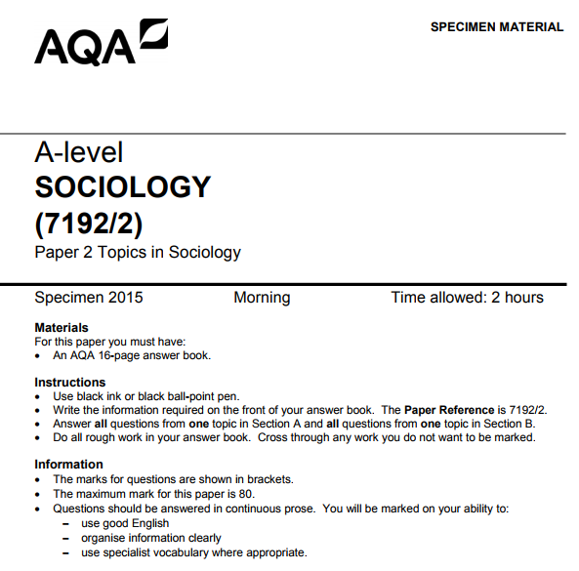
Exam Practice Questions
Focussing on Marriage, Divorce and Cohabitation

Slide 11
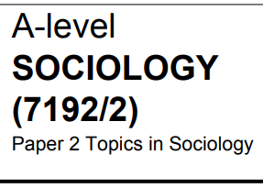
Outline and Explain two reasons for the decline in marriage in recent decades (10)
Reasons/ concepts
Cost of weddings
Cost of housing
Consumerism
Individualisation
Secularisation
The welfare state
Decline of tradition
Equal Pay Act
Women into work
Patriarchal ideology
Reason One
Perspectives you could use
Functionalism/ New Right
Marxism
Liberal Feminism
Radical Feminism
Postmodernism
Personal Life Perspective
Contrast:
Structure/ Agency
Modernity/ Postmodernity
Explain
Analyse
From 1
Pspctve
Analyse
From a second pspctve
‘conclude’
Repeat for point 2, analyse using different perspectives

Slide 12
Outline and Explain two reasons for the decline in marriage in recent decades (10)
One economic reason is the increasing cost of living in recent years: for example, the increasing cost of housing and the increasing cost of weddings
Young adults stay living with their parents longer to save up for a mortgage, often into their 30s
It’s often a choice between ‘marriage’ or ‘house deposit’: most people just co-habit because they can’t afford to get married
Men especially might feel embarrassed to marry if they still live with their parents, because it’s not very ‘masculine’
People would rather by a house because ‘material security’ is more important than the ‘security of marriage’
This also reflects the importance changing gender roles: now women are taking on the ‘breadwinner role’, there’s no obvious need to marry a man.
Applies especially to low income earning, working class men.
People also fail to save for weddings because of the pressure to consume in postmodern society
However, this only applies to those who want a big ‘traditional’ wedding, which costs £15K
The significance of economic factors criticise the postmodernist view that marriage declining is simply a matter of ‘free-choice’.

Slide 13
Evaluate the Causes and Consequences of the Changing Patterns in Divorce since the 1960s (20)
Causes
Consequences
Long Term Increase
1969 divorce act
Economic factors
Liberal Feminism: Women in to work/ changing gender roles
Moral Decline/ Welfare State (New Right)
Postmodernism: decline tradition/ religion.
Short term decrease:
Decline Marriage
Immigration
Increased cost housing
Increase family diversity
Increase single parent and single person households
Rad Feminism
New Right
Postmodernism/ Late Modernism
Point 1—Economic Factors
Linked Evaluation
Point 2—Social Policy Changes
Linked Evaluation
Point 3—Feminism and Changing Gender Roles
Linked Evaluation
Point 4—Postmodernisation and Individualisation
Linked Evaluation
Overall Evaluations

Slide 14
Family and Household Diversity

Slide 15
Family and Household Diversity
Focussing on the final aspect of bullet point two of the AQA’s A-level sociology specification
‘changing patterns of marriage, cohabitation, separation, divorce, childbearing and the life course, including the sociology of personal life, and the diversity of contemporary family and household structures’.

Slide 16
How have families and households become more diverse?
In the 1950s the ‘traditional nuclear family’ was much more common. Since then, the nuclear family has declined and other family and household types increased:
The ‘main types’ of family which have ‘replaced’ the nuclear family:
Other forms of increasing diversity (which ‘cut across’ those to the left)
Reconstituted families
Divorce-extended families
Single parent families
Single person households
LAT relationships
Multigenerational households
The modified extended family
Shared households/ families of choice
There are more cohabiting rather than married couples
There is more cultural (‘ethnic’) diversity
There are more openly same-sex couples and families
There is greater ‘organisational diversity’: of gender roles
There is greater ‘life-course diversity’
More adults are continuing to live with their parents

Slide 17
Theories of Family Diversity
The Cereal Packet Family used to be portrayed in the media as the ideal
This was the heterosexual, married couple with children living in one house.
Rapaports (1980s) suggested this was a ‘myth’ - only found in 20% of households
The Rapaports argued families were more diverse in the five following ways>
Organisational
Cultural
Class based
Life-cycle
Cohort
Postmodern thinkers argue that diversity is so intense that ‘the family’ no longer exists:
Alan and Crow (2001): ‘there is no such thing as ‘the family’, there are many different families’
There is no ‘standard’ life course a family passes through.
Mainly because of increasing divorce and cohabitation families are less stable.
Beck Gernsheim: ‘there are no longer any ‘norms’ about family life’:
Families are now negotiated
Many people live apart but are in committed relationships
Reproductive technologies especially change the basics of family life.

Slide 18
Three ways in which family life varies by ethnicity
Marriage and Divorce
Birth rate/
family size
Gender equality
British Asians more likely to be married than white British (>50% compared to 37%).
However, divorce rates are higher among third and fourth generation Asians.
Single parent families: most common among = 48% black Caribbean families (22% white, 10% Indian).
Recent immigrant families have higher birth rates.
Bhatti (1999) found that most Asian mothers and fathers supported traditional gender roles.
Asian families typically more ‘patriarchal’: around 3000 3rd/ 4th gen. still subject to forced marriage.

Slide 19
Three ways in which family life varies by social class
Marriage and Divorce
Birth rates/
family size
Gender equality
Middle classes more likely to get married
Teen pregnancy rates higher among poor children
Men do more housework in dual earner households
Men in lower income households do more housework than men in higher income households

Slide 20
Three ways in which family life varies by sexuality
Marriage and Divorce
Birth rates/
family size
Gender roles
Civil Partnerships and same sex marriage not legal until 2004 and 2013 respectively
Lower rates of separation
Same sex couples less likely to adopt children
Housework tends to be share more equally

Slide 21
Outline and Explain two ways in which changes to gender roles may have influenced diversity of family structures (10)
ONE WAY….
A SECOND WAY…
Women taking on the breadwinner role
Men being expected to take on the caring role
Women more financially independent and no longer dependent on men
Linked to the rise of the negotiated family… men and women more likely to discuss who does what…
More divorce, so more single parent families
Take longer to establish careers: more SPHH, more childless couples have babies later
Younger families more equal DDOL than older families (organisational diversity varies with cohort)
Greater equality with women going into work

Slide 22
Why are families (and households!) becoming more diverse?
1. Decrease in marriage, increase in Divorce and Cohabitation
2. Increasing choice and individualism
3. Feminism, changing Gender Roles
4. Economic
Factors
5. Social
Policies
6. Declining stigma against non –nuclear families
7. Other
Factors

Slide 23
Why are families (and households!) becoming more diverse?
Increase in divorce means more single parent households (female headed) and more single person households (mainly men)
More people CHOOSING to live alone/ more ‘families of choice’.
Women going into work: more childless couples
Rise in affluence means more single person households
The divorce act/ equal pay act: New Right argues = decline of nuclear family
Less social pressure to get married or stay married: thus more complex family life-cycles
Also: technologies and expansion Higher Education

Slide 24
Assess the view that changing gender roles are the most significant factor in explaining the increase in family diversity (20)
Introduction: outline some of the factors and some of the increase in family diversity
POINT (‘FACTORS’)
EXPLAIN EFFECT ON FAMILY DIVERSITY
ANALYSE USING PERSPECTIVES
EV: HOW IMPORTANT IN RELATION TO OTHER FACTORS?
Changing gender roles
Dual earner/ divorce/ single parent/ single person.
Lib Fem: $ equality/ rad Fem X equality
Most significant? (Giddens)
Economic factors
Dual earner, and single person households
Marxism: capitalism needs family instability?
Most significant? Economic determinism
Post-modernisation
patchwork/ donor/ single person/ co-habitation/ same sex families
Post/ late mod: new ‘family type’: negotiated family
Most significant? (broadest factor)
Social policies
Divorce act/ equal pay act: single parent/ single person
Feminism: progressive/ New Right undermining nuclear family
Least significant? Attitudes change first?
Conclusion: How significant are changing gender roles?

Slide 25
Power and Equality in Relationships

Slide 26
Power and equality in relationships
Focusing on bullet point 4 of the AQA’s Families and Households syllabus:
‘gender roles, domestic labour and power relationships within the family in contemporary society’
This aspect of the syllabus is fundamentally about equality (or lack of it) between partners in relationships
It especially focuses on the issues of how and why the above have changed (or remained the same) in recent years.

Slide 27
Four Key sub topics/ questions
How do we measure power differences and equality in relationships?
Conceptualising increasing equality
Evidence on increasing (but not actual) equality
Why are relationships more equal today?
Why are relationships not yet equal?
Variations by class/ sexuality/ ethnicity

Slide 28
How might we measure?
Who does the housework?
Cooking, laundry, DIY etc…
Who does the ‘parenting’?
Time spent with kids
School run
Emotion work
Who has economic power>?
Relative earnings/ who controls income (pooling etc.)
Who uses physical power/ violence?
Domestic violence and abuse statistics
Try and add a study

Slide 29
Try and add studies to support/counter
Who does the housework?
Who does the ‘parenting’?
Who has economic power>?
Who uses physical power/ violence?

