Slide 1
Theories of the family
This information is useful for all exam questions, but particularly those looking at gender roles, the role of the family in society and whether the nuclear family is still dominant

Slide 2
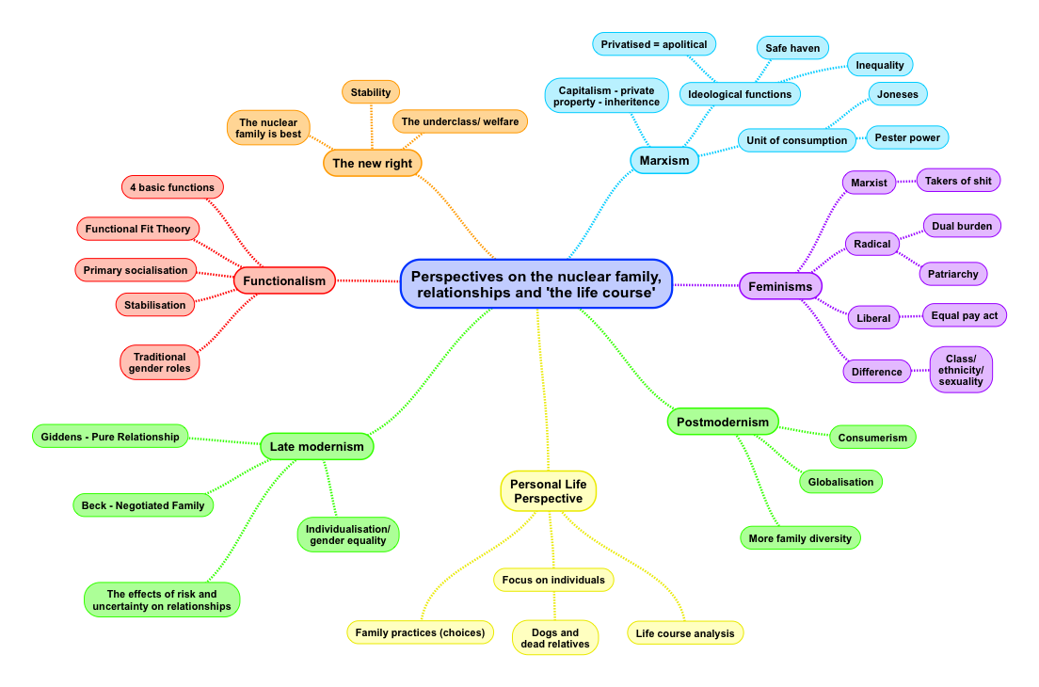

Slide 3
SUMMARY OF FUNCTIONALIST VIEWS OF THE FAMILY
George Murdock: nuclear family as universal
The nuclear family, consisting of adults of both sexes in a socially approved sexual relationship, has been found throughout history and different cultures.
4 functions of the family:
Sexual – adults provide sexual fulfilment and monogamy
Reproductive – new children are born
Education – primary socialisation – socialising children into the norms and values of society
Economic – the family has an economic role in having adults working, consumption and providing future workers.
Problems with his view:
Doesn’t take account of new forms of family diversity
Sees heterosexual relationships and marriage as essential to families.
Doesn’t take account of changes in the family in terms of children born via IVF or surrogacy.
Talcott Parsons: nuclear family emerged with industrialisation as it was more geographically and socially mobile. Prior to industrialisation the more common family type was the extended family. Nuclear families over time became smaller and better able to address the needs of an industrialised society. Over time the family lost functions to other institutions i.e. schools, NHS
2 functions of the family:
Primary socialisation - – socialising children into the norms and values of society
Stabilisation of adult personalities – a monogamous relationship of a married husband and wife provides support for both individuals to enable them to fulfil their roles and socialise their children into their appropriate gender roles.
These two functions are ‘basic and irreducible’ – only the nuclear family can do them
Problems with his view:
It is possible that nuclear families existed before industrialisation.
The family still performs important functions i.e. they would have to decide to take a child to a hospital.
Other institutions can undertake roles like primary socialisation.
Ignores family diversity
Talcott Parsons: view of the sexual division of labour
Men and women are biologically suited to having different roles in the family as this suits their innate needs.
Different roles of men and women:
Men = instrumental, taking on the breadwinner role and providing for the family
Warm bath theory:
Women, due to their naturally caring nature, provide a metaphorical ‘warm bath’ to their husbands by being warm, welcoming and helping to sooth his cares after a day at work.
Problems with his view of gender roles:
- Oakley would argue it reinforces traditional stereotypes of men and women’s roles leading to canalisation and manipulation.
It ignores the way in which these gender roles are socially constructed and reinforces sexism i.e. that women should stay at home because they have given birth.
Radical feminists would argue it ignores domestic violence and abuse against women
Problems with Functionalism as a theory
Ignores family diversity and sees it as problematic
Overstates the positive nature of primary socialisation – what about abusive families. Marxists would argue children are socialised into a false class consciousness rather than a value consensus.
Has an overly optimistic view of the family.
Primary socialisation:
Socialisaiton into the accepted norms and values in society.
Organic analogy:
Society works like a body – the family is like the heart
Value consensus:
Agreed beliefs and attitudes in society
Similarities of Murdock and Parsons:
Both see primary socialisation as important
Differences of Murdock and Parsons:
Different views in the number of functions of the family and where the nuclear family came from

Slide 4
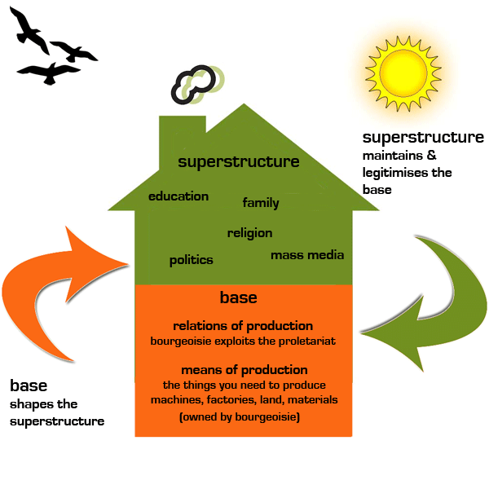
SUMMARY OF MARXIST VIEWS OF THE FAMILY
KARL MARX: view of how society works (base/superstructure, relationship of Bourgeoisie and Proletariat)
The Bourgeoisie own the means of production (factories, businesses etc). They exploit the proletariat for their labour. The proletariat are kept in their place through the use of ideology (ideas that capitalism is ok) in institutions like the family.
FRIEDRICH ENGELS: the nuclear family emerged with capitalism
Before the emergence of capitalism people lived in a form of primitive communism where belongings and wealth were collectively owned. The need for a nuclear family was not necessary.
The modern nuclear family helps to solve the problem of inheritance:
Capitalism creates private property – people and families wish to protect their own interests. A monogamous family allows for men to know who their wealth will be passed to (typically the eldest male heir). This reproduces inequality in wider society. He regarded the position of women as equivalent to ‘glorified prostitutes’. He can
Problems with his view:
> Patriarchy predated capitalism
> Too deterministic – sees capitalism as the cause for all social problems.
ELI ZARETSKY: the family is a safe haven
The family provides a place where men can take their frustrations out which they experience at work. It acts as a safe haven from the pressures of capitalism and work.
How the family supports capitalism:
The family acts as a unit of consumption – buying items from big companies that it needs to survive i.e. food, clothing etc. Men work and pay taxes. Women are a source of unpaid labour.
View of the role of men and women:
Women help to socialise children into a false class consciousness. Men and women hold different roles – these help to prop up the nature of capitalism. Men take their frustrations about their jobs out on their wives.
Problems with his view :
> Outdated – there is greater choice in relationships today.
Both men and women now work.
Ignores the dark side of the family
LOUIS ALTHUSSER: role of the family as part of the Ideological State Apparatus
Family socialises children into a false class consciousness as part of its role as an ideological state apparatus. This makes children accept their place in the hierarchy of society without challenging it.
Problems with Marxism as a theory:
• Too deterministic - it assumes people passively accept socialisation and family life, and that the future is pre determined.
• Ignores family diversity in capitalist society, and that many women now work full time as well
• Feminists argue that the Marxist focus on class ignores the inequalities between men and women, which is the real source of female oppression.
• Marxism ignore the benefits of nuclear family e.g. both parents support the children
Capitalism
False class consciousness
Conflict structuralism
Alienation
Bourgeoisie
Proletariat
Ideological state apparatus
Repressive state apparatus

Slide 5
Key concepts:
Patriarchy
Domestic labour
Emotional labour
Economic dependency
Conjugal roles
Equal Pay Act 1970
Sex Discrimination Act 1975
Equality Act 2010
Manipulation
Canalisation
Feminist views of the family
Liberal feminism: view of the family and society
Patriarchy is maintained through socialisation - equality can be overcome with reform e.g. legal changes
Recognise that women taking the main responsibility for childcare and housework can have an adverse effect on their power, career and health.
Argue the best way to improve the position of women is through legal changes and social reform.
Aim to establish equality of opportunity for women with men, and allow them to make choices between motherhood, career or both.
Ann Oakley: gender socialisation and the role of women in the family
Gender socialisation, she argues leads to canalisation
This is where children are channelled into different gender identities by their parents e.g. dressing girls in pink, and boys in blue, and through encouraging children to play with different types of toys.
Parents manipulate their children by encouraging different types of activity e.g. boys can be boisterous but girls have to be sweet.
Marxist feminism: view of the family and society
See it’s current form as resulting from class inequalities in capitalist society. Women are doubly exploited in society, both as workers in an unequal, capitalist society, which pays them less on average for their labour. And for the burden they hold in the home.
Breughal: women as a reserve army of labour
Women's unpaid domestic labour helps to maintain capitalist exploitation by reproducing the labour force at no cost to the employer. Women act as a RESERVE ARMY OF LABOUR – they are easy to hire and fire.
Fran Ansley: ‘safety valve’
Domestic labour provides the capitalist system with current workers (e.g. men) that are rested, fed and provided with a ‘safety valve’ in the home from the frustrations they feel at work.
Ansley says: “When wives play their traditional role as takers of shit, they often absorb their husbands’ legitimate anger and frustration at their own powerlessness.”
Women also care for children who they socialise into the dominant ideologies of capitalism- social inequality and the dominance of men over women. They teach their children that the inequalities of capitalism are just how it is, because they don’t know any better.
Weaknesses of feminism (look at individual types)
Feminists have been accused of only looking at the negative aspects of the family, they ignore the fact that females may enjoy and choose to look after children and run a home. Hakim argues that women now have a preference- they choose their role.
This perspective assumes women are passive victims. Alan and Crow, would argue that (post)modern families are based on choice- women might want to be housewives and have the right to choose to be so.
Ignores the increase of co-parenting /fathering in families
More women are working and have economic independence. That 70% of divorces are initiated by women shows women can and do flee relationships that don’t work out.
Criticism of Marxist feminism- day-to-day relationships in the family mean the family is less likely to create an obedient workforce. Children have more status and influence over family life.
Strengths of Feminism as a theory (look at individual types)
Has drawn attention to the inequality women face in the family.
Liberal feminism has helped to make shifts in legislation.
Have identified the ways in which women’s lives have changed – particularly liberal feminism ie. Sharpe’s study on the aspiration of girls.
Radical feminism: view of the family and society
See patriarchy as built into the structure of society and based upon biological difference.
Jessie Bernard: ‘being a housewife makes women sick’ – women who are married are more likely to experience depression
Firestone: the family is fundamentally patriarchal – women are most at risk of being controlled or abused following the birth of a child.
Duncombe and Marsden: ‘triple shift’
Changes in equality laws have led to greater pressure being placed upon women. They now take on a paid job, housework and the emotional burdens of the home
Real world examples to support the feminist view of the role of women
#MeToo
Gender Pay Gap
27.1% of women and 13.2% of men had experienced any domestic abuse since the age of 16, equivalent to an estimated 4.5 million female victims and 2.2 million male victims.

Slide 6

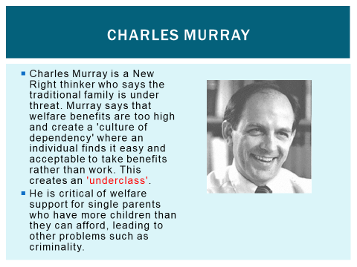
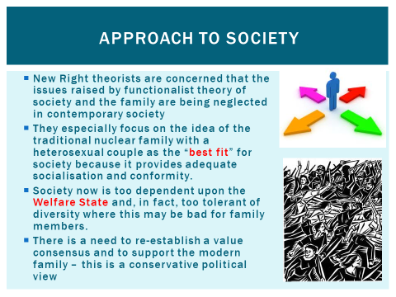
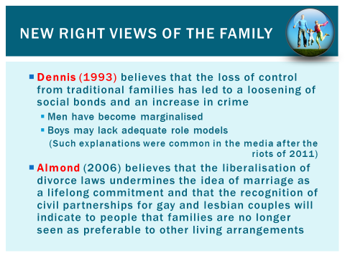

Slide 7
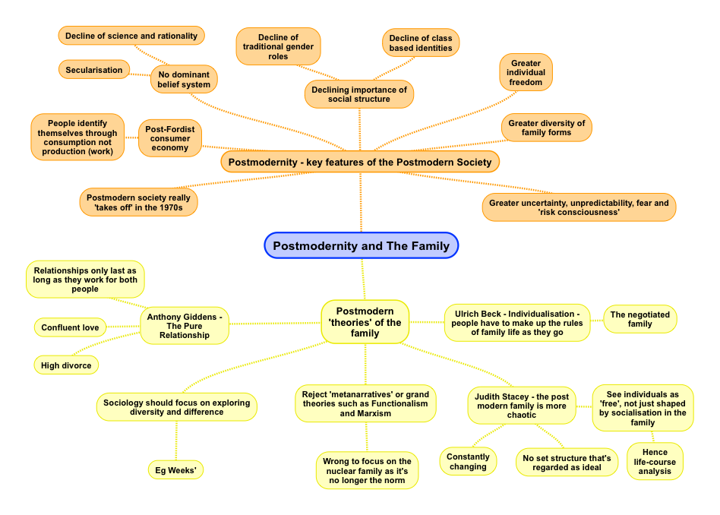

Slide 8
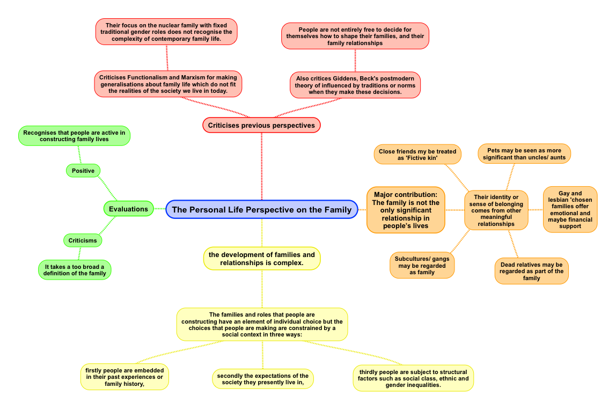
Carol Smart

Slide 9
Family Exam Questions: Theory (with some cross over with gender roles and diversity)
Outline and explain two functions of the family [10]
Assess the view that the family remains a largely patriarchal institution
Assess Sociological explanations for changes in the patterns of marriage and cohabitation (20)
Assess the view that the modern nuclear family is the most effective type of family unit in which to socialise children and stabilise adult personalities (20)
Assess the view that relationships in Britain are characterised by Symmetry (20)
Assess the Feminist view of family life and relationships (20)
Assess the view that the main aim of the of the family is to serve the needs of capitalism (20)
Assess the view that the nuclear family best serves the needs of a modern society [20]

