Slide 1
Late night women’s hour
Late Night Woman's Hour (Home, 28 October, 2016)

Slide 2
Component | Section | Framework | Set Texts | Any Unseen? 1 audio visual (10 mins*) and 1 print | Marks | Time
1 | A | Media Language | Not all, but 2 from the following; Tide, WaterAid, Kiss of Vampire, The Daily Mirror, Formation | ML will be unseen analysis Representation will be comparative of a set text to unseen ML and Rep from; Advertising, Marketing, Newspaper or Music Video | 10 | 20
 |  | Representation Context |  |  | 25 | 30
 |  |  |  |  | 35 | 60*
1 | B | Industry Context | Not all, but 2 from the following; Tide, WaterAid, The Daily Mirror, Straight Outta Compton, Late Night Woman’s Hour, Assassin’s Creed 3: Liberation. | NO 1 stepped question on industry and context | 15 | 20
 |  |  |  | 1 stepped question on audience | 10 | 15
 |  | Audience
 |  |  |  |  | 25 | 35

Slide 3
COMPONENT 1: INVESTIGATING THE MEDIA
EXAM 35%
Section | A & B | A & B | B | B | B
Sector | Advertising | Newspaper | Film | Radio | Video Game
Text | Tide | Daily Mirror | Straight Outta Compton | Late Night Woman’s Hour | Assassins Creed III: Liberation
 | WaterAid
Media Language | Y | Y
Representation | Y | Y
Industries |  | Y | Y | Y | Y
Audiences | Y | Y |  | Y | Y
Contexts | Y | Y | Y | Y | Y

Slide 4
we will be looking at…
Ownership and funding | Industry | Curran and Seaton
Regulation
Impact of technology
Global production and distribution
Targeting | Audience | Stuart Hall: Reception Theory
Categorisation
Construction
Consumption
Interaction

Slide 5

industry
CONTEXT
The radio industry is one of the oldest and most traditional media industries, it has experienced rapid change in recent years due to technological changes, in particular the way audiences access and respond to radio products
1st wave - Starting in the 1920s, listened to at home by all the family on a big valve wireless
2nd wave - advent of television in the fifties, when radio became a secondary medium.
3rd wave - responding to the new formats and platforms of digital media. Radio from around the world can be accessed online anytime anywhere – this is exciting for audiences and advertisers. The websites attached to radio stations offer extra services and value, with blogs, playlists, podcasts, artist profiles, DJ profiles and pictures, videos, competitions, and more. This makes listening to radio online a popular and worthwhile experience

Slide 6
RADIO INDUSTRY
CONTEXT
Public Service Broadcasting (PSB) | Commercial Radio
Regional and national (Over 40) | Regional and national (Over 300)
Annual licence fee | Funded by on-air advertising
Free the BBC of all political and commercial influences | National Commercial radio such as Classic FM, Talksport and Absolute Radio
Annual licence fee amount is set by the government. | Bauer Media Group - Kiss and Magic. Bauer Media Group is a multinational conglomerate that operates in 16 countries. It owns a range of global magazine titles and part of its organization is Bauer Radio
Cannot profit commercially
“Educate, inform and entertain” as part of its PSB remit,
Freedom to target niche audiences

Slide 7
Theory: Curran and seaton
The idea that the media is controlled by a small number of companies primarily driven by the logic of profit and power
The idea that media concentration generally limits or inhibits variety, creativity and quality
The idea that more socially diverse patterns of ownership help to create the conditions for more varied and adventurous media productions.
APPLY
What arguments can you think of that LNWH supports Curran and Seaton?
Can you think of any counter points (using LNWH) that challenge Curran and Seaton?

Slide 8
Theory: Curran and seaton
Think about the importance of the BBC as a major deliverer of radio and TV programmes
The role of the BBC as a PSB organization and its relative freedom from commercial pressures, such as having to sell advertising, due to being funded by our licence fees. How might this impact on its freedom to be innovative and creative and to target niche and diverse audiences.
The ethos of the BBC and its need to address a range of audiences
The BBC’s flexibility in terms of being able to commission programmes which would appeal to minority audiences
The organization of BBC radio, similar to television, means that specific stations have a distinct style and ethos, and therefore appeal to different audiences. (eg Gardener’s Question Time)

Slide 9
Social And Cultural Contexts
Changing roles of women
Woman’s Hour
1950s Housewife
Time of Change 1960s
#metoo
Still gender pay gap and inequality in the world of work
Remember the way audience responds to, and interpret LNWH will reflect their social and cultural circumstances.
Is there now an audience for a late night talk shown aimed at women specifically because of their social status?
How might original 1940s women have responded to the broadcast?

Slide 10
Regulation Revision
Body | Industry | Set Text
 | Film | Straight Outta Compton
 | Video Game | Assassins Creed III: Liberation
 | Newspaper / Magazine | Daily Mirror / Vogue
 | Radio / TV | LNWH / Humans

Slide 11
Regulation Revision
Body | Industry | Set Text
BBFC MPAA | Film | Straight Outta Compton
 | Video Game | Assassins Creed III: Liberation
 | Newspaper / Magazine | Daily Mirror / Vogue
 | Radio / TV | LNWH / Humans

Slide 12
Regulation Revision
Body | Industry | Set Text
BBFC MPAA | Film | Straight Outta Compton
VSC | Video Game | Assassins Creed III: Liberation
 | Newspaper / Magazine | Daily Mirror / Vogue
 | Radio / TV | LNWH / Humans

Slide 13
Regulation Revision
Body | Industry | Set Text
BBFC MPAA | Film | Straight Outta Compton
VSC | Video Game | Assassins Creed III: Liberation
IPSO | Newspaper / Magazine | Daily Mirror / Vogue
 | Radio / TV | LNWH / Humans

Slide 14
Regulation Revision
Body | Industry | Set Text
BBFC MPAA | Film | Straight Outta Compton
VSC | Video Game | Assassins Creed III: Liberation
IPSO | Newspaper / Magazine | Daily Mirror / Vogue
OCFOM | Radio / TV | LNWH / Humans

Slide 15
regulation
OFCOM was established in 2003 as a new UK regulator
BBC is also self-regulatory and works with OFCOM to ensure they there will be no need for intervention, unless in extreme cases
OFCOM is funded by fees from the industry and a grant from the government
Commercial and community radio stations have to apply for their license from OFCOM and have to abide by their rules and regulations regarding what they broadcast
OFCOM has a remit to
  Ensure that a wide range of television and radio services of high quality that wide appeal is available
  Maintain plurality in the provision of broadcasting
  Adequately protect audiences against offensive or harmful material
  Protect audiences against unfairness or infringement of privacy
An audience member can complain to OFCOM, who them must assess the complaint under the Broadcasting Code and decide what action, if any, to take
Can you think of any examples where a complaint against a BBC radio programme has caused offense and had major repercussions?

Slide 17
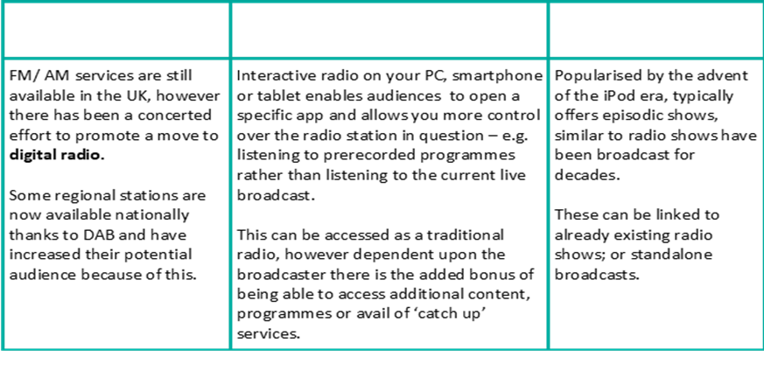
The Impact of Technology
CONTEXT
Technology has had a huge impact on the continued success of Radio and made LNWH a possibility.
Which of the following have you used? Where? Why? On what device? What about apps, multi-media content, webcams?
How have they affected LNWH?
DAB
(Digital Audio Broadcast)
Convergence
Podcasting

Slide 18
Late Night Woman’s Hour (LNWH)
CONTEXT
Woman’s Hour was first broadcast in 1946 and is now broadcast everyday at 10am on Radio 4
Radio 4 is a speech-based station and it tends to target an older audience demographic, its known for Intelligent speech and the most insightful journalism.
The introduction of LNWH into Radio 4 schedule demonstrates the BBC’s awareness of the need to cater for a younger female audience and may not be addressed by current output
LNWH is broadcast monthly at 11pm, the assumption is that a lot of listeners will choose to listen via podcast and the post-watershed broadcast time allows for more adult content
Each episode is based around a theme and involves informal and in depth discussion (themes have included female friendship, women in sport and anxiety)
LNWH will contain:
  Presenter - Lauren Laverne
  Contributors - academics, writers, broadcasters, artists etc.
  Discussion
  (Phone ins)
LISTENING TASK

Slide 19
Audience and industry notes
AUDIENCE Who is the target market for this episode? (age/gender/nationality etc. socio-economics & psychographics) How does it appeal to its target audience? How is the audience positioned to receive the messages within the product? (Language, mode of address, topic, formal/informal dialect)
INDUSTRY How does this episode meet the needs and purposes of the BBC as a PSB? Consider the license fee funding of the BBC; how does this source of funding relate to the content of the show? What aspects of the programme might make this programme not suitable for commercial radio? Consider how this programme is distributed and consumed (podcasts/iplayer/DAB) and how this relates to convergence. How might this be beneficial to the show in relation to its time slot? (11pm) Consider the choice of Lauren Laverne as host of the show Why do you think she was chosen? What does she bring to the show? How can her previous exploits be linked to the show and the BBC’s agenda

Slide 20
audience
Late Night Woman's Hour (Home, 28 October, 2016)

Slide 21
Radio audiences
How is the role of a radio programme different to that of a television programme for the audience
  Blind medium
  Companion medium
  Intimate medium
  Undemanding medium

Slide 22
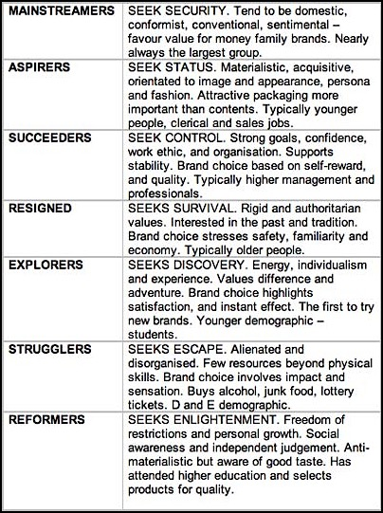
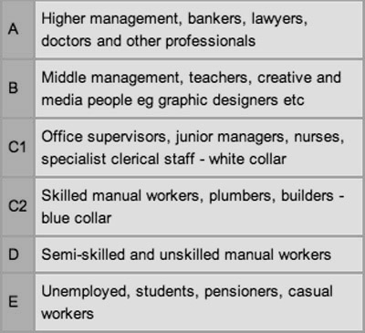
Demographics is a common and traditional method of audience profiling is known as demographics. This defines the adult population largely by the work that they do.
Psychographics is a way of describing an audience by looking at their behaviour and personality traits
The 4Cs

Slide 23
Audience profile
Write a demographic and psychographic (age, gender, socio-economic) audience profile of LNWH listeners
Justify the decisions you have made

Slide 24
Audience appeal
Lauren Laverne
  Similar age to target audience
  Northern accent subverts stereotypes of Radio 4 makes her more relatable to audience
Language and mode of address aimed at a younger female demographic
Appeals to niche audience and previously under-represented group due to scheduling time
Guests
  Academic
  Female
Multi-platform
Global audience
Changing attitudes in society (equality at home and work, #metoo etc) demanded a forum for discussion

Slide 25
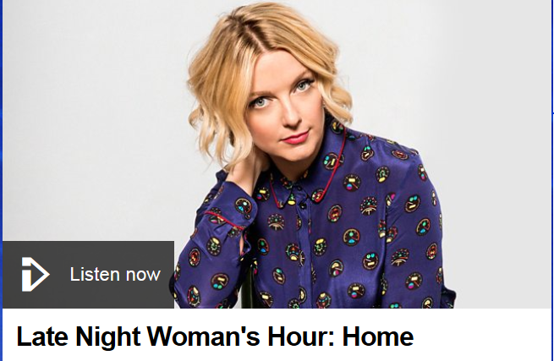
marketing
Cross-Platform marketing: Other radio stations and BBC television will promote radio stations and events related to BBC radio for example ‘Big Weekend’
Billboard and magazine adverts for station and presenters
Each station has its own website within the umbrella website for BBC radio (live streaming, archive programmes, interactive elements can be accessed by a global audience)
Promotional adverts
BBC Taster is an interactive service that enables the BBC to showcase ideas and new talent (http://www.bbc.co.uk/taster)
What about their social media presence?

Slide 26
Framework | Theorist | Prompts | Component 1
 |  |  | Section A: Language and Representation |  |  |  | Section B: Industries and Audiences
 |  |  | Marketing | Advertising | Music Video | Newspaper |  | Film | Radio­ | Video Game
 |  |  | Kiss of the Vampire | Tide, WaterAid | Formation | Daily Mirror |  | Straight Outta Compton | Late Night Woman’s Hour | Assassins Creed III: Liberation
Media Language | Roland Barthes | The 5 Codes (SEARS) | Y | Y | Y | Y
 | Tzvetan Todorov | Narrative
 | Steve Neale | Genre
Representa tion | Stuart Hall | Stereotyping and inequality | Y | Y | Y | Y
 | David Gauntlett | Pick ‘n’ Mix | Y | Y | Y
Industries | Curran and Seaton | Power and Industries |  |  |  | Y |  | Y | Y | Y
Audience | Albert Bandura | Media Effects |  | Y |  |  |  |  |  | Y
 | George Gerbner | Cultivation |  | Y |  | Y
 | Stuart Hall | Reception x 3 |  | Y |  | Y |  |  | Y | Y

Slide 27
Theory: Stuart Hall (Audience)
Reception Theory
There are 3 hypothetical positions from which an audience can ‘read’ a text
  Dominant
  Negotiated
  Oppositional
Write a paragraph applying this to LNWH
Consider
  Who is the intended/primary audience? How would they receive the show?
  How would those outside the primary audience receive the show?

Slide 29
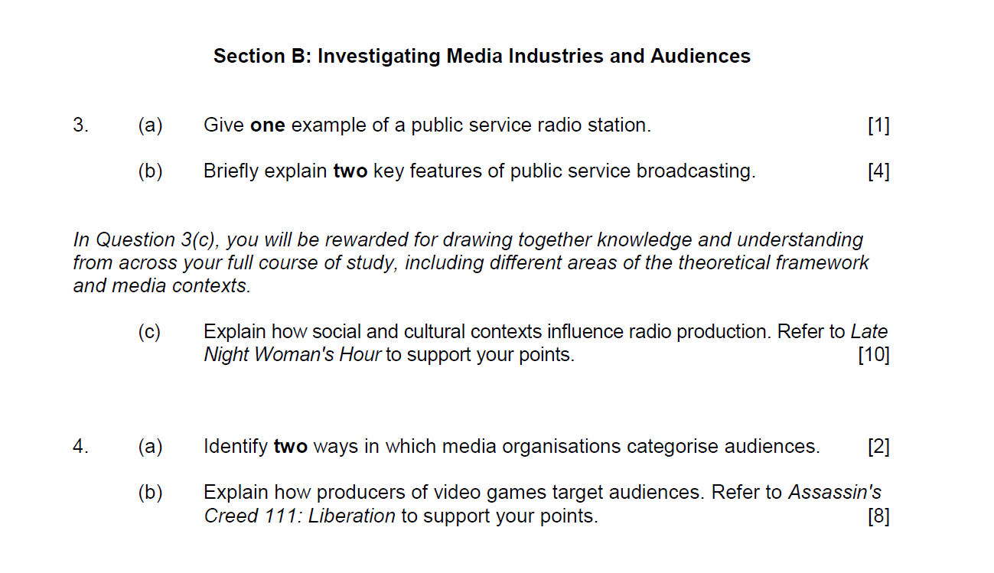

Slide 30
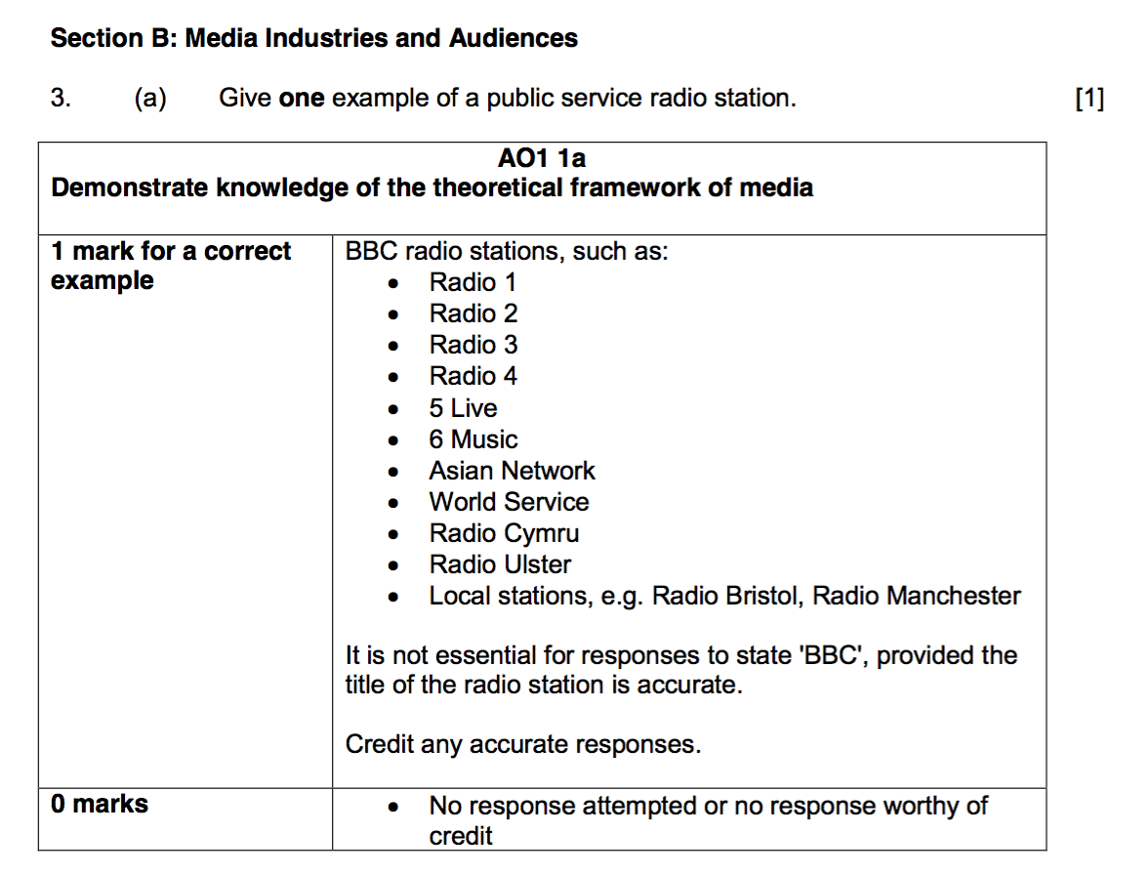

Slide 31
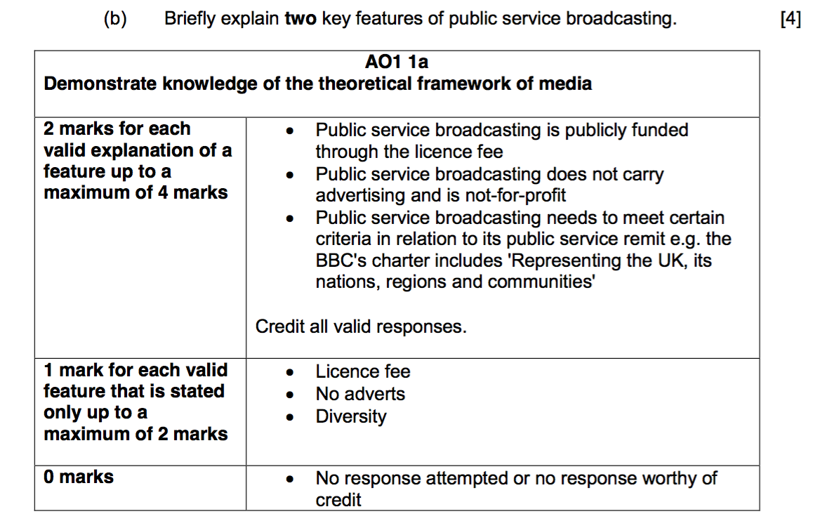

Slide 32
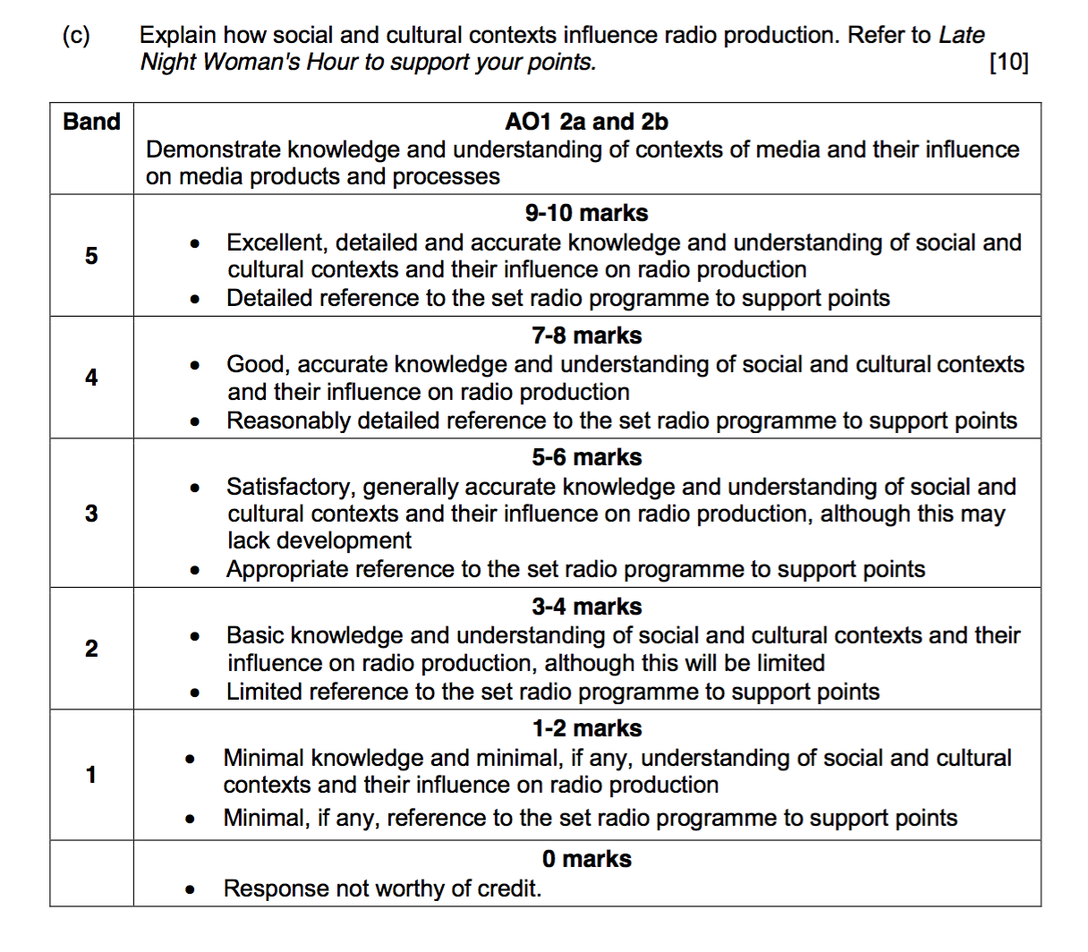

Slide 33
