Slide 1
Practical knowledge

Slide 2
Terminology
What is meant by reliability
What is meant by validity
What is meant by accuracy
What is meant by precision
What is a controlled experiment
What are controlled variables

Slide 3
Terminology
Mean medium (middle value) and mode (number with highest frequency)
Ratios
Percentage change
Dilutions and Serial dilutions
Serial dilution is a method of diluting a stock solution where concentration decreases by the same quantity in each successive step

Slide 4
Dilutions
Dilutions dilute the concentration of a stock solution by a know factor
Simple dilutions C₁V₁=C₂V₂
Serial dilutions is a stepwise dilution that quickly amplifies a volume or amount that is too small to measure accurately.
Usually used with bacteria to obtain a single colony

Slide 5
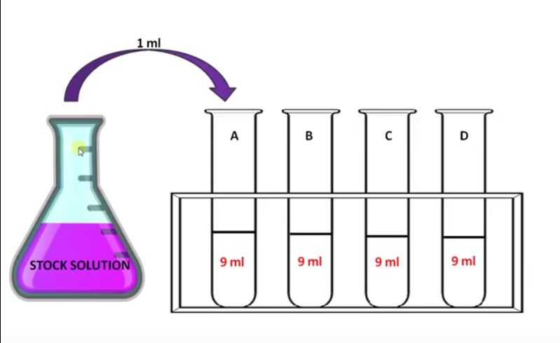
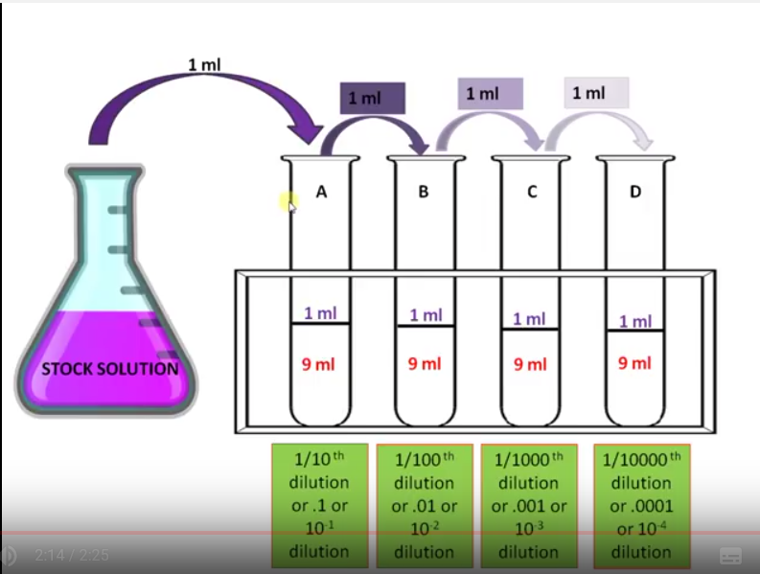
https://www.youtube.com/watch?v=MCrNjHcfcpY

Slide 6
Other ways to work out dilutions
C1V1=C2V2
Where C1 = stock concentration
V1 is volume of stock solution required to make your dilution
C2= concentration of the diluted solution
V2= is the volume of the diluted solution
For example you are given a 1.5M solution of salt. You want to make 15mls of a 0.25M salt solution.
C1=1.5M
V2=15mls
C2=0.25
Rearrange equation so can work out V2 (which is volume of stock require to make dilution)
V2 = C1V1/C2=1.5x15/0.25
= 1.5mls of stock diluted with 13.5mls water (makes 15mls)

Slide 7
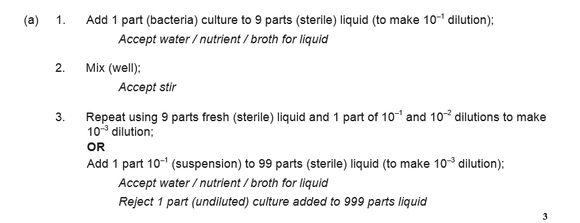
a) A student used a dilution series to investigate the number of cells present in a liquid culture of bacteria.
Describe how he made a 1 in 10 dilution and then used this to make a 1 in 1000 dilution of the original liquid culture of bacteria (3).
What is a serial dilution?

Slide 8
(b) Using an optical microscope, the student determined there were 15 cells in 0.004 mm³ of the 1 in 1000 dilution of the culture.
Calculate the number of cells in 1 cm³ of undiluted liquid culture.
Answer = ____________________ Number of cells (2)

Slide 11
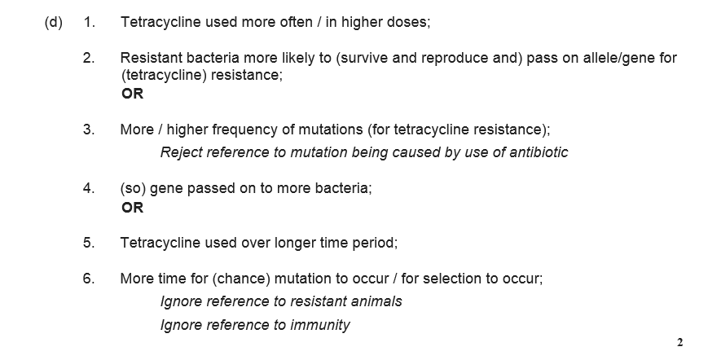

Slide 13
Log and Exponents
Power function
Power functions are a type of scaling function allowing two variables to be compared when one variable has an unusual size e.g body mass and metabolic rate
Exponential function
Bacteria divide exponentially in optimal growth conditions/ PCR
Doubling in a period of time
Typical j shaped curve
Log transformations
Normalises data and makes very large numbers easier to work with – plot a large range
Reduces skew in the data
Log ₁₀ (1000) =3 because 10³ = 1000
Plot as a straight line

Slide 14
Exponential function
Exponential growth is where a function’s growth rate is proportional to the function’s current value. Exponential growth can be seen in things like human population or virus spreading.

Slide 15
Percentage error
Mathmatical way expressing how out your result is from the ideal result
For example you want to know how accurate a 5ml pipette is
You dispense 5ml of water and weigh the dispensed volume. The volume is 4.98ml
4.98-5/5x100 = - 0.4% (less than it should have been)

Slide 16
Percentage uncertaintaties
Repeating a measurement is a method for reducing the uncertainty.
With many readings it’s possible to also identify those that are exceptional (that are far away from a significant number of other measurements).
Sometimes it will be appropriate to remove outliers from measurements before calculating a mean.
On other occasions, particularly in Biology, outliers are important to include.
For example, it is important to know that a particular drug produces side effects in one person in a thousand.
If measurements are repeated, the uncertainty can be calculated by finding half the range of the measured values.

Slide 17
Percentage uncertainty

Slide 18
Which graph to use

Slide 19
In Biology, the Royal Society of Biology recommends that where the interim values of a continuously changing variable are not known, data points should be joined by straight lines.

Slide 20
Required practical 1
Investigation into the effect of a named variable on the rate of an enzyme-controlled reaction: The effect of temperature on the rate of the reaction catalysed by trypsin
What do you need to know?
Why you buffer an experiment
What are the controlled variables
What would be an effective controlled experiment.
How to work out rate

Slide 22
Required practical 2
Preparation of stained squashes of cells from plant root tips; set up and use of and optical microscope to identify the stages of mitosis in these stained squashes and calculation of a mitotic index:
Root tip squash using onion root meristem tissue
What do you need to know
Why meristematic tissue?
Resolution/magnification
How to work out the real size of an object
How to work out total magnification
Why you use a stain (highlight specific component)
Why specimen is thin
Stops light
Too many layers of cells so difficult to see detail
How do you prepare a slide?
Need to recognise stages in Mitosis
Mitotic index = number cells undergoing mitosis/total number of cells

Slide 24
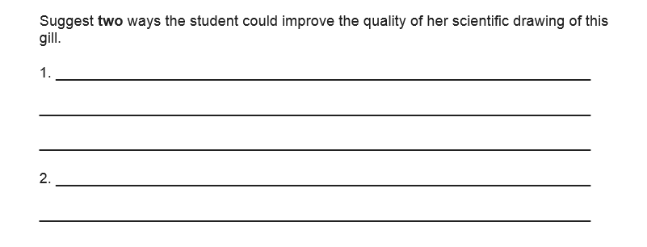

Slide 26
Required practical 3
Production of a dilution series of a solute to produce a calibration curve with which to identify the water potential of plant tissue:
Determining the water potential of potato tuber cells
What do you need to know
What is a calibration curve?
How do you work out the water potential of a tissue sample
How to work out dilutions.
What is processed data-percentage change
Why do you use processed data

Slide 27
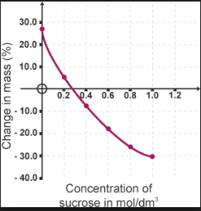
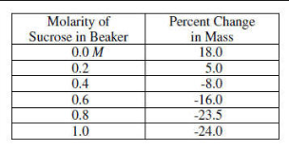
How to plot the graph
You need to state what you plot on the X and Y axis-always IV on the x axis
Where is the solution isotonic with the external solution?
How do you convert sucrose concentration (mol/dm³) into a water potential (Kpa)?

Slide 31
Required practical 4
Investigation into the effect of a named variable on the permeability of cell-surface membranes:
The effect of alcohol concentration on the leakage of pigment from beetroot cells
What you need to know
How to prepare a calibration curve to work out the concentration of an unknown substance
How alcohol/temp/detergents effect the permeability of the cell membrane
Subjective results
Use of a colorimeter
Equlibration

Slide 33
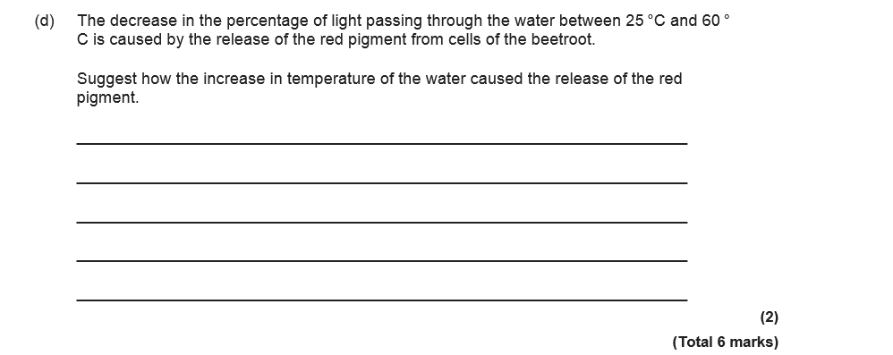

Slide 34
Required practical 5
Dissection of animal or plant gas exchange or mass transport system or of organ within such a system:
What you need to know
Risk assessments – hazard, effect, how to reduce the risk
Ethics

Slide 35
Required practical 6
Part A: Comparing the effects of different antimicrobial substances on growth of bacteria in a lawn plate culture (semi-quantitative)
Type of selection-directional
Antibiotics DO NOT CAUSE the mutation, within a population the mutation occurs which confers antibiotic resistance
Antibiotics added-all bacteria without mutation die (susceptible), rest pass on their advantageous allele to the next generation (survive-resistant)
If amount antibiotic too low or course not completed a population resistant bacteria grow
Serial dilution to get single colonies
Aseptic technique
Reduces chance of contamination
Sterile (dip in 70% alcohol) and heat
Wash hands
Wipe area with disinfectant
Remove the lid of the McCartney bottle and, without putting the lid down, move the neck of the bottle quickly through the Bunsen flame. This helps to prevent microbes from the air entering.

Slide 36
Zone of inhibition
Which is the most effective antibiotic on dish 1?
What is the most effective concentration?
How would you work out the area?
Area of zone = πr2 (Use 3.14 as π)

Slide 37
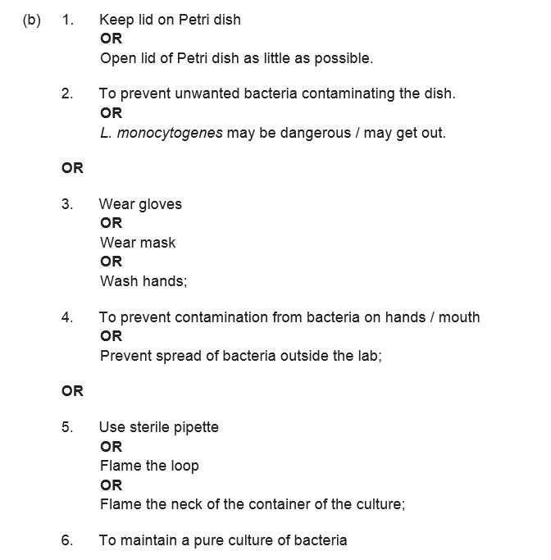

Slide 38
Required practical 7
Use of chromatography to investigate the pigments isolated from leaves of different plants eg leaves from shade-tolerant and shade-intolerant plants or leaves of different colours:
An investigation of pigments present in leaves
What you need to know
TLC-mobile phase (solvent) stationary phase (TLC plate)
Rf value
Method
Different plants have different types of photosynthetic pigment
Each type of pigment has a different optimum wavelength where maximum absorption of light energy occurs
Plants will have adapted to their habitat so that their photosynthetic pigment proportions match the wavelengths of light
May also have adapted to contain other non-photosynthetic pigments to protect/help them (see below)
﻿Shade-tolerant plants﻿ have chloroplasts adapted to low light conditions but are really sensitive to higher light levels
often contain anthocyanins, a purple pigment that is thought to protect the chloroplasts when exposed to higher levels of light.

Slide 40
Required practical 8
Investigation into the effect of a named factor on the rate of dehydrogenase activity in extracts of chloroplasts
What factors effect photosynthesis (limiting factors) –Light intensity, Temperature, carbon dioxide concentration (will this have an effect? – no not part of light dependent reaction))
Traditionally the production of oxygen and starch are used as evidence for photosynthesis. The light-dependent reactions produce a reducing agent. This normally reduces NADP, but in this experiment the electrons are accepted by the blue dye DCPIP. Reduced DCPIP is colourless. The loss of colour in the DCPIP is due to reducing agent produced by light-dependent reactions in the extracted chloroplasts
What you need to know
NADP is reduced by dehydrogenase enzyme
Redox indicator dye –DCPIP (electron acceptor) and is reduced by dehydrogenase in chloroplasts- from blue to colourless
Rate dehydrogenase activity by rate DCPIP goes clear
Colorimeter
Light intensity-distance from lamp
Method
Controlled variables
Work out rate

Slide 41
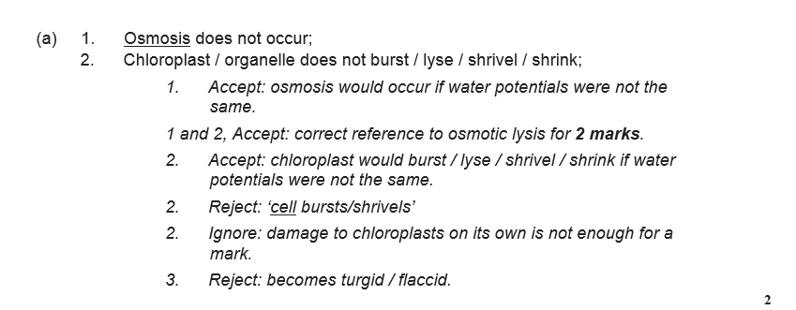

Slide 42
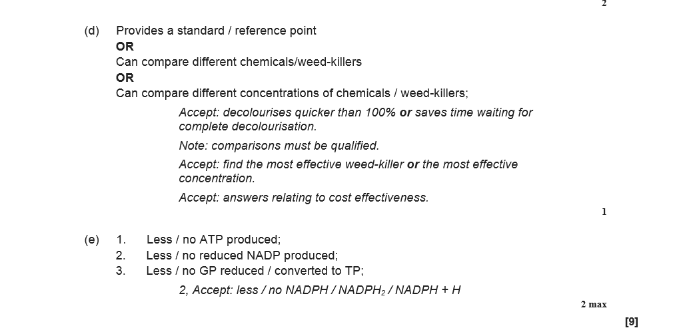

Slide 43
Required practical 9
Investigation into the effect of a named variable on the rate of respiration of cultures of single-celled organisms
How you can measure aerobic and anaerobic respiration in yeast
What you need to know
Factors effect rate respiration – temp, substrate conc, different respiratory substrates
Controlled variables
Equilibration
Relationship between production gas and increase volume and therefore pressure
How do you know that yeast respiring anaerobically?-Janus green –green to pink

Slide 46
Required practical 10
Investigation into the effect of an environmental variable on the movement of an animal using either a choice chamber or a maze
What you need to know
Handle living organisms safely and ethically – use only once, replace to reduce stress
Use of a choice chamber or a maize
Chi squared test

Slide 48
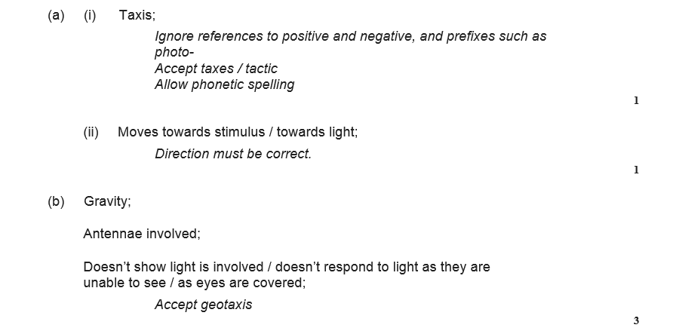

Slide 50
Required practical 11
Production of a dilution series of a glucose solution and use of colorimetric techniques to produce a calibration curve with which to identify the concentration of glucose in an unknown ‘urine’ sample
semi quantitative (colour indicates concentration) and quantitative (mass of ppt correlates to amount sugar) benedicts tests
Calibtation curve and dilutions
Controlled variables
Remove precipitate by filtering
Use a colorimeter
Not filtered absorbance increase (as % light transmission decrease) as glucose concentration increases.-more ppt more light absorbed
Filtered absorbance decrease as conc glucose increases-low conc dark blue as copper ions reduced (as increase glucose concentration) lighter blue solution

Slide 51
Required practical 12
Investigation into the effect of a named environmental factor on the distribution of a given species
Sampling random and systematic
Running mean
How is the study area chosen?
What size and shape should the quadrat be?
What should be recorded within the quadrat?
What strategy should be used for placing the quadrats?
How many quadrats need to be placed?
Minimum 20 (20% of area)
Students t test and spearman’s rank

Slide 52
Other experiments
Visking tubing (digestion)
Spirometer (vital capacity etc)
Respirometer (aerobic/anaerobic respiration)
Potometer (transpiration)
Ultracentrifugation
Messelsohn and Stahl
Electrophoresis/PCR/Recombinant DNA
Food tests
ELISA

