Slide 1
3.1.1Monomers and Polymers

Slide 2
Learning Objectives
Understand that the variety of life, both past and present is extensive, but the biochemical basis of life is similar for all living things
Know that monomers are the smaller units from which larger molecules are made.
Know that monosaccharides, amino acids and nucleotides are examples of monomers.
Know that polymers are molecules made from a large number of monomers joined together.
Understand that a condensation reaction joins two monomers together with the formation of a chemical bond and the elimination of a water molecule.
Understand that a hydrolysis reaction breaks a chemical bond between two molecules and involves a molecule of water.

Slide 3
What you should know from GCSE
Many small molecules (monomers) join together to form very large molecules (polymers)
Protein molecules are made up of long chains of amino acids

Slide 4
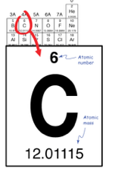
Life shares a common biochemistry
All organisms are mostly built from
4 elements: C, O, N and H.
C is the second
most abundant element in the human body
(after O).

Slide 5
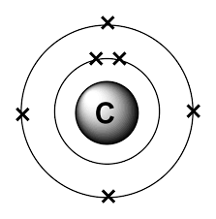
Why is carbon so common in living organisms?
Its electron configuration
means that it has the ability
to form 4 bonds.
What type of bonds does
carbon form with other atoms?
When four bonds are formed the carbon atom is very stable. What element does it resemble
then?

Slide 6
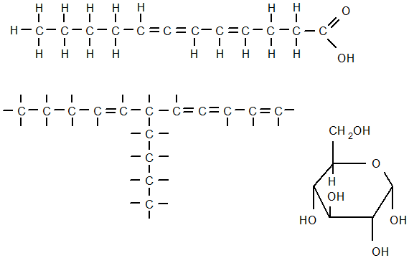
Why are all Living Organisms Composed of Carbon?
Carbon has 4 special features
It can form stable covalent bonds with other carbon atoms forming straight chains, branched chains and rings

Slide 7
C can form covalent bonds with other atoms
Eg O, H, N and C
Means that functional groups can be introduced giving specific chemical properties to the molecules that contain them.
https://www.youtube.com/watch?v=IXROzlRf284 (6.57) Craig Savage video

Slide 8
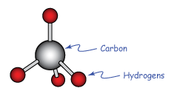
Carbon Compounds have a 3d structure usually based on a tetrahedral shape (except where there are double or triple bonds)

Slide 9
Carbon can form double or triple bonds with other C atoms
By sharing two or three electron pairs
Leading to shorter and stronger molecules
And huge variety

Slide 10
Monomers and Polymers

Slide 11
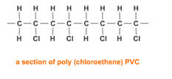
http://www.bbc.co.uk/schools/gcsebitesize/science/aqa/substancesfromcrudeoil/polymersandethanolrev1.shtml (see animation)

Slide 12
Monomers and Polymers in Biology
Group name | Monomer | Polymer | % dry mass of living organisms
Carbohydrates | Monosaccharide | Polysaccharide | 15
Proteins | Amino acid | Polypeptide | 50
Nucleic Acids | Nucleotide | Polynucleotide | 15
Would you have expected the protein figure to be so high?

Slide 13
Lipids are not polymers made up of monomers

Slide 14
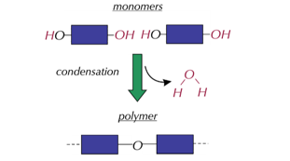
Monomers form polymers through condensation reactions
A molecule
of water is
released

Slide 15
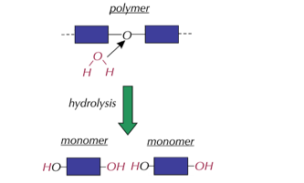
Polymers can be broken down to their constituent monomers through hydrolysis reactions
a molecule
of water is
inserted

Slide 16
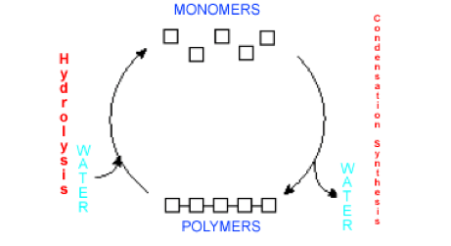
Summary

