Slide 1
3.1.2 Carbohydrates

Slide 2
Learning Objectives
Understand that monosaccharides are the monomers from which larger carbohydrates can be made.
Understand that glucose, galactose and fructose are common monosaccharides
Know that glucose has two isomers, alpha glucose and beta glucose and recall their structures.
Understand that condensation reactions produce disaccharides through the formation of glycosidic bonds to produce maltose, sucrose and lactose.

Slide 3
Learning Objectives
Understand that glycogen and starch are polysaccharides formed by the condensation of alpha glucose and that cellulose is formed by the condensation of beta glucose.
Understand the structures of glycogen, starch and cellulose are how they are well suited to their functions.
Recall the biochemical tests for reducing and non-reducing sugars and starch.
Understand how to use calibration curves to provide quantitative data on the concentration of unknown solutions.

Slide 4
What you should know from GCSE
Starch can be broken down into sugars

Slide 5
Preparatory Work
Sweet spot: Carbohydrates by Penguin Prof
https://www.youtube.com/watch?v=M6ZLDJluj6I

Slide 6
Structure of Carbohydrates

Slide 7
Carbohydrates
There are 3 main classes:
Monosaccharides (single sugars)
Disaccharides (double sugars)
Polysaccharides (many sugars)

Slide 8
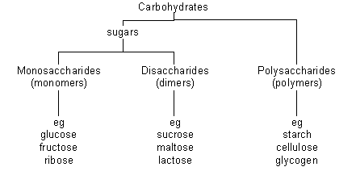
soluble and sweet
insoluble

Slide 9
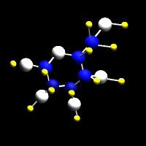
Monosaccharides
General formula: (CH₂O)n
Named according to the number of carbon atoms
If n=3 - triose e.g. glyceraldehyde
If n=5 - pentose e.g. deoxyribose, ribose
If n=6 - hexose e.g. fructose, glucose, galactose
Generally monosaccharides are used for
Energy
As building blocks (monomers) for polysaccharides

Slide 10
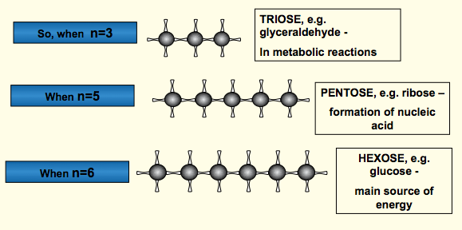
Functions Monosaccharides

Slide 11
Numbering of Carbons in Glucose
Perhaps the most important hexose is glucose
Watch the video on GOL and learn to draw
6
CH₂OH
The carbons in a glucose ring are numbered clockwise from the oxygen atom.
5
H
C
O
H
H
C
C
1
4
OH
H
HO
C
C
OH
3
2
H
OH

Slide 12
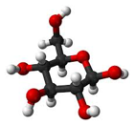
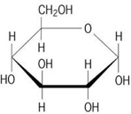
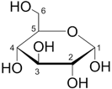
Glucose can be represented in many different ways

Slide 13
Alpha and Beta Glucose
Glucose can exist as isomers known as α & β glucose. Look at the diagrams; on carbon 1, the hydroxyl group points either up or down. In all other ways the molecules are identical.
OH
B
An Isomer = molecules that have the same chemical formula but different structural formula
a
OH

Slide 14
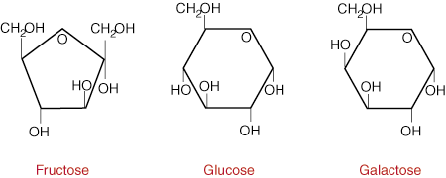
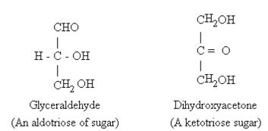
Two further isomers of glucose
What are the differences?

Slide 16
Disaccharides
Formed from pairs of monosaccharide units (monomers)
Joined by a glycosidic bond (A type of covalent bond)
Through a condensation reaction. Follow the link below and see the reaction by hovering your mouse over the molecules. Watch several times until you are absolutely sure that you understand what’s happening.
http://www.biotopics.co.uk/as/disaccharideformation.html

Slide 17
Now watch this (you need to run the slide show to make it animate)
Glucose
CH₂OH
CH₂OH
CH₂OH
C
O
H
C
O
H
H
H
H
C
H
C
C
C
OH
H
OH
H
OH
C
C
OH
OH
C
C
OH
H
OH
H
OH
Maltose
CH₂OH
CH₂OH
H
C
O
H
H
C
O
H
C
H
C
C
H
C
OH
H
OH
H
OH
C
C
OH
O
OH
C
C
OH
O
H
H
H
OH
Glycosidic
Bond
OH
H
This is a CONDENSATION reaction, where a water molecule is lost.

Slide 18
Short hand version
C
C
C
O
C
O
C
C
C
C
C
C
OH
OH
C
C
two alpha glucose molecules (monomers)

Slide 19
Forming a disaccharide
C
C
C
O
C
O
C
C
C
C
C
C
OH
OH
C
C
The hydroxyl groups on C1 of one molecule and C4 of the other molecule react

Slide 20
Forming a disaccharide
C
C
C
O
C
O
C
C
C
C
C
C
O
C
C
H₂O

Slide 21
Forming a disaccharide
C
C
C
O
C
O
C
C
1
4
C
C
C
C
O
C
C
producing a disaccharide
with a 1,4 glycosidic bond

Slide 22
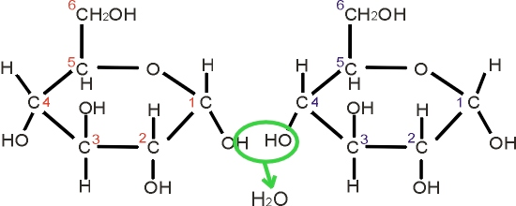
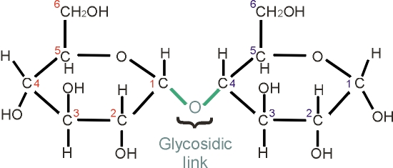
alpha glucose
reacts with
alpha glucose
Practise drawing
the
reaction yourself before you carry
on with the
booklet
forming the disaccharide called
or bond
maltose

Slide 23
Formula of disaccharides
Formula: Cn(H₂O)n-1 for disaccharides where n = the number of carbon atoms
This makes sense because one molecule of water is lost in the reaction.

Slide 24
Disaccharides: Word Equations
glucose + glucose → maltose + H2O
glucose + galactose→ lactose + H2O
glucose + fructose→ sucrose + H2O

Slide 25
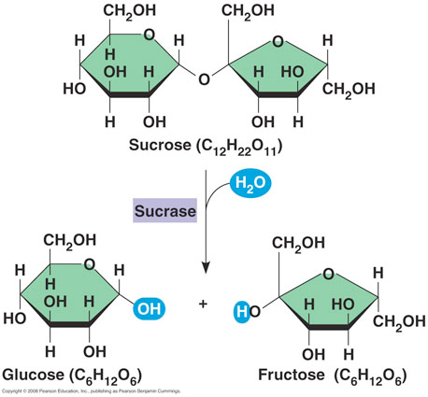
Hydrolysis
Condensation reactions can be reversed by hydrolysis.
Definition: The chemical insertion of a molecule of water to split a disaccharide into its constituent monosaccharides.
Enzymes involved in hydrolysis are
Amylase, maltase
Sucrase and lactase.

Slide 26
Food Tests: Reducing Sugars
You probably carried out food tests at GCSE. At A level you learn new tests and you are expected to know exactly how to carry them out.
All monosaccharides and two disaccharides (maltose and lactose) are also referred to as reducing sugars
With heat, they can reduce the blue copper sulphate in Benedict’s solution to red copper oxide
How? Cu2+ ion gives Benedict’s solution its blue colour.
The colour change is caused by the sugar donating an electron to the Cu2+ ion reducing it to Cu+
Cu+ is a red colour
Remember OIL RIG?: Reduction = gain of electrons - so the sugar is a reducing sugar.

Slide 27
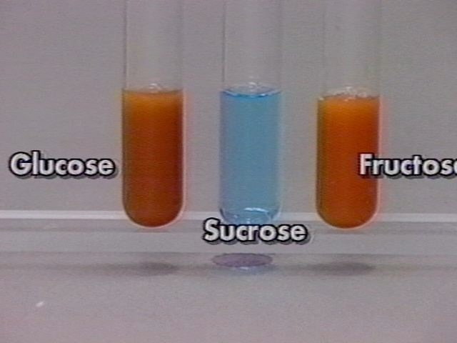
Method: Add an equal volume of Benedict’s reagent (blue) to the solution being tested and heat in a water bath (95-100 degrees C). If a reducing sugar is present then it will gradually turn through green, yellow and orange until a brick red precipitate forms.
Is this a qualitative or quantitative test?
Hint: qualitative test results contain no numbers.
You will be expected to know this method for exams

Slide 28
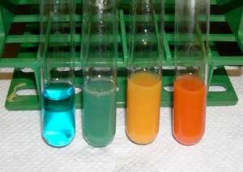
The colour of the precipitate depends on the concentration of reducing sugar
Zero reducing sugar = blue
(sucrose for example)
0.5% reducing sugar = green
1.0% reducing sugar = yellow
2% reducing sugar = brick red
Why is it not possible to distinguish between very concentrated samples, even when their concentration is different?

Slide 29
Calibration Curves
Read the information in your booklet and answer the questions
Make sure you have graph paper to plot the calibration curve.
In the A level exam you will be expected to know practically how to produce calibration curves and then how to use them to determine concentrations of unknown solutions.

Slide 30
Test for Non Reducing Sugars
All disaccharides, except for maltose and lactose, are also referred to as non-reducing sugars. (Therefore in this spec, sucrose is the only disaccharide that is a non reducing sugar).
They cannot reduce the blue copper sulphate in Benedict’s solution

Slide 31
Method for Non reducing sugars – make sure you learn this method
Add Benedict’s solution to sample and heat - negative result, no reducing sugar present
Heat with hydrochloric acid
Acid hydrolyses the disaccharide
Add an alkali (sodium hydrogen carbonate) to neutralise the acid (Benedict’s solution will not work in acidic conditions)
Retest sample with Benedict’s solution
Red precipitate shows non reducing sugar was present in sample

Slide 32
Polysaccharides
Polymers are formed from three or more monosaccharides (monomers) joined with glycosidic bonds
Two main types: Storage (starch and glycogen) and structural (cellulose)

Slide 33
Forming polysaccharides
Glucose
CH₂OH
CH₂OH
CH₂OH
CH₂OH
H
C
O
H
H
C
O
H
H
C
O
H
H
C
O
H
C
H
C
C
H
C
C
H
C
C
H
C
OH
H
OH
H
OH
H
OH
H
OH
C
C
OH
O
OH
C
C
OH
O
OH
C
C
OH
O
OH
C
C
OH
O
O
O
H
OH
H
H
H
OH
H
H
H
OH
H
H
H
OH
In this example, 3 condensation reactions have produced 3 water molecules to produce the polysaccharide.

Slide 34
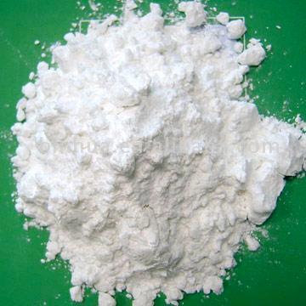
Starch
Role: Insoluble store of glucose in plants
A mixture of two glucose polymers: amylose & amylopectin

Slide 35
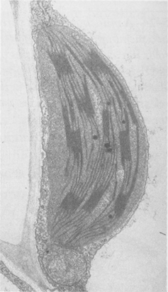
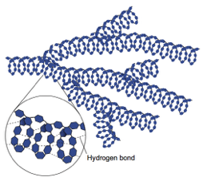
Starch
Amylose Structure
(a linear molecule with no branches)
Around 1000 or more
α glucose monomers
with 1,4 glycosidic bonds
Forms a spiral structure
because of the angle of the glycosidic bond Hydrogen bonds hold the structure
in place

Slide 36
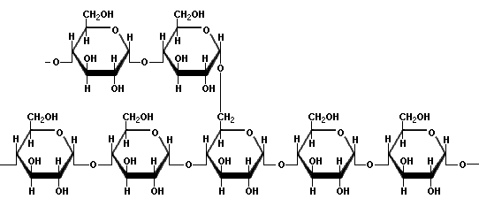
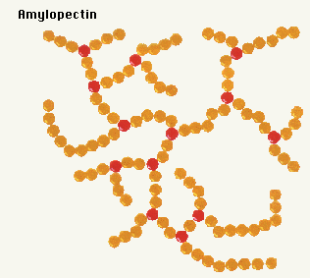
Amylopectin
α glucose monomers
with 1,4 and some 1,6
glycosidic bonds (every 25
Units) Giving a Branched,
open structure.
Amylopectin sits inside the amylose helix. Why do you suppose this is advantageous for a storage molecule?

Slide 37
Relating Structure to Function
Compact shape takes up little space (a lot can be stored in a small space)
Insoluble – therefore does not affect water potential, so water is not drawn into the cells by osmosis.
Easily hydrolysed to alpha glucose for respiration (by amylase)
The branched form has many ends each of which can be acted on by enzymes simultaneously meaning that glucose monomers are rapidly released.

Slide 38
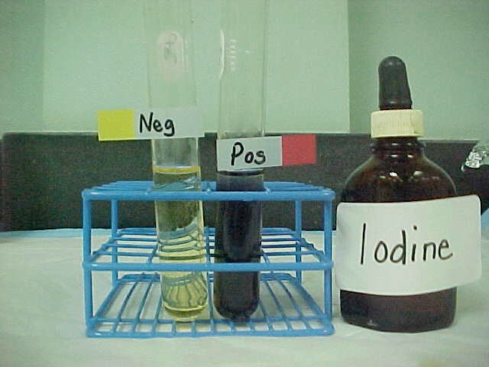
Test for starch - 2/3 drops
Method: Place 2cm3 of the sample being tested into a test tube and add 2 drops of iodine. The presence of starch is indicated by a blue black colour.
Iodine

Slide 39
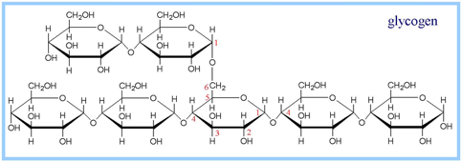
Glycogen
Role: an insoluble, compact store of glucose in animals, found mainly in muscle and liver
Alpha glucose units
1,4 and 1,6 glycosidic bonds
But many more 1,6 bonds than starch.

Slide 40
Structure and Function
Compact shape takes up little space
Insoluble - therefore osmotically inert and does not diffuse outside of cells
Easily hydrolysed to glucose for respiration (by amylase) because more branches than starch and so more of the ends can be worked on simultaneously by enzymes.
Speed of hydrolysis important because animals have a higher metabolic rate than plants.

Slide 41
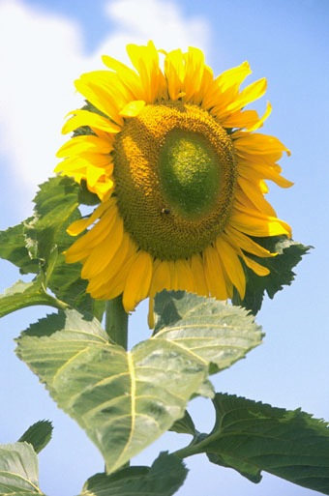
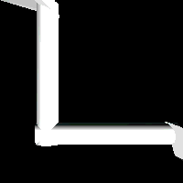
Cellulose
O
O
O
O
O
Role: Structural polysaccharide in plants
Made from Beta glucose
1,4 glycosidic bonds
long parallel chains
H-bonds link adjacent chains

Slide 42
Linking of β-Glucose Molecules
When Beta glucose molecules link together by condensation reactions one has to rotate by 180 degrees
H
O
OH
H
O
OH
+
HO
H
HO
H
H
O
OH
HO
H
HO
H
H
O
OH

Slide 43
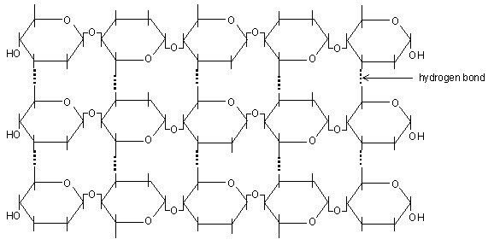
Cellulose -poly 1- 4 glucose but with beta glucose
This difference leads to parallel, straight chains that bundle together because of the formation of H bonds between hydroxyl groups in adjacent chains. These bonds cannot form between alpha glucose units because they are not rotated

Slide 44
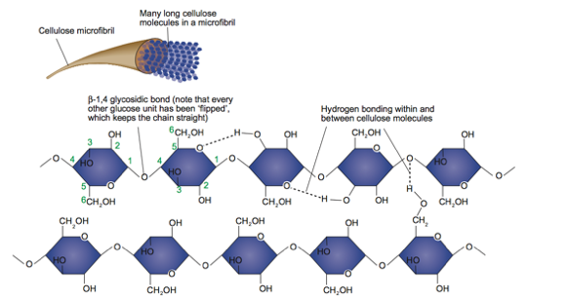

Slide 45
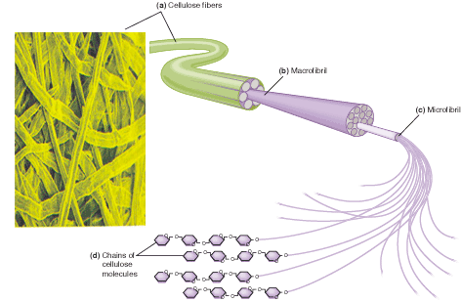
60 -70 cellulose molecules become tightly cross linked to form bundles called Microfibrils. These join together with other microfibrils to form a macrofibril which bundle together to form cellulose fibres. The cell wall has multiple layers of fibres running in different directions to increase strength. Microfibrils are very strong and rigid and give huge structural stability to the plant

