Slide 1
3.1.4 Proteins

Slide 2
Learning Objectives
Know that amino acids are the monomers from which proteins are made, composed of an amine group, a carboxyl group and an R group bonded to a central carbon atom.
Know that dipeptides are formed by the condensation of two amino acids, and polypeptides by the condensation of many amino acids, joined by peptide bonds.
Know that a functional protein may contain one or more polypeptides.
Understand that the 20 amino acids, common to all organisms. differ only in their R group.

Slide 3
Learning Objectives
Recall the role of H bonds, ionic bonds and disulphide bridges in the structure of proteins.
Understand the relationship between primary, secondary, tertiary and quaternary structure and protein function.
Be able to relate the structure of proteins to the properties of proteins named throughout the specification.
Recall the Biuret test for proteins.
Understand how to use chromatography to identify amino acids in a mixture.

Slide 4
What you should know from GCSE
Proteins are made of chains of amino acids which fold to produce a specific shape.
The roles of proteins include enzymes, antibodies, hormones and as a structural component of muscle tissue.
Chromatography can be used to separate mixtures and identify molecules within a mixture.

Slide 5
Introductory or recap video
Bozeman on proteins: https://www.youtube.com/watch?v=2Jgb_DpaQhM
http://fold.it/portal/ game referenced in Bozeman video

Slide 6
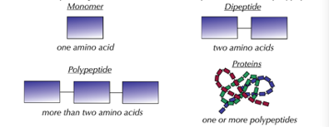
Proteins are polymers composed of monomers

Slide 7
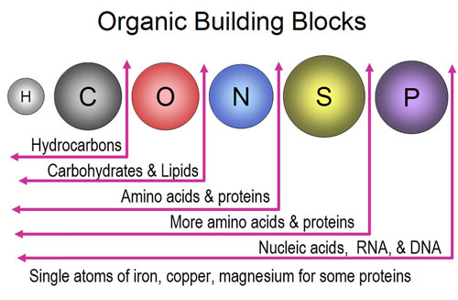
Proteins ‘of first importance’
Large molecules
Composed of 4 elements:
C, H, O and N
Some have S

Slide 8
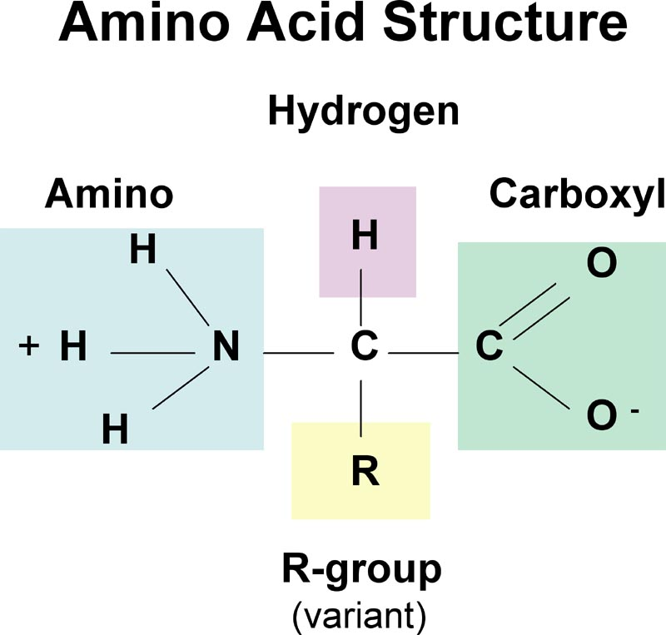
Look at first :
http://www.biotopics.co.uk/as/aa.html
Amino acids are soluble in water where they form polar ions (negative and positive poles - zwitterions).

Slide 9
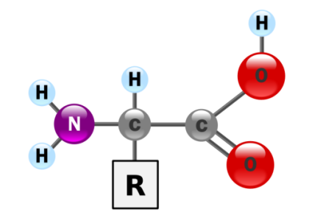
Extension: amino acids are amphoteric
Amino acids have both acidic and basic properties. They are amphoteric. This means they can act as buffer solutions. A buffer solution is one that can resist the tendency to alter its pH even when small amounts of acid or alkali are added to it. Vital in biological systems.
carboxyl group
(acid group)

Slide 10
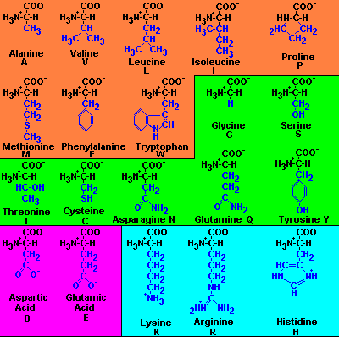
20 R groups, making 20 different amino acids, making an almost limitless number of possible combinations and therefore types of protein.

Slide 11
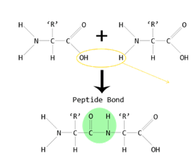
Peptide bonds
http://www.biotopics.co.uk/as/aminocon.html

Slide 12
Polypeptides
chains of amino acids linked by condensation reactions and peptide bonds can form polypeptides through polymerisation
https://smartsite.ucdavis.edu/access/content/user/00002950/bis10v/media/ch02/peptide_bonding.html

Slide 13
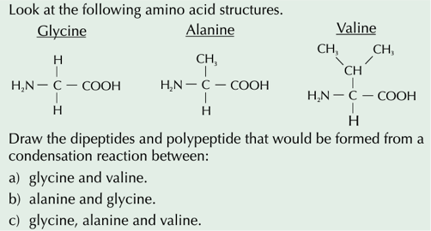
Practice Questions

Slide 14
Protein Structure
Can have up to four levels of structure:
Primary (all proteins)
Secondary (all proteins)
Tertiary (some proteins)
Quaternary (some proteins)
http://www.biotopics.co.uk/as/aminocon.html

Slide 15
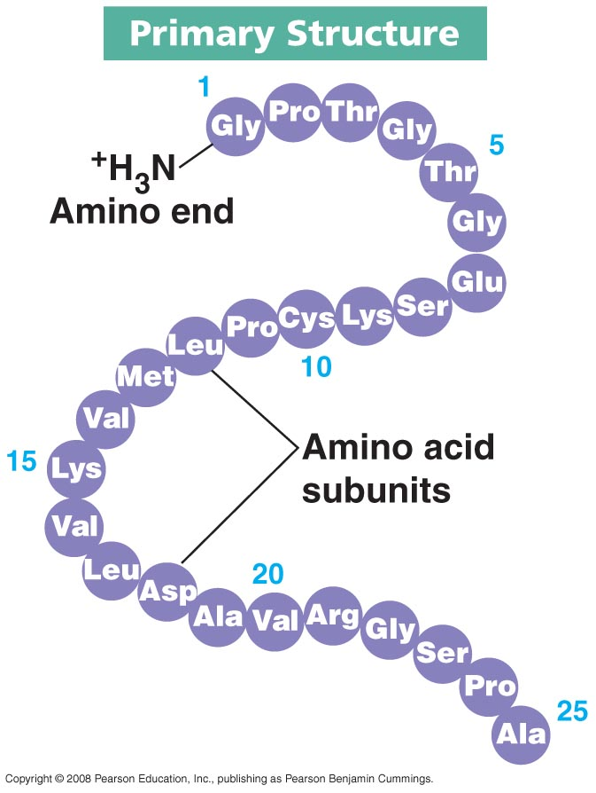
Primary structure
The sequence (and number) of amino acids in the polypeptide chain is known as the primary structure, linked by peptide bonds only
Determines shape and function of protein

Slide 16
Secondary structure
The chains fold into two different regular shapes – alpha helices (most common) and beta pleated sheets (less common).
H-bonding forms between the –CO and the -NH of adjacent amino acid. No R groups are involved.
These are found in all proteins (because all proteins have same backbone) and some proteins will have both helices and pleated sheets within their structure.
Secondary structure results in the R groups sticking out to the side ready to bond forming the tertiary structure.

Slide 17
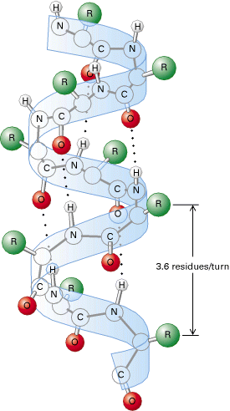
Alpha Helices: Dotted lines show where hydrogen bonds form between N-H groups and the oxygen of a C=O group in the next turn of the helix

Slide 18
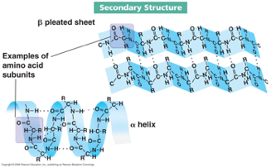
Beta Pleated sheets: The polypeptide chain zigzags backwards and forwards forming a sheet. Once again it is held together by H bonds. The sheet is not flat but pleated because of the carbon having tetrahedral angles

Slide 19
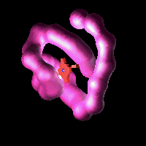
Tertiary structure
Further folding of the polypeptide chain (usually the alpha helix), caused by bonding between R-groups only, to form a specific 3d shape
H-bonds (weak)
Ionic bonds (stronger and vulnerable to changes in pH)
Disulphide bridge (very strong, covalent bonds)
and hydrophobic interactions
making a globular protein
affected by temp & pH

Slide 20
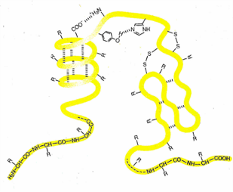
Student Activity in work booklet
carboxyl terminus (C terminus) and
amino terminus (N terminus) at either ends of protein

Slide 21
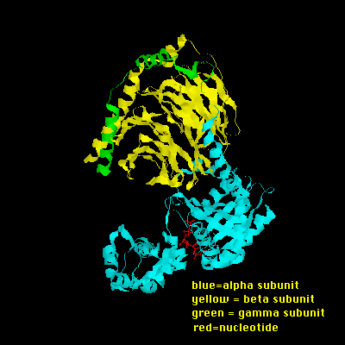
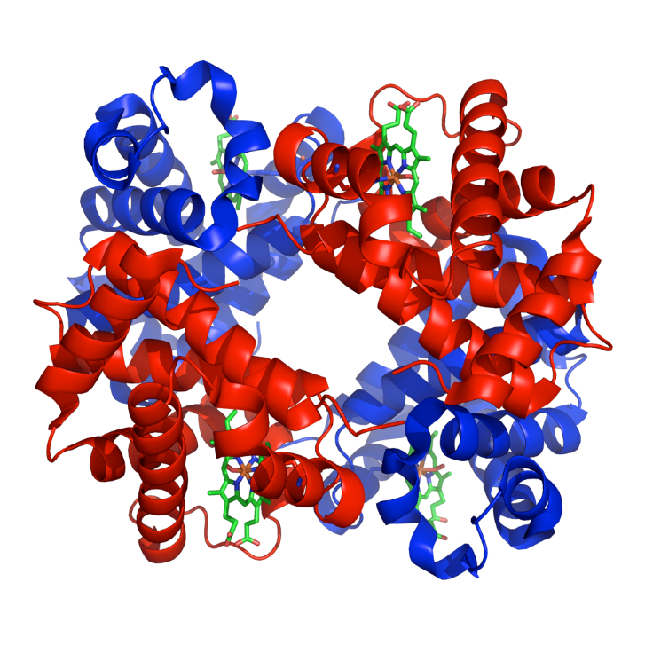
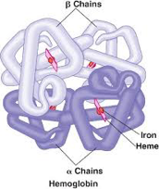
Quaternary structure
Where more than one (2 or more) polypeptide chains combine to form complexes
Joined by bonds similar to those in the tertiary structure
Only some proteins exhibit quaternary structure
For example, Haemoglobin consists of 4 polypeptide chains held by disulphide bridges and a non protein prosthetic group.

Slide 22
Protein shape and function
Proteins have many different roles in living organisms. Their role depends upon their molecular shape, which can be of two types.
Fibrous proteins such as collagen have structural roles, they consist of polypeptide chains linked in parallel chains or sheets with numerous cross links to make fibres
Globular proteins such as enzymes perform metabolic functions. Their shape is compact and folded - spherical.

Slide 23
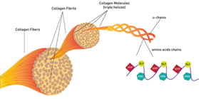
Collagen Research Activity
Collagen is the most abundant protein in the human body. It is regarded as the substance that holds the whole body together and can be found in the bones, muscles, skin and tendons. Research the structure of collagen.
How does its structure and shape help it function? Why is it described as a fibrous protein?
https://www.youtube.com/watch?v=FYbe8hAWvjU

Slide 24
Globular protein research
choose a named globular protein, other than haemoglobin or an enzyme, and research it and write short notes on how its structure is related to its function.

Slide 25
Fibrous | Globular
Have structural functions e.g. keratin a resistant protein found in skin cells helps to prevent the entry of pathogens | Have metabolic functions e.g. enzymes such as amylase, hormones such as insulin
The polypeptide chain has regular repetitive sequences and is coiled into a helix or pleated sheet - secondary structure. Sheets provide flexibility to the molecule | Polypeptide chains have irregular sequences of amino acids that form secondary and tertiary structures and have a specific 3d shape (tightly folded to form a spherical shape)
Structure maintained by H bonding | Structure maintained by H bonding, ionic bonds and disulphide bridges between atoms in R groups. Also hydrophobic bonds as their non polar R groups point inwards
Parallel polypeptide chains cross linked to form long fibres, which provide strength | Surface of the molecule has depressions in it into which other molecules can fit
Stable | Relatively unstable - 3d structure can be affected by temp and pH
Usually insoluble in water (external R groups are non polar) | Usually soluble in water (external R groups are polar)

Slide 26
Functions of proteins
Nutrition
Transport
Movement
Sensitivity and coordination (nervous system and the hormone system)
Reproduction
Protection (immune system)
Research and then produce a table giving an example and a function for each one eg haemoglobin is an example of a transport protein – what is its function in animal systems?
e.g. Amylase
e.g. Haemoglobin
e.g. Actin & myosin
e.g. Antigens
e.g. Membrane proteins
e.g. Collagen & keratin
e.g. Insulin
e.g. Antibodies

Slide 27
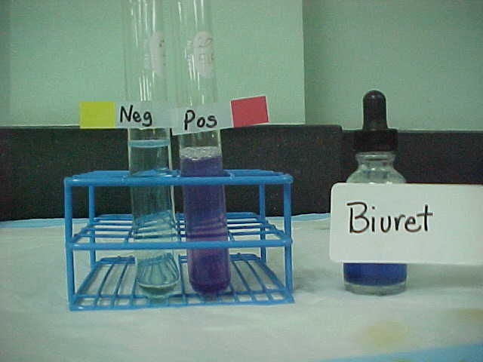
Biuret test for Proteins
Place a sample of the solution to be tested in a test tube and add an equal volume of Biuret reagent (copper II sulfate solution and sodium hydroxide)
A purple/lilac colour shows protein is present
If the solution stays blue then the result is negative.

Slide 28
Plants and Animals
Plants can make their own amino acids as long as they can obtain nitrate from the soil, which is then converted to amino groups and combined with the products of photosynthesis
Animals cannot make amino acids themselves and so must take in protein as part of their diet. These are then broken down into amino acids that can form other proteins. Some cannot be built and so essential amino acids are needed, usually found in meat.

