Slide 1
3.1.4.2 Many proteins are ENZYMES

Slide 2
Learning Objectives
Appreciate that enzymes catalyse a wide range of intracellular and extracellular reactions that determine structures and functions from cellular to whole organism level.
Know that each enzyme lowers the activation energy of the reaction it catalyses.
Appreciate how models of enzyme action have changed over time.

Slide 3
Learning Objectives
Recall the induced-fit model of enzyme action.
Understand the specificity of enzymes.
Know how the properties of an enzyme relate to the tertiary structure of its active site and its ability to combine with complementary substate (s) to form an enzyme-substrate complex.

Slide 4
What you should know from GCSE
The kinetic theory of states of matter.
Temperature is a measure of the average kinetic energy that particles within a system are moving/vibrating with.
The shape of an enzyme is vital to its function in speeding up chemical reactions. Enzymes are affected by temperature and pH.
The use of enzymes in the body during digestion, protein synthesis and respiration.

Slide 5
What you should know from GCSE
The use of enzymes industrially and within the home, including the advantages and disadvantages of using enzymes.
The calculation of rate and the factors that affect the rate of chemical reactions.
Evaluation of the use of catalysts in industrial processes

Slide 6
Preparatory Work
1. Watch the video on BBC Bitesize on enzymes to recap your GCSE knowledge:
https://www.bbc.com/bitesize/guides/zwxv6yc/revision/2
https://www.bbc.com/bitesize/guides/zcttv9q/revision/5
2. Read the article entitled Enzymes Fast and Flexible by Dianne Gull, originally published in Biological Sciences Review, Vol 6, No.2 pp 26-29.
Answer the questions that follow.

Slide 7
Naming Enzymes:
Recommended names
Systematic name
Short name, often ending in ‘ase’ eg. lactase
Describes the type of reaction being catalysed eg.
ATP:creatine phosphotransferase (the transfer of a phosphate group)
Glucose isomerase (changes glucose to fructose)

Slide 8
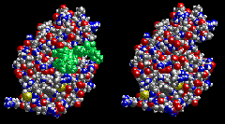
Structure of enzymes
Globular proteins with tertiary structure.
Active site has a specific shape that only the substrate can fit.
Enzyme substrate complex held together by weak non covalent interactions (H, ionic, hydrophobic).
There are around 40,000 different enzymes in human cells, each controlling a different chemical reaction.
Click to link to jmol interactive representation courtesy of University of Arizona

Slide 9
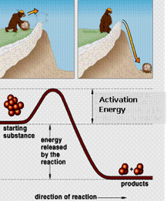
Chemical reactions
3 conditions must be met for a chemical reaction to take place:
1.The reactant molecules must collide with sufficient energy to alter the arrangement of their atoms to form products.
How Enzymes Work (from PDB-101) – YouTube

Slide 10
Chemical reactions
2.The energy of the products must be lower than that of the reactants
3.Activation energy must be supplied, often in the form of heat.
https://www.youtube.com/watch?v=np2JUCVvBwQ

Slide 11
How do enzymes lower Activation energy?
By putting stress on the bonds within a molecule
Or by holding molecules closer together.
This increases the chances of a reaction, and so lowers the energy required to begin it.
11

Slide 12
How do enzymes lower Activation energy?
Alternatively the enzyme can make the local conditions inside the active site quite different from those outside (pH, water concentration, charge for example) so that the reaction is more likely to happen.
Why is it important in living organisms that the activation energy is lowered?
https://www.youtube.com/watch?v=D0ZyjpAin_Y
12

Slide 13
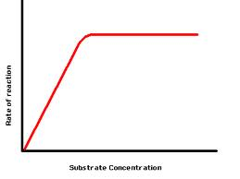
Enzymes have an optimum rate for a given set of conditions, it is not possible to exceed this
enzyme active sites become
saturated
max rate
as the substrate concentration
increases the chance of a successful collision between enzyme and substrate also increases so rate increases

Slide 14
Enzymes lower the activation energy by forming enzyme/substrate complexes.
Reaction mechanism
Substrate + Enzyme
Enzyme/substrate complex
Enzyme/product complex
Product + Enzyme

Slide 15
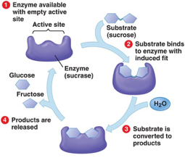
Reaction Mechanism

Slide 16
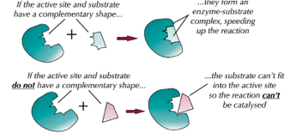
Enzyme substrate complexes can form because the shape of the active site and the substrate are complementary to each other.

Slide 17
Lock-and-key hypothesis assumes the active site of an enzyme is rigid in its shape
Models of enzyme action
However crystallographic studies indicate proteins are flexible.

Slide 18
The Induced-fit hypothesis suggests the active site is flexible and only assumes its catalytic conformation after the substrate molecules bind to the site. In other words the enzyme has a certain general shape that alters slightly to accommodate the substrate placing strain on the substrate molecule.
When the product leaves the enzyme, the active site reverts to its inactive state.

Slide 19
Induced fit model
The induced fit model helps to explain why enzymes are so specific and only bond to one particular substrate. The substrate doesn’t only have to fit the active site, it has to make the active site change in the right way as well.
https://www.youtube.com/watch?v=NdMVRL4oaUo

Slide 20
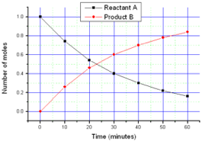
Measuring Enzyme Activity
We can measure the rate of reaction in two ways:
1) the appearance of product over time
2) the disappearance of reactants over time

Slide 21
Enzymes and Rate of reaction
A chemical reaction proceeds when molecules with sufficient kinetic energy,
collide, and react.
Initially, product is formed at a high rate as there are plenty of substrate molecules to fit the active sites.
As substrate molecules become scarce, the rate of product formation slows down and eventually levels out when all of the substrate has been converted to product

Slide 22
Estimating the initial rate of a reaction
You can use a tangent to estimate the initial rate of reaction from a graph. The initial rate of reaction is the rate of reaction right at the start of the reaction where time is zero.
To work out the initial rate of reaction carry out the following steps:
Draw a tangent to the curve at time zero, using a ruler.
Calculate the gradient of the tangent.
Work out the units for rate (divide the units of the y axis by the x axis).

Slide 23
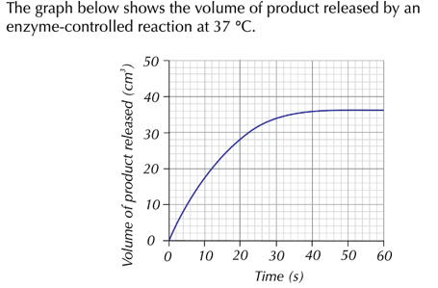
Worked Example

Slide 24
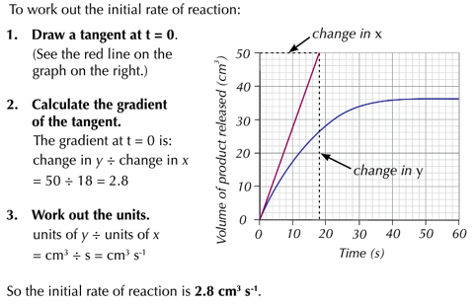

Slide 25
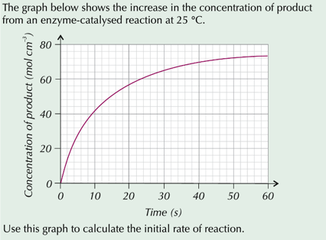
Practice Question

Slide 26
Factors affecting Enzyme Activity
Temperature
pH
Substrate Concentration
Enzyme Concentration
26

Slide 27
Effect of temperature
Temperature at which enzyme works best (optimum)
Increased kinetic energy increases collisions
Enzyme is denaturing due to vibration
y
A
B
Rate of Reaction
0
10
20
30
40
50
60
Temperature/ ⁰C

Slide 28
Region A on the Graph | Region B on the Graph
As the temperature increases from 0 ºC to 40 ºC, the rate of reaction increases. At 40 ºC, it reaches its maximum rate of reaction. | As the temperature increases above 40 ºC, the rate of reaction decreases until at 57 ºC the rate of reaction is zero.
Explanation: Increasing the temperature provides more heat energy This gives both the enzyme and the substrate more kinetic energy. Both enzyme and substrate move faster. This results in more collisions More enzyme-substrate complexes are Formed The rate of reaction is increased until its maximum. This temperature is described as the optimum temperature | Explanation: High temperatures result in more kinetic energy being given to the enzyme and substrate. The enzyme molecules vibrate more as the kinetic energy increases. The Hydrogen bonds holding the tertiary structure of the protein break. This changes the shape of the enzyme The active site changes shape The substrate can no longer fit There is less / no reaction occurring We say the enzyme has been denatured.

Slide 29
Enzymes and Temperature
Generally the rate doubles for each 10 degrees C rise until the optimum is reached, usually 40 degrees C in humans.
Low temps can inactivate the enzymes due to zero KE of molecules (reversible)
But most are denatured between 50 and 70 degrees C (irreversible)
Exposure time is important

Slide 30
pH and enzymes
The pH of a solution is a measure of its hydrogen ion concentration.
Each enzyme has a pH at which it works fastest.
The pH of a solution is calculated using the formula: pH = -log₁₀ (H⁺ )
A hydrogen ion concentration of 1x10⁹ therefore has a PH of 9

Slide 31
pH affects the formation of hydrogen bonds and ionic bonds in proteins and so affects shape.
Each enzyme has an optimum pH at which it works fastest
trypsin
cholinesterase
pepsin
(stomach - acidic)
B
C
(neurones -neutral to alkaline)
A
(small intestine -
optimum pH
= 8)
Rate of Reaction (M)
2
4
6
8
10
pH

Slide 32
Effect of pH on Enzyme action
pH at which the enzyme functions best (optimum)
A
y
Enzyme is denaturing
Enzyme is denaturing
Rate of Reaction
B
B
5
6
7
8
9
10
pH

Slide 33
Region A on the Graph | Region B on the Graph
At pH of 7.0, there is a maximum rate of reaction (y); pH 7.0 is optimum FOR THIS ENZYME | As the pH moves away from the optimum, the rate of reaction decreases. Below pH5.7 and above pH 8.3 there is no reaction
Explanation: A solution of the optimum pH has a number of hydrogen ions in it which does not disrupt the ionic bonding of this enzyme. No change in the shape of the enzyme No change in the shape of the active site Substrate can fit Enzyme-substrate complexes are formed Rate of reaction is maximum. | Explanation: Change in pH has disrupted the ionic bonding in the tertiary structure of the protein This changes the tertiary shape of the protein The shape of the active site is changed The substrate cannot fit Enzyme substrate complexes not formed. Reaction rate is reduced / none.

Slide 34
Effects of pH on enzymes
Extremes of pH denature enzymes by breaking ionic bonds and hydrogen bonds that stabilise tertiary structure (non reversible)
Less extreme changes can inactivate enzyme (reversible)
pH fluctuations inside organisms are usually small, this means that they are far more likely to reduce an enzyme’s activity than to denature it.
34

Slide 35
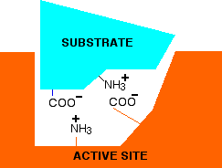
Why do the bonds break?
The arrangement of the active site is partly determined by the hydrogen and ionic bonds between -NH2 and -COOH groups that make up the enzyme. The change in H+ ions affects this bonding, causing the active site to change shape.
Enzyme with an optimum pH. Substrate attaches to enzyme via two ionic bonds.

Slide 36
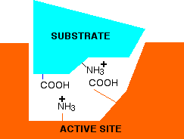
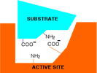
Why do the bonds break?
At low pH (<7) the NH3+ group will not be affected but the COO- will pick up a H ion. Ionic bonds can no longer form between enzyme and substrate.
pH > 7, there are insufficient H ions so that
NH2 cannot become NH3+

Slide 37
Substrate Concentration
Enzyme concentration is limiting
V max – maximum rate of reaction
B
y
Substrate conc^{n.} is
limiting
Reaction rate
A
Similar
to shopping
sales - rate of entry,
number of people
waiting outside
Substrate concentration
x

Slide 38
Region A on the Graph | Region B on the Graph
Description: Rate of reaction increases as the substrate concentration increases until substrate concentration X. At substrate concentration X there is a maximum rate of reaction y. | Description: As the substrate concentration increases above X, the rate of reaction remains constant at its maximum y.
Explanation: The more substrate molecules present, the greater the chance of collision with the enzyme More collisions so more enzyme – substrate complexes formed. Increased rate of reaction Substrate concentration is limiting | Explanation: Increasing substrate concentration has no effect on reaction rate. All the enzyme’s active sites are occupied Enzymes are working at maximum turnover rate Enzyme concentration is limiting

Slide 39
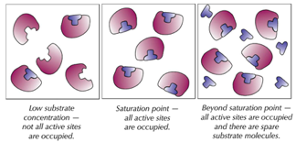

Slide 40
Enzyme concentration
Normally there is excess substrate so the rate continues to rise as enzyme concentration is increased
Substrate is limiting, rate levels off.
B
y
Enzyme is limiting
Reaction rate
A
Enzyme concentration
x

Slide 41
Region A on the Graph | Region B on the Graph
Description: Rate of reaction increases with increased enzyme concentration | Description: Rate of reaction levels off as enzyme concentration increases beyond concentration x
Explanation: More enzymes so more active sites More enzyme-substrate complexes formed More products formed Rate of reaction increased Limiting factor is enzyme concentration | Explanation: All substrate molecules have formed enzyme-substrate complexes Limiting factor is substrate concentration

Slide 42
Buffers and Controls
In enzyme experiments it is essential to use buffers and controls.
Buffers maintain a constant pH. If acid is added, the buffer ‘soaks up’ the hydrogen ions.
Controls are duplicate experiments, identical in every aspect to the experiment, except that the enzyme is boiled and cooled to denature it and thus cannot affect the DV.

Slide 43
Enzyme Inhibition
Enzyme inhibitors are substances that directly or indirectly interfere with the functioning of the active site of an enzyme and so reduce its activity.
Two types:
Competitive inhibitors that bind to the active site of the enzyme.
Non competitive inhibitors that bind to the enzyme at a position other than the active site.
https://sciencestruck.com/competitive-inhibition-vs-non-competitive-inhibition
43

Slide 44
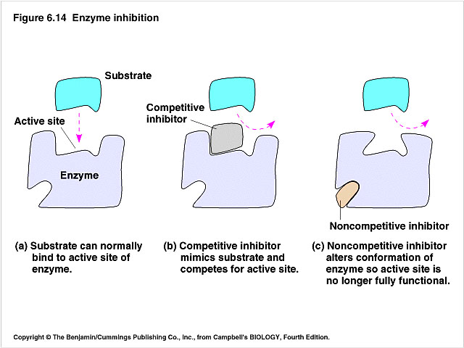
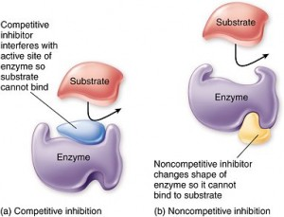
Inhibition of enzymes
inhibition of enzymes

Slide 45
Extension: Heavy metal poisoning
Silver reacts with the -SH groups of cysteine residues in the protein chain.
This can affect the way that the tertiary structure forms leading to a change in the shape of the active site. Mercury, copper and lead can all behave in a similar way.

Slide 46
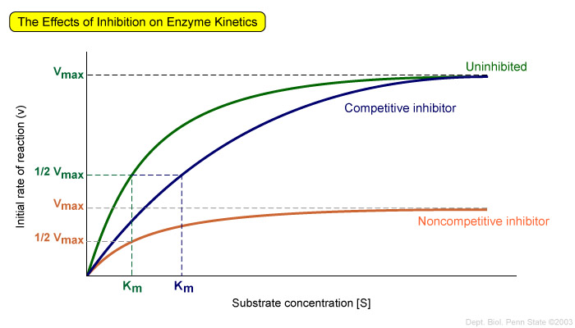
if substrate concentration increased,
more chance of substrate colliding with active site, preventing inhibitor molecule from binding
higher concentration of substrate does not increase rate of reaction, because active site not involved

Slide 47
Differences | Competitive inhibitor | Non-competitive inhibitor
shape of molecule
site on enzyme
effect of increasing inhibitor conc.
effect of increasing substrate conc.

Slide 48
Metabolic Pathways
A metabolic pathway is a series of reactions in which each step is catalysed by an enzyme. Cells have evolved to use the products of their own reactions for feedback inhibition of enzyme activity. Feedback inhibition involves the use of a reaction product to regulate its own further production
.
Swiffy Output (abpi.org.uk)

Slide 49
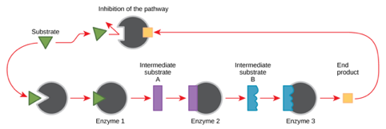
Describe the events shown in the diagram

Slide 50
Pharmaceutical Drugs
Understanding how enzymes work and how they can be regulated is a key principle behind the development of many of the pharmaceutical drugs.
Statins are a group of medicines used to control blood cholesterol.
The end product of a metabolic pathway known as the mevalonate pathway, produces cholesterol.
How do statins work to reduce cholesterol?

