Slide 1
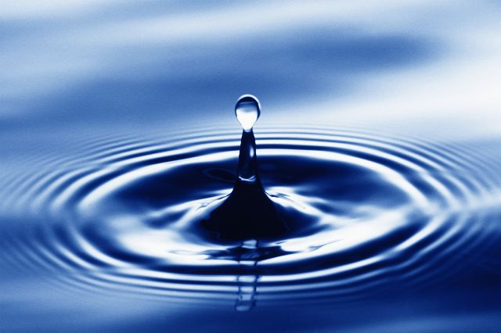
WATER
1

Slide 2
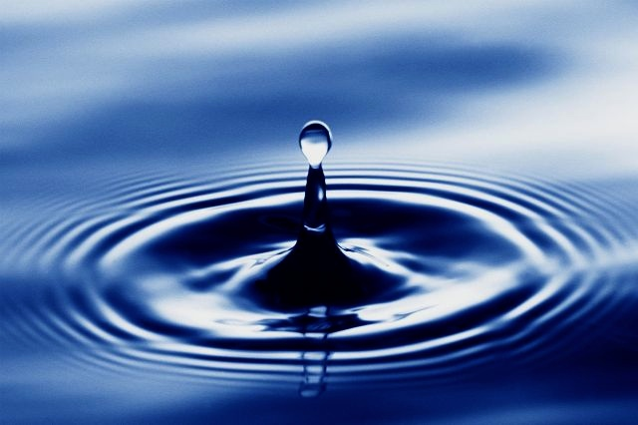
Learning Objectives
Describe the structure of the water molecule
State the properties of the water molecule
Explain the importance of the water molecule to living organisms
Specification reference: 3.1.7
2

Slide 3
What you should know from GCSE
Heat can be transferred by evaporation
Water has a high specific heat capacity
Water reacts with many elements and compounds and is a solvent in which many chemicals can dissolve
Water is a covalent compound

Slide 4
GCSE Definitions
Evaporation: Takes place when fast moving particles at the surface of a liquid overcome the forces of attraction from other particles and escape.
Specific Heat capacity: The amount of energy required to raise the temperature of 1kg of a substance by 1 degrees C. Water has a specific heat capacity of 4200 J/Kg/degrees C

Slide 5
GCSE Definitions
Element: Consists of only one type of atom.
Compound: A substance that is made of one or more different elements that are chemically bonded together .

Slide 6
GCSE Definitions
Solvent: A dissolved substance is a solute. The liquid used for dissolving is called a solvent. Solute + solvent = a solution.
Covalent Compound: Non metals combine together by sharing electrons to make a covalent compound. The shared pair of electrons holds the two atoms together (a covalent bond). The group of atoms bonded together in this way is called a molecule.

Slide 7
The atoms in water are held together by covalent bonds
Dot and Cross Diagram for Water

Slide 8
Unequal sharing of electrons in Covalent Bonds
One atom might exert more of a force on the electron cloud than an other
equal sharing (two identical atoms)
very unequal sharing
slightly unequal sharing
Which diagram best represents the atoms in a water molecule?

Slide 9
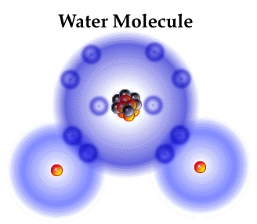
The Water molecule has slightly unequal sharing of electrons
Which atom exerts the greater force in the molecule?
Why?
Does this affect the overall charge on the water molecule?
9

Slide 10
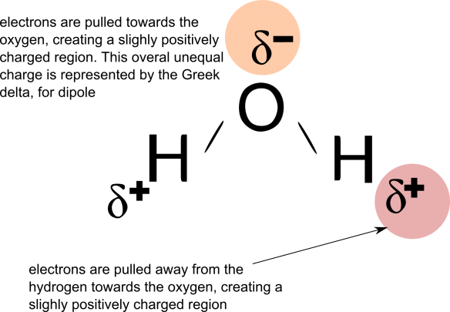
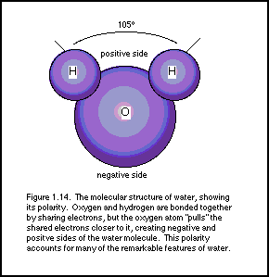
The Water molecule is a dipole
A dipole is created in molecules where there is an uneven distribution of charge. The bond is said to be polar.
Text

Slide 11
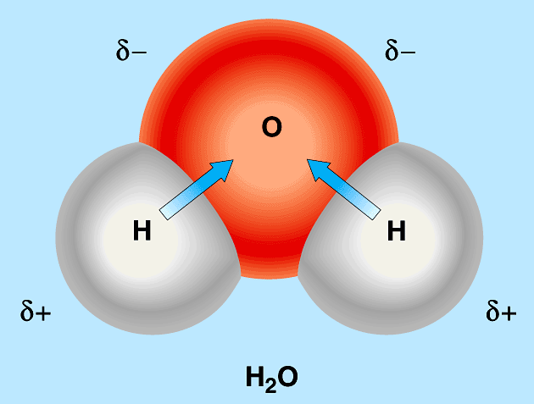
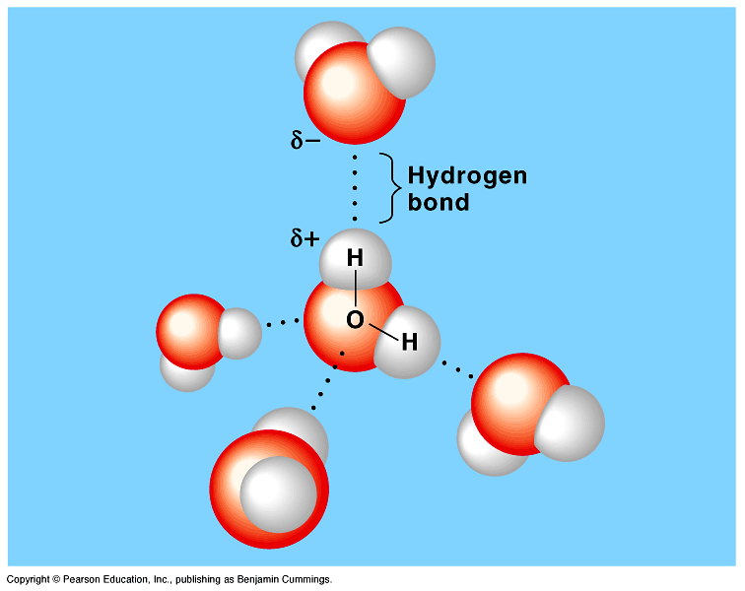
The dipole allows H bonds to form
Hydrogen Bonding in Water – YouTube
Animation shows dynamic nature of H bonding.
When two water molecules are in
close contact their opposing charges
attract each other forming a hydrogen bond.
On average a liquid water molecule will form
3 out of 4 possible H bonds. Solid water will
Form all 4 because the molecules are locked
into place. Learn to draw.
11

Slide 12
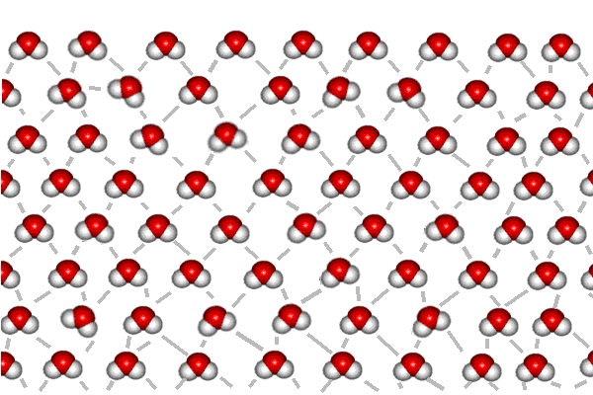
Hydrogen Bonds allow cohesion between water molecules
The most important property of water molecules is that they can ‘stick’ together by forming hydrogen bonds with other water molecules (known as cohesion)
Individually they are weak but multiple H bonds give a strong lattice framework
The grey lines show the hydrogen bonds. Notice that each of the interior molecules have four hydrogen bonds but on the surface there are only two.
12

Slide 13
The fact that water is a dipole and forms H bonds between its molecules leads to some important properties that are vital to living organisms and processes.

Slide 14
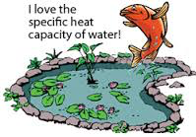
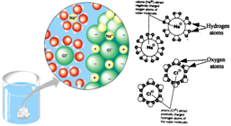
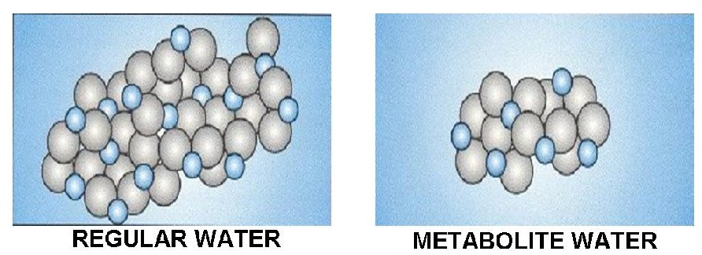
5 key Biological Properties of Water
A solvent
A High specific Heat Capacity
A metabolite

Slide 15
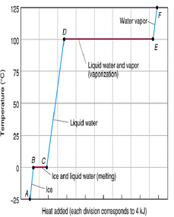
5 key Biological Properties of Water
Strong cohesion between molecules
A large latent heat of vaporisation.

Slide 16
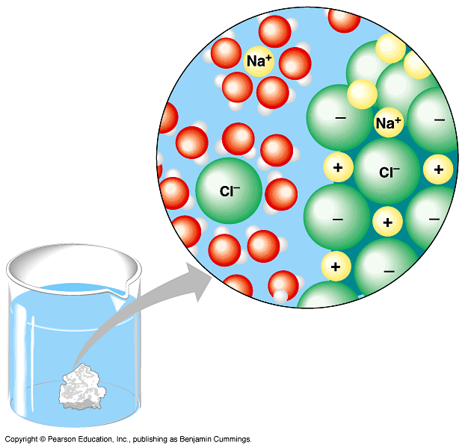
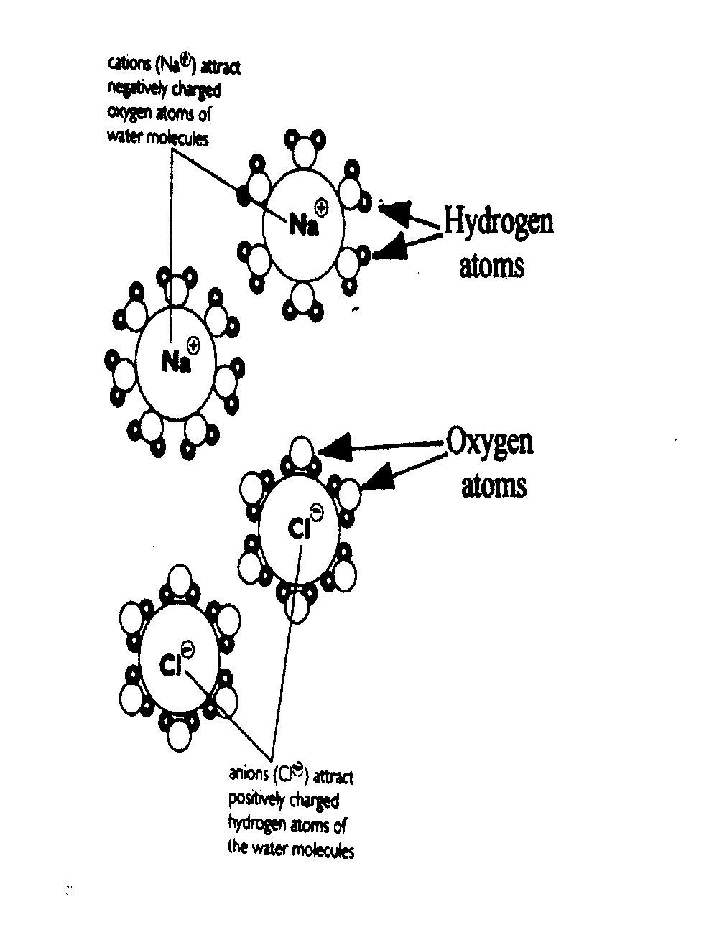
The universal solvent for other polar molecules or ionic compounds Importance: allows chemical reactions to take place in solution and the transport of molecules.
Uncharged or Non polar substances such as lipids do not dissolve well in water and are called hydrophobic
Polar substances that
dissociate in water are
said to be hydrophilic
16

Slide 20
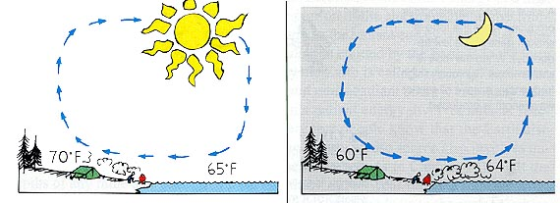
Water has a high specific heat capacity
What is the specific heat capacity of water? What does this mean? Why so high?
20
Water’s high specific heat capacity means that it takes a lot of energy to heat it up and it has to lose a lot of energy to cool down. As a result, aquatic environments have stable temperatures. Water acts as a temperature buffer
Why does it have

Slide 21
Water as a TEMPERATURE STABILISER
Biological Importance
Water’s high specific heat capacity means that it takes a lot of energy to heat it up and it has to lose a lot of energy to cool down (tea and toast analogy). As a result, aquatic environments have stable temperatures. Water acts as a temperature buffer. Why else is this important for organisms?
21
The specific heat capacity is the amount of energy needed to change 1kg of a substance by 1 degree C

Slide 22
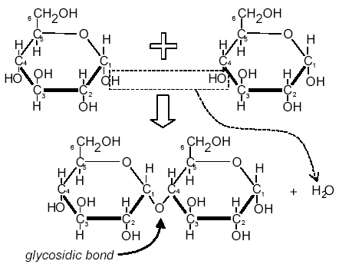
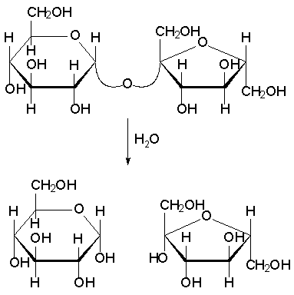
Water is a METABOLITE
Condensation Reaction
Hydrolysis
Biological Importance: Many chemical reactions in organsims use and produce water. Can you think of any other examples from GCSE?
22

Slide 23
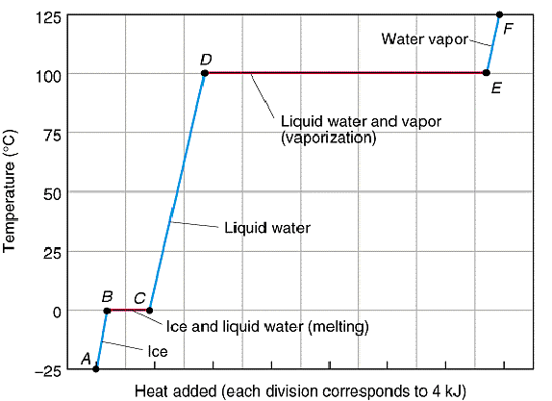
Water has a high latent heat of vaporisation
What is it that makes it so high?
23

Slide 24
What is Latent Heat of Vaporisation? Why is it so high for water?
Latent heat of vaporisation or evaporation is the energy needed to convert liquid water where the molecules are attracted through their hydrogen bonds, to water vapour, where they are not.
The high number of hydrogen bonds restrict the movement of molecules making it difficult for water molecules to escape (evaporate, become vapour) and so this is why it is so high for water.
The molecules that do escape have high KE. As they escape, they take energy from the system. The remaining energy of the molecules that are left is lower and this leads to a cooling effect.
https://www.khanacademy.org/science/biology/water-acids-and-bases/water-as-a-solid-liquid-and-gas/v/evaporative-cooling
24

Slide 25
Biological Importance:the high latent heat means that Water is an excellent coolant
http://www.bbc.co.uk/programmes/p0037pn8
25

Slide 26
Strong cohesion between water molecules Biological Importance: water can act as a TRANSPORT MEDIUM
Long columns of water can be supported and drawn up very tall trees in xylem tubes.
Low viscosity allows
easy flow.
26

Slide 27
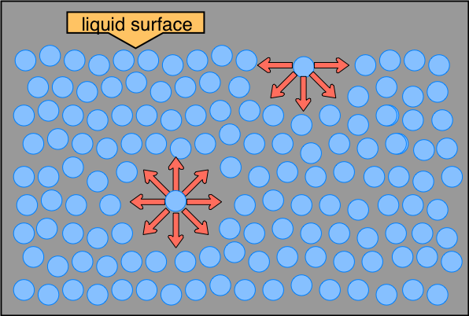
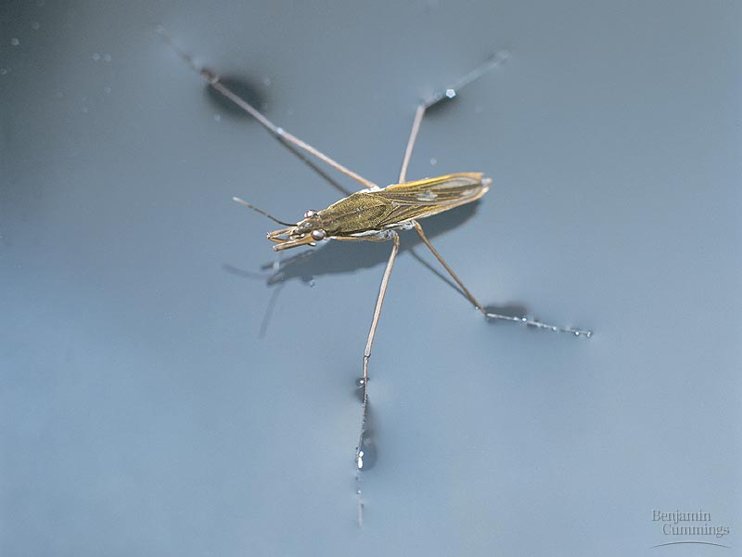
Strong cohesion between water molecules Biological Importance: surface tension where water meets air
Allows small organisms to move and live on water. Pond Skater http://www.bbc.co.uk/programmes/p00gwm9h
27

Slide 28
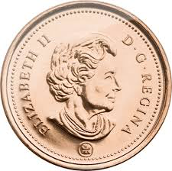
Observing Cohesion
How many drops of water can be held on a penny?
28

Slide 29
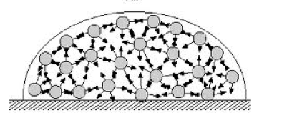
Observing Cohesion
Why is a dome shape formed?
Attractive cohesive forces hold the molecules together. The cohesive forces result from H bonding.
https://www.youtube.com/watch?v=bxS8z0uH47Q
Cool surface cohesion trick!
29

Slide 30
Water is a good THERMAL INSULATOR
Not on spec, but important
What do we mean by a ‘thermal insulator’?
Why does ice float on water?
At what temperature is the density of water at its maximum?
30

Slide 31
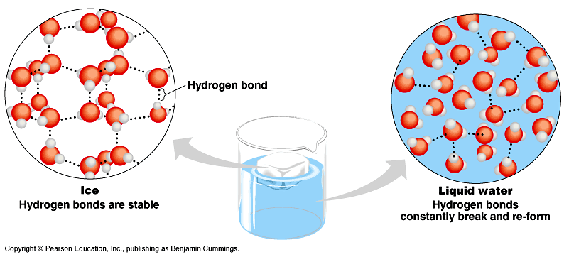
When water freezes, each molecule forms hydrogen bonds with four others. This creates a lattice that holds the molecules further apart than in liquid
The molecules are held apart
meaning that their density is low
The molecules are closer together, their
density is higher
31

Slide 32
Consolidation
Make a table with the properties of water on one side
And the biological significance of the properties on the other side.
Complete consolidation work sheet

