Slide 1
AS/A-LEVEL BIOLOGY 3.1.8 Inorganic ions presentation
To be used alongside AQA AS/A-level Biology inorganic ions teaching notes
Version 1.0

Slide 2
Specification
Know that inorganic ions occur in solution in the cytoplasm and body fluids of organisms. Some in high concentrations, some in very low concentrations
Understand that each type of Ion has a specific role, depending on it’s properties
Be able to recognise the role of ions in the following topics: Iron as a component of haemoglobin, Hydrogen ions and pH, sodium ions in the co transport of glucose and amino acids, phosphate ions as components of DNA and ATP

Slide 3
Atoms
All matter is made up of atoms
Each atom is made of three types of particle:
neutrons, with no charge
protons, with a positive charge
electrons with a negative charge
The neutrons and protons form the nucleus
The electrons orbit around the nucleus
In an atom, the number of protons is the same as the number of electrons (so no overall charge)
Version 1.0

Slide 4
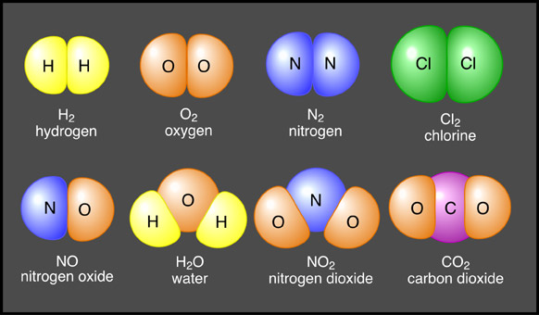
What can you remember?
Which are elements, which are compounds, which are molecules? How do you know which are molecules?
Notes:
All molecules as molecule is smallest physical unit of a compound and either made of two joined elements which are the same or different. Bottom line –compound-consistes of 2 or more different elements combined in a fixed ratio. A compound has characteristics that are different from those elements. An elemnet is a substance that can not be broken down into another substance-none are elements

Slide 5
Biological Balderdash
Term | Definition
Atom | Smallest component of an element, consisting of protons, electrons and neutrons.
Molecule | The smallest physical unit of a compound and made of two or more atoms joined together chemically. Molecules may contain atoms of the same element joined together or atoms of different elements chemically joined together.
Element | One of a class of substances which cannot be separated into simpler substances by chemical means,
Compound | A pure substance composed of two or more elements whose composition is constant.
Organic compounds | Compounds that contain carbon (in large amounts and forming macromolecules) and which are produced within living organisms.
Inorganic Compounds | Smaller molecules which may not contain carbon and if they do , it is not in large proportions.
Work in a group of 3
Notes:
What is the difference between a compound and a molecule?
A molecule is formed when two or more atoms join together chemically. A compound is a molecule that contains at least two different elements. All compounds are molecules but not all molecules are compounds.
Molecular hydrogen (H₂), molecular oxygen (O₂) and molecular nitrogen (N₂) are not compounds because each is composed of a single element. Water (H₂O), carbon dioxide (CO₂) and methane (CH₄) are compounds because each is made from more than one element. The smallest bit of each of these substances would be referred to as a molecule. For example, a single molecule of molecular hydrogen is made from two atoms of hydrogen while a single molecule of water is made from two atoms of hydrogen and one atom of oxygen.

Slide 6
Chemical reactions BFY 9
When elements react, their atoms join with other atoms to form compounds.
This involves giving, taking or sharing electrons to form ions or molecules
What names do we give to the resultant attachments?

Slide 7
Atoms combine by
Sharing electrons – covalent bonds (between non-metals only)
Gaining or losing electrons – ionic bonds (between metal and non-metal
Aim: to be like the noble gases, with a full outer shell

Slide 8
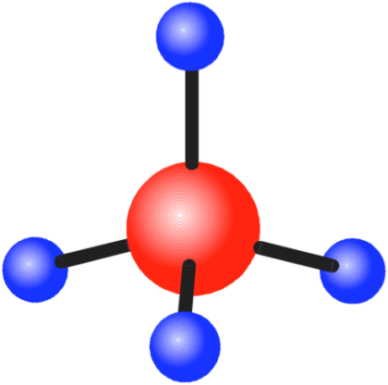
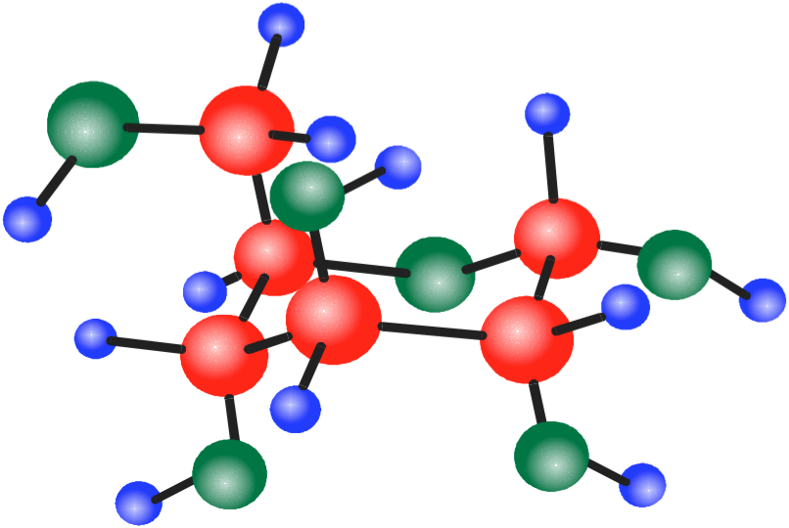
Compounds
07/17/11
Methane
Sodium chloride (salt)
Glucose
Ionic or covalent?

Slide 9
Ionic bonding
https://www.youtube.com/watch?v=WWc3k2723IM

Slide 10
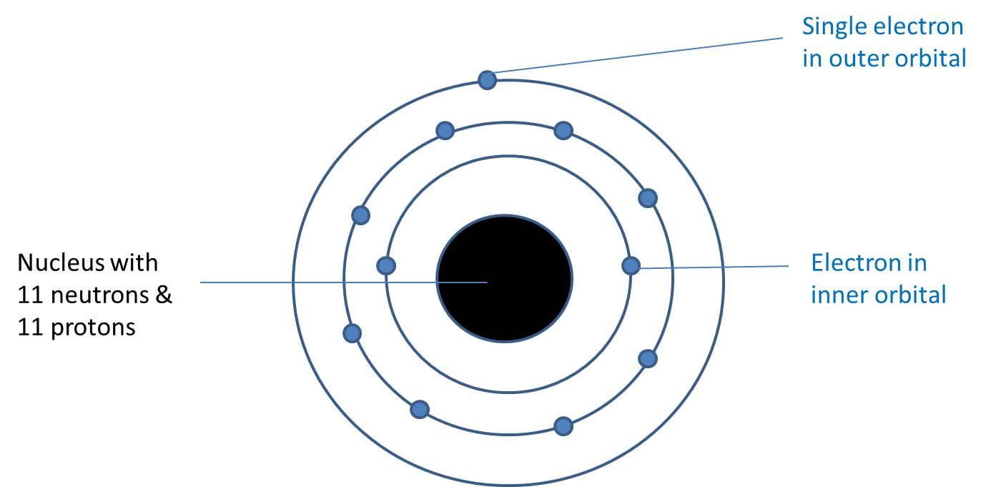
A sodium atom

Slide 11
Stability of atoms
Each atom has one or more orbitals of electrons
Atoms are more stable if their outer orbital is full
Stability is achieved by either gaining or losing electrons from the outer orbital
Version 1.0

Slide 12
A sodium ion is formed when a sodium atom loses the electron from its outer orbital

Slide 13
Ions are formed when an atom gains, or loses, electrons
If an atom loses one or more electrons, it becomes a positively charged ion
If an atom gains one or more electrons, it becomes a negatively charged ion
If placed in an electric field, ions will migrate to the electrode with the opposite charge
Negatively charged ions migrate to the positive electrode (anode), so are called anions
Positively charged ions migrate to the negatively charged electrode (cathode), so are called cations

Slide 14
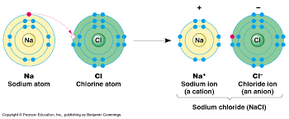
Representing ions
A sodium ion still has 11 protons but having lost one electron it only has 10 electrons, ie it has a positive charge
Na (atom) – 1 electron = Na⁺ (sodium ion)
Some atoms gain electrons
If a chlorine atom gains one electron it becomes a negatively charged chloride ion
Cl (atom) + 1 electron = Cl– (chloride ion)

Slide 15
What is the formula of the following ions?
Sodium
Calcium
Chloride
Iron
Hydrogen

Slide 16
Some ions are complex-Polyatomic ions
They contain more than one atom, eg,
Nitrate (NO₃–)
phosphate (PO₄^{3–})
Carbonate
Nitrite (NO₂–)
Ammonium (NH⁴⁺⁾
Hydroxide (OH⁻)
https://www.youtube.com/watch?v=MJZeZvDxcx8

Slide 17
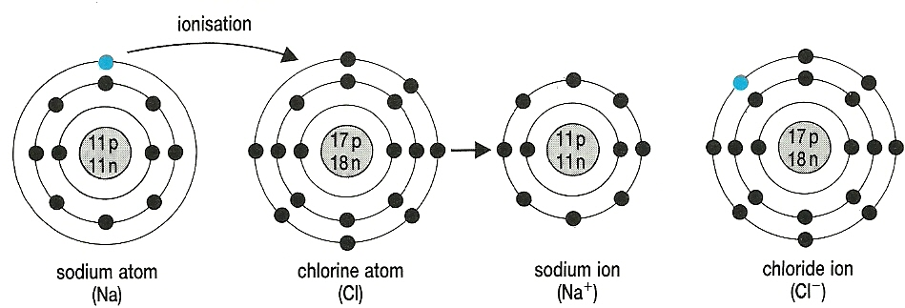
A cation and anion can share electrons
When they do, their opposite charges attract each other forming an ionic bond

Slide 18
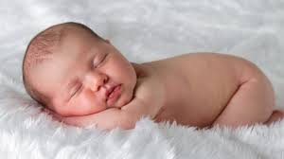
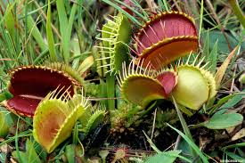
What are the main elements that make up living organisms?

Slide 19
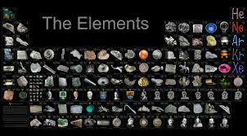
Elements
92 elements in the periodic table (occur in nature)
Humans need 25
Plants need 17
96% of all living matter made up of just 4 elements Carbon, Hydrogen, Oxygen and Nitrogen
Remaining 4% is made up of the other 21 elements.
Known as Macronutrients-required in small amounts eg Fe
Micronutrients-required in v. small quantities eg copper or zinc
Notes:
Trace amounts-talk about copper deficiency-usually from malabsorption-gastric bypass surgery-found in legumes and cereal and zinc-found in a lot of enzymes which then can not work-various -lack of iron anaemic

Slide 21
Organic Molecules
Contain many C atoms as well as H and O.
Are large molecules - MACROMOLECULES
Produced only by living organisms so are found only in:
- Living organisms themselves
- Products of living organisms’ death and decay eg oil

Slide 22
Organic molecules
Carbohydrates
Proteins
Lipids
Nucleic acids (DNA and RNA)

Slide 23
Inorganic molecules
Smaller molecules, which if carbon is present, it is not arranged in long chains and not in such large proportions. Eg CO₂, and CO
May be found inside living things and in non living situations.
Many are needed by living organisms in the form of ions (mineral ions)

Slide 24
Macronutrients and Micronutrients
These are inorganic ions that play important roles in cell metabolism.
Macronutrients are needed in SMALL amounts.
Eg Na⁺, Fe²⁺, H⁺, PO4³⁻, Ca²⁺, K+, Mg²⁺, Cl-, SO4²⁻
Micronutrients are needed in TINY (trace) amounts.
Eg Cu²⁺, Zn²⁺
You must know these ones and what their roles are
Notes:
Pause here and get ideas from pupils what these are used for before next slide with completed table on it. Ca2+ most abundant cation 1.5% total body weight-bones and teeth, Na+ ions found in extracellular fluid-eefect transport of water by osmosis Mg”+muscle/nerve/coenzymes

Slide 26
Inorganic Element/Ion/Molecule | Role
Iron Fe ²⁺ | A constituent of haemoglobin in blood
Phosphate PO4³⁻ | Found in plasma membrane, nucleic acids and ATP
Hydrogen, H⁺ | Maintains pH
Sodium, Na⁺ | Co Transport of amino acids and glucose
Notes:
Draw this table

