Slide 1
Homegroup JD/Unicef UK activity
For Unit 1, we’re going to be learning about two very different organisations, the for-profit company, JD Sports and the not-for-profit charity, Unicef UK
Have a look at the next 5 slides and write down your answers.
Save your work in this file in a folder called Business Unit 1 Assignment A – you’ll need it when we start Unit 1 next week

Slide 2
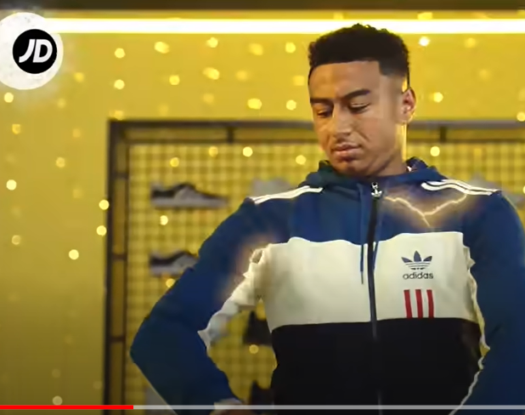
Watch JD’s ad from last Christmas (click the link below) Write down 3 words come to your mind about JD when you watch it?
https://www.youtube.com/watch?v=DR-Bj_UIFH8

Slide 3
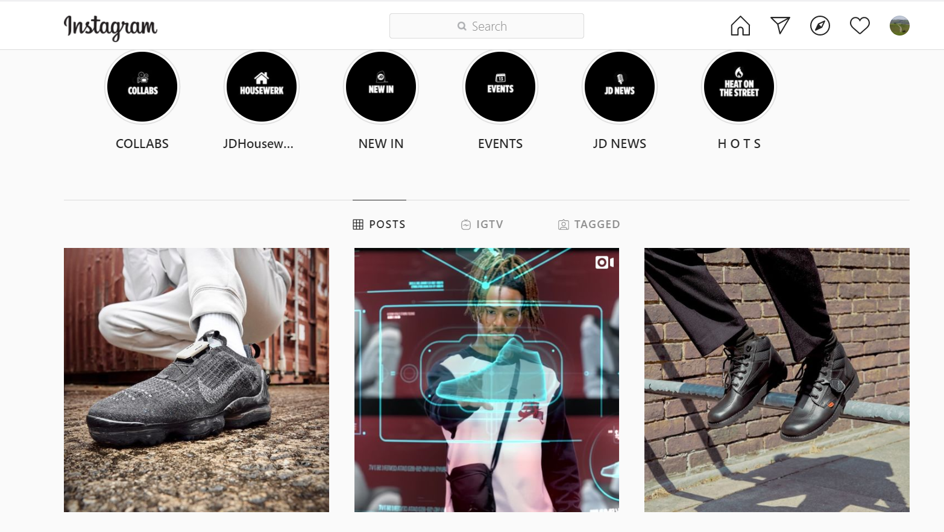
Have a look at JD on Instagram Write down how many followers they have How old do you think their average customer is?

Slide 4
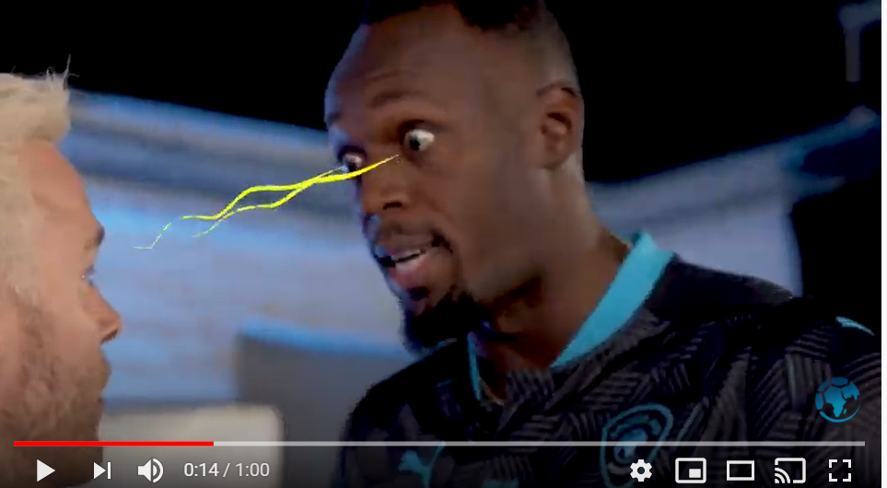
Watch this promo film for Unicef UK’s ITV football telethon Soccer Aid
Write down 3 words that come to mind about Unicef UK when you watch it?
Notice JD’s logo – what’s their relationship to Unicef UK?
https://www.youtube.com/watch?v=NqtWm3d4354

Slide 5
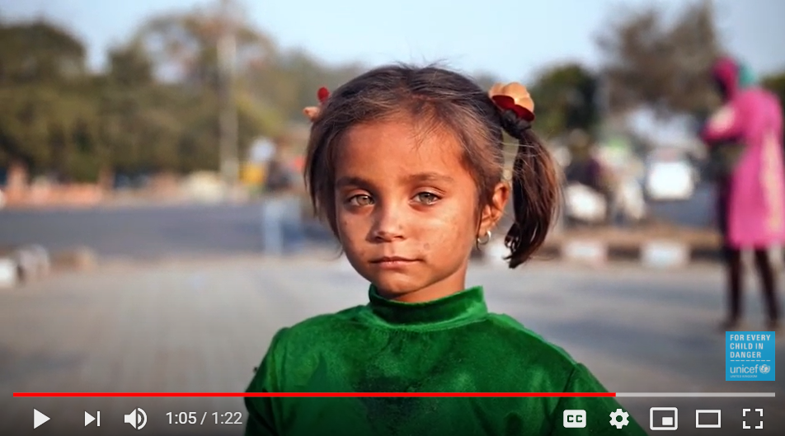
Watch this film about Unicef – write down what the organization exists to do
https://www.youtube.com/watch?v=MMlijiK-nEo
Unicef’s purpose is to…

Slide 6
Have a look at Unicef UK on Instagram Write down how many followers they have How old do you think the average person who gives to Unicef UK is?

