Slide 1
Welcome to First Award in Business My name is Ilse Howling You’ll also be taught by Sofia Neves De Abreu or Ellen Bateman

Slide 2
What we’ll do today
1. Welcome and hello
2. About the course
3. 1st practical skills – uploading onto Godalming Online
4. Quiz

Slide 3
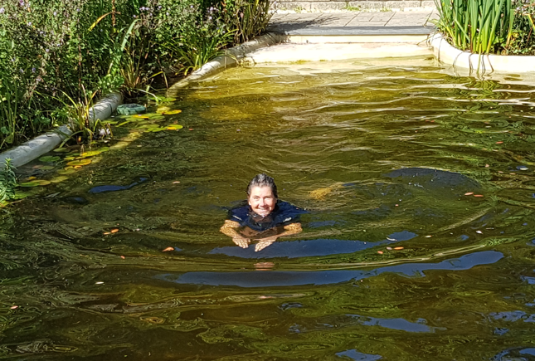

Slide 5
In pairs/solo 10 mins…
Say hello to the person next to you. Find out about them and be ready to introduce them to us
Find out:
What school they went to
Something they like (favourite artist, a sport they play, a team they support)
Something they don’t like
Their best bit of Summer
Keep a note/remember what they said, ready to introduce them to the rest of us in a few minutes time

Slide 6
How do you do your best work?
Focus? Music? Headphones? Movement? Deadline? Talking/listening? Playful, confident
Know it matters/someone gives a damn, fear? Shouting/ (commitment)

Slide 7
About the course:
4 Units
This term
Unit 1- Introducing Business (Ilse) Unit 2 – Finance for Business (Sofia/Ellen)
Next term
Unit 3 – Enterprise in the Business World (Sofia/Ellen)
Unit 4 – Promoting a Brand (Ilse)

Slide 8
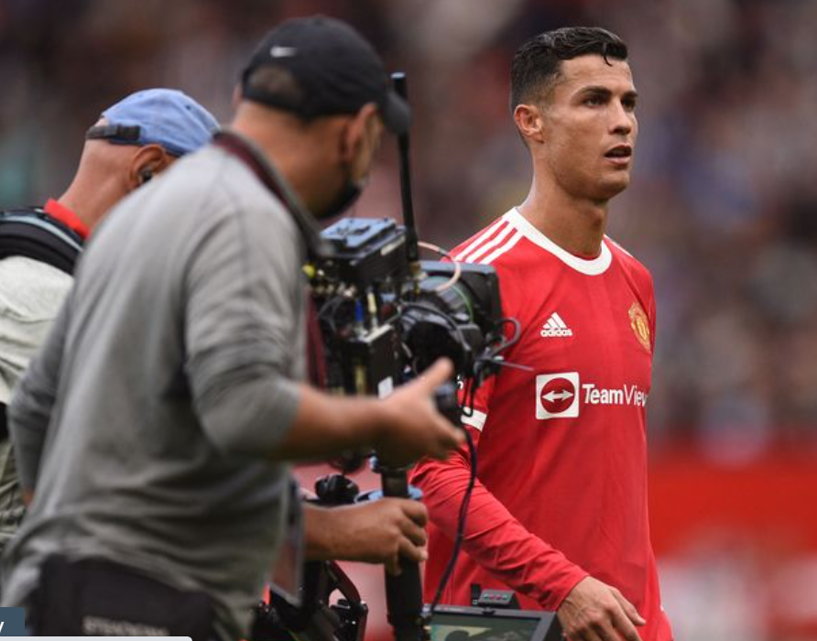
What is a business?
https://www.mirror.co.uk/sport/football/news/ronaldo-transfer-man-utd-shares-24857507

Slide 9
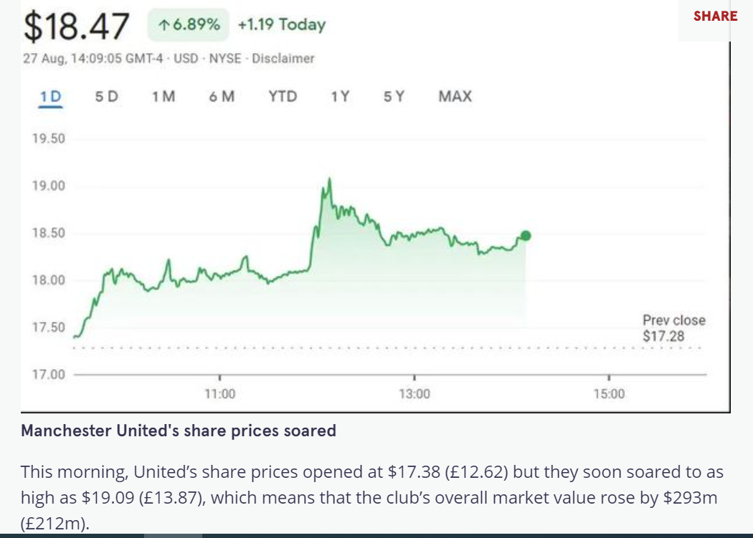

Slide 10
What is business?
A business is defined as an organization or enterprising entity engaged in commercial, industrial, or professional activities. Businesses can be for-profit entities or they can be non-profit organizations that operate to fulfill a charitable mission or further a social cause.
Source: Investopedia https://www.investopedia.com/terms/b/business.asp
Anyone run a business? (you, family, friends?) Large, small, new, old, p/nfp, UK?, sector?
What do all have in common? (customers, goals, measure success)

Slide 11
Unit 1 Introducing Business
You will:
Explore different types of business – for-profit and not-for-profit See what businesses are trying to achieve
Discover how important it is for a business to know their customers – and how they do market research
Know how to create a marketing mix

Slide 12
How your work’s assessed
Units 1, 3 and 4 are internally assessed on the basis of COURSEWORK
Unit 2 – Finance for Business – is externally assessed using an onscreen test. The Examination Board – Edexcel – sets and marks the test. Most likely the exam will be in December 2020.

Slide 13
What is Coursework?
What coursework means is that all the work you do is examined – but you do it as you go along – in class and as homework - not under pressure of a timed exam at the end.
For business, your work divides into three assignments and each one has a deadline which you must meet (missing a deadline is like missing an exam – and you’d have to leave the course)
You’ll get your marked assignment back 10 days after the deadline. I’ll give you feedback on the work and, if it’s good enough, you’ll have a chance to make improvements for a final submission
If you are going to be absent on the hand in date you must negotiate the hand in with your teacher in advance.
If you are absent for a valid reason on the day you will need to negotiate handing in with your teacher (usually on the first day back)
Handing your work in on time matters. Refer to your Student Handbook on Godalming Online for the full departmental hand-in policy.

Slide 14
How the marking works - All assignments start off with Pass (P) questions, then Merit (M) questions and Distinction(D) questions. To achieve each level, you must also have achieved the previous level
To come back here next year… ☺
Pass
Basic standard
Merit
GCSE standard
Distinction
Great work

Slide 15
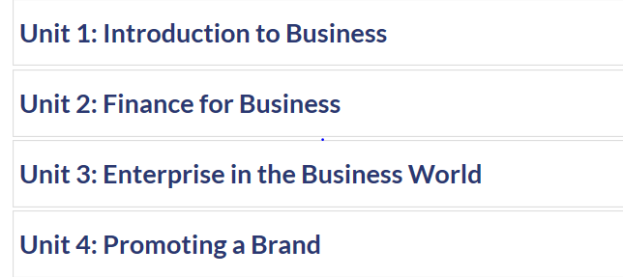
Now for something practical
Know how to save your work – then you’ll never lose it
Access it anytime – in college or at home
Sit at a computer, log-on and in your own work area create a folder called Business, inside it, create four sub folders like this:

Slide 16
Business Quiz and Upload

Slide 17
Today Tips to help your work be brilliant: - Save your work: find your business folder - Research - Working with side by side screens - Quoting sources - Using snip to drop in pictures (I love pictures ☺) Beginning Unit 1 Introducing a Business Complete P1/M1 and upload by end of class on Weds 23 September

Slide 18
Top Tips for Doing Well
Use the files on Godalming Online and add to it with your own internet research using reliable sources
Write about brands and companies you’re interested in (from the recommended choice)
Upload your work on GOL at the end of every lesson
Now answer the Course quiz – download from GOL
Fill in the answers, save your work in a file called
“Business Course Quiz” and upload your answers in the
upload area called Course Quiz Upload

Slide 19
How do you do research?
Google, not Bing; annual reports, newspapers, Wikipedia, youtube, analysts, BBC bitesize, Snap, Insta, Twitter, Glassdoor, LinkedIn

Slide 20
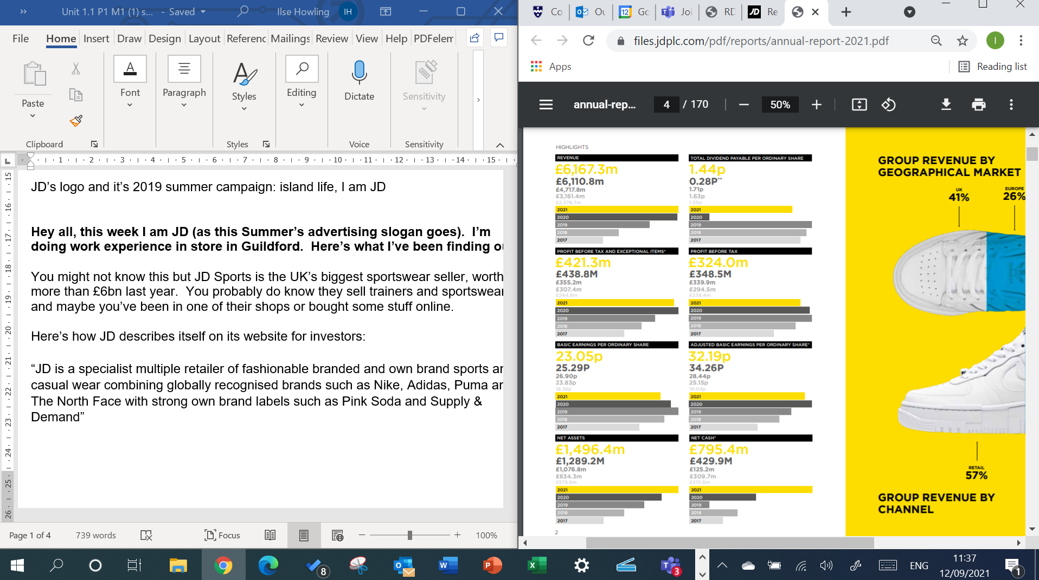
Work with your screens side-by-side Here, I’m working on the left screen, using facts from JD Sports’ Annual Report on the right screen

Slide 21
What is plagiarism?

Slide 22
How not to plagiarise – give the source for where your ideas came from
Include sources for every piece of work you submit – for example:
Sources
BBC News: How JD Sports became a £5bn company - https://www.bbc.co.uk/news/business-45482460

Slide 23
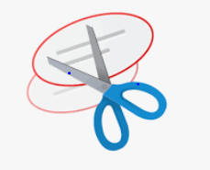
What’s this?

Slide 24
How not to plagiarise – give the source for where your ideas came from
Include sources for every piece of work you submit – for example:
Sources
BBC News: How JD Sports became a £5bn company - https://www.bbc.co.uk/news/business-45482460

