Slide 1
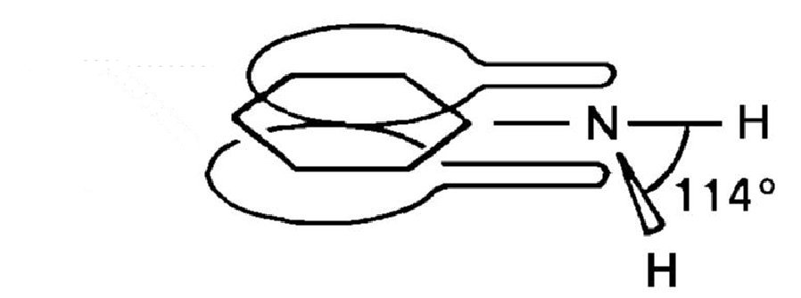
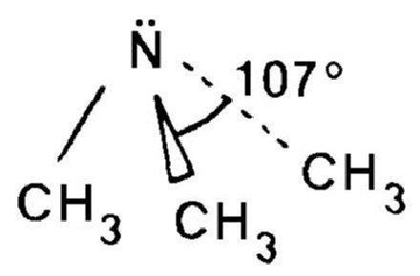
Amines and amides
extended π system
in phenylamine
localized
lone pair
in trimethylamine

Slide 2
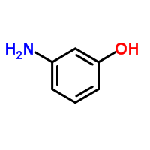
Naming a physical properties – page 1
Naming amines and physical properties - http://www.chemguide.co.uk/organicprops/amines/background.html#top
If the NH₂ group is in the middle of a chain the prefix ‘amino’ is used:
Eg 3-aminophenol

Slide 3
Pages 2-4 in class experiment

Slide 4
Basic properties of the amine – page 5
Video https://www.youtube.com/watch?v=FDuo9spEpys
Read http://www.chemguide.co.uk/organicprops/amines/base.html#top
Alkyl groups push electrons towards the N better than H (remember carbocation stability).
Base strength increases
3^{y} > 2^{y} > 1^{y} > NH₃

Slide 5
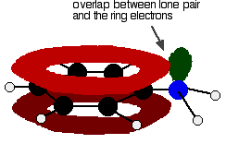
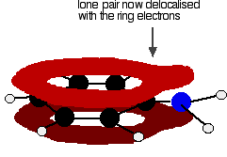
Basic properties of the amine – page 5
In aromatic amines, the N lone pair is partially delocalised into the benzene ring, lowering the base strength.
3^{y} > 2^{y} > 1^{y} > NH₃ > aromatic

Slide 6
Preparation of amines – page 6
http://www.chemguide.co.uk/organicprops/amines/preparation.html#top
With a halogenoalkane and ammonia:
With excess ammonia the amine and NH₄Cl is formed.
With little ammonia the amine salt is formed (to make the amine add NaOH_{(aq)}).
With excess halogenoalkane secondary, and tertiary amines are formed.

Slide 7
Mechanisms - page 7
Lone pair on N can attack δ+ C of haloalkane.
-
+
X
C
X
C
NH₂
H
NH₃
NH₃
C
NH₂
-
NH₄⁺X

Slide 8
Making amines from nitrile – page 7
Reduction of nitrile compounds

Slide 9
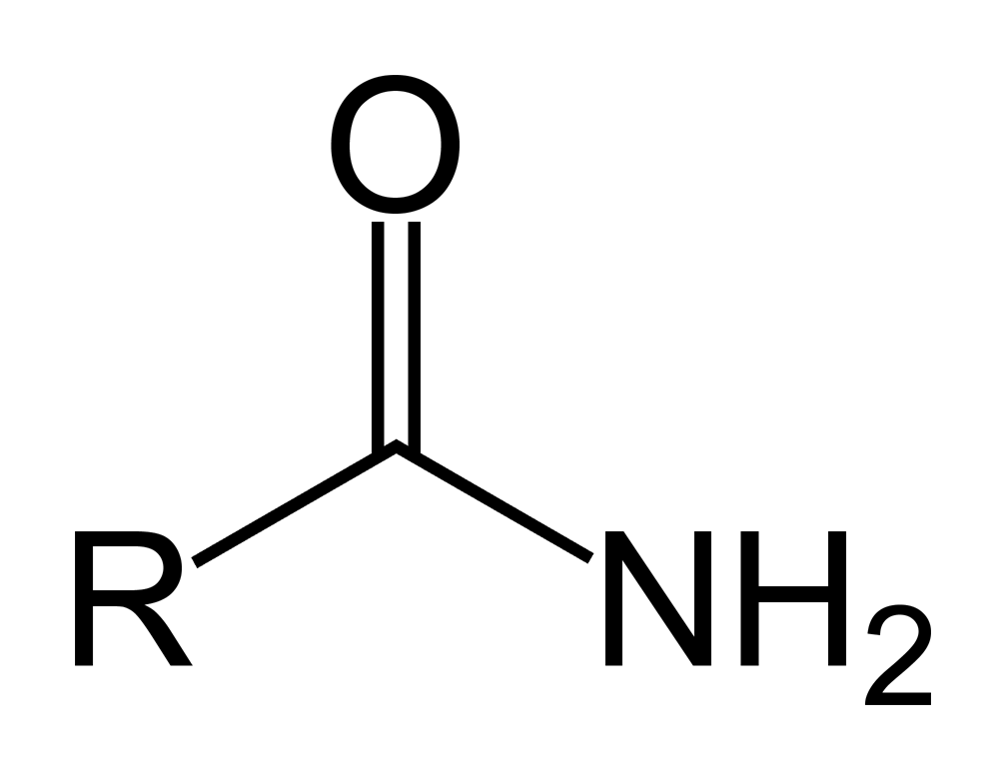
Amides – page 9
Naming video https://www.youtube.com/watch?v=2Zrw14UyVas
Physical properties http://www.chemguide.co.uk/organicprops/amides/background.html#top

Slide 10
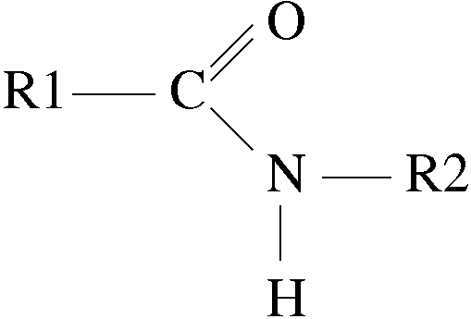
Amides – page 9
Alkanamide
N-Alkylalkanamide

Slide 11
Preparation of amides – page 10
Preparation
http://www.chemguide.co.uk/organicprops/amides/preparation.html#top
Video on mechanism (2.30min onwards)
https://www.youtube.com/watch?v=gMKtGulgGH8

