Slide 1
Script Layout and Formatting
Notes:
1

Slide 2
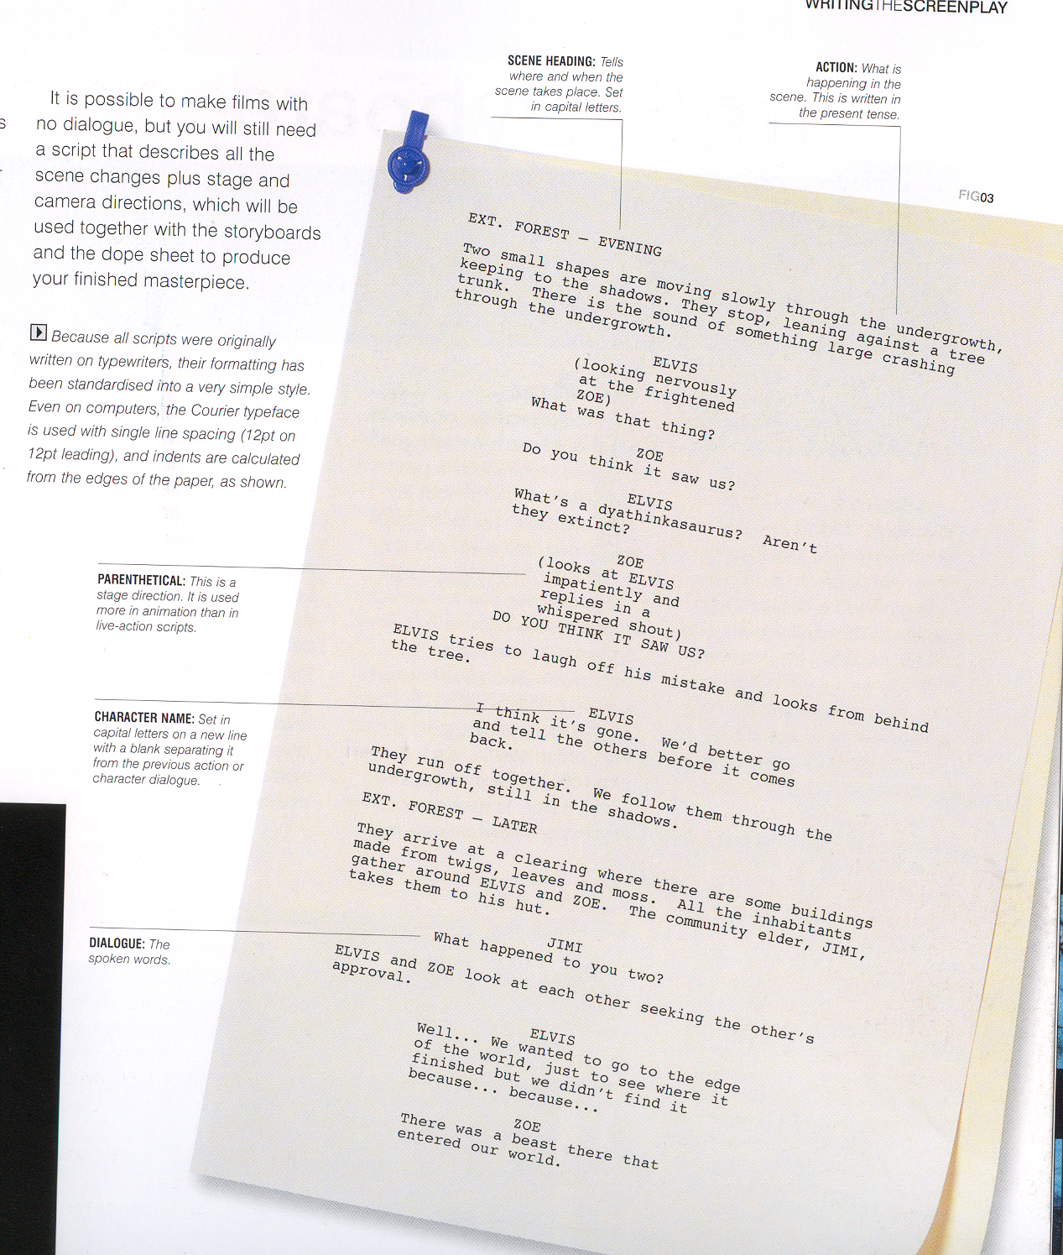

Slide 3
Slug Line
Day
Night or
Morning/Afternoon
etc.
Brief description of location
EXT. EDGE OF PLAYGROUND – DAY
We are at the edge of an empty school playing field, presumably after school.
INT. or EXT.

Slide 4
Stage Directions
Always in CAPS
Costume
Characters age
We are at the edge of an empty school playing field, presumably after school. Next to a chainlink fence is NICK, a scowling 10-year-old boy, who wears a school uniform. He appears to have wooden legs. From his hinged knees are some protruding strings leading to traditional crosses of wood, similar to those found on marionettes. These crosses and strings have been tangled around the fence and NICK is stuck. Every so often a ball flies into frame, hitting the fence perilously close to NICK. We soon see who is kicking the ball. It is ROB, also 10, dressed in the same school uniform. He wears Reebok Classics with foil spurs, a large cowboy hat and is looking down, so the brim hides his face.
Stage directions always in italics

Slide 5
Dialogue
Characters name, centred alignment
NICK
(O.S.)
His name’s Rob Forrest. It’s nothing I can’t handle.
THERAPIST
(A little hurt)
I appreciate your honesty.
Dialogue,
align left –
tabbed x3
Parenthesis

Slide 6
You may need to add ‘technical information’ to your script.
You will need to ‘align right’ for technical information.

Slide 7
Camera info
ECU of Nick.
Editing info
Cut to:

Slide 8
Remember to…
Always use ‘courier new’ pt12 font.
Be clear on what is:
Slug line(s)
Stage directions
Dialogue
Technical Information
Be expressive and creative in your writing.
How often do you get a chance to write a story for the screen?

