Slide 1
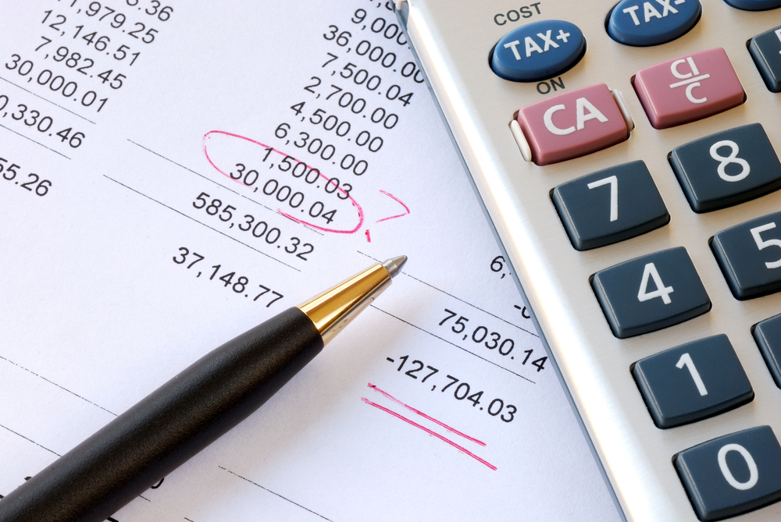
Profit and Loss Account or Income Statement

Slide 2
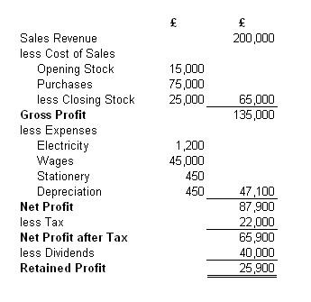
What does it look like?
Notes:
Students to familiarise themselves with structure...
Questioning:
Explain costs of sales?
Difference between gross profit and net profit?

Slide 3
Learning Objectives
Explain the main components of a trading, profit and loss account and the way it is constructed
Calculate gross profit and net profit
Evaluate ways in which a business could improve its profit

Slide 4
What is it?
A profit and loss account is a statement that shows the income the business has received from its trading activities.
It also shows all the money the business has spent performing these business activities.
Profit is made when sales are greater than costs
Loss is when costs are greater than sales
Making a profit is a key business objective
Notes:
Because looking back over the last 12 months PandL statements are said to give a historic view.

Slide 5
Why use it?
It can measure the success of a business compared with previous years or other business
The calculation of profit can assess the actual performance of the business compared with expectations
It can help in obtaining loans or finance from banks or other lending institutions (creditors would want some proof that the business was capable of repaying any loans)
It enables the owners and managers of a business to plan ahead, for example for future investment in the company

Slide 6
Who wants to know?
A profit and loss account has to be prepared following a number of accounting conventions and is regulated by law. It is also audited by external accountants.
Stakeholder groups want to know how the business has performed during a given period, which is usually one year.
Because of these safeguards to ensure accuracy and truthfulness external stakeholders regard it as a key document in assessing the performance of a business.
Users include:
Shareholders are an obvious example of those assessing profitability
Government agencies such as the HMRC require data on profits or losses to be able to calculate the tax liability of an organisation
Suppliers to a business also need to know the financial position of companies they trade with in a order to establish their reliability, stability and creditworthiness

Slide 7
Cost of sales: Direct costs (raw materials)
Opening stock: The stock the business had at the start of the year.
Trading Account: tells us what the sales of the company have been and the direct costs of making those sales
Purchases made throughout the year.
Profit and Loss Account: Once gross profit is calculated, a business can then calculate how much profit or loss it has made by adding extra income or subtracting its expenses.
Closing stock is stock left over at the end of the year. We always take away closing stock as it has not yet been sold or used so it is not part of costs of sales
Profit and Loss Appropriation Account: This shows how the company’s profit or loss is distributed

Slide 8
Gross Profit
Is an indicator of how efficient the firm is at managing its cost of sales.
It is the difference between sales revenue and the cost of making or purchasing the goods sold
Gross profit = sales revenue – cost of goods sold
The examiner expects you to know:
What gross profit measures
How to calculate gross profit

Slide 9
Net Profit (operating profit)
Often referred to as the bottom line. It tells us the actual profits of the business after ALL costs have been paid.
After calculating gross profit you then remove all other expenses and overheads. This results in net profit.
Net profit = gross profit – (expenses + overheads)
Net profit is an indicator of how efficient a firm is overall at managing ALL of its costs.
Watch the ‘what is profit’ video on GoL

Slide 10
Activities
Read the Chapter 11 handout, highlighting key points.
Complete the ‘Profit and Loss’ worksheet.
20 minutes

Slide 11
Profit Quality
Is the profit “high quality” or “low quality”?.
A high quality profit is one which can be repeated or sustained.
A low quality profit is one which it is difficult to repeat. The profit is likely to benefit from one or more “exceptional items” which will not repeat.

Slide 12
Profit Quality
Exceptional items include:
One-off profits on selling major items of property, plant and equipment (e.g. selling a piece of land)
Income from a significant insurance claim
(Items are those which are material, resulting from events or transactions within a business’s ordinary activities).
Extraordinary items include:
One-off costs such as the costs associated with shutting down a factory.
Cost of management restructuring.
(Items which are material, possess a high degree of abnormality, are not expected to recur and are resulting from events or transactions outside of the ordinary activities of a business).

Slide 13
How might a business improve profit?
Raising prices? (PED, YED, downside?)
Selling more items (Capacity utilisation? Possible? Desirable?)
Reducing costs? (Better use of resources? Cheaper resources?)

Slide 14
Activities
Log on to GoL and work your way through the Profit and Loss activities
Go to COMP 2 / FINANCE / INCOME STATEMENTS
30 minutes

Slide 15
Plenary
'A profitable business should always pay a high dividend to its shareholders.'
Discuss this statement with the person sitting next to you.
What are the reasons for and against paying high dividends?
Notes:
In pairs, reasons for statement / reasons against. What would their conclusion be?

