Slide 1
Learning Objectives
Define the purpose and uses of the product life cycle
Describe what happens to cash flow at different stages of the life cycle
Explain the limitations of the product life cycle

Slide 2
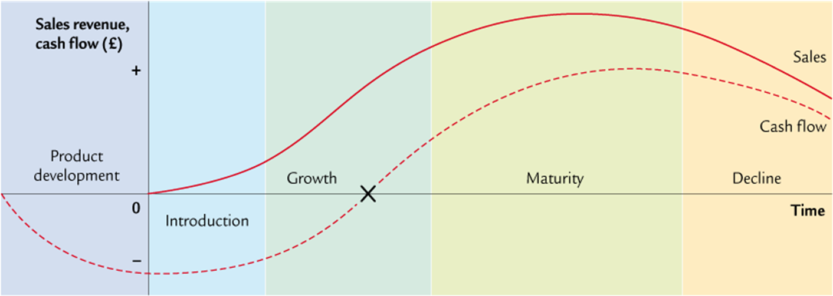
Product Life Cycle – Stages
Notes:
Starter

Slide 3
Uses of the product life cycle
Illustrates the trends in revenue that a product may generate for the business.
Identify points to consider launching new products.
Identify when extension strategies need to be introduced.
Identify where spending may be required (e.g. R&D, advertising etc.
Identify when a product should no longer be sold.

Slide 4
Uses of the product life cycle
To forecast future behaviour of sales.
Indication of profitability of a product at each stage of its cycle.
To be a tool of analysis to assist in the formulation of marketing strategies.
As a device to achieve the aims of the business, i.e. manipulate the product marketing.
To help a business manage its product portfolio.

Slide 5
Limitations of the product life cycle
May not be effective in predicting future sales of a product.
Backwards-looking / self-fulfilling
The PLC model should not determine decisions about products

Slide 6
Extending the Product Life Cycle
Consider any / all of the following: Change price. Change promotion. Change product – restyle. Change distribution – online. Develop ne market segments. Find new uses for the product. Re-position the product.
Product culls: Elimination of the non-profitable products that have no other use (e.g. key customer requires them). Weak products take management time and may be create negative cash flow.
Product Life Cycle is short if: The rate of technological change is rapid. There is a high degree of innovation in the market. Customers’ tastes are changing rapidly. The product is a fashion item. The product is badly marketed.

Slide 7
Cash Flow and the Product Life Cycle
Developing new products is expensive, even existing products have costs attached, such as advertising or distribution.
All of these costs affect cash flow and for most products we can estimate cash flow against different stages of the product life cycle

Slide 8
Cash Flow and the Product Life Cycle
R&D is expensive – cash flow is likely to be negative before product launch.
Introduction: cash flowing out of the business is likely to still be greater than cash flowing in.
Growth: Eventually revenue will be greater than spending and cash flow may become positive.
Maturity: Cash flow should be at its highest.
Decline: Sales decline therefore cash flow does also.

Slide 9
Activity
Use the notes on GoL to identify
How a business uses the PLC
The limitations of the PLC
Research into two large different companies that have a range of products at different stages of the life cycle eg Unilever (www.unilever.co.uk)
AGBarr (www.agbarr.co.uk)
Draw two life cycles and plot a range of products at different stages of the life cycle
Notes:
http://www.tutor2u.net/business/quizzes/gcse/productlifecycle/quiz.html

Slide 10
Plenary
Read the Burton’s biscuits case study.
With the person next to you, discuss each question and the points you would make for each question.
Write your joint answers on the A3 sheet (use different colours to highlight different AOs)

