Slide 1
Comp 2: Promotion
With the person you are sat next to, compile a list of all of the different methods of promotion you see on a daily basis

Slide 2
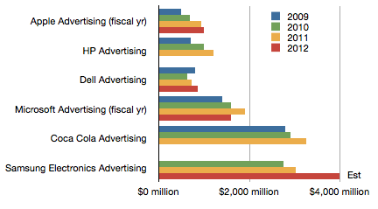

Slide 3
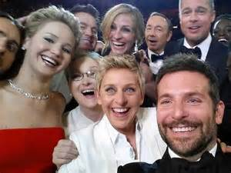
DeGeneres: Meryl, here’s my idea … I’m going to take a picture of us, and we’ll see if we can break the record for the most retweets”
What followed, for what it’s worth, made Twitter history.

Slide 4
Spontaneous?
The world’s most-retweeted post wasn’t 100% spontaneous.
It was a carefully planned multimillion-dollar business arrangement that served the mutual interests of Samsung, ABS network, Twitter and the biggest stars in Hollywood, for whom TV face-time is money.

Slide 5
The cost?
Samsung paid ABC roughly $18 million for 5 minutes worth of prime-time ads plus unspecified amount for product placement throughout the broadcast to c. 43 million viewers
Samsung also sponsored 10 tweets featuring celebrity “selfies”
Twitter was also paid to promote the selfies through its Twitter Amplify program

Slide 6
Keeping it real?
Quote from the night: “It was a great plug for the Samsung brand…Ellen’s selfie is going to be more impactful than their commercials. You can’t buy that magic of going viral.”
Samsung later issued the following statement: “While we were a sponsor of the Oscars … we were delighted to see Ellen organically incorporate the device into the selfie moment … a great surprise for everyone... In honor of this epic moment … we wanted to make a donation to Ellen’s charities of choice: St Jude’s and the Humane Society [of the United States]. Samsung will donate 1.5 million dollars to each charity.”

Slide 7
Learning Objectives
Explain what is meant by promotion
Explain the difference between above the line and below the line strategies used by businesses to promote their products
Understand how different types of business organisation in different situation will use a range of different promotional strategies
Explain the importance for a business of selecting the most appropriate promotional strategy
Evaluate the impact of selecting the right promotional strategy on a business and its stakeholders

Slide 8
What is promotion?
Promotion is the attempt, through various forms of media, to draw attention to a product and thereby gain and retain customers.
The process of communicating with customers or potential customers
To provide customers with information
To increase sales or market share
To give products an image
To establish a corporate image
To enable long term planning to take place (life cycles)

Slide 9
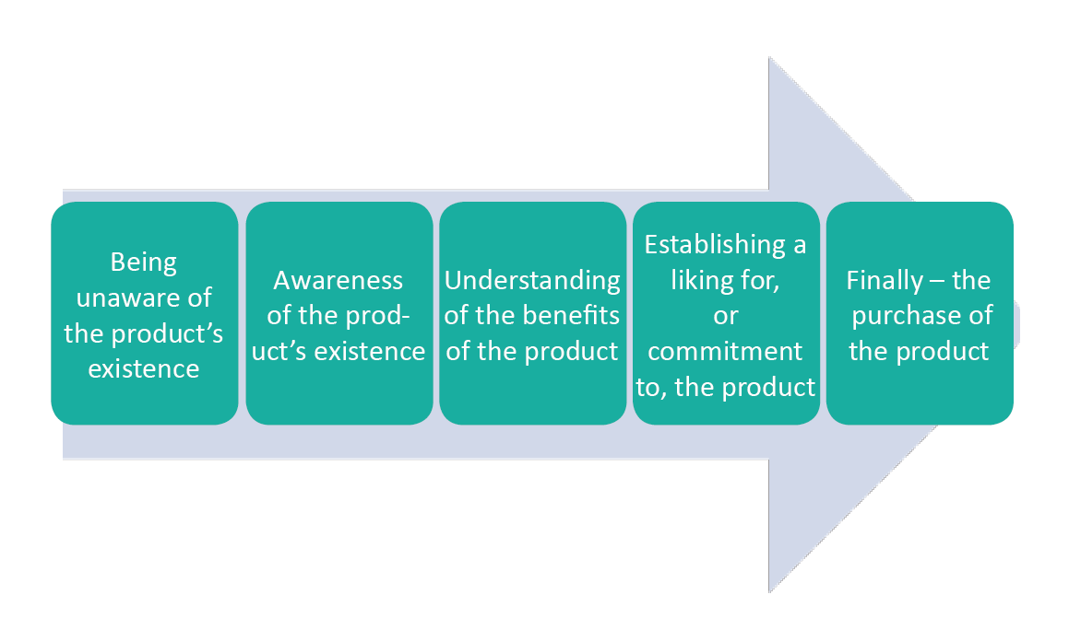
Stages of promotion

Slide 10
Promotion
Above the line
Generally called advertising. Carried out through ependent media which allows a business to reach a mass audience easily
e.g. advertising, TV, Radio, Cinema, Newspapers, Posters
Below the line
Offers a wide range of alternative promotional strategies and these are often used to support above-the-line promotion. Targets consumers directly. Business has direct control over the methods used.
e.g. Public Relations (PR), merchandising, sponsorship, direct marketing, personal selling, competitions

Slide 11
Choice of media? Depends upon…
Above the line
Advertising, TV, Radio, Cinema, Newspapers, Posters
Target market
Cost
The reach of the media
The type of product
The amount of information to be conveyed

Slide 12
Typically used for:
Below the line
Personal selling, packaging, sales promotions, direct mailing, exhibitions and trade fairs, public relations.
Short term promotions (special offers)
B2B promotion
Providing information
Where personal selling is required

Slide 13
Range of promotion methods
Promotion can be altered to appeal to different target markets

Slide 14
Innovative examples of ‘guerrilla marketing’
Guerrilla marketing is an advertising strategy that focuses on low-cost unconventional marketing tactics that yield maximum results.
It is the act of executing an unusual or unexpected marketing activity in a common, everyday place in order to generate a buzz for products or services. The main point of guerrilla marketing is to get your business's name in front of as many people as possible in an unexpected way.
Guerrilla marketing is usually a low or no-cost form of marketing that can reap substantial profits if implemented correctly.
Notes:
http://www.creativeguerrillamarketing.com/what-is-guerrilla-marketing/
http://study.com/academy/lesson/what-is-guerrilla-marketing-definition-strategies-examples.html

Slide 15
Factors impacting on the promotional strategy
Product differentiation
The marketing budget available
The stages in the product life cycle
Cultural sensitivity
The target market
Competitors actions

Slide 18
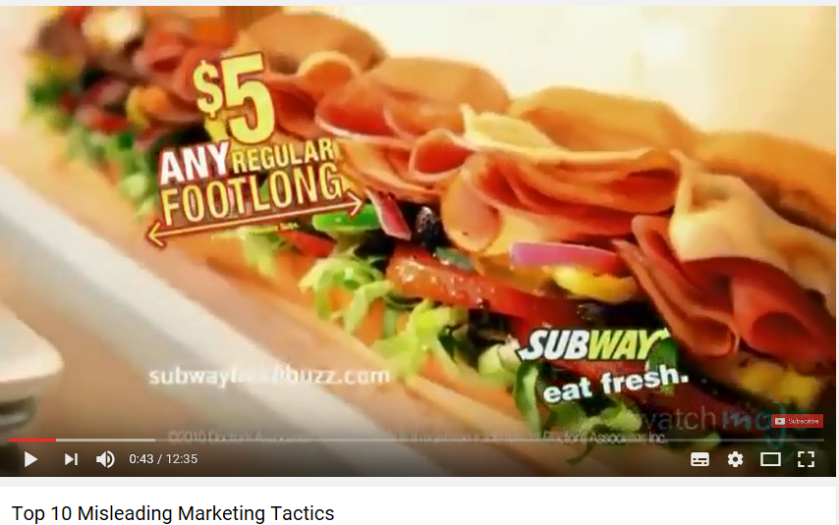
Top 10 misleading marketing techniques

Slide 19
Activities
Use the Promotion notes on GoL and your own research to complete the ‘Promotion Basics’ worksheet
Investigate both a successful and an unsuccessful marketing campaign. Explain what affect the campaigns had on the image of the organisation. Be prepared to share your findings with the group

Slide 20
Plenary
'Promotion is the most important aspect of the marketing mix'. To what extent do you agree with this statement?

Slide 21
Homework
Due Thursday 12th January
Complete the pricing strategies mind map
Definition
When it is used
Why it is used (e.g. profit maximisation, increase markets share, push out competitors etc)
Due Monday 16th January
Complete the ‘Promotion basics’ worksheet
Investigate both a successful and an unsuccessful marketing campaign.
Explain what affect the campaigns had on the image of the organisation.
Write up your findings and bring them to class

