Slide 1
New technology and marketing

Slide 2
Starter Activity
How has new technology changed the way that businesses sell their products/services and how consumers shop?

Slide 3
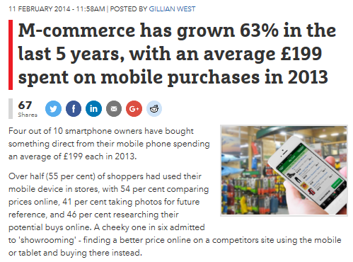
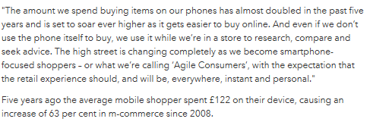

Slide 4
Learning Objectives
Explain how new technology is used in marketing (including the role of digital media, social media, e-tailing and m-commerce)
Explain the impacts of new technology on existing businesses such as high street retailers.
Evaluate the impact of new technology of on the marketing activities of businesses and its stakeholders.

Slide 5
Explain how new technology is used in marketing
Each of the 4 Ps has to change and evolve to meet the demands of this new method (i.e. the internet) of reaching customers.
Clicks and bricks
Social media
M-commerce
E-tailing
Pricing and the internet
Notes:
Students should come up with examples of businesses who use this type of technology

Slide 6
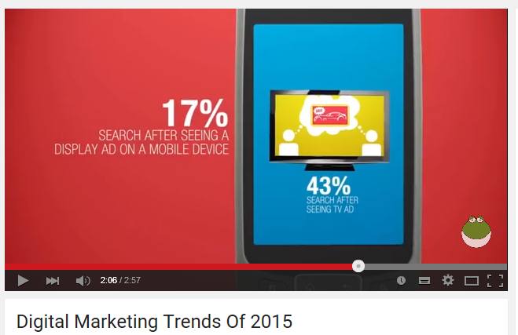
M-commerce / Mobile Marketing
Notes:
https://www.youtube.com/watch?v=l_Ei7CxXwuo

Slide 7
Explain the impacts of new technology on existing businesses such as high street retailers.
With the person next to you, identify the benefits and drawbacks of new technology on a retail fashion business (e.g. Superdry, New Look) or a supermarket
Advantages | Disadvantages
Can reach a global market (even if only a small business) | Fierce competition
Reduce costs by not having to be close to consumers (may close stores or locate stores in cheaper areas) | Dependent on efficient delivery services
Longer opening hours | Costs of ensuring the site is safe for consumers to use and data is protected.

Slide 8
The impact of new technology on the marketing mix
Businesses involved in e-tailing or using new technology need to consider the impact on their marketing mix.
Product | Price | Promotion | Place
USP | Competitive pricing Skimming/penetration | Will revolve around use of the internet (e.g. email alerts, cookies etc) | More choice. There may be no need for the business to close to it’s customers

Slide 9
Activity – Evaluate the impact of new technology on the marketing activities of a business and its stakeholders
Carry out research online to find out what new technology is available to small and large scale businesses to help them market their products and services.
Write up your findings and relate to a specific small / large business.
15 minutes
Choose a business and investigate how new technology helps their marketing effort.
Evaluate the impact(e.g. better targeting, costs savings, greater impact, improved access to potential consumer)
30 minutes
Notes:
In pairs

Slide 10
Plenary
Explain the impact of new technology on the marketing mix

