Slide 1
Decisions about the marketing mix

Slide 2
The marketing mix will differ in different contexts
Local vs national vs global
Perfect competition vs monopolistic competition vs oligopoly
Goods vs services
Niche vs mass markets
B2B vs B2C
Notes:
Discussion point – in pairs - give each a bullet point. Students need to think of a business for each context and identify and explain how their marketing mix will differ and why?

Slide 3
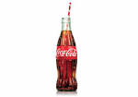
The importance of global marketing and global brands
Brand = name, term, sign, symbol, design or any other feature that allows consumers to identify the goods and services of a business and to differentiate them form those of competitors.
McDonald’s ‘golden arches’; Nike ‘swoosh’; Adidas three stripes; Virgin V; coke bottle

Slide 4
What are the reasons for branding?
CREATE CUSTOMER LOYALTY A barrier to entry for competitors
DIFFERENTIATE THE PRODUCT Gives a clear product identity when there is similarity in design
PRICING FLEXIBILITY Creates price inelastic demand. Customers pay higher prices
TRUST Customers re-purchase because they trust the product
BRAND IMAGE To attract customers through the ‘classic’ or ‘quirky’ positioning

Slide 5
Impact of branding
Notes:
https://www.youtube.com/watch?v=JKIAOZZritk

Slide 6
Why might businesses market their products internationally?
PROFIT: Prices may be higher, costs lower and markets less competitive
SPREAD RISK: Less vulnerable to changes in the economic conditions in one market
EXTEND PRODUCT LIFE CYCLE: Products that maybe in decline in one market can be re-launched in a new one
LEGAL: There maybe fewer restrictions on labour, environmental issues and products such as alcohol, tobacco, pharmaceuticals

Slide 7
Why are global brands considered ‘gold dust’ to a business?
BENEFITS Economies of scale; marketing, operational, managerial, financial
RE-PURCHASE Wherever customers travel the brand can be purchased
E.g. a Big Mac is a Big Mac no matter where you are in the world!

Slide 8
Why is the overseas market different?
POLITICAL Instability can result in investments being ‘written off’, e.g. Zimbabwe, Russia
CULTURAL Understand differences in language, colour, body shape, gender and ‘bribes’
LEGISLATION Differences in product labelling and safety, environment impact, advertising
ECONOMIC GDP, average income, distribution of income, taxation
SOCIAL Demographics, role of women, educational attainment, religion, attitudes
BUSINESS PRACTICE Whether to customise products to the market, accounting practices, transportation networks, media opportunities, market structures and competitors

Slide 9
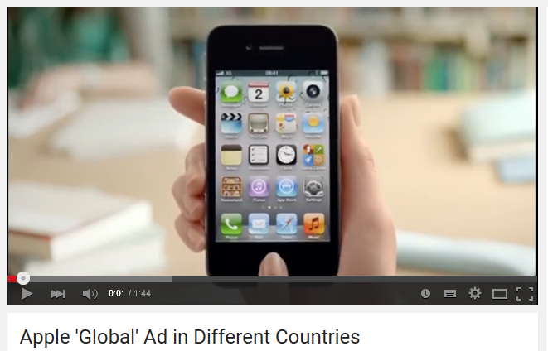
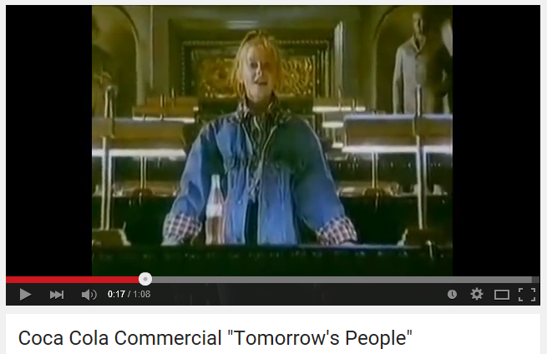
Understand the importance of global marketing and global brands
Notes:
Videos to demonstrate same advertising in different countries
Apple - https://www.youtube.com/watch?v=MoE9XxXUatA
Coca Cola – link takes you to page where can play the different versions from around the world (same ad apart from the opening child)
https://www.youtube.com/results?q=coca+cola+tomorrow%27s+people+around+the+world

Slide 10
Activity - evaluate the marketing mix in different contexts
Identify a global brand.
Analyse how their marketing varies from one country to another (relate specifically to the 4Ps in the marketing mix)
Explain the reasons for this.
Investigate the problems the business is likely to have when involved in global marketing.
Notes:
Individual task – then put in pairs to compare their answers / findings.

Slide 11
Plenary
How might the marketing mix be adapted to meet the different needs of consumers in the global marketplace?

