Slide 1
Recruitment and selection

Slide 2
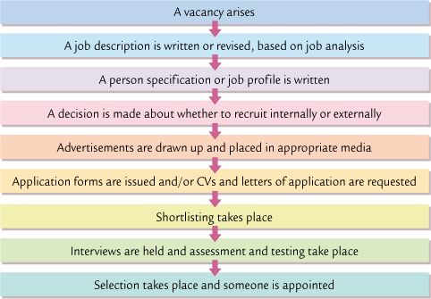

Slide 3
Job Analysis
What is the job title?
Do we need to change the job role?
Do we want a full-time or part-time employee?
What qualifications will the person need?
What characteristics are we looking for?

Slide 4
Job Description
Person Specification
Job title
Who the employee will be responsible to
List of all the tasks they will undertake in their work
Essential qualifications
Essential characteristics
Desirable qualifications
Desirable characteristics

Slide 5
Information Required by a Firm
Personal details
Education and qualifications
Work experience
Posts of responsibility
Other interests
Name and contact details of TWO referees

Slide 6
Objectives of a Job Interview
To find out if the person is able to do the job well
To find out if the person will “fit” in the organisation
An interviewer must:
Treat all applicants fairly
Try and find out as much as possible about the applicant

Slide 7
Short-Listing
Read the letter of application and CV
“Grade” the application (eg A, B, C or marks out of 10)
Decide which applications are the best and why
Other methods
Aptitude and attainment tests
Psychometric or personality tests
Assessment centres

Slide 8
Internal recruitment
selecting someone from within the organisation.
Notice board
Intranet
Company newsletter
Advantages:
Saves on recruitment costs
You know who you are employing
Good for morale
Disadvantages:
External applicants may have been better quality
Limits the number of applicants
There is still a vacancy to be filled

Slide 9
External recruitment
selecting someone from outside the organisation.
Employment Agencies, Headhunters
Advertising in the media
Job centres, Careers Service
Advantages:
Wider choice of applicants
Applicants may be better quality
All vacancies are filled
Disadvantages:
More expensive than internal recruitment
You may take on someone who was good in interview but not good in the job
May upset an internal employee

