Slide 1
Motivational theory
The study of factors that influence the behaviour of people in the workplace.

Slide 2
Motivational Theory
In 1995 FFC was placed 95th in the league, 1 place from relegation to the Conference. The home fans were extremely unhappy, and the manager got sacked. The fans made threatening cheers at each home game.
A new manager was appointed – Micky Adams, who had a few free transfers but the side was mainly the same.
One year later they sat on the top of the same league, what happened?
The players pay had not risen, the key difference was in the players motivation.

Slide 3

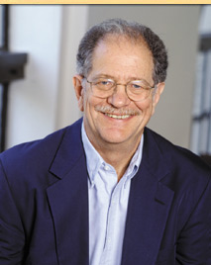
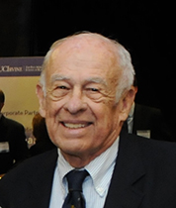



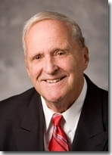
Timeline/origins
F.W. Taylor (1856 – 1915)
Elton Mayo (1880 – 1949)
Frederick Herzberg (1923-2000)
Abraham Maslow (1908 – 1970)
Victor Vroom (1963 theory)
Porter & Lawler (1968 theory)

Slide 4
F W Taylor (Scientific approach to management)
  Extreme division of labour
    breaking a job into small repetitive tasks, each of which can be done at a speed with little training.
  Payment by piecework
    payment by results, e.g. per item produced.
  Tight management control
    To ensure that workers concentrate on their jobs and follow the correct processes
Notes:
F.W. Taylor (1856 – 1915) was an American engineer who invented work-study and founded the scientific approach to management
Scientific Management – Business decision making based on data that is researched and tested quantitatively in order to improve efficiency of an organisation.
He considered money to be the main factor that motivated workers, so he emphasised the benefits of Piece Work.
Higher efficiency would generate higher profits and thus higher wages to workers.
Taylor saw Humans as Machines
This method had a big influence on Mass production but introduced at Ford Motor Company it led to poor industrial relations and saw a growth in trade unions.

Slide 5

Mayo (Hawthorne effect)
  Recognition, belonging, and security are more important that money in motivating employees.
  Employees should be seen as members of a group.
  Managers need to pay attention to individuals social needs.
  Increased results are due to greater communication and improved relations with informal groups.
Notes:
Elton Mayo (1880 – 1949) was a follower of F.W. Taylor, but his experiments led him to conclude that Scientific Management could not explain the importance of peoples behaviour in the workplace.
Many of his findings, including the Hawthorn Effect, came from research he did at the Western Electric School factory in Hawthorn, USA and provided the foundations for the Human Relations School of Management.
His early research involved trying to measure the impact on productivity of improving the lighting conditions in the Western Electric Factory.
He followed F.W.Taylor’s Scientific principles by testing changes in light conditions against one group of workers against a group of workers with unchanged lighting.
The results: productivity rose in areas where lighting was improved.
This result questioned Taylor’s assumption about the importance of money in motivating workforce and emphasised the importance of Human Relations.

Slide 6
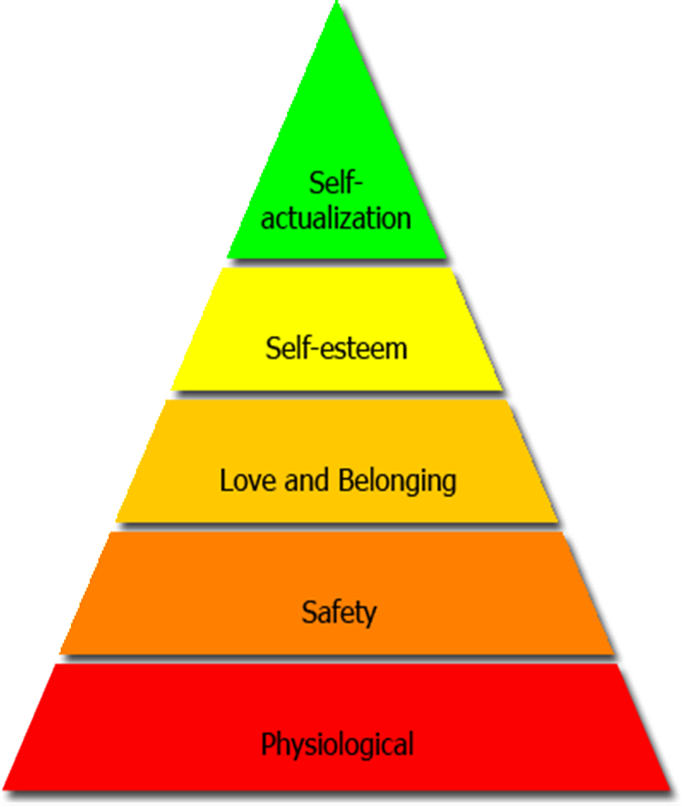
Maslow’s Hierarchy of Needs
Notes:
Abraham Maslow (1908 – 70) was an American psychologist whose work on human needs has had a major influence on management thinking.
His Hierarchy of Needs suggests that people have similar types of needs from low level basic to the need for achievement.
Physiological needs earning an income and having reasonable working conditions.
Safety needs: a secure job, a safe working environment, clear lines of accountability and responsibility.
Social needs: a sense of belonging, being a part of a team, facilities like staff rooms, canteens etc.
Esteem needs: self-respect and respect from others, positive feedback, recognition and status for achievement and opportunities for promotion
Self – Actualisation: fulfilling one’s potential through actions and achievements, Maslow did not believe this need could be filled fully and thought people would always strive to develop further and achieve more.

Slide 7

Maslow’s Hierarchy of Needs?
  Do all Humans have the same set of needs?
  Do different people have different degrees of needs?
  Can anyone’s need ever be said to be fully satisfied?
Notes:
Maslow thought employees needed to work up the hierarchy of needs and if employees didn’t have access to gain those needs then it would lead to de-motivation.
This theory is appealing but some key issues are raised:
Do all Humans have the same set of needs?
Do different people have different degrees of needs?
Can anyone’s need ever be said to be fully satisfied?

Slide 8
Herzberg
Two-Factor theory of job satisfaction and dissatisfaction
Motivators | Hygiene / maintenance factors
Sense of Achievement | Working Conditions
Recognition for effort & achievement | Supervision
Nature of the work itself | Pay
Responsibility | Interpersonal relations
Promotion & improvement opportunities | Company policy and Admin, inc paperwork, rules, red tape
Notes:
Frederick Herzberg (1923-2000) was an American psychologist whose research led him to develop the Two-Factor theory of job satisfaction and dissatisfaction.
He suggested some factors had the potential to give job satisfaction (Motivators) and some factors can reduce job satisfaction (Hygiene or maintenance factors).

Slide 9
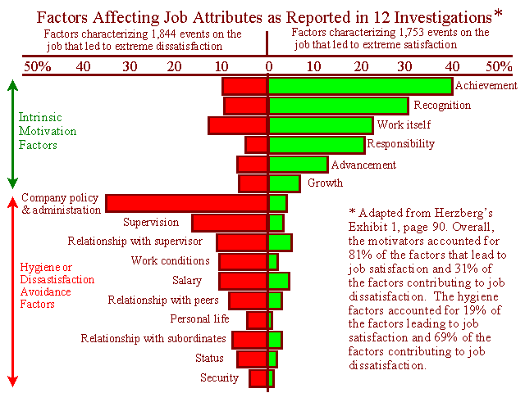
Notes:
All of the Motivators concern the job itself rather than issues such as pay, and all are likely to motivate workers and improve productivity.
All of the Hygiene factors ‘surround’ the job: they do not concern the job itself, ensuring that they are acceptable to the workforce prevents dissatisfaction rather than causing motivation.
One of the main principles is Job Enrichment
This is the attempt to motivate workers by giving them opportunity to use their abilities and allowing them greater independence and authority over the control of their work.
Herzberg critics are mainly based on the fact that he drew conclusions about workers as a whole from a limited sample of 200 accountants and engineers.

Slide 10
Herzberg & Maslow
There are close links between the two theories
Motivators
Achievement
Recognition
Work itself
Responsibility
Advancement
Personal Growth
Hygiene factors
Supervision
Working Conditions
Relationship with peers
Pay
Security
Company Policy

Slide 11
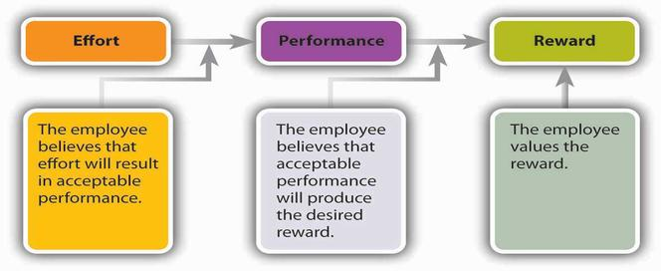
VROOM (Expectancy theory)
Notes:
Explains why individuals choose one behavioural option over another
Employees will be motivated if they believe that
there is a positive correlation between effort and performance
That good performance will be rewarded
Their efforts will be worthwhile

Slide 12
VROOM (Expectancy theory)
3 components
Expectancy: Effort → Performance
Instrumentality: Performance → Outcome
Valence: Outcome → Reward
Does this sound like SMART targets?
Notes:
Expectancy
Expectancy is the belief that one's effort (E) will result in attainment of desired performance (P) goals
Individuals assess if they have the right skills to achieve the goal
The goal must be achievable
The individual must have some control over the outcome
Instrumentality
Instrumentality is the belief that a person will receive a reward if the performance expectation is met.
Pay increase
Promotion
Recognition
Sense of accomplishment
Commission
For this to work there must be trust, control and policies
Valence - the value the individual personally places on the rewards
-1 avoiding the outcome
0 indifferent to the outcome
1 welcomes the outcome
In order for the valence to be positive, the person must want to achieve the outcome

Slide 13
Vroom
Valence is behavioural; the decision is measured on the value of the reward
Expectancy and instrumentality are attitudes, whereas valence is rooted in an individual’s value system.
Examples of valued outcomes in the workplace include,
pay increases and bonuses,
promotions,
time off,
new assignments,
recognition, etc.
If management can effectively determine what their employee values, this will allow the manager to motivate employees in order to get the highest result and effectiveness out of the workplace.

Slide 14
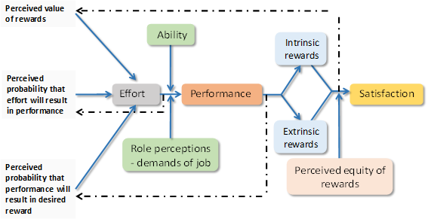
PORTER AND LAWLER
Notes:
Porter and Lawler used Victor Vroom’s expectancy theory as a foundation to develop their expectancy model. Similar to Vroom’s theory Porter and Lawler concluded that an individual’s motivation to complete a task is affected by the reward they expect to receive for completing the task. However Porter and Lawler introduced additional aspects to the expectancy theory.
Intrinsic and Extrinsic Rewards
Porter and Lawler categorised the reward as intrinsic and extrinsic
Intrinsic rewards are the positive feelings that the individual experiences from completing the task e.g. satisfaction, sense of achievement.
Extrinsic rewards are rewards emanating from outside the individual such as bonus, commission and pay increases.
Porter and Lawler’s model suggested that an individual’s view regarding the attractiveness and fairness of the rewards will affect motivation.
Porter and Lawler said that motivation is also affected by
the individual’s ability to perform the task and their perception of the task

Slide 15
PORTER AND LAWLER
Porter and Lawler’s model suggested that an individual’s view regarding the attractiveness and fairness of the rewards will affect motivation.
Intrinsic and Extrinsic Rewards
Intrinsic rewards are the positive feelings that the individual experiences from completing the task e.g. satisfaction, sense of achievement.
Extrinsic rewards are rewards emanating from outside the individual such as bonus, commission and pay increases.
Motivation is also affected by the individual’s ability to perform the task and their perception of the task
Notes:
Porter and Lawler used Victor Vroom’s expectancy theory as a foundation to develop their expectancy model. Similar to Vroom’s theory Porter and Lawler concluded that an individual’s motivation to complete a task is affected by the reward they expect to receive for completing the task. However Porter and Lawler introduced additional aspects to the expectancy theory.
Intrinsic and Extrinsic Rewards
Porter and Lawler categorised the reward as intrinsic and extrinsic
Intrinsic rewards are the positive feelings that the individual experiences from completing the task e.g. satisfaction, sense of achievement.
Extrinsic rewards are rewards emanating from outside the individual such as bonus, commission and pay increases.
Porter and Lawler’s model suggested that an individual’s view regarding the attractiveness and fairness of the rewards will affect motivation.
Porter and Lawler said that motivation is also affected by
the individual’s ability to perform the task and their perception of the task

Slide 16
Conclusion
Motivation does increase efficiency
Organisations will benefit from motivated employees
Theories may be very useful in helping organisations achieve this

