Slide 1
Management

Slide 2

Management? Leadership?
Are Management and Leadership the same thing?
  Discussion points:
  If you get promoted at work is it more likely your new role will be a manager or a leader?
  Can you be a leader without being a manager?
  Can you be a manager without being a leader?
  What is the difference?

Slide 3
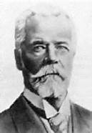
The Functions of Management according to Fayol
Henri Fayol (1916)
  Planning
  Organising
  Commanding
  Co-ordinating
  Controlling
Do you think this is still relevant today?

Slide 4
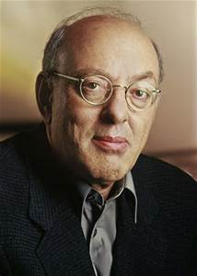
Managerial Roles
Henry Minzberg (1980s) said in addition to the FUNCTIONS of management, the manager should also fulfil certain ROLES:
  Interpersonal Roles – The manager as a figurehead, representing the business.
  Information Roles – The manager communicates at a level that subordinates might not be able to due to structural constraints or contact the manager might have.
  Decision Making Roles – Minzberg advocates fluid decision making rather than meticulous forward-planning. He thought planning should be ongoing rather than systematic and that communication should be verbal rather than formal / written.
  WHY?

Slide 5

Activity
Answer Question 1 on page 396 of Hall, Jones and Raffo.

Slide 6
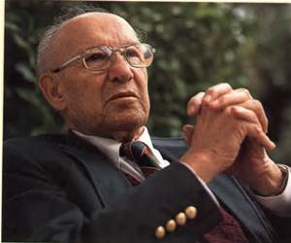
The Functions of Management according to Drucker
Peter Drucker (1955)
  Setting Objectives
  Organising work
  Motivating employees and communicating information to them
  Job measurement – checking that tasks have been performed and objectives met
  Developing people – including training
  Do you agree more with Fayol or Drucker?

Slide 7
Management by Objectives (MBO)
  Peter Drucker (1955)
  In the same paper as Drucker presented his ideas on the FUNCTIONS of management, he further developed the first point (See the previous slide again)…..
  Setting objectives
  His clarification of this point is known as:
MANAGEMENT BY OBJECTIVES

Slide 8
The MBO Process

Slide 9
Advantages of MBO

Slide 10
Disadvantages of MBO

Slide 11
Activity
Answer Question 2 on page 397 of Hall, Jones and Raffo

Slide 12
McGregor’s Theory X and Y
Theory X | Theory Y
Workers are motivated by money | Workers have many different needs which motivate them
Workers are lazy and dislike work | Workers can enjoy work
Workers are selfish, ignore the needs of organisations, avoid responsibility and lack ambition | If motivated, workers can organise themselves and take responsibility
Workers need to be controlled and directed by management | Management should create a situation where workers can show creativity and apply their job knowledge

Slide 13
Activity
Read the Theory x and Theory Y notes
Answer Question 3 on page 399 of Hall, Jones and Raffo

