Slide 1
Revision tips
How to start…

Slide 2
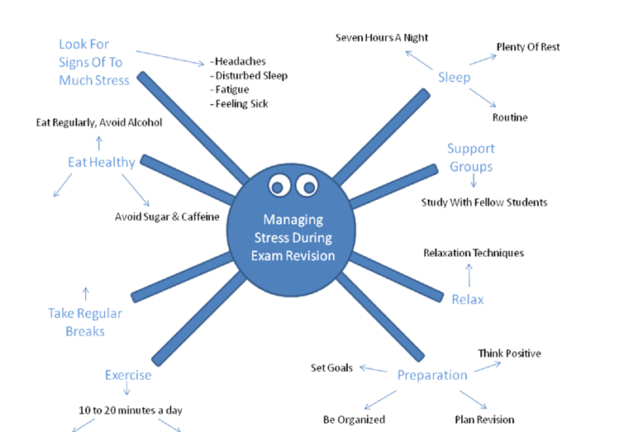

Slide 3
Stage 1 get organised
Sort all your work by topic in ring binder with dividers
(use the attached checklist/GOL help you structure this)

Slide 4
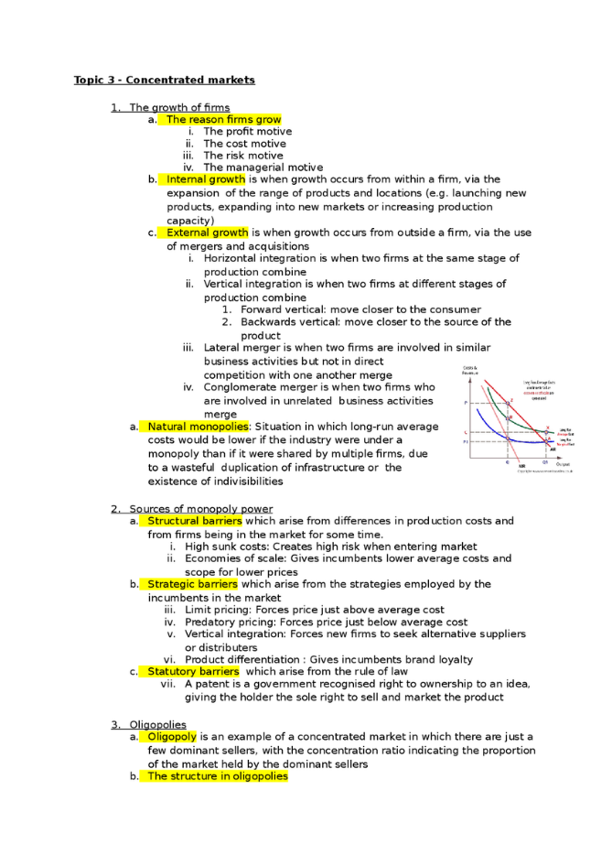
Stage 2 information management
For each topic, summarise the exam board handout on to a side of A4
Use whatever method works for you
Diagrams
Bullet points
Colours
Highlights

Slide 5
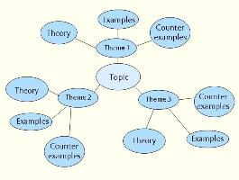
Stage 3 Condense & consolidate
Reduce your information to its simplest form
When you have summarised every topic, return to each topic and see if you can further condense the information into a spider gram or any other visual method

Slide 6
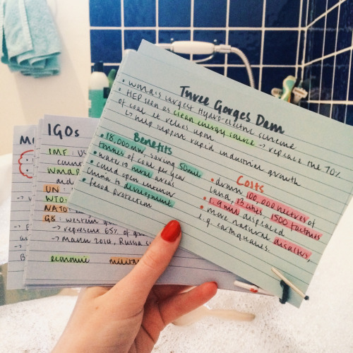
Stage 4 secure key terms & definitions
Check your subject knowledge
Return to the beginning again and make a revision card of key terms for each topic to ensure that you remember the business terminology, definitions and concepts

Slide 7
Stage 5 build it back up
Return to the exam board topic checklist – identify each topic where it says that you will need to analyse or evaluate – these topics are likely to be used in the longer mark answers and will require greater consideration
Using this shortlist of topics, make a bullet point list of analysis and evaluation points that relate to that topic
(for example consider advantages/disadvantages, winners/losers, short term/long term implications, stakeholders affected etc.)

Slide 8
Stage 6 exam practice
Although they are the previous syllabus and a slightly different mark scheme, it is also worth looking at last year’s AS papers BS1 and BS2 to see the types of questions and mark schemes that are issued – the content/subject knowledge is very similar.
Looking at the longer mark questions on these past papers, try and adapt them to a 10 or 15 mark question – there are only so many questions that can be asked on any topic – doing some bullet point essay plans is good preparation for Comp 2.
The exam board is WJEC (Eduqas) – there is information on their website and there is more than enough to keep you busy and informed on the Business Site of Godalming Online.

Slide 9
finally be sensible!
Work SMART
Look at how many weeks left before the exams start and make a revision plan so that you have a week by week (and day by day) target and it is manageable
Find a quiet space to work where you
can really concentrate
Get enough sleep

